Slide 1
BIPM Workshop on digital electronics for RMO SIRTIs
8 June 2022
on-line

Slide 2
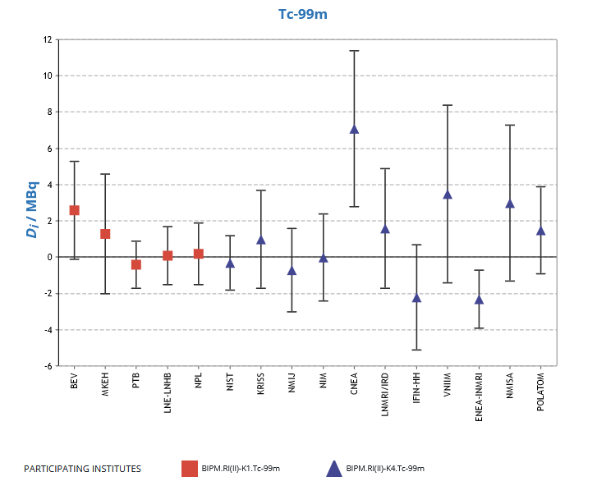
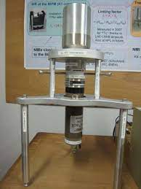
The BIPM SIRTI
Well-type NaI(Tl) for integral counting above low-energy threshold
Not primary measurement:
- No extrapolation to zero keV
- Measurements relative to ⁹⁴Nb reference source
Calibrated against the SIR ionization chamber at the BIPM for ^{99m}Tc, ¹⁸F, ⁶⁴Cu,…
Travelling instrument to run comparisons successfully at NMIs world-wide, since 2009

Slide 3
WHY RMO SIRTIs?
The BIPM SIRTI carried out comparisons in 15 NMIs from 5 RMOs in 10 years
(14 KCs for ^{99m}Tc, 10 KCs for ¹⁸F, 6 KCs for ⁶⁴Cu, 1 KC for ¹¹C)
The BIPM SIRTI should re-visit 4 participants to complete the list of RNs.
About 20 other NMIs/DIs in the RMOs did not participate yet
At a rate of 2 KCs/yr, about 20 years would be needed to cover the needs with the BIPM SIRTI alone
In addition, the list of RNs has been recently increased to include ¹²³I and ¹⁵³Sm, and is planned to further increase, implying re-visiting the same NMIs again.

Slide 4
WHY RMO SIRTIs?
RMO SIRTIs would help to speed up the comparison loop by running comparisons e.g. with the laboratories not yet visited by the BIPM SIRTI
RMO SIRTIs would enlarge the number of participants by visiting laboratories that are not member state of the BIPM

Slide 5
Digital electronics for the RMO SIRTIs: what are the needs?
The BIPM SIRTI electronics is based on commercial equipment except for the live-time module (LNHB) and clock frequency (BIPM)
Need to find an alternative
for long-term robustness of the system
Digital electronics (commercial or home made?)
looks to be a promissing solution

Slide 6
Digital electronics for the RMO SIRTIs: what are the needs?
Detector is NaI(Tl)
  Intrinsic light decay constant: 230 ns
  + 10 % of phosphorescence with 150 ms decay constant
  At high rate: build up of phosphorescence (potential shift of the baseline)
Output from PMT (anode):
Output from preamp (ORTEC Scintipack):
Integral counting above low-energy threshold
defined by ^{93m}Nb x-ray peak
  Dead-time correction only (no pile-up correction needed)
400 ns
80 μs

Slide 7

Count rate is up to 20 000 s⁻¹ (or more if possible)
to enable counting for 3 half-lives
  Need to check the independence of the measurement versus count rate
Notes:
Vertical axis is inversely proportional to count rate corrected for dead-time and decay/ fit with Boltzman eq Y = A2 + (A1-A2)/(1+exp(x-x0)/dx)

