Slide 1
CCRI(III) comparisons, membership and bibliography
CCRI(III)
BIPM, 04-06 March 2015
José M. Los Arcos
CCRI Executive Secretary
IR Department Director

Slide 2
Comparison Reports
CCRI(III) OR RMO.RI(III) COMPARISON REPORTS PUBLISHED 2013-2015
Comparison | Report title | Publication | PILOT
CCRI(III)-K11 | International key comparison of neutron fluence measurements in monoenergetic neutron fields: CCRI(III)-K11 | Metrologia 51 (2014) Tech. Suppl. 06009 | LNE-IRSN
CCRI(III)-K8 | International Key Comparison of Thermal Neutron Fluence Measurements - CCRI(III)-K8 | Metrologia 52 (2015) Tech. Suppl. 06011 (this week) | PTB
RMO.RI(III) | None

Slide 3
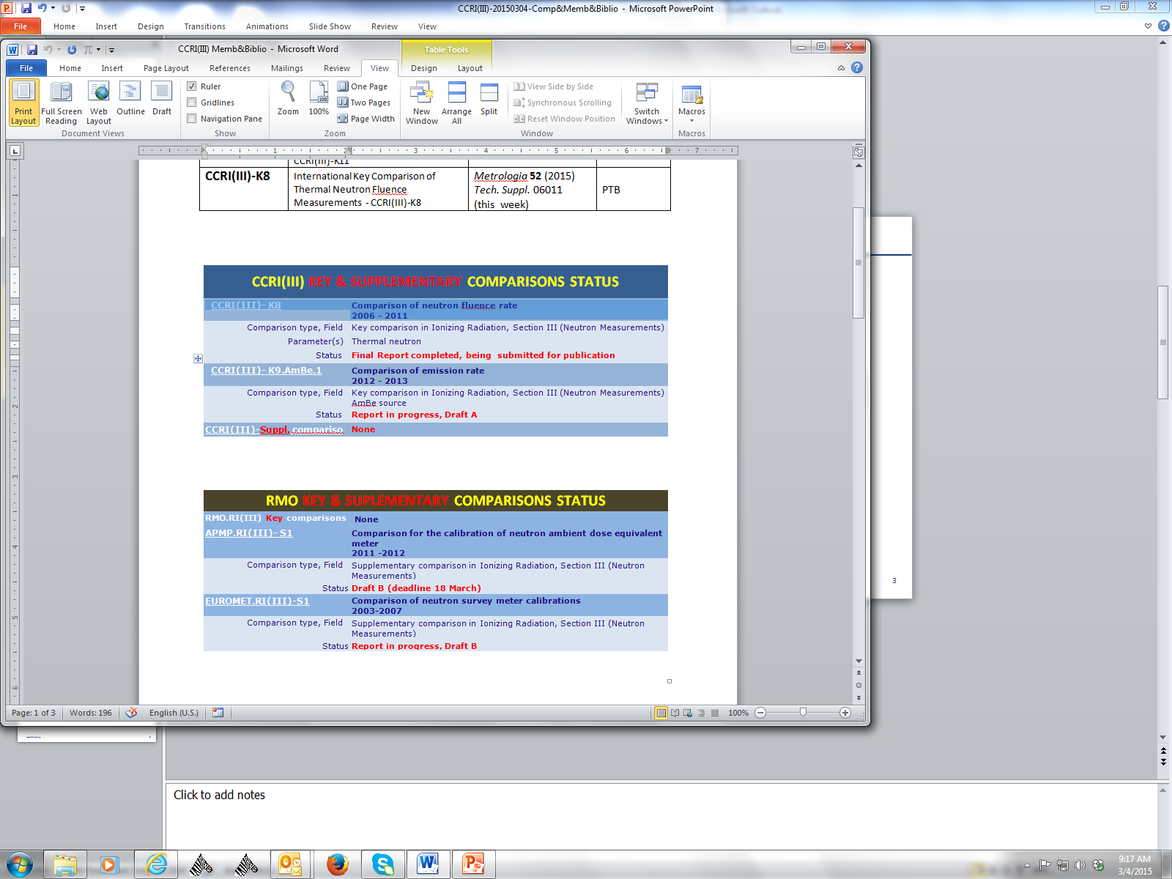
CCRI(III) Key & Supplementary Comparisons Status

Slide 4
RMO.RI(III) Key & Supplementary Comparisons Status

Slide 5
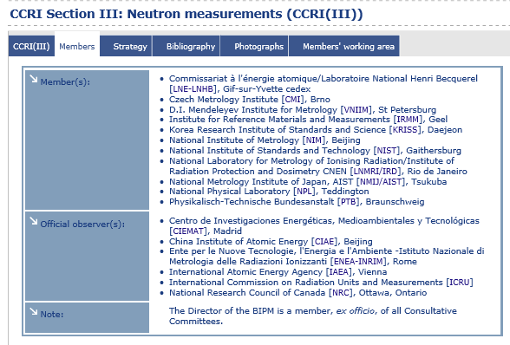
CCRI(III) Membership (as of 20150304)

Slide 6
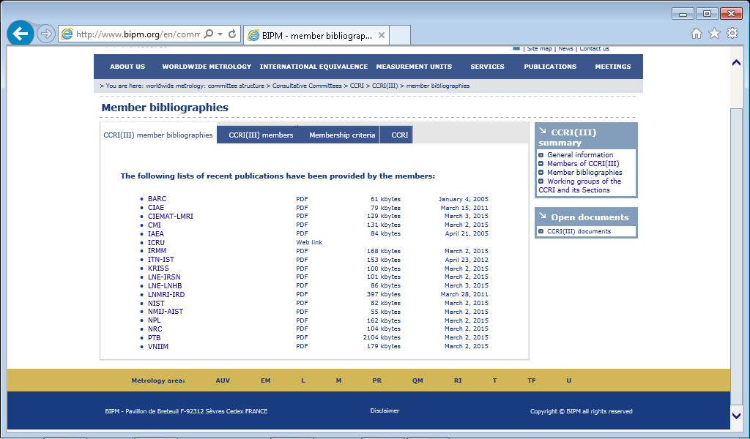
CCRI(III) Bibliographies

