Slide 1
An International Resource Registry for National Metrology Institutes
Introductions

Slide 2
NIST
Office of Data and Informatics (ODI) of the Material Measurement Laboratory
  Robert Hanisch, director
  Ray Plante, interoperability expert
  ODI has responsibility for ~100 Standard Reference Data products and leads NIST efforts to improve data dissemination
Information Technology Laboratory
  Mary Brady, group lead
  Sharief Youssef, lead developer
  ITL partners with MML/ODI in a number of software development efforts

Slide 3
An International Resource Registry for National Metrology Institutes
Dr. Robert Hanisch
Director
Office of Data and Informatics
Material Measurement Laboratory
National Institute of Standards and Technology

Slide 4
The Issue
The network of NMIs hold valuable collections of reference data and provide state-of-the-art metrology services
How does one find out, across all NMIs, where particular data and data-related services (e.g., APIs) are located?
  Standard Reference Data
  Reference Data
  Data associated with publications
  Data associated with Standard Reference Materials (SRMD)
  Simulation data
Need a data-focused analog to the KCDB

Slide 5
Concept
Build an international registry of NMI data resources
  A simple database of metadata that describes where data collections are located, what kind of data they contain, how the data can be accessed, etc.
Resource descriptions (metadata) would be provided by NMIs
Metadata would be federated using the Open Archive Initiative – Protocol for Metadata Harvesting (OAI-PMH)
  Used in the research library community for more than 20 years
  Readily available software implementations
  Other federation mechanisms can be considered
Federated resource registry would be searchable through web page and via application programming interface (API)

Slide 6
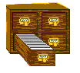



Federated Architecture
Full
Searchable
Registry
harvest
BIPM
(pull)
replicate
OAI/PMH
Local
Publishing
Registry
Full
Searchable
Registry
NMIs
and/or
RMOs
search
queries
Local
Publishing
Registry
Users,
applications

Slide 7
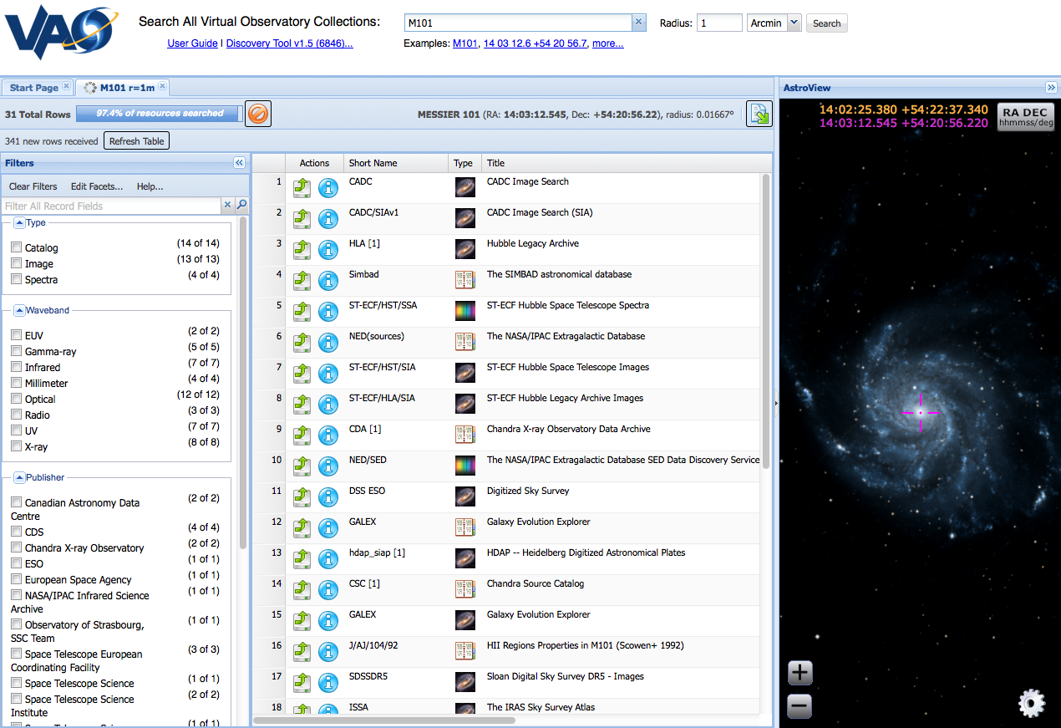
Example from Astronomy
Search criteria; instead of astronomical object name,
could be “aluminum oxide” or “electron scattering”
List of data
resources
with direct
links
Facets or filters
that permit easy
refinement of
search

Slide 8
Benefits
Improved collaboration and coordination amongst NMIs
Reduced duplication of effort
Sharing of data resources that are expensive to develop
Identification of gaps in measurement science data and collaboration on most effective approach to fill them
Result would be a global ecosystem of measurement science data resources of value to broad research and industrial communities.

Slide 9
Implementation
NMIs need to agree upon a simple metadata schema for describing data resources
  ~Two international meetings with ~20 people representing a variety of NMIs
NMIs and/or RMOs collect metadata for data products and services
NMIs and/or RMOs run a standard OAI/PMH software service for metadata access
A federated database will be developed with search interface and APIs
Curation expenses will be shared by a few large NMIs and BIPM
Software implementations for essentially all aspects of this system are readily available and can be deployed with minimal effort. Software can be deployed on existing systems.

Slide 10
Pilot Project
A pilot project starts now
With NMI volunteers
A few meetings to agree on metadata, set up federated system
NIST will provide necessary software (though NMIs would be free to develop their own if desired)
Demonstrate pilot in October 2016, then broaden scope.

Slide 11
Next Steps
Each NMI identify
  Technical staff to collaborate on deployment of federated registry software
  Domain expert staff to collaborate on metadata requirements, definition
Set up follow-on meetings
  Metadata discussion, telecon, January 2016
  Registry software discussion, telecon, February 2016
  Face-to-face meeting, BIPM, 15 April 2016

