Slide 1

CCTF TE: “Optical links for atomic clock comparisons”
February 23, 2026
Agenda:
Welcome address: Davide Calonico, Chair of the CCTF WG
Introduction: “Links for optical clocks and adjacent technologies” - Tara Fortier (NIST)
“Time and frequency transfer using White Rabbit” - Paul-Eric Pottie (Refimeve, France)
“Frequency transfer over optical fiber links” - Cecilia Clivati (INRIM, Italy)
“ELSTAB (ELectronic STABilized) - precise time and frequency transfer over optical fiber with autonomous calibration” - Albin Czubla (GUM, Poland)
“Frequency-comb-based time transfer over free-space” - Laura Sinclair (NIST, USA)
“Satellite optical links” - Haifeng Jiang (University of Science and Technology of China (USTC))

Slide 2
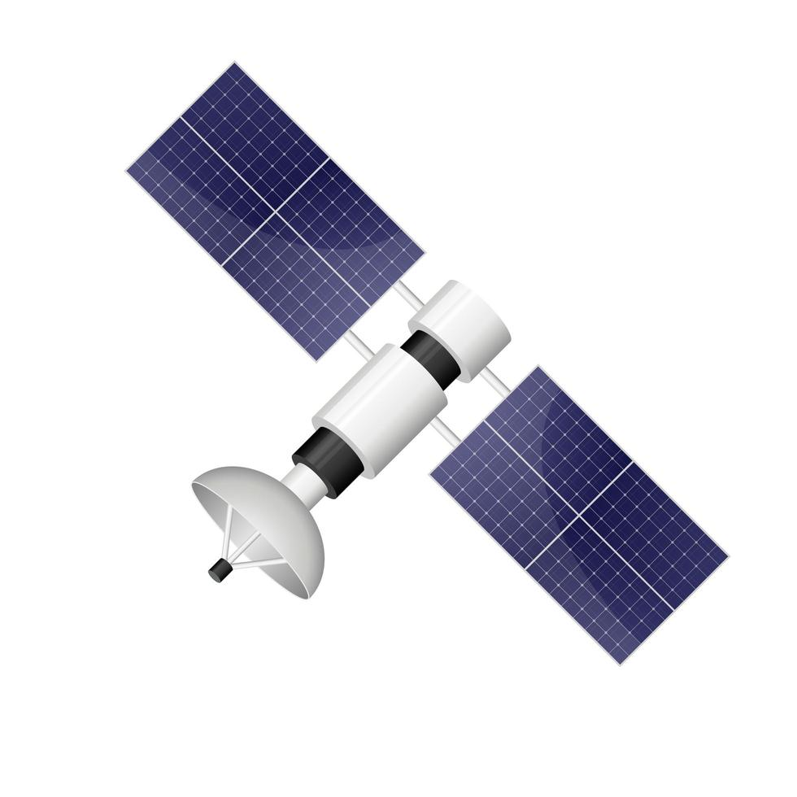
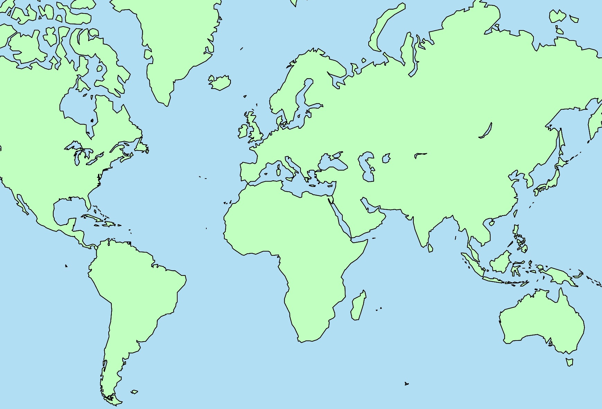
Atomic references and UTC
Satellite links take ~ 1 month of averaging to support frequency transfer at 1 x10⁻¹⁶ :
Optical clocks can achieve 1 x 10⁻¹⁶ after seconds of averaging.
GNSS links currently cannot support the improvement in performance of optical clocks
SU
NRC
NPL
PTB
NIST
SYRTE
NIM
NMIJ
NIS
NPLI
KRISS
CENAM
BSJ
BIPM
(UTC)
AGGO
NMIA
UTC(k) time scales are linked and compared using GNSS.
UTC(k) laboratories contribute clock and time transfer data to the BIPM for computation of UTC.
UTC is disseminated by the BIPM as the time differences, UTC - UTC(k) in ns, published monthly in Circular T.
Levine, Judah. "A review of time and frequency transfer methods." Metrologia 45(2008)

Slide 3
Microwave link vs atomic clock instability
10
-12
GPS IPPP
Fortier, Luiten, & Margolis.
"Optical atomic clocks: defining the future of time and frequency metrology." Optica 13 (2026)
10
-13
¹³³Cs clocks
-14
GNSS CV
10
10
-15
VLBI
Fractional stability, Δf/f
10
-16
ACES common view
Optical clocks
TWCP
10
-17
10
-18
10
-19
10
0
10
1
10
2
10
3
10
4
10
5
10
6
10
7
Averaging Time (s)

Slide 4
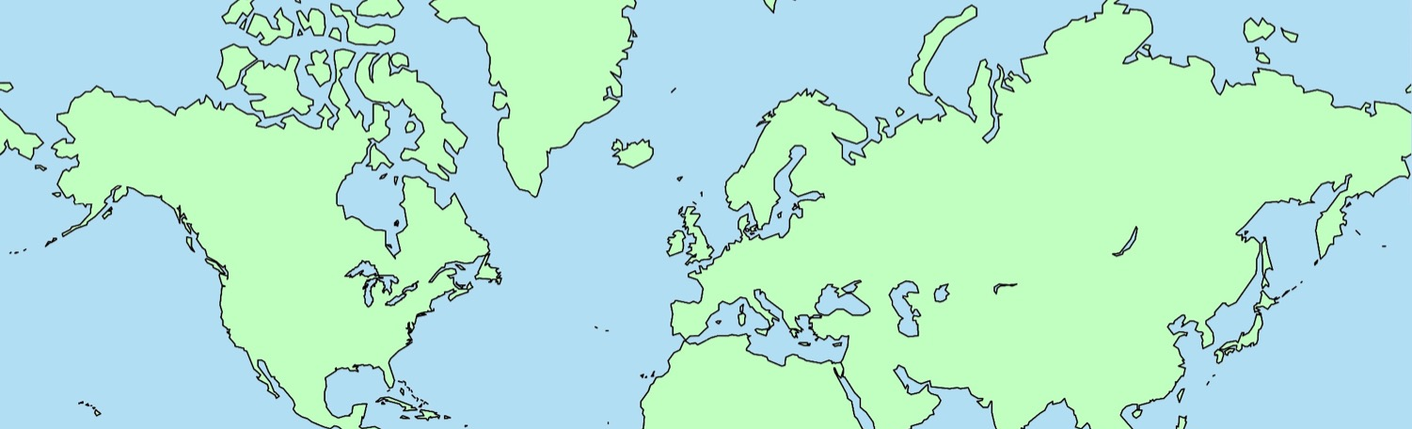
Optical atomic clock networks
Satellite time transfer
Stability: 10⁻¹⁶ @ one month
Optical clocks ~ 10⁻¹⁶ @ 1s
Sr⁺
Yb⁺
Yb⁺
Sr
Al⁺
Sr⁺
Sr
Sr
Yb
Sr
Hg
Yb
Sr
Al⁺
Yb
Yb
Al⁺
Ca⁺
Terrestrial bidirectional optical links:
1. Fiber optic networks
Doppler cancelled links: high-fidelity frequency transfer over hundreds of km
White rabbit: Ethernet-based fiber system that combines synchronous frequency transfer, two-way delay measurement , and phase detection (< ns time synchronization)
2. Free space optical time-transfer
Single frequency lasers
Optical pulse trains from OFCs
Municipal links:
USA: NIST, Boulder / JILA (3 km)
  B. A. C. O. N. "Frequency ratio measurements at 18-digit accuracy using an optical clock network." Nature 591 (2021)
Japan: NTT / RIKEN / U. Tokyo (~100 km)
  Fujieda et al. "Fiber-optic frequency and timing transfer over an urban optical fiber link." IEEE UFFC 3 (2023).
China 58 km link
  Tang-Yin Liao et al “Remote Comparison of Two Sr Optical Lattice Clocks through a 58 km Fiber Link.” Chin. Phys. Lett., 2025,
Notes:
If we return to the global picture of optical clock networks we see that North America is geographically isolated. Clocks in Japan and Europe have fiber optic networks that enable continental and intercontinental comparison. Fiber networks are powerful because they can support time/frequency transfer below 10-18 over 100s of km.
In Boulder, global comparison against other clocks requires time/frequency transfer via microwave GPS and satellite links, whose capabilities significantly degrade the performance of the optical clocks.

Slide 5
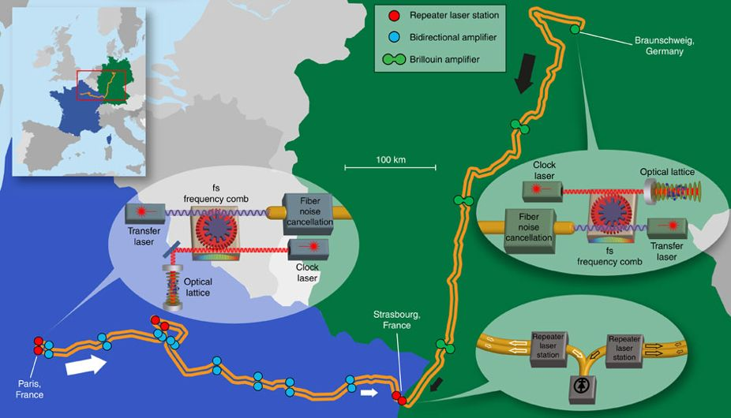
Optical atomic clock networks
Satellite time transfer
Stability: 10⁻¹⁶ @ one month
Optical clocks ~ 10⁻¹⁶ @ 1s
Sr⁺
Yb⁺
Yb⁺
Sr
Al⁺
Sr⁺
Sr
Sr
Yb
Sr
Hg
Yb
Sr
Al⁺
Yb
Yb
Al⁺
Ca⁺
Ca⁺
Terrestrial bidirectional optical links:
1. Fiber optic networks
Doppler cancelled links: high-fidelity frequency transfer over hundreds of km
White rabbit: Ethernet-based fiber system that combines synchronous frequency transfer, two-way delay measurement , and phase detection (< ns time synchronization)
2. Free space optical time-transfer
Single frequency lasers
Optical pulse trains from OFCs
European fiber optic network
Riehle, F. Optical clock networks. Nature Photon 11, (2017).
Lisdat, et al, Nature Communications(2016)
K. Predehl et al. Science 336 (2012)
Notes:
If we return to the global picture of optical clock networks we see that North America is geographically isolated. Clocks in Japan and Europe have fiber optic networks that enable continental and intercontinental comparison. Fiber networks are powerful because they can support time/frequency transfer below 10-18 over 100s of km.
In Boulder, global comparison against other clocks requires time/frequency transfer via microwave GPS and satellite links, whose capabilities significantly degrade the performance of the optical clocks.

Slide 6
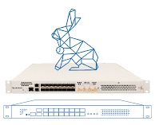
Optical atomic clock networks
Satellite time transfer
Stability: 10⁻¹⁶ @ one month
Optical clocks ~ 10⁻¹⁶ @ 1s
Sr⁺
Yb⁺
Yb⁺
Sr
Al⁺
Sr⁺
Sr
Sr
Yb
Sr
Hg
Yb
Sr
Al⁺
Yb
Yb
Al⁺
Ca⁺
Terrestrial bidirectional optical links:
1. Fiber optic networks
Doppler cancelled links: high-fidelity frequency transfer over hundreds of km
White rabbit: Ethernet-based fiber system that combines synchronous frequency transfer, two-way delay measurement , and phase detection (< ns time synchronization)
2. Free space optical time-transfer
Single frequency lasers
Optical pulse trains from OFCs
Rizzi, Mattia, et al. "White rabbit clock characteristics." 2016 IEEE International Symposium on Precision Clock Synchronization for Measurement, Control, and Communication (ISPCS).
Notes:
If we return to the global picture of optical clock networks we see that North America is geographically isolated. Clocks in Japan and Europe have fiber optic networks that enable continental and intercontinental comparison. Fiber networks are powerful because they can support time/frequency transfer below 10-18 over 100s of km.
In Boulder, global comparison against other clocks requires time/frequency transfer via microwave GPS and satellite links, whose capabilities significantly degrade the performance of the optical clocks.

Slide 7
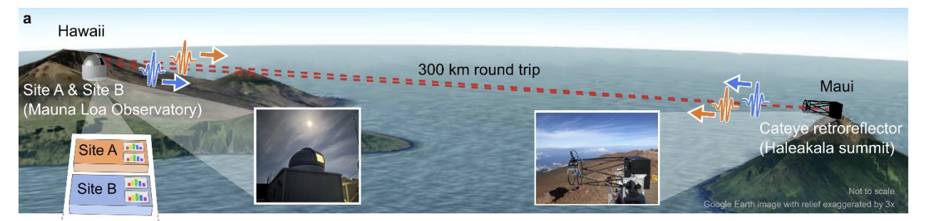
Optical atomic clock networks
Satellite time transfer
Stability: 10⁻¹⁶ @ one month
Optical clocks ~ 10⁻¹⁶ @ 1s
Sr⁺
Yb⁺
Yb⁺
Sr
Al⁺
Sr⁺
Sr
Sr
Yb
Sr
Hg
Yb
Sr
Al⁺
Yb
Yb
Al⁺
Ca⁺
Ca⁺
OFC: Caldwell, Emily D., et al. "Quantum-limited optical time transfer for future geosynchronous links." Nature 618 (2023)
Single frequency laser: Gozzard, D. R., et al. "Stabilized free-space optical frequency transfer." Physical Review Applied 10 (2018)
2. Free space optical time-transfer
Single frequency lasers
Optical pulse trains from optical frequency combs
Notes:
If we return to the global picture of optical clock networks we see that North America is geographically isolated. Clocks in Japan and Europe have fiber optic networks that enable continental and intercontinental comparison. Fiber networks are powerful because they can support time/frequency transfer below 10-18 over 100s of km.
In Boulder, global comparison against other clocks requires time/frequency transfer via microwave GPS and satellite links, whose capabilities significantly degrade the performance of the optical clocks.

Slide 8
Microwave link vs atomic clock instability
10
-12
GPS IPPP
Fortier, Luiten, & Margolis.
"Optical atomic clocks: defining the future of time and frequency metrology." Optica 13 (2026)
10
-13
-14
¹³³Cs
GNSS CV
10
Submarine fiber link
10
-15
White rabbit (500 km)
Fractional stability, Δf/f
10
-16
Optical clocks
TWCP
10
-17
-18
Free-space 300 km
10
1000 km fiber link
10
-19
Averaging Time (s)
10
0
10
1
10
2
10
3
10
4
10
5
10
6
10
7

