Slide 1
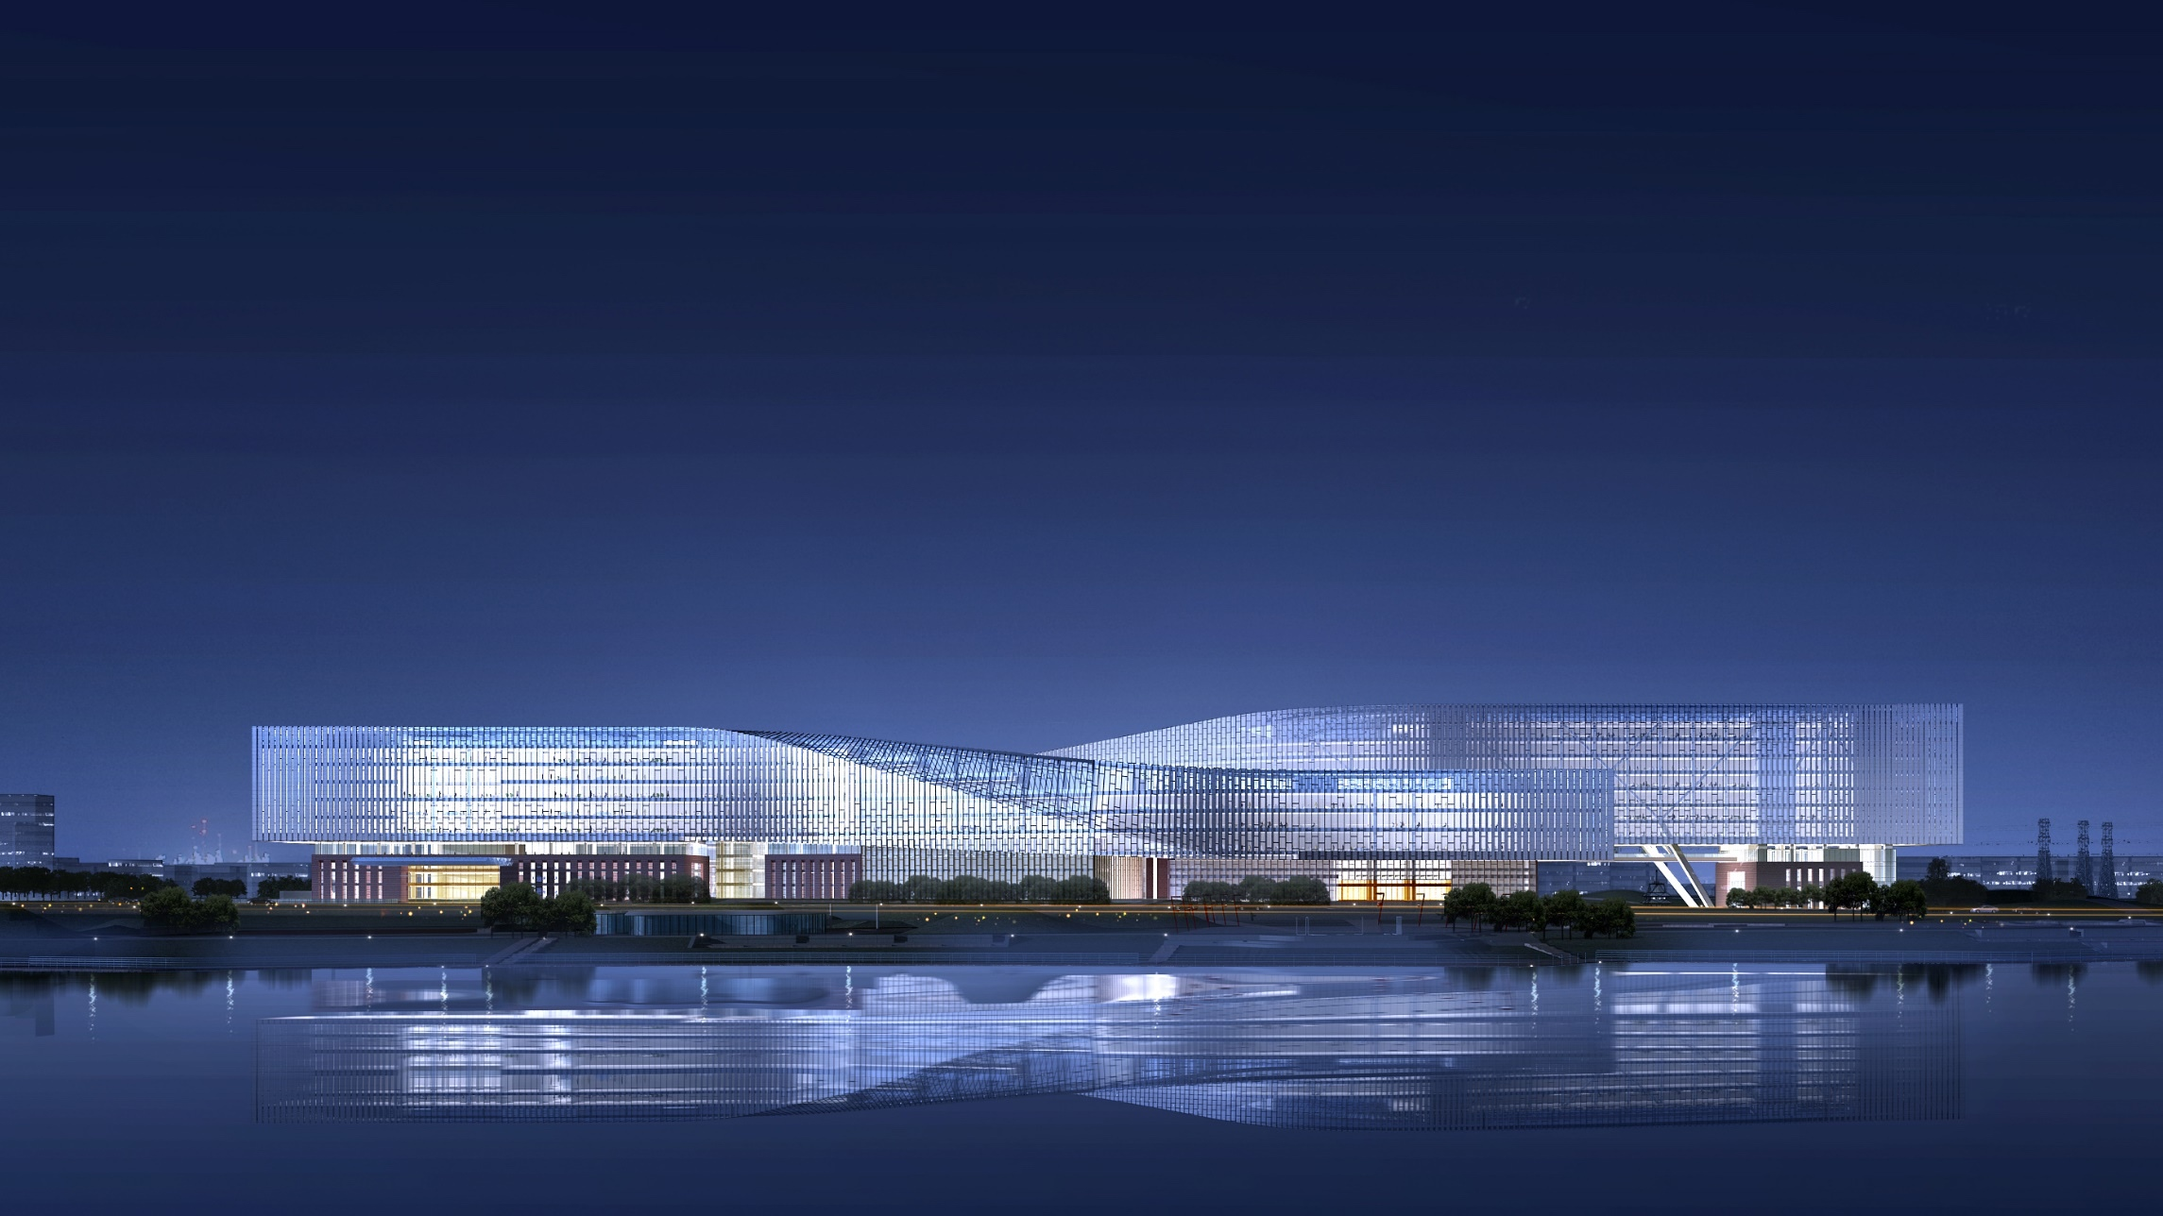

CCTF Technical exchange
Satellite optical links
Hai-feng Jiang
University of Science and Technology of China
2027-2-23 online
Notes:
Thanks chairman for introduction, good morning, afternoon and evening. And happy Chinese new year.

Slide 2
Outline
Motivation of Satellite optical links (SOL) for optical clock comparison
Technical Challenge of Satellite optical links: Doppler effect
Plan and progress of SOL in China
Notes:
My talk include three parts: Motivation of Satellite optical links (SOL) for optical clock comparison
Technical Challenges of Satellite optical links; and Plan and progress of SOL in China

Slide 3

Why Do We Need Satellite Optical Links?
Beyond Geographical Limits
Optical links bypass terrestrial obstructions and Earth's curvature, extending range by ~2× (≈6 dB extra loss) versus ground-only links.
Ultra-High Stability & Precision
Optical carriers with interference detection deliver femtosecond timing and much finer spatial reference points.
The 10⁻¹⁸ Imperative
I-SOC Scientific Data
Optical links are the only viable path to exploit next-generation space clocks, reaching 10⁻¹⁸ uncertainty far faster than microwave links.
Time to 1·10⁻¹⁸ statistical uncertainty:
Link Type
Integration Time
Microwave (MWL)
~160 Days
Optical (FCOL)
~35 Days
Source: ESA I-SOC Scientific Requirements (2017)
Notes:
Why do we need Satellite Optical Links? Firstly, global-scale ground optical clock comparisons require a simple linking method; a link network constructed through several satellites can complete the comparison of ground optical clocks worldwide. On the other hand, the instability of traditional microwave carrier-based space-to-ground links cannot well meet the requirements of optical clock comparisons. As pointed out in I-SOC Scientific Requirements, the stability of optical links has more advantages.

Slide 4
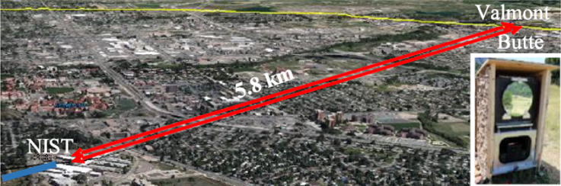
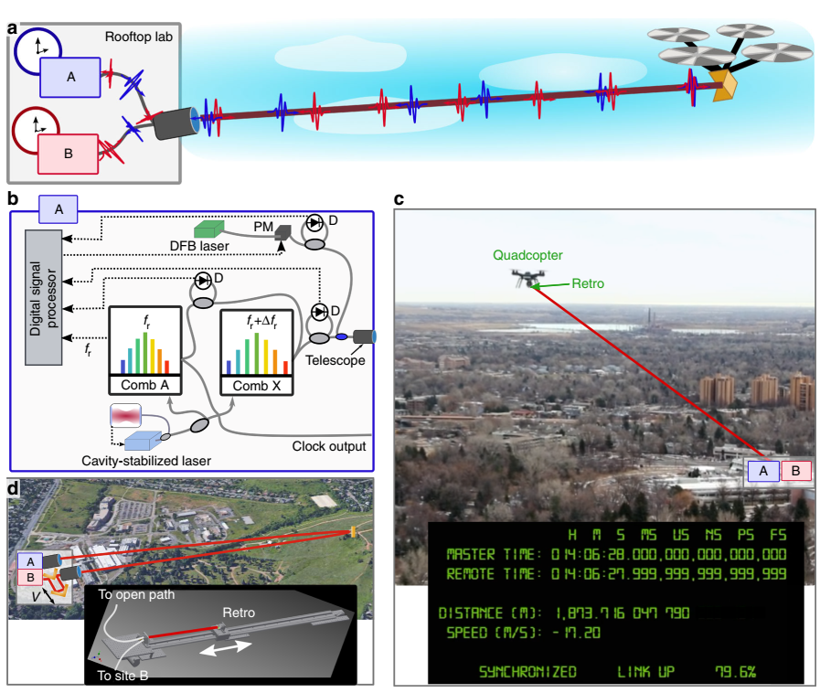
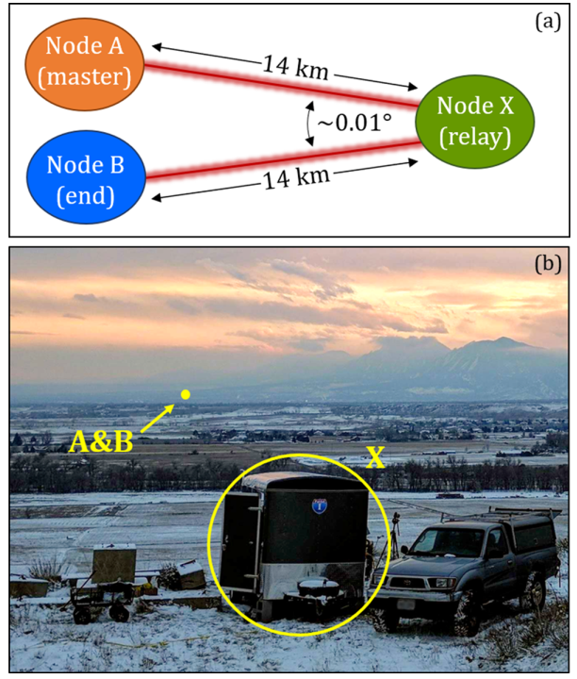
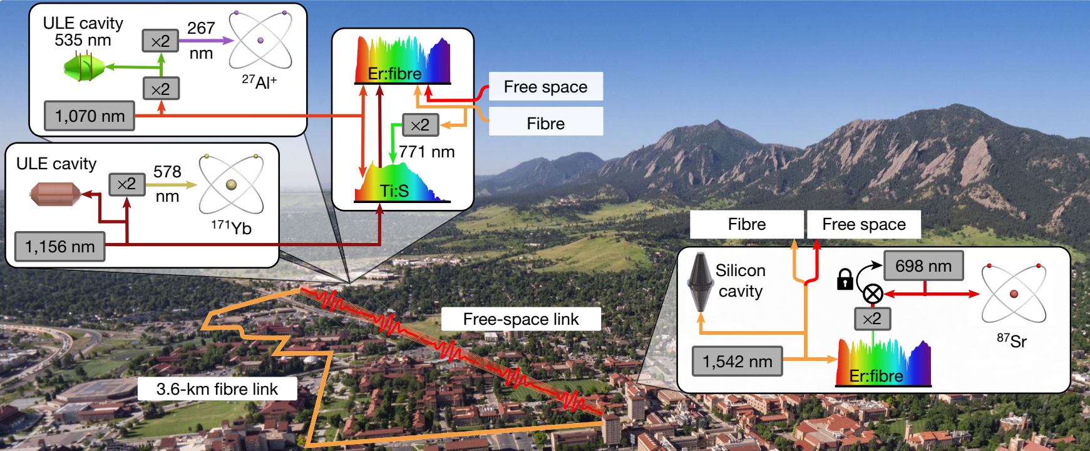
Free space optical links on the ground
NIST group pioneering works based on optical comb：
2013, scheme first proposed [Nat. Photonics 7, 434–438 (2013).]
2016，round-trip 12km atmosphere，5E-19@1000s
2019，flying quadcopter，24m/s, E-18@100s
2020, 14 km freespace， three-node network，6E-19@200s
2021，BACON，free space and fiber optical comparison network，5E-18@10000s
Appl. Phys. Lett. 109, 151104 (2016)
Nat. Commun. 10, 1–7 (2019).
APL Photon. 5, 076113 (2020)
Nature. 591:564-569 (2021)
Notes:
Technically, space-to-ground optical links are fundamentally the same as ground-based free-space optical links. As Lora Sinclair just demostrated, NIST has pioneered this work—since 2013, they have experimentally demonstrated high-stability free-space links using optical frequency combs and interferometry.

Slide 5
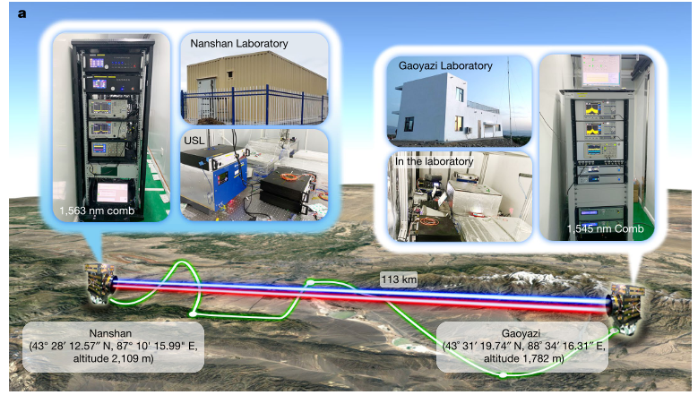
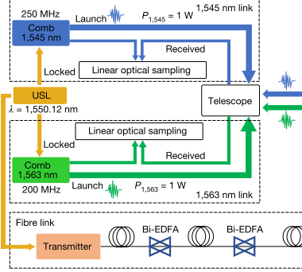
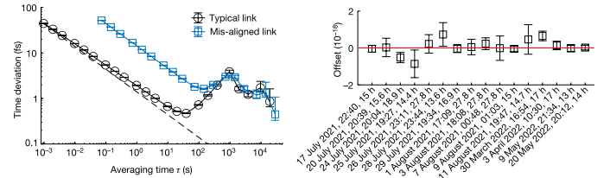
Free space optical links on the ground
Launch a stronger laser：up to Watt level
Detection sensitivity: Nanowatts level
Loss：up to 89 dB
Qi. Shen et al. Nature, 610: 661–666 (2022)
Notes:
Extending the distance to the satellite-ground distance requires enduring greater transmission loss, which can be achieved by increasing the optical frequency comb's optical power to the watt level. As what we did.

Slide 6
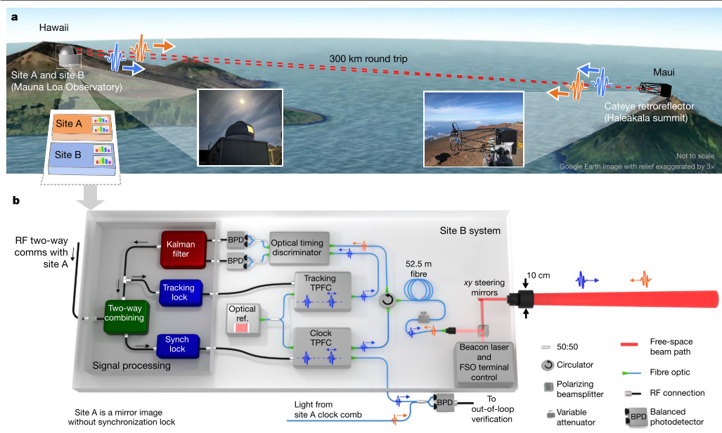
Free space optical links on the ground
Below 1 p W
Loss : up to 100 dB
Caldwell, E. D., et al. (2023). Nature 618(7966): 721-726.
Notes:
Alternatively, tracking interferometry enables more efficient use of received optical power, improving sensitivity from nanowatts to below picowatts.

Slide 7
Outline
Motivation of Satellite optical links (SOL) for optical clock comparison
Challenge of Satellite optical links: Doppler effect
Plan and progress of SOL in China
Notes:
Of course, achieving a space-to-ground optical link still poses significant challenges. Here, I will not address the financial and engineering difficulties, but only the technical issues. We believe that the Doppler effect is the only factor that has not been fully evaluated.

Slide 8
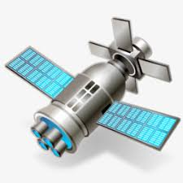
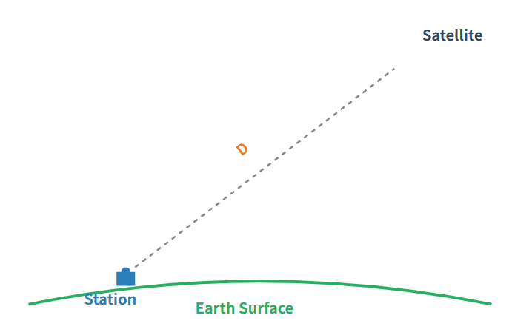



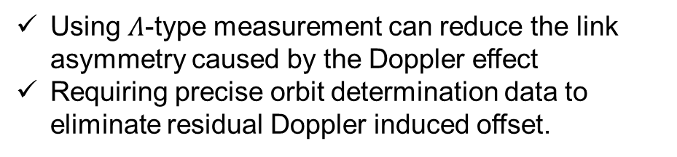

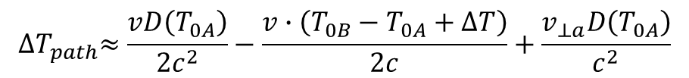

Technical Challenge of Satellite optical links
Challenge of the Doppler effect:
1. Introduces link asymmetry between satellite-to-ground uplink and downlink
2. Introduces errors during timing process of optical linear sampling
link asymmetry
$${∆T}_{path}≈\frac{vD\left(T_{0A}\right)}{2c^{2}}−\frac{v∙\left(T_{0B}−T_{0A}+∆T\right)}{2c}+\frac{v_{⊥a}D\left(T_{0A}\right)}{c^{2}}$$
radial speed $v$
$$T_{0B}+∆T$$
Using $Λ$-type measurement can reduce the link asymmetry caused by the Doppler effect
Requiring precise orbit determination data to eliminate residual Doppler induced offset.
$$T_{0A}$$
radial speed $v_{⊥a}$ of station
Notes:
The Doppler effect has two mechanisms of action: Firstly, the asymmetrical change in the optical path of the link introduces a systematic errors, which, as shown in the formula, are proportional to the relative Doppler motion speed. Here, we have taken into account that the satellite moves faster, so we choose the lambda line pairing link transmission time, which can reduce the impact. Even so, the time error is still at the picosecond level or above. Further reduction requires precise orbit determination data for calibration and correction. We have conducted data simulations for this, and will introduce its impact in detail later.

Slide 9
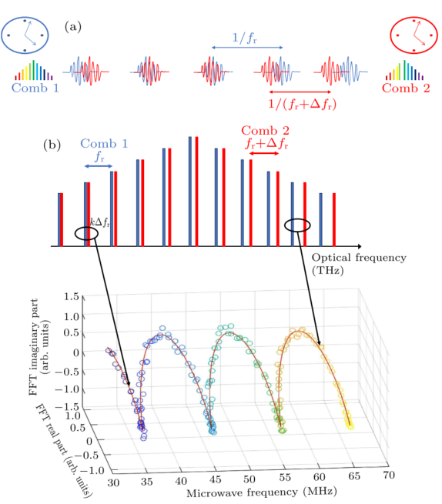
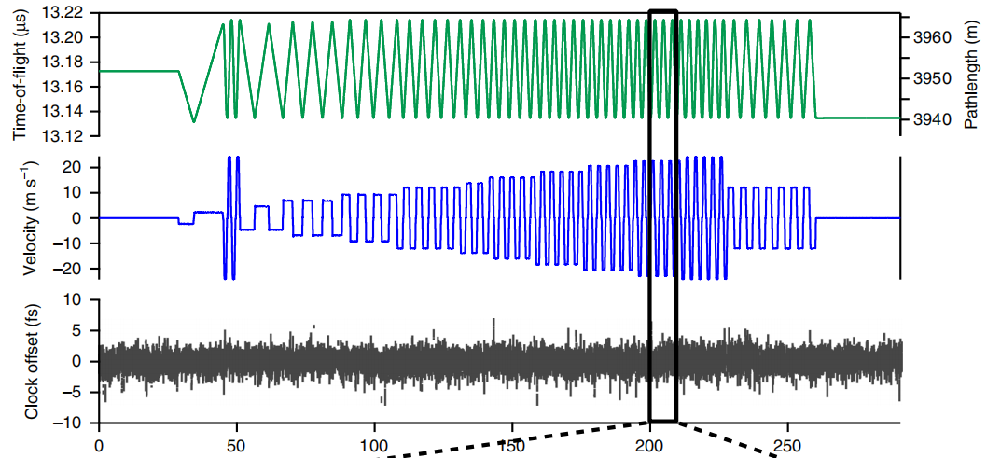
Free-space TF technology
Challenge of the Doppler effect:
1. Introduces link asymmetry between satellite-to-ground uplink and downlink
2. Introduces errors during timing process (optical linear sampling)
Error induced by dispersion of RF part and optical comb: Calibration and correction process
Time-frequency transfer at 24 m/s using simulator and flying quadcopter
Phy. Rev. A 99, 023844 (2019)
Nat. Commun. 10, 1819 (2019)
Notes:
On the other hand, Doppler effect can introduce error during timing process in the optical linear sampling process. the Doppler effect shifts the interference spectrum—causing timing errors due to RF and optical dispersion. Prior experiments achieved stable links at 24 m/s Doppler shift, but operational requirements demand velocities orders of magnitude higher. A tracking interferometry perhaps have less trouble for timing, though experimental validation is still needed.

Slide 10
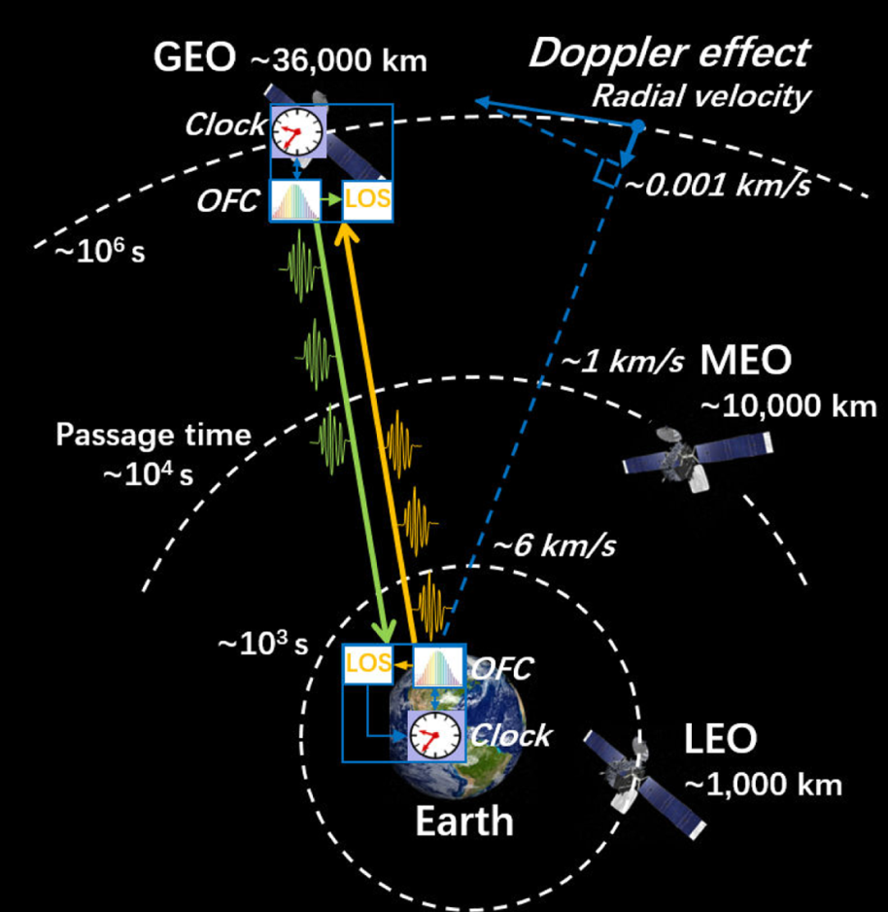
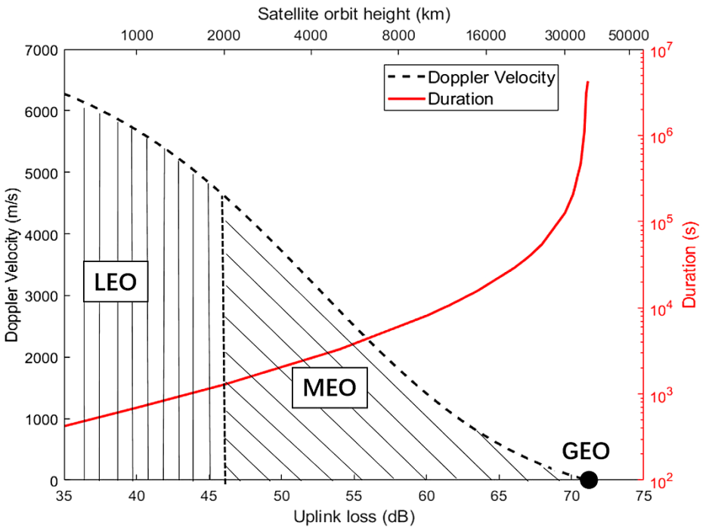
Technical Challenge of Satellite optical links
Doppler velocity: a few km/s dynamic range for MEO
a few hundred dynamic range for IGSO
Shen q. et. al. Optica 8, 471(2021)
Notes:
Taking into account both Doppler velocity and visibility range, we believe that medium and high orbit satellites are more suitable for optical link relay. The Doppler velocity of MEO satellites is at the kilometer per second level, while that of IGSO satellites is at the hundred meters per second level.

Slide 11
Outline
Motivation of Satellite optical links (SOL) for optical clock comparison
Technical Challenge of Satellite optical links
Plan and progress of SOL in china
Notes:
Now, let me introduce Plan and progress of SOL in china

Slide 12
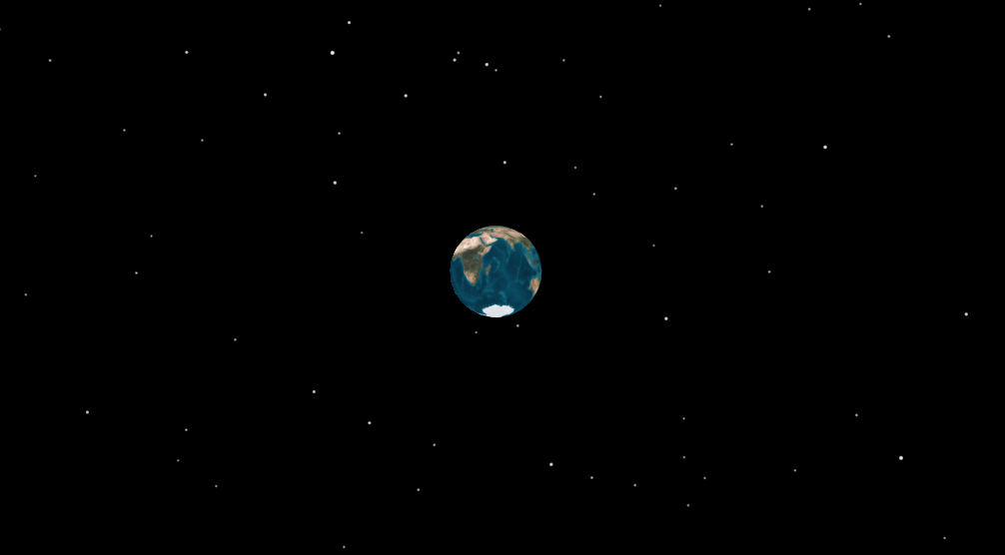
Outline
~20-degree inclined satellite orbit
Target: Support common view ground clock comparison with instability below 5E-18 MDEV@10000s （~29 fs TDEV@10000s）
Transition orbit: Circular orbit 20000km
2020: Project initiation
2025.01: Prototype design completed
Initial orbit:
Highly elliptical orbit
Perigee: 10,000 km
Apogee: 20,000 km
2026.01: Initial electrical model ready
2026.12: Initial qualification model completed
2027.12: Flight model (final sample) ready
2028: Launch
Final orbit: Geosynchronous orbit at 36,000 km
Notes:
The Target is Support common view ground clock comparison With instability below 5E-18@10000s（29 fsTDEV@10000s). China initiated the medium and high orbit satellite program in 2020. It is now in the initial prototype development stage and is scheduled for launch in 2028. The satellite's orbit is designed as follows: the initial orbit has a perigee of 10,000 kilometers and an apogee of 20,000 kilometers; the transition orbit is a 20,000-kilometer circular orbit; and the final orbit is an IGSO orbit. The orbital inclination is approximately 20 degrees.

Slide 13
SOL in China
Payloads and ground stations of the SOL
Each ground station：
Sr optical clock:
1397 nm output
Telescopes (2 sets):
600 mm diameter aperture
Er:fiber-based optical frequency comb:
100 mW output for each telescope
centered at 1560 nm with ~ 10 nm bandwidth,
~100.0015 MHz repetition rate
Highly-chirped pulse with ~ 80 ps duration
Connection to fiber link or Sr optical clock:
1550.12 nm or 1397 nm
Telescope :
1200 mm diameter aperture
Er:fiber-based optical frequency comb:
1 W output for telescope
centered at 1560 nm with ~ 10 nm bandwidth,
~100 MHz repetition rate
Highly-chirped pulse with ~ 80 ps duration
Notes:
The payloads includes a Sr optical clock, two 60 cm diameter telescopes, and a Er:fiber based optical frequency comb. Each ground station is equipped with similar devices, with a laser 10 times stronger and a telescope with a diameter twice as large.

Slide 14
星地光钟比对（单链路）：进入E-18量级
 | 任务书指标 | 设计指标
时频传递链路 | 5 E-18 | 2.8 E-18
星载光钟 | 5 E-18 | 5 E-18
地面光钟 | 5 E-19 | 5 E-19
卫星相对论效应 | 4.5 E-18 | 3.5 E-18
地面相对论修正 | 3 E-18 | 3 E-18
合计（按累加） | 1.9 E-17 | 1.7 E-17
合计（按均方根） | 9.0 E-18 | 7.4 E-18
SOL in China-Summary
Instability budget of the SOL @ 10000 s
TDEV （fs）@ 10000 s | Two ground stations common view | Space-ground clock comparison
Equipment Noise (Including Doppler effect 2 and Ground stations)​ | 12 (6 for Doppler effect 2) | 8
Link Asymmetry Error (Doppler effect 1) | 6 | 6
Atmospheric Asymmetry Error​ | 5 | 5
Telescope Asymmetry Error ​​ | 2.4 | 1.6
Total | 14.5 / 25.4 | 11.3 / 20.6
Not well understood!
Target: ~29 fs
Notes:
This is instability budget of the link at 10000 second in TDEV. Equipment Noise is 12 fs, Link Asymmetry Error is 6 fs, Atmospheric Asymmetry Error​ is 5 fs and Telescope Asymmetry is 2.4 fs. In stability of a common view link should be below 24.4 fs.

Slide 15
Link Asymmetry Error (Doppler)
Simulation Results of Doppler effect 1
 | Common-view time-frequency comparison |  |  | Satellite-ground clock comparison
 | 10000-20000 km elliptical orbit | 20000-km circular orbit | IGSO Orbit | IGSO Orbit
Orbit Precision | 0.3m, 0.1mm/s | 0.3m, 0.08mm/s | 0.3m, 0.07mm/s
Simulated Instability at 10,000 s (TDEV) | 1.8 fs | 1.6 fs | 2.9 fs | 19 fs (include relativistic effects)
Target: 6 fs
Notes:
We suppose that the accuracy of the precise orbit determination can reach 0.3 meters, and the speed determination accuracy is within 0.1 mm/s. According to our simulation results, the contribution of the Doppler effect 1 in all orbits is less than 6 fs.

Slide 16
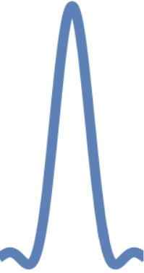
113 km TF-link under simulated Doppler effect 2
SOL faces extreme Doppler shifts (~km/s):
Realistic velocity (km/s) is impractical to replicate on Earth
Directly simulate Doppler-induced frequency shifts: Use shifted-locking ultra-stable lasers
113 km free space link
Comb
Comb
Frequency-shifted USL
USL
fiber TF link
Notes:
Recently, we conducted a high-speed Doppler demonstration experiment on a 113-kilometer field link, using a fiber link as an out-of-loop verification. The Doppler effect was simulated by modulating the laser frequency/phase.

Slide 17
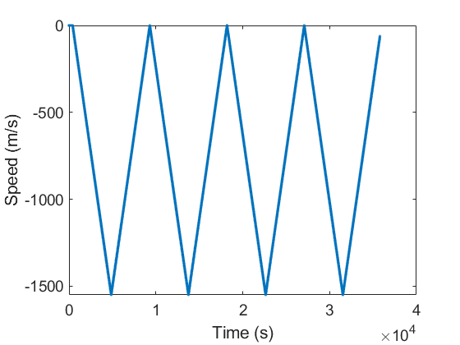
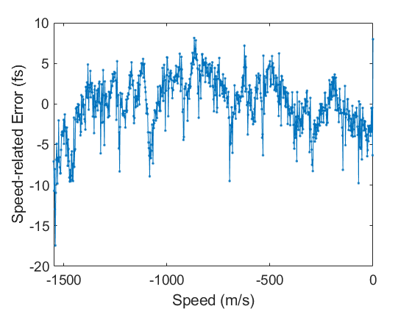
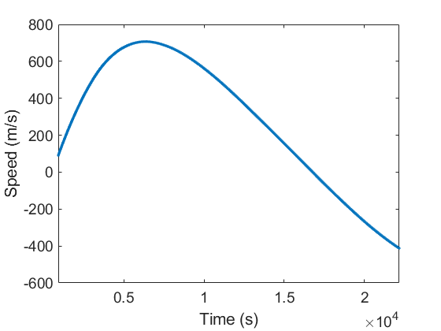
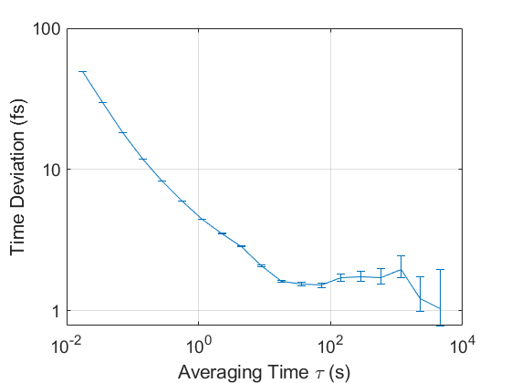
113 km TF-link under simulated Doppler effect 2
triangle frequency scanning (-1.5km/s to zero)
Average error under each speed
redial velocity curve for a simulated MEO orbit
Instability
Notes:
This is the preliminary results of the Doppler effect 2. within a dynamic range of 1500 m/s, the peak-to-peak value of the Doppler effect 2 was less than 30 fs. The real orbit was accurately reversed, and the TDEV approached 1 fs at several thousand seconds. We are still working on this, may submit a paper in a few months.

Slide 18
Conclusion and perspective
Conclusion:
SOLs can support global scale ground clocks comparison with instability below 5E-18 MDEV@10000s （29 fs TDEV@10000s）.
Most likely we will have a SOLs serve for optical clock comparison in 2028.
Perspective:
Welcome international colleagues around the world to use this Chinese experimental satellite to compare optical clocks.
Notes:
Now I conclude my talk. SOLs can support global scale ground clocks comparison with instability below 5E-18 MDEV@10000s （29 fs TDEV@10000s）.Most likely we will have a SOLs serve for optical clock comparison in 2028. Welcome international colleagues around the world to use this Chinese experimental satellite to compare optical clocks.

Slide 19






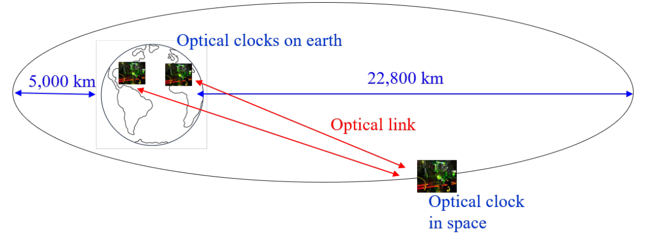
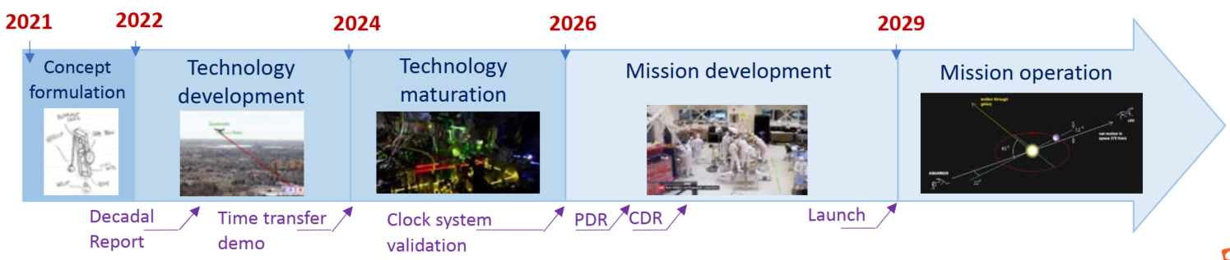
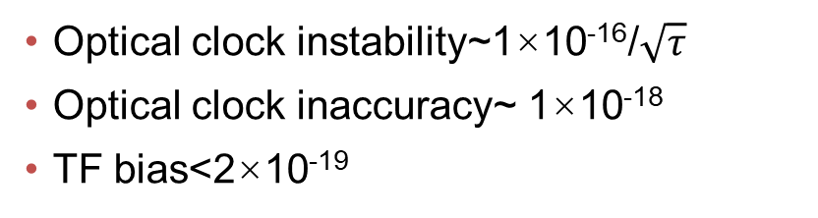
SOL plan in USA
NIST/JPL（FOCOS）
Optical clock instability~1×10⁻¹⁶/$\sqrt{τ}$
Optical clock inaccuracy~ 1×10⁻¹⁸
TF bias<2×10⁻¹⁹
Quantum Sci. Technol. 7 (2022) 044002
Notes:
At the end, I want to notice that these is another SOL plan in USA, I donot have much information except the paper published in 2022. this plan slightly later than Chinese one. But has better stability.

Slide 20

The end!
Thank you for your attention!
Notes:
Thank you for your attention!

Slide 21
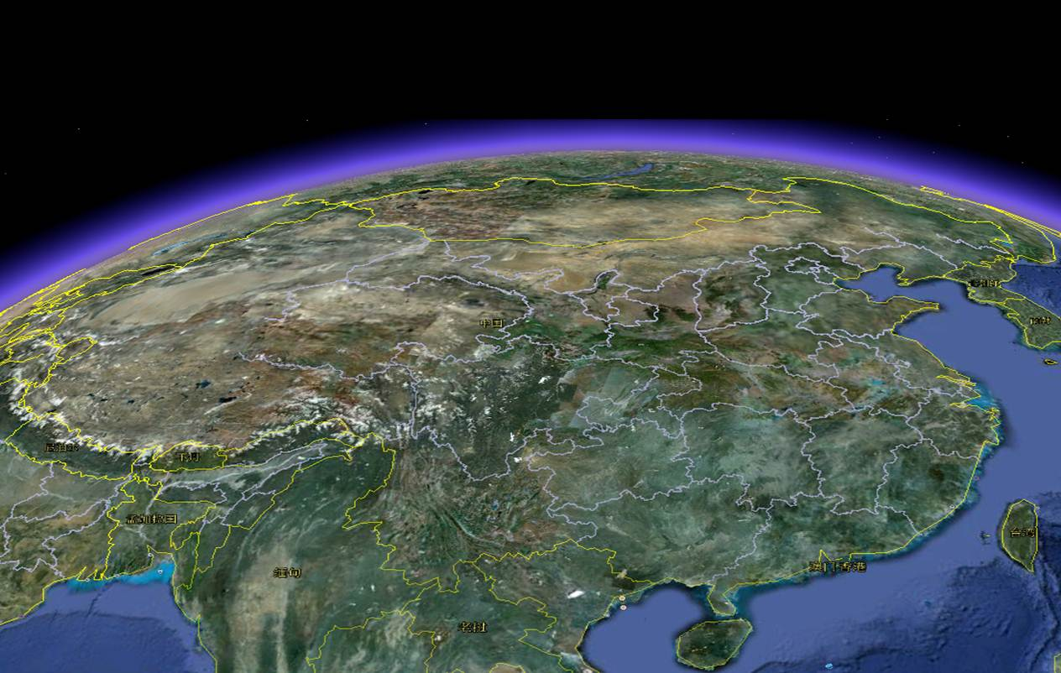
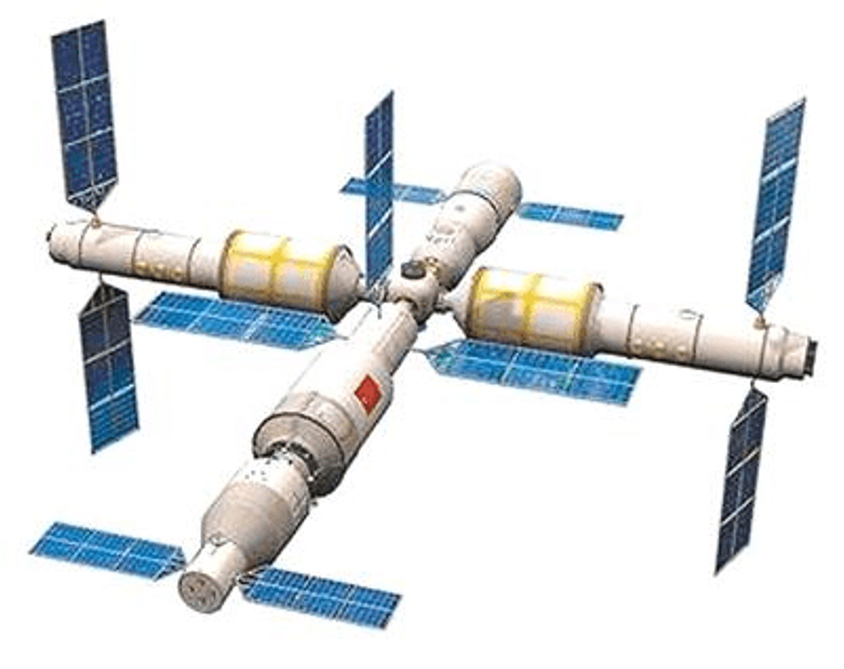




Assessment of the SOL
Optical link with common link noise
Full optical link
Beijin
$$\frac{Δf}{f}=−\frac{ΔU}{c^{2}}$$
Hefei
2 Ground
Stations
Ground stations distance (100-200 m)
Estimation instability of link equipment
Ground stations distance (~1000 km)
Instability of the fiber link: <1E-19@10000s
Notes:
The link assessment consists of two steps: First, nearby ground stations establish links with the satellite to evaluate link stability caused by equipment noise through comparison. Second, stations at least 1,000 km apart, connected by optical fibers, assess link stability by comparing their connections.

