Slide 1
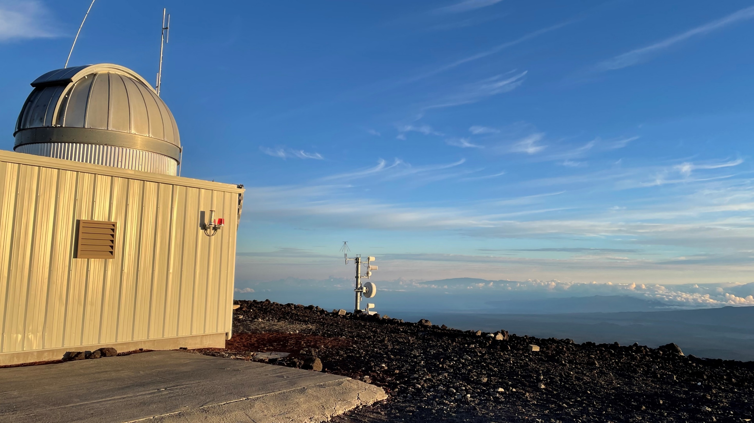
Frequency-Comb-Based Time Transfer over Free-Space Links
Laura Sinclair
National Institute of Standards and Technology
Boulder, CO, USA
laura.Sinclair@nist.gov
CCTF Technical Exchange
February 23rd, 2026

Slide 2
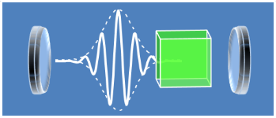
The optical frequency comb
Passively Mode-Locked Laser
Output time of laser pulses and phase relationship between pulses are variable
And set by the dynamics of the laser cavity
In the frequency domain, broad spectral bandwidth
A laser with short pulses with relatively low timing jitter
t

Slide 3

The optical frequency comb
Fully Self-Referenced Optical Frequency Comb
Stabilize a passively mode-locked laser
Output time of comb pulses and phase relationship between pulses are fixed
And defined by the reference oscillator
.
.
$${1/f}_{r}$$
Reference Plane
t
k+4
k+3
k+2
k+1
k
k-1
Controller
~
Reference Oscillator

Slide 4

The optical frequency comb
Fully Self-Referenced Optical Frequency Comb
Stabilize a passively mode-locked laser
Output time of comb pulses and phase relationship between pulses are fixed
And defined by the reference oscillator
In the frequency domain, a “comb” of optical frequencies
.
$${1/f}_{r}$$
Time Domain
t
k+4
k+3
k+2
k+1
k
k-1
Fourier Transform of many pulses
Frequency Domain
Controller
~
f_{n} = nf_{rep}+ f_{ceo}
Reference Oscillator
f
$$f_{r}$$

Slide 5
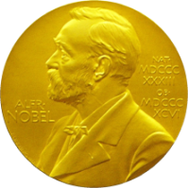
The optical frequency comb
Fully Self-Referenced Optical Frequency Comb
Stabilize a passively mode-locked laser
Output time of comb pulses and phase relationship between pulses are fixed
And defined by the reference oscillator
In the frequency domain, a “comb” of optical frequencies
An ultra-precise fixed ruler for time and frequency
Nobel Prize 2005
T. Hänsch
J. Hall
$${1/f}_{r}$$
Time Domain
t
k+4
k+3
k+2
k+1
k
k-1
Fourier Transform of many pulses
Frequency Domain
Controller
~
Broadband, narrow linewidth, few-fs timing jitter
Reference Oscillator
f
$$f_{r}$$

Slide 6



Frequency Combs Make
Timing Comparisons at 18-Digits Possible
“Dual-comb” measurements:
Attosecond-level precision on pulse arrival timing
Clock or reference oscillator
Clock or reference oscillator
Optical Reference Oscillator
Sets pulse spacing
Timing Comparison
Comb with pulse output
~5ns
Comb with pulse output
Site B
Controller:
Count pulses
Ticks of local timescale defined by pulses crossing this reference plane
Site A
Define a local timescale with sub-femtosecond precision
Generate a frequency reference with sub 10⁻¹⁸ precision

Slide 7

Free-space Time Transfer Challenges
Clock or reference oscillator
Clock or reference oscillator
Optical Reference Oscillator
Timing Comparison
Comb with pulse output
Comb with pulse output
Site A
Site B
Free-space channel challenges

Slide 8
Free-space Time Transfer Challenges
Clock or reference oscillator
Clock or reference oscillator
Optical Reference Oscillator
Timing Comparison
Comb with pulse output
Comb with pulse output
Site A
Site B
Free-space channel challenges
Intensity fluctuations (scintillation)- orders of magnitude variations in received power

Slide 9
Free-space Time Transfer Challenges
Clock or reference oscillator
Clock or reference oscillator
Optical Reference Oscillator
Timing Comparison
Comb with pulse output
Comb with pulse output
Site A
Site B
Free-space channel challenges
Intensity fluctuations (scintillation)- orders of magnitude variations in received power
2. Time-of-flight fluctuations- picosecond level fluctuations in pulse arrival time

Slide 10
Free-space Time Transfer Challenges
Clock or reference oscillator
Clock or reference oscillator
Optical Reference Oscillator
Timing Comparison
Comb with pulse output
Comb with pulse output
Site A
Site B
Free-space channel challenges
Intensity fluctuations (scintillation)- orders of magnitude variations in received power
2. Time-of-flight fluctuations- picosecond level fluctuations in pulse arrival time
Solved by: operation at the quantum-limit, long integration time and ns-scale ambiguity range
Solved by: two-way operation

Slide 11
Expanding the Toolbox to Handle Long Distances:
The Time Programmable Frequency Comb
The Time Programmable Frequency Comb
Combine a self-referenced comb with modern digital control
Output time of comb pulses and phase relationship between pulses can be adjusted to an arbitrary user-defined value with attosecond-level accuracy
Values are still defined by the reference oscillator
A numerically controlled optical oscillator
Controller
~
Digital Timing Commands
Reference Oscillator
E.D Caldwell, L.C. Sinclair, N.R. Newbury and J.-D. Deschenes, “The time-programmable frequency comb and its use in quantum-limited ranging”, Nature 610 667-673 (2022)

Slide 12
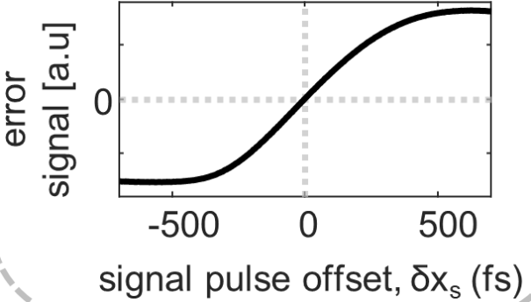
Time Programmable Comb -> Tracking Comb
A quantum limited timer
Incoming signal pulses (remote)
Signal Comb
(Remote site)
+Δt
Time Offset of signal pulse
Tracking Comb (local oscillator)
Timing Comparison
Controls: Move +Δt
Heterodyne Voltage
Measure
Tracking Local Oscillator (LO) Comb
Feedback
Caldwell, E. D., Sinclair, L. C., Newbury, N. R. & Deschenes, J.-D. The time-programmable frequency comb and its use in quantum-limited ranging. Nature 610, 667–673 (2022).

Slide 13

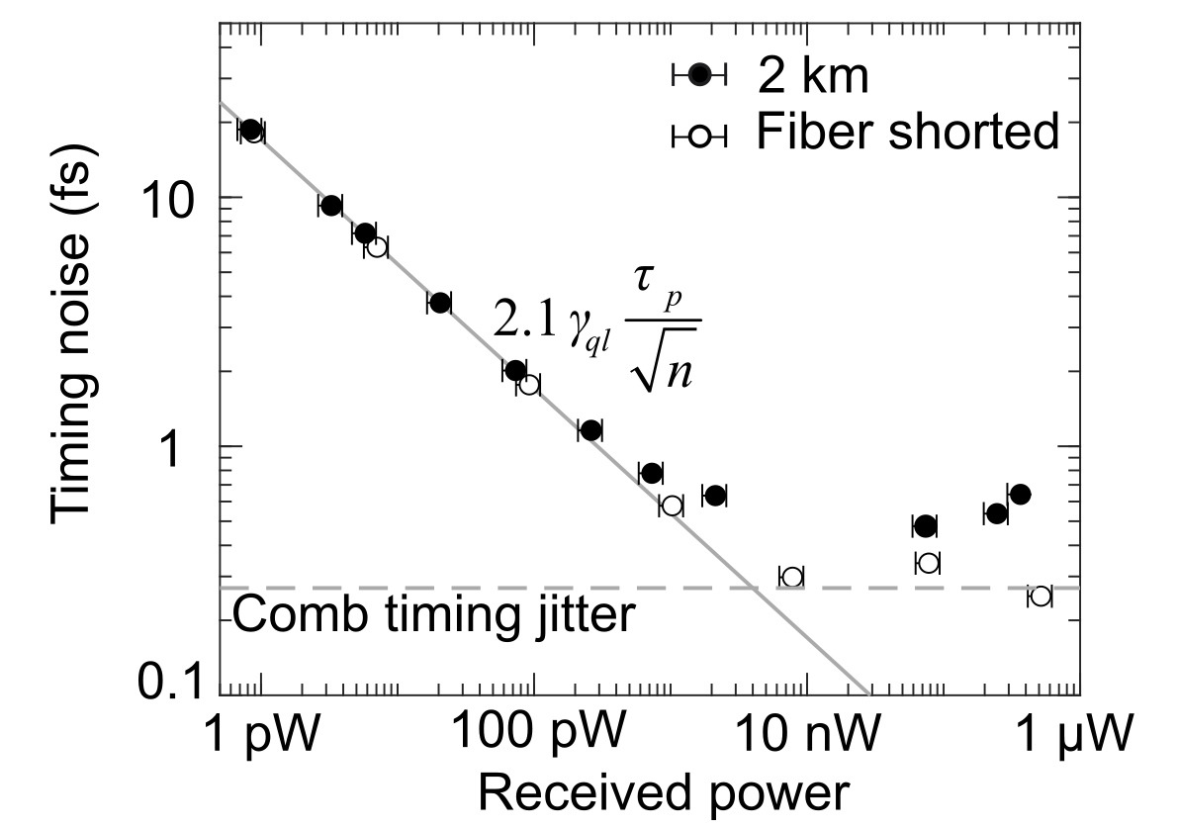
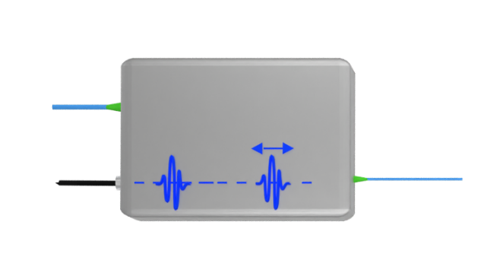

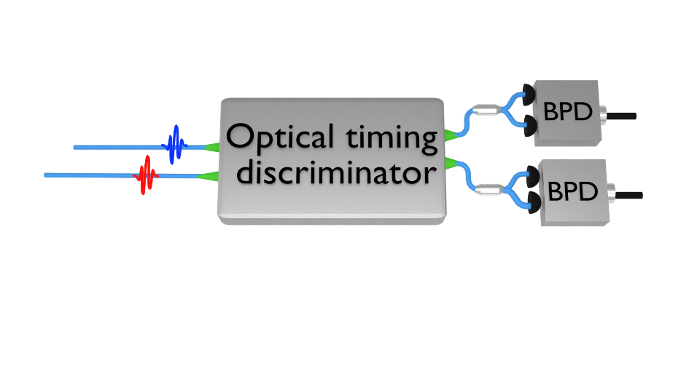

Time Programmable Comb -> Tracking Comb
A quantum limited timer
clock optical reference
incoming pulse train
(<< 1 photon per pulse)
Quantum
limited
timer
time offset
Measurement time: 38 μseconds
0.000 000 623 ns
TPFC
clock
ref.
Digital PLL
LPF
26 kHz
unbalanced MZI + balanced heterodyne detection (BPD)

Slide 14

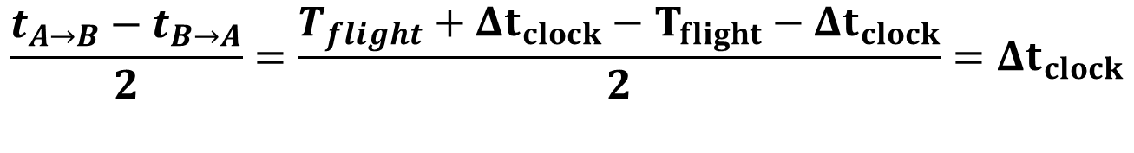
Two-way optical time transfer:
Precise detection plus removal of propagation noise
Free-space channel
Clock or reference oscillator
Clock or reference oscillator
Optical Reference Oscillator
t_{B→A}=T_{flight} - Δt_{clock}
t_{A→B}=T_{flight} + Δt_{clock}
Optical Timing Comparison
Optical Timing Comparison
Comb with pulse output
Single-mode reciprocal link
Comb with pulse output
Site A
Site B
Two-way combination cancels common time-of-flight noise and has attosecond precision from time programmable comb measurement:
$$\frac{t_{A→B}−t_{B→A}}{2}=\frac{T_{flight}+Δt_{clock}−T_{flight}−Δt_{clock}}{2}=Δt_{clock}$$

Slide 15

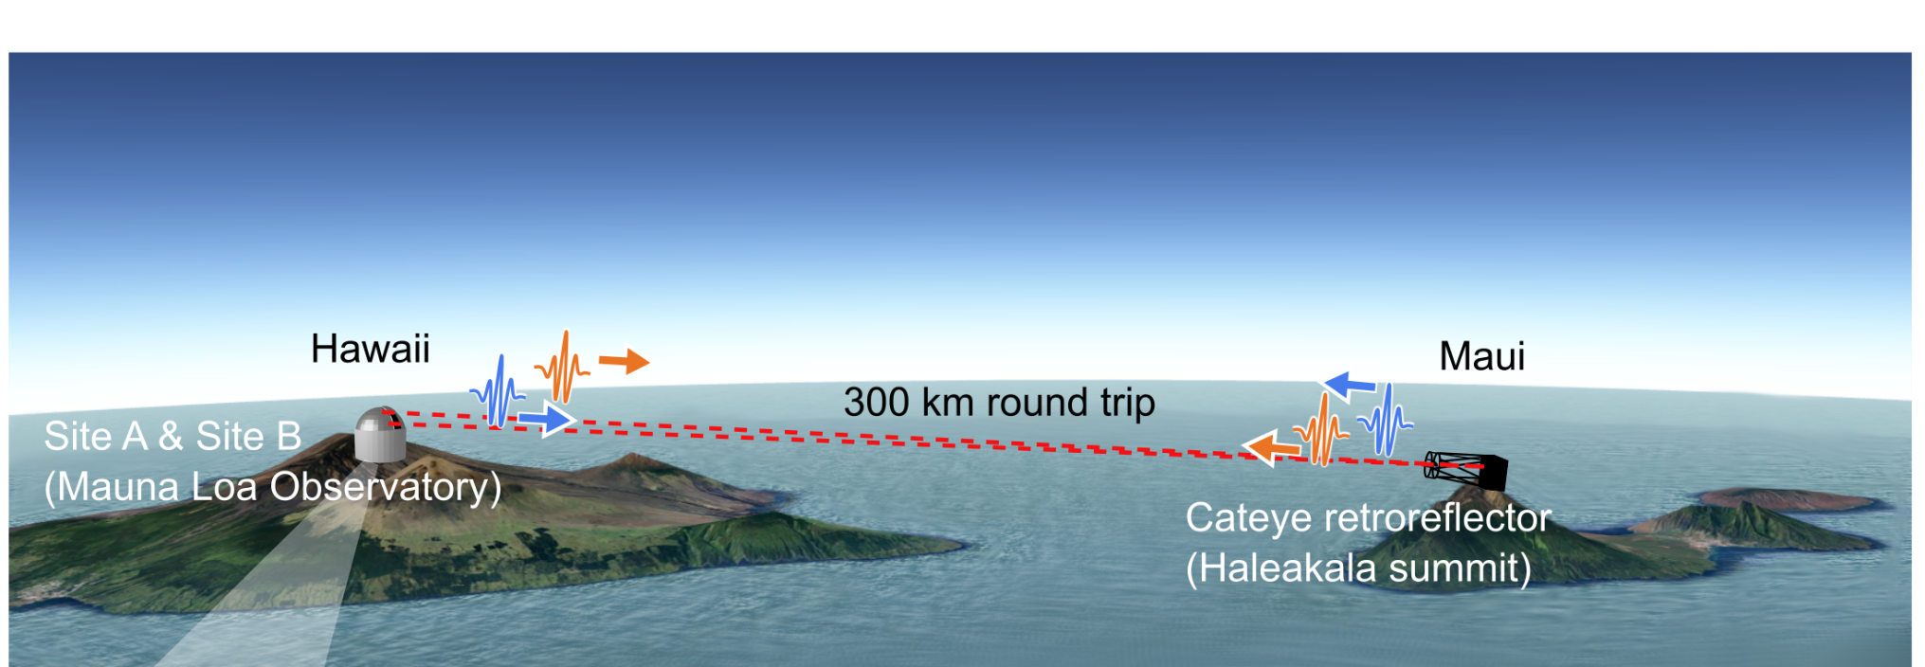
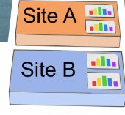

Optical Time Transfer at the Quantum Limit
Over 300 km of Turbulent Air
Octosig
Folded link geometry
Truth by direct “shorted” comparison at Mauna Loa Observatory
Link loss ~90 dB!
Site support: University of Hawaii and NOAA
E. D. Caldwell et al. Quantum-limited optical time transfer for future geosynchronous links. Nature 618, 721–726 (2023)

Slide 16
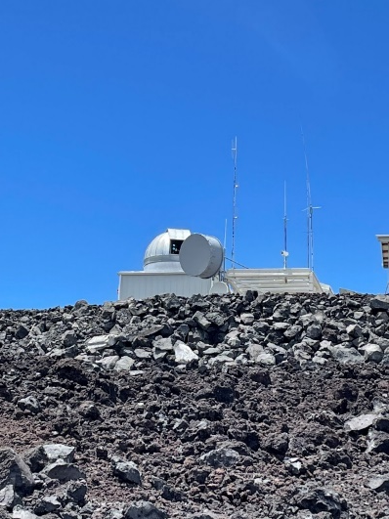
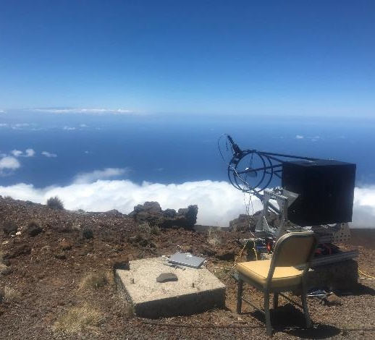
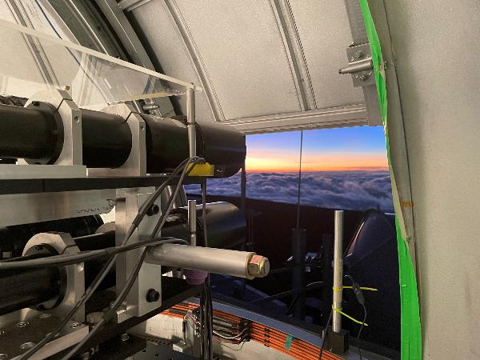
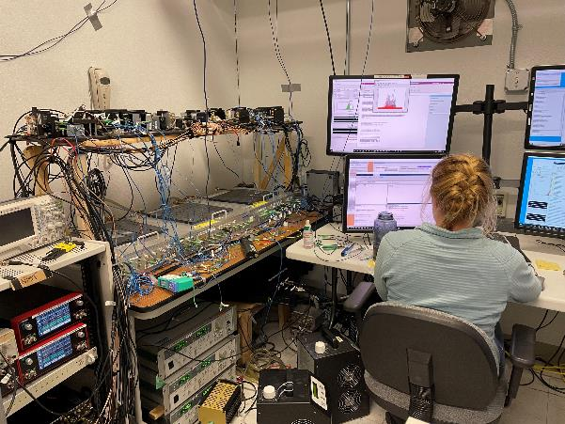
Optical Time Transfer at the Quantum Limit
Over 300 km of Turbulent Air
Octosig
Folded link geometry
Truth by direct “shorted” comparison at Mauna Loa Observatory
Link loss ~90 dB!
Site support: University of Hawaii and NOAA
E. D. Caldwell et al. Quantum-limited optical time transfer for future geosynchronous links. Nature 618, 721–726 (2023)

Slide 17
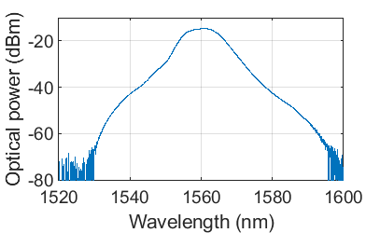
Optical Time Transfer at the Quantum Limit
Over 300 km of Turbulent Air – Some Numbers
Free-space channel
Clock or reference oscillator
Clock or reference oscillator
Optical Reference
200 MHz
Repetition rate
200 MHz
Repetition rate
Comb with pulse output
Single-mode reciprocal link
Comb with pulse output
195 THz
Free-running
Cavity-stabilized laser
195 THz
Free-running
Cavity-stabilized laser
4 mW
Centered at 1560 nm
4 mW
Centered at 1560 nm
Tracking Comb Detection
Tracking Comb Detection
Site A
t_{B→A}=T_{flight} - Δt_{clock}
t_{A→B}=T_{flight} + Δt_{clock}
Site B
feedback
E. D. Caldwell et al. Quantum-limited optical time transfer for future geosynchronous links. Nature 618, 721–726 (2023)

Slide 18
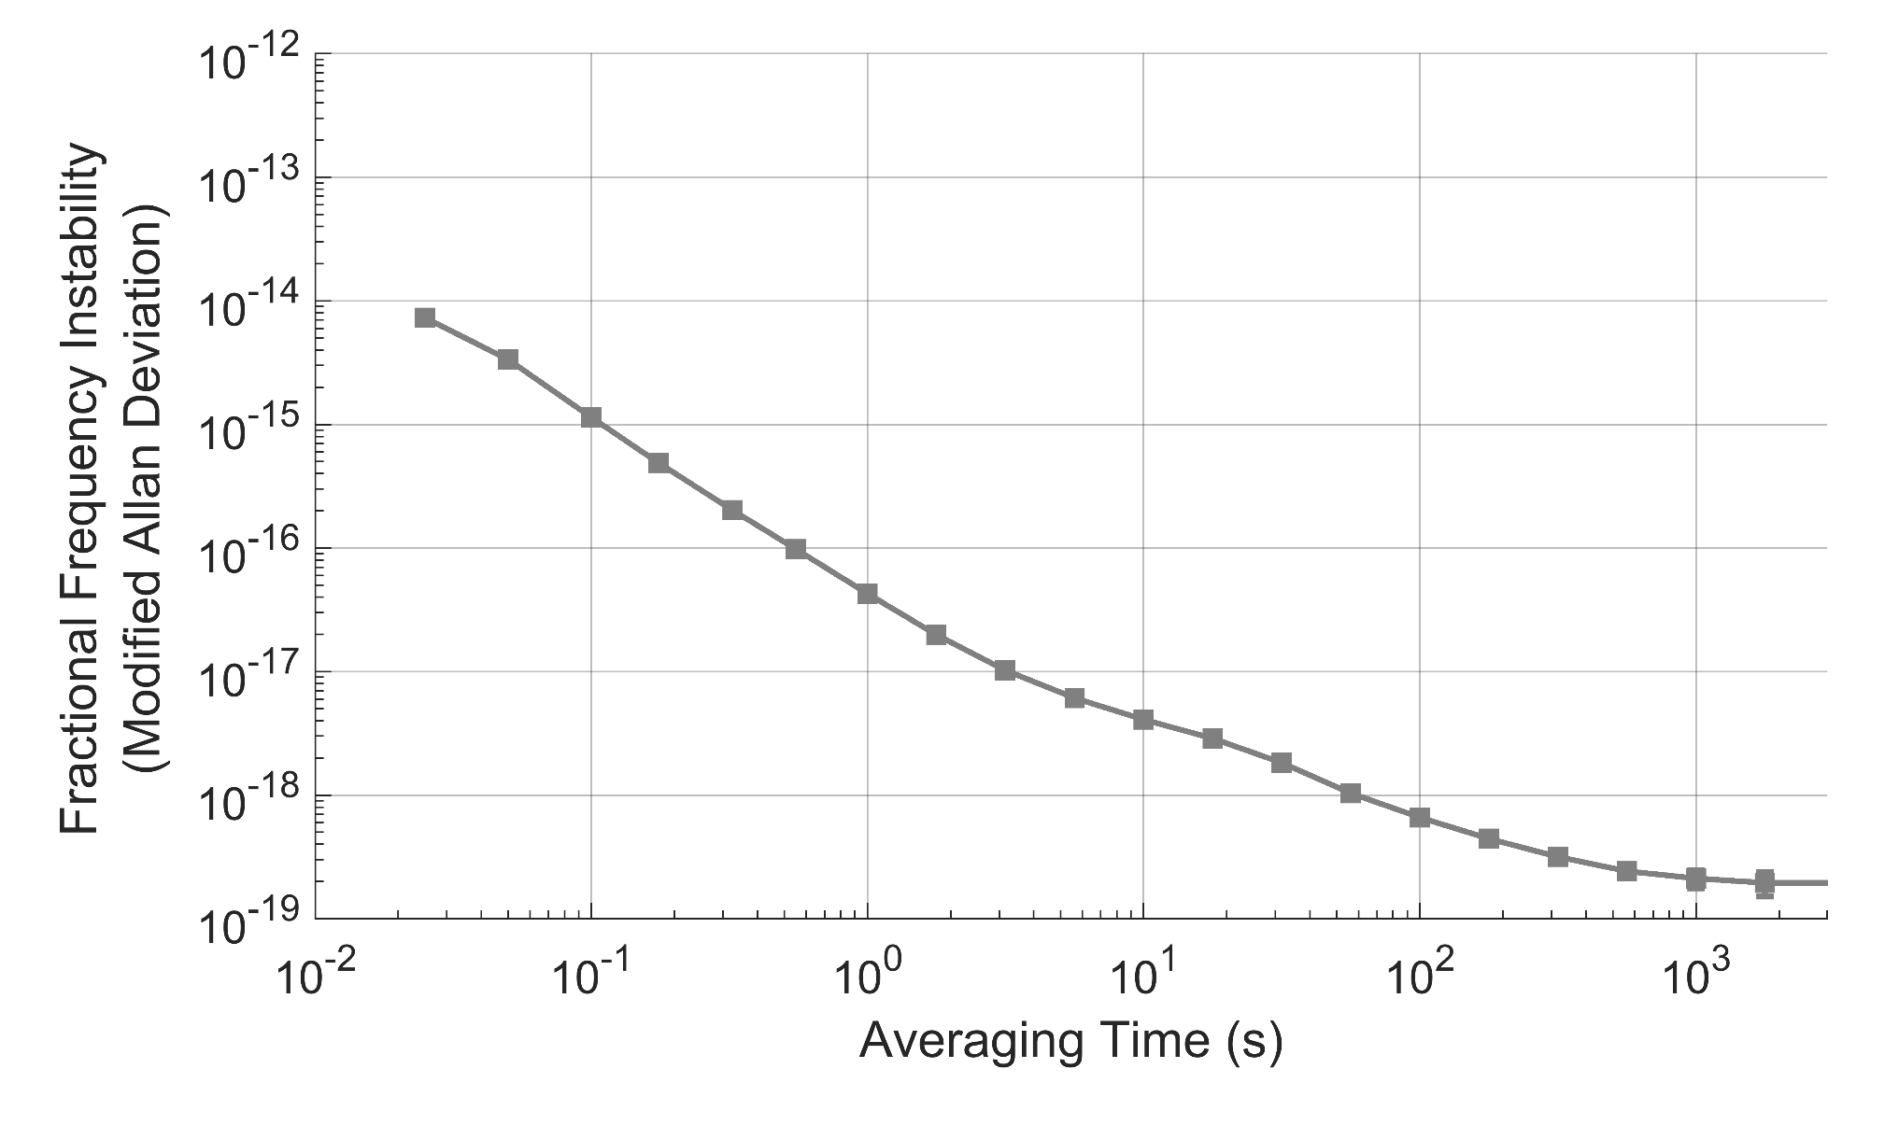
Optical Time Transfer at the Quantum Limit
Over 300 km of Turbulent Air
fiber shorted
Caldwell, E. D. et al. Quantum-limited optical time transfer for future geosynchronous links. Nature 618, 721–726 (2023)

Slide 19
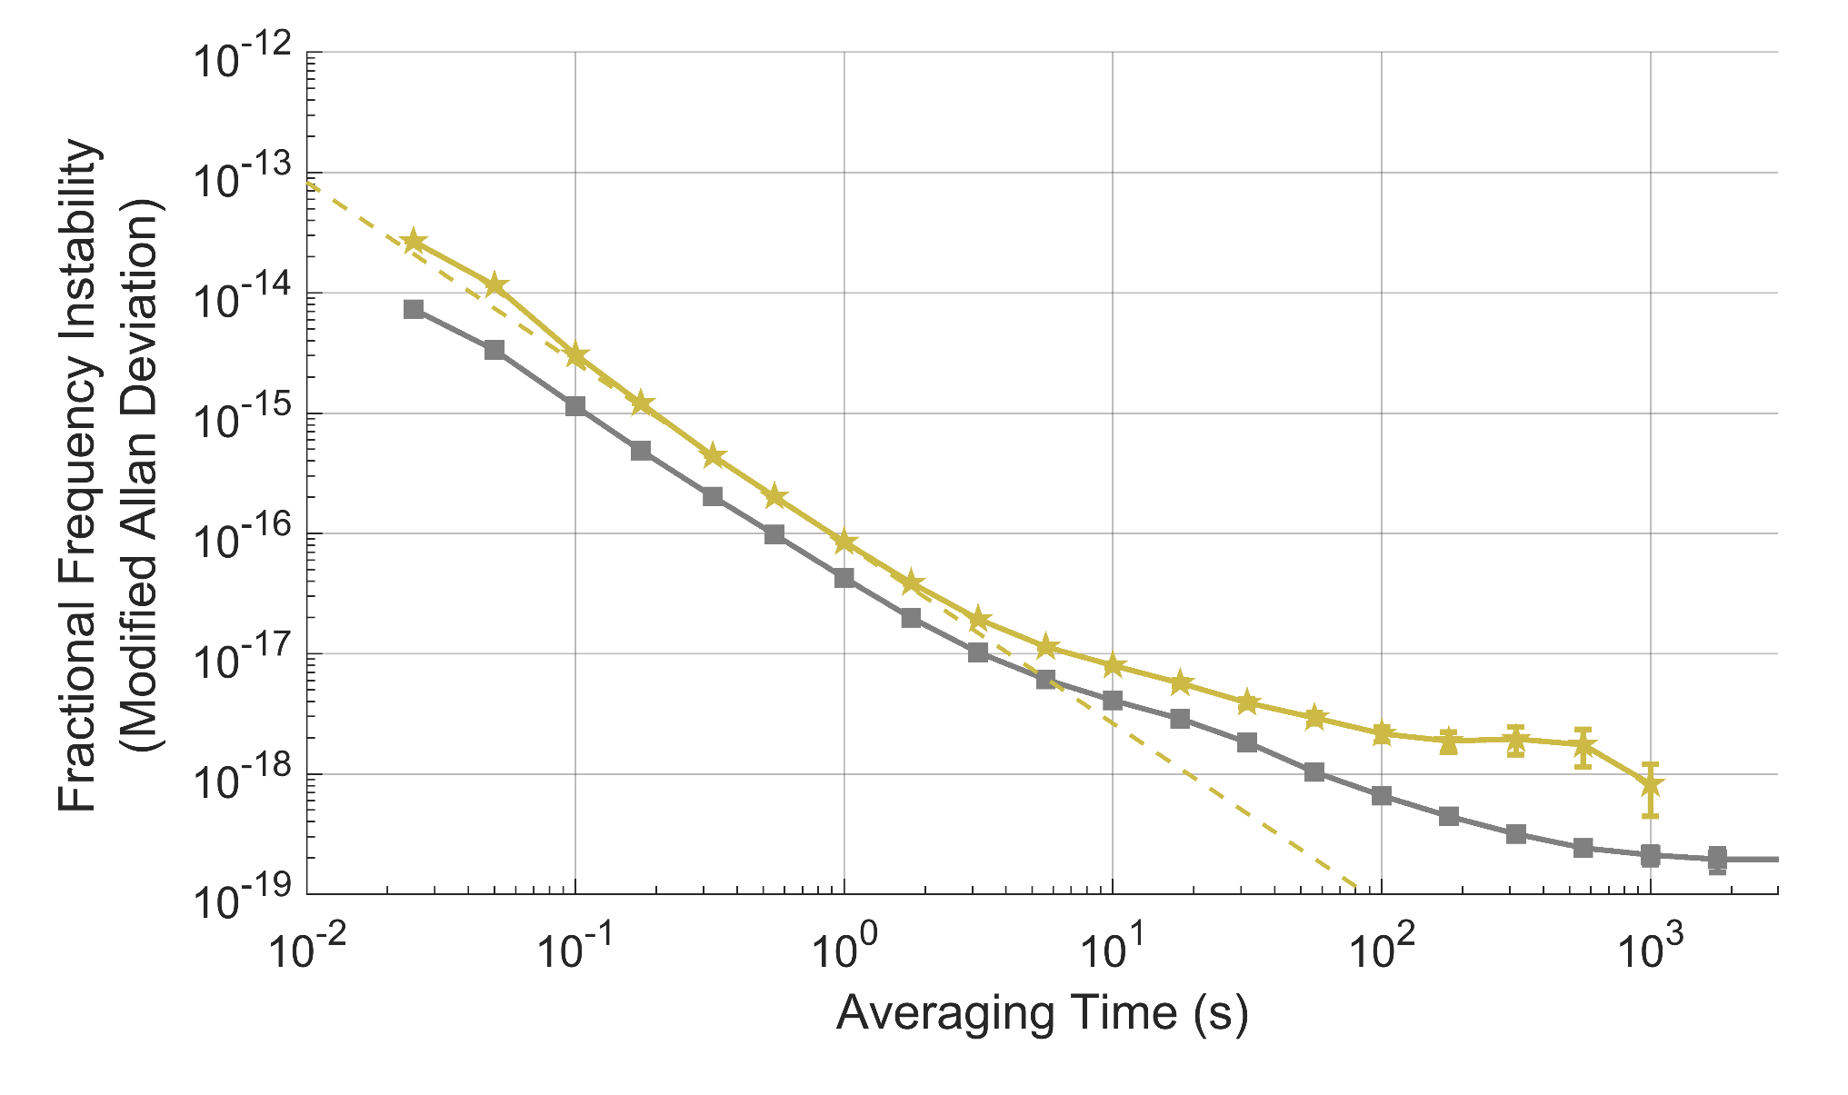
Optical Time Transfer at the Quantum Limit
Over 300 km of Turbulent Air
2 km
fiber shorted
Quantum limit
(2km power)
Caldwell, E. D. et al. Quantum-limited optical time transfer for future geosynchronous links. Nature 618, 721–726 (2023)

Slide 20
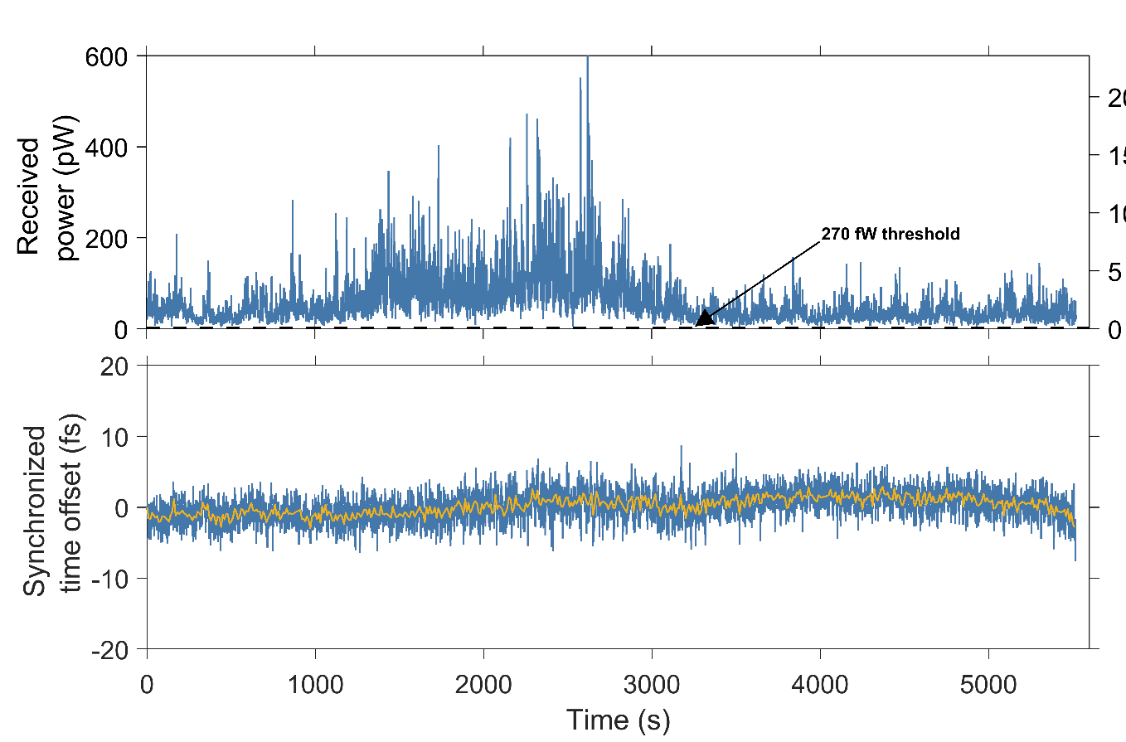
Optical Time Transfer at the Quantum Limit
Over 300 km of Turbulent Air
Sub-femtosecond synchronization
Shot-noise limited SNR
  270 fW threshold (~1/100 photons per pulse)
4 mW launch
1 second average
10 second average
Caldwell, E. D. et al. Quantum-limited optical time transfer for future geosynchronous links. Nature 618, 721–726 (2023)

Slide 21
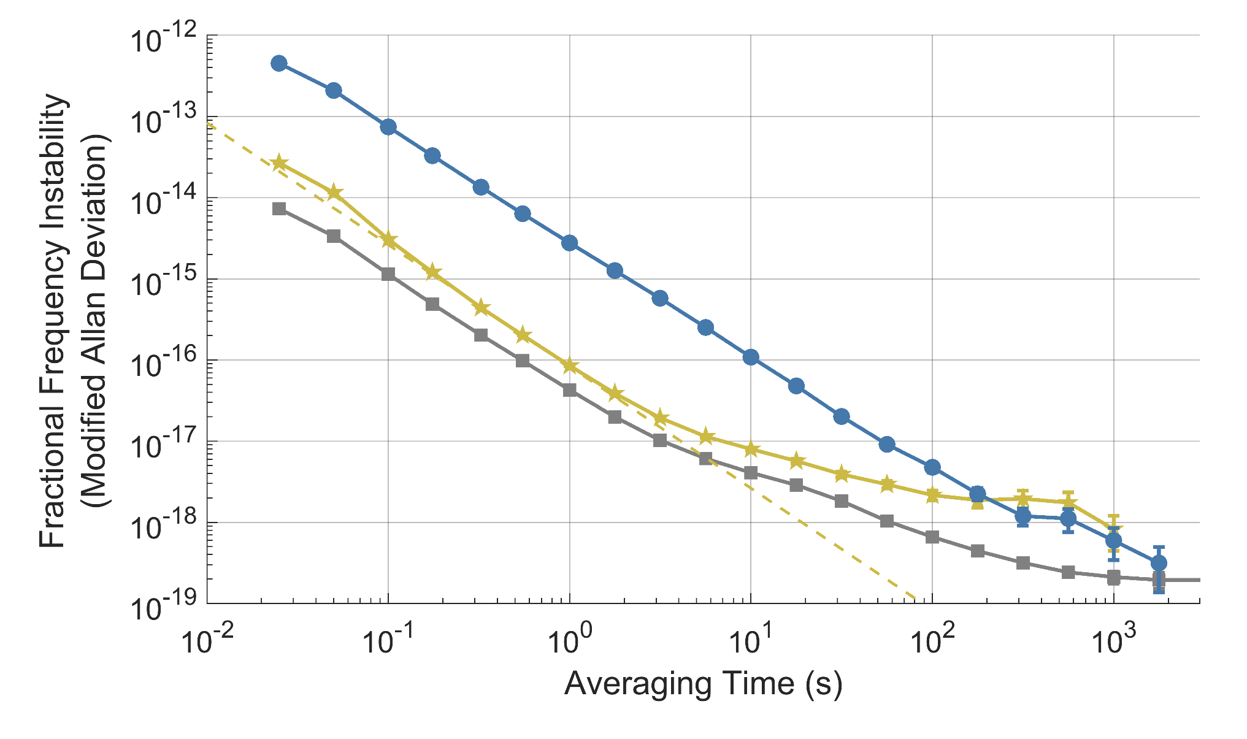
Optical Time Transfer at the Quantum Limit
Over 300 km of Turbulent Air
300 km, 4 mW launch
2 km
fiber shorted
Quantum limit
(2km power)
Caldwell, E. D. et al. Quantum-limited optical time transfer for future geosynchronous links. Nature 618, 721–726 (2023)

Slide 22
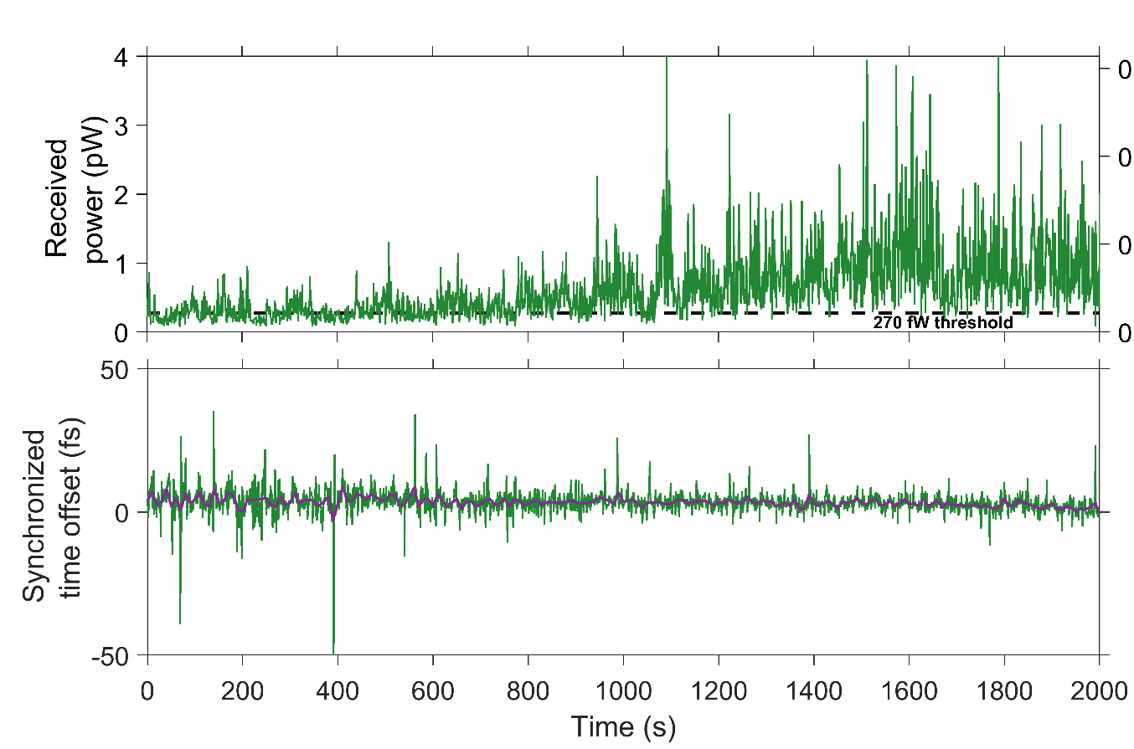
Optical Time Transfer at the Quantum Limit
Over 300 km of Turbulent Air
Sub-femtosecond synchronization
Shot-noise limited SNR
  270 fW threshold (~1/100 photons per pulse)
40 uW launch
4 mW launch
1 second average
1 second average
10 second average
10 second average
Caldwell, E. D. et al. Quantum-limited optical time transfer for future geosynchronous links. Nature 618, 721–726 (2023)

Slide 23
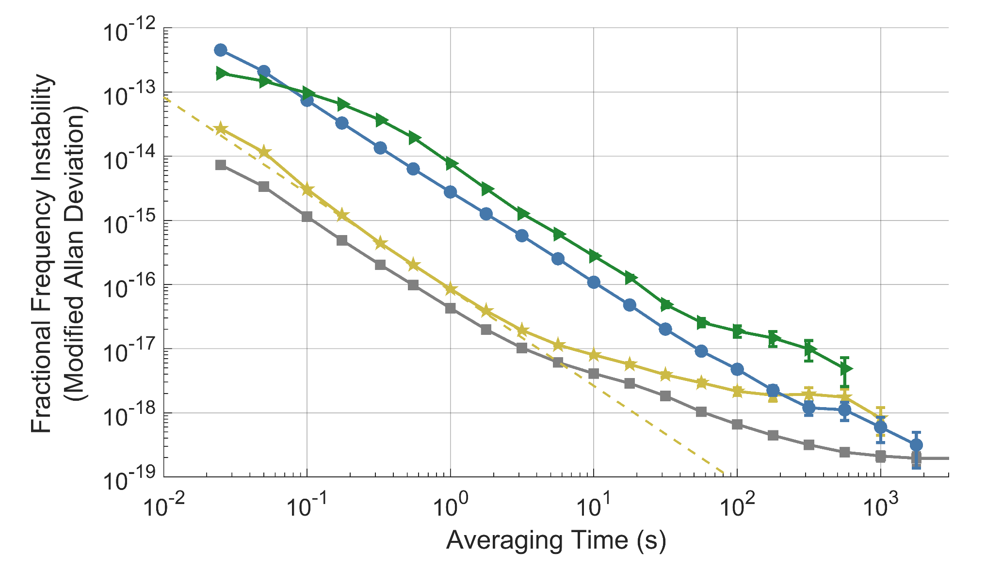
Evaluation of Tracking Comb-based Time Transfer:
Fractional Frequency Instability- 2km to 300 km
300 km, 40 μW launch
300 km, 4 mW launch
2 km
fiber shorted
Quantum limit
(2km power)
Caldwell, E. D. et al. Quantum-limited optical time transfer for future geosynchronous links. Nature 618, 721–726 (2023)

Slide 24
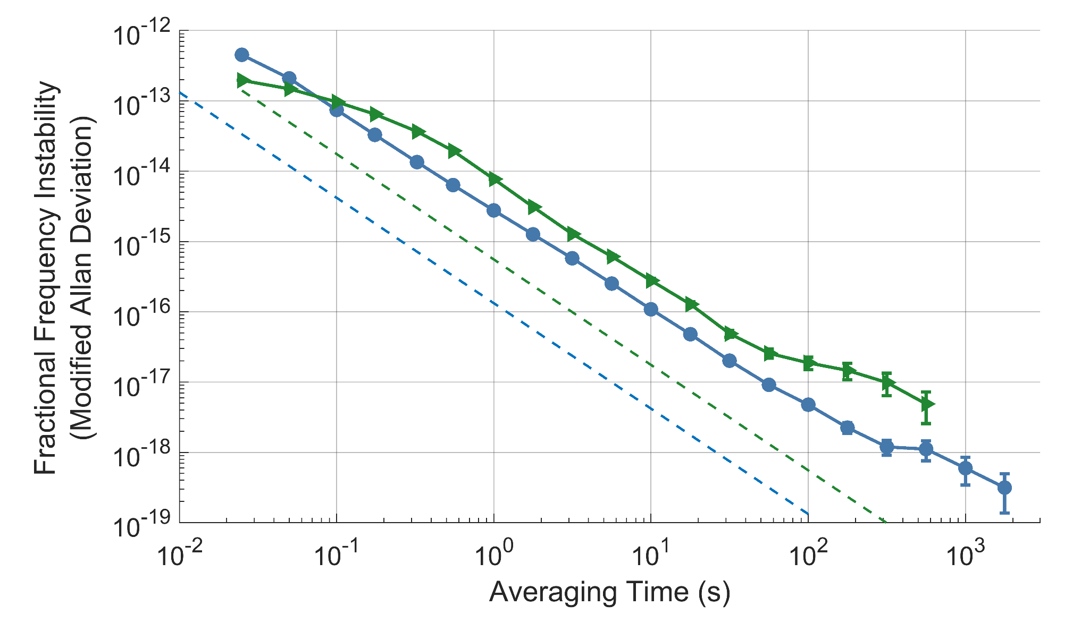
Optical Time Transfer at the Quantum Limit
Over 300 km of Turbulent Air
While the full synchronized signal is not quantum limited, the acquisition and measurement system still is
Synchronization is limited by extra turbulence noise
300 km, 40 μW launch
300 km, 4 mW launch
Quantum limit
(rec. power from 4 mW launch)
Quantum limit
(rec. power from 40 μW launch)
Caldwell, E. D. et al. Quantum-limited optical time transfer for future geosynchronous links. Nature 618, 721–726 (2023)

Slide 25
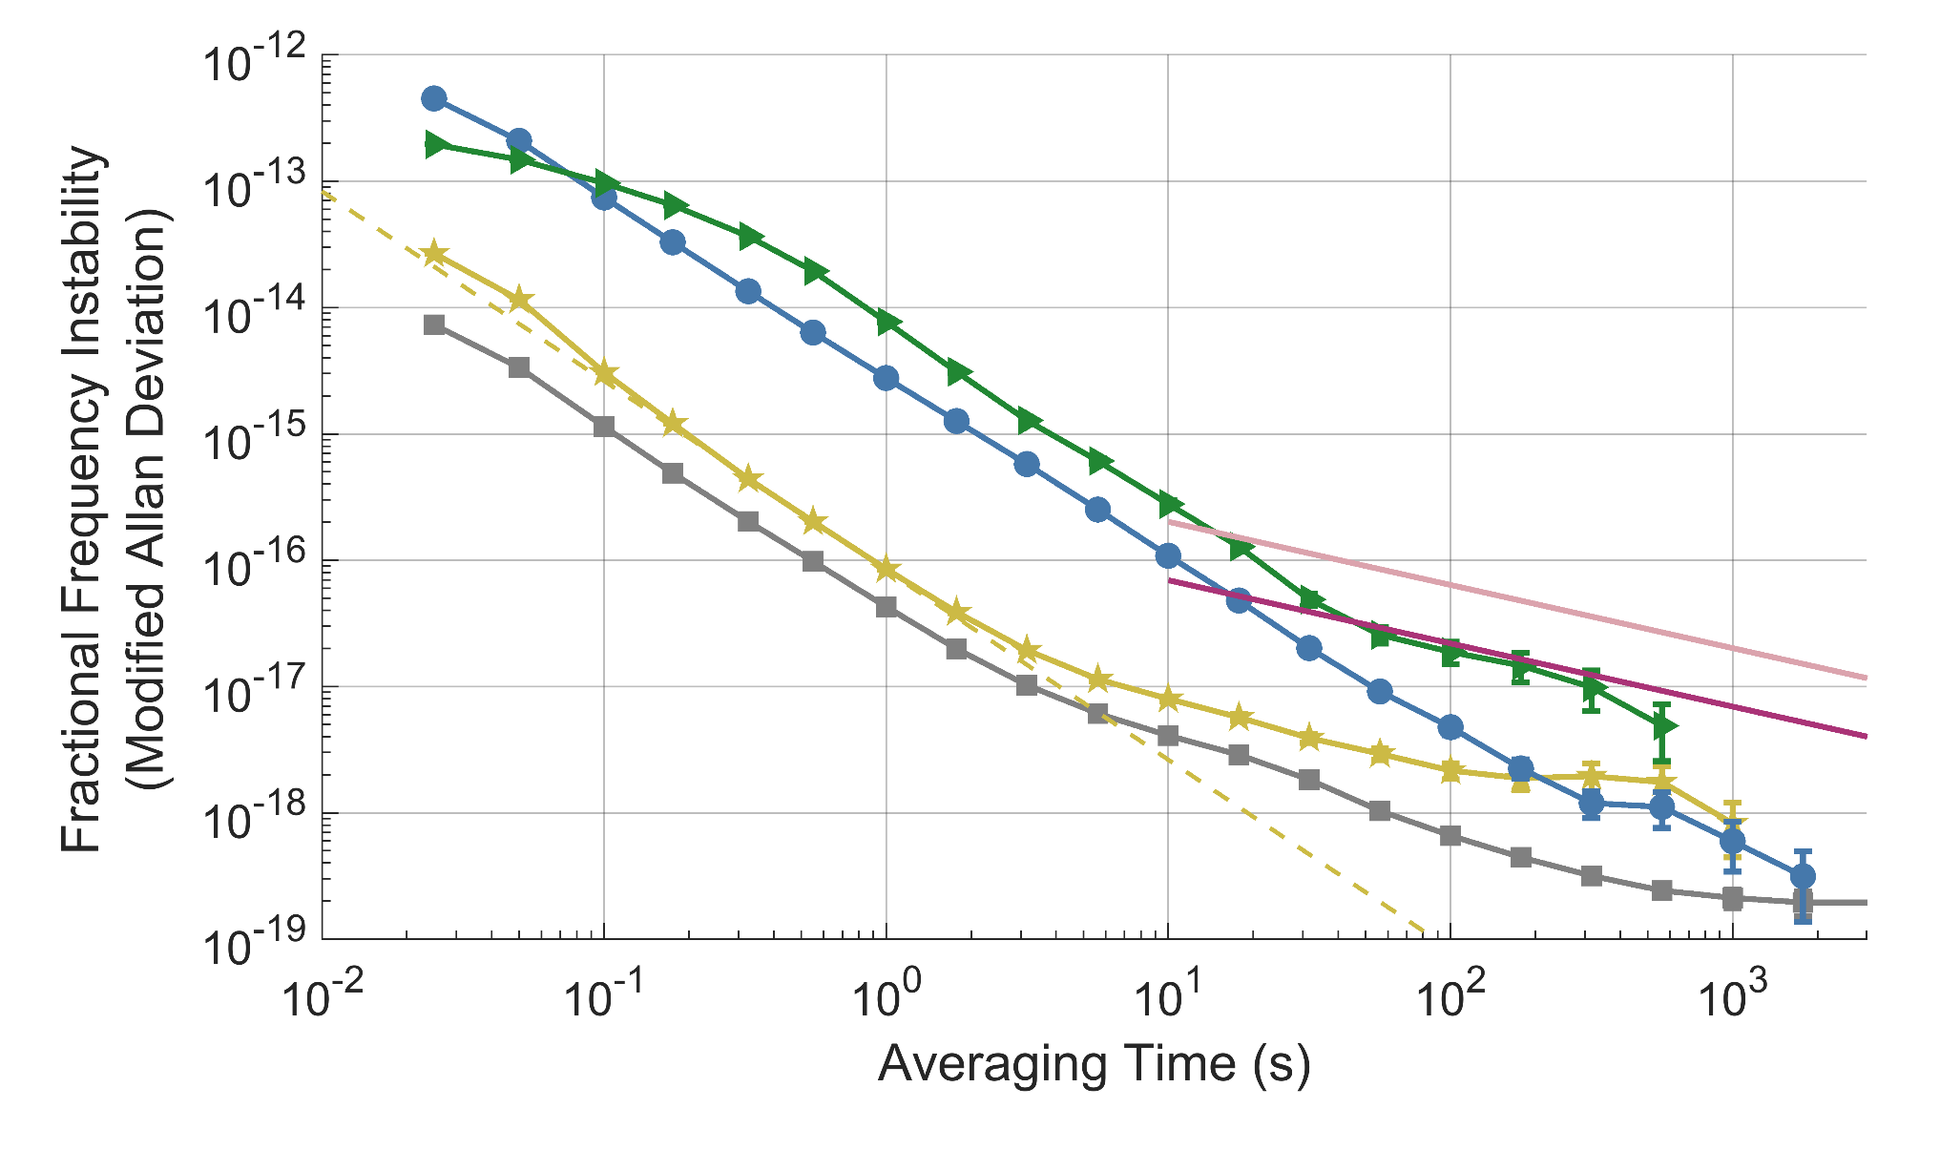
Optical Time Transfer at the Quantum Limit
Over 300 km of Turbulent Air
300 km, 40 μW launch
300 km, 4 mW launch
2 km
fiber shorted
State-of-the-art transportable clocks [1]
State-of-the-art laboratory clocks [2]
Quantum limit
(2km power)
[1] Takamoto, M. et al. Test of general relativity by a pair of transportable optical lattice clocks. Nature Photonics 1–5 (2020).
[2] Boulder Atomic Clock Optical Network (BACON) Collaboration et al. Frequency ratio measurements at 18-digit accuracy using an optical clock network. Nature 591, 564–569 (2021).
E. D. et al. Quantum-limited optical time transfer for future geosynchronous links. Nature 618, 721–726 (2023)

Slide 26
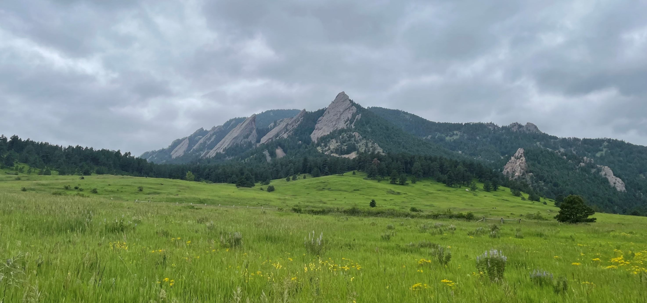
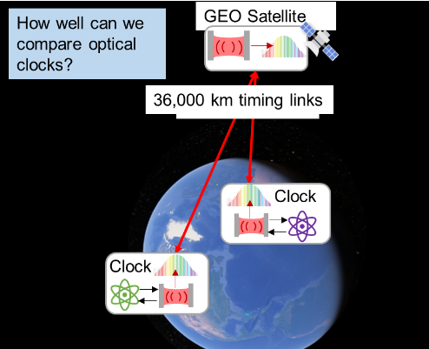
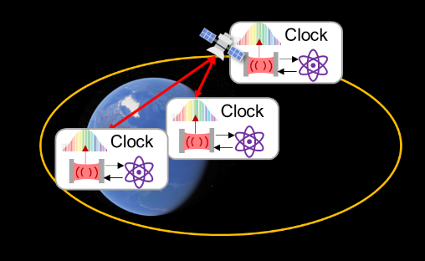
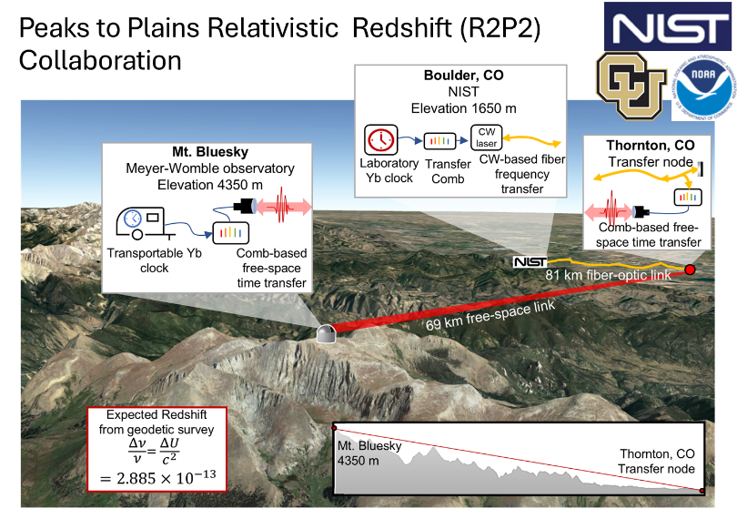
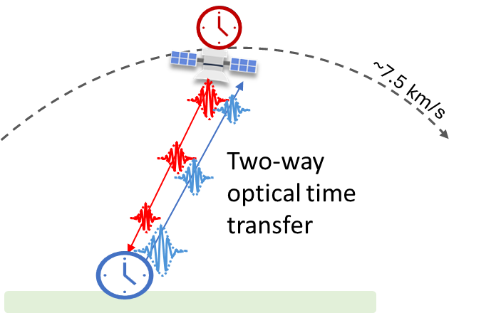
Looking to the Future
  Longer spans using ground-to-satellite links, good-enough oscillators on-board satellites and state-of-the-art ground clocks
  Modeling suggests existing tracking comb optical time transfer with minimal modifications would work (E.D. Caldwell et al, APL Photonics, 9, 016112 (2024)
  Terrestrial networks using the exquisite precision of atomic optical clocks
    Peaks to Plains Relativistic Redshift (R2P2) Collaboration -- a comparison of Yb lattice clocks separated by 2700 m of elevation (successful hardware shakedown summer 2025)
  Re-envisioning tracking comb optical time transfer to support the Doppler shifts and slew rates of ground-to-satellite links (collaboration with University of Western Australia)

Slide 27






Thanks for listening. Questions?
Current Optical Time Transfer Project
NIST
Emily Caldwell, Ian Coddington,
Christopher Dennis, Fabrizio Giorgetta, Laura Sinclair,
William Swann, and Theodora Triano
OctoSig Consulting/Waxwing Instruments
Hugo Bergeron, Jean-Daniel Deschenes
Upcoming talks:
  EFTF: Emily Caldwell and Shawn McSorely (University of Western Australia)
  IFCS: Fabrizio Giorgetta and myself
Recent Review Paper:
E.D. Caldwell, T. M. Triano, L.C. Sinclair, “High-precision optical time and frequency transfer”, Advances in Optics and Photonics, 17, 375-440 (2025)
Past OTT Project Members
Esther Baumann, Hugo Bergeron, Martha Bodine,
Mick Cermak, Allie Christensen, Jennifer Ellis,
Christopher Flood (CU Aerospace), Isaac Khader,
Paritosh Manurkar, Nathan Newbury,
Sarah Stevenson, Benjamin Stuhl (Space Dynamics Laboratory), and Saad Syed
Funding support over the years from:
Site specific support from:
NTIA, NOAA, and the University of Hawaii
QSEC-TAQS
27

