Slide 1
10th CCAUV RMOWG Meeting Report
SUN Qiao, APMP
CCAUV General Meeting
2019-09-26

Slide 2
List of participants
RMO TC or WG representatives
Chairman Dr Qiao Sun (NIM)
AFRIMETS Dr Riaan Nel (NMISA)
APMP Dr Ryuzo Horiuchi (NMIJ)
COOMET Dr Alexander Enyakov (VNIIFTRI)
EURAMET Mr Stephen Robinson (NPL)
SIM Dr Gustavo Ripper (INMETRO)
BIPM/CCAUV
CCAUV President & CIPM Dr Takashi Usuda
CCAUV Executive Secretary Dr Gianna Panafilo
BIPM KCDB Coordinator Dr Susanne Picard

Slide 3
List of participants
GUESTS
Dr Enver Sadikoğlu (UME)
Dr Thomas Bruns (PTB)
Mr Christiaan Veldman (NMISA)
APOLOGIES
Mrs Valentina Pozdeeva (BelGIM)
Dr Alexander Yankovsky (VNIIM)

Slide 4
Meeting agenda
1. Welcome to the BIPM (the CCAUV President)
2. Appointment of a Rapporteur
3. Confirmation of the agenda
4. Approval of the minutes of the 9th meeting, held in 2017
5. Action points from the 9th meeting, held in 2015
6. CCAUV President report
7. Actions for sustainable MRA operation
7.1 Hybrid comparison suggested by APMP
7.2 Hybrid comparison endorsed by JCRB
8. Discussion of KCDB issues
8.1 Demonstration of KCDB 2.0 (about 1.5 hours)
8.2 Discussion of KCDB 2.0
9. Other agenda points
10. Recommendations for actions
11. Approval of the next Chairperson
12. Date of next meeting

Slide 5
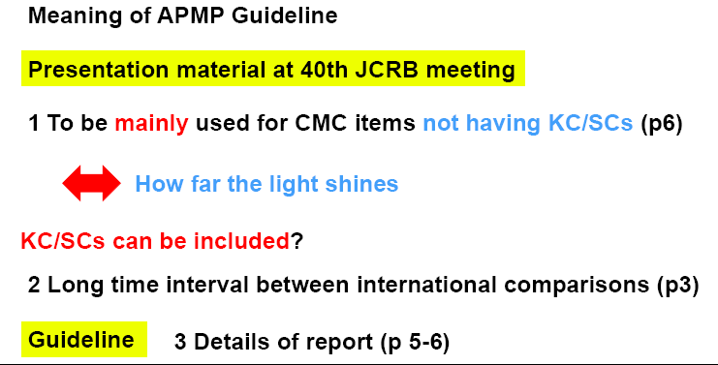
Hybrid comparison
7.1 Hybrid comparison suggested by APMP

Slide 6
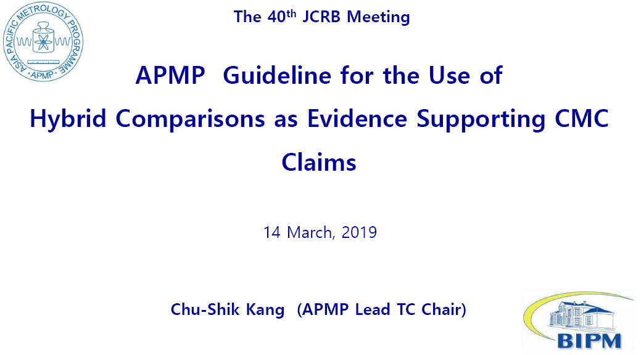
Hybrid comparison
7.1 Hybrid comparison suggested by APMP

Slide 7
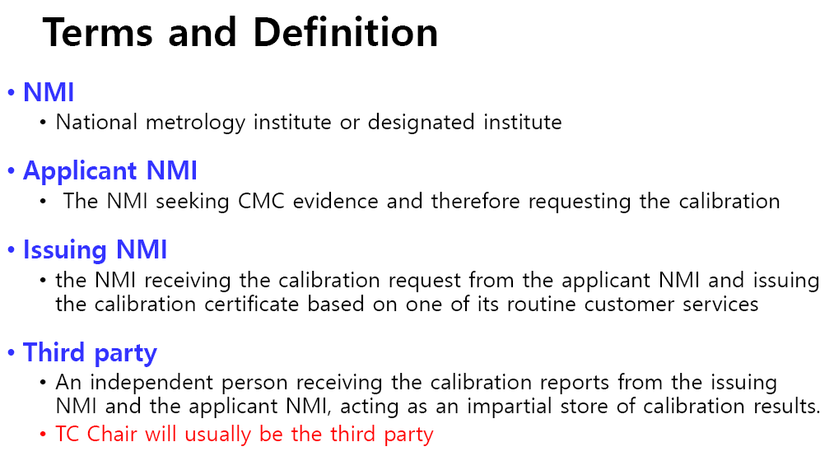
Hybrid comparison
7.1 Hybrid comparison suggested by APMP

Slide 8
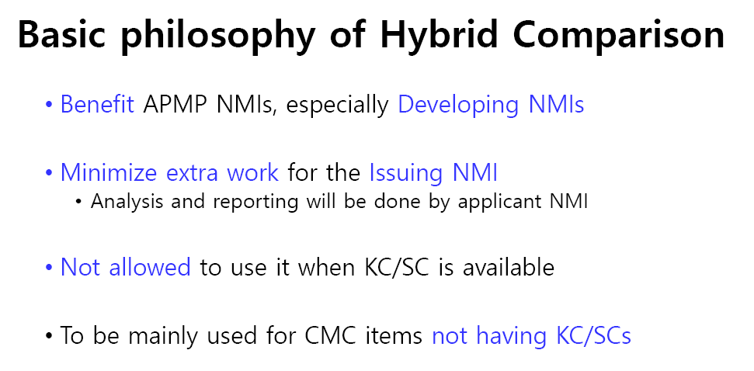
Hybrid comparison
7.1 Hybrid comparison suggested by APMP

Slide 9
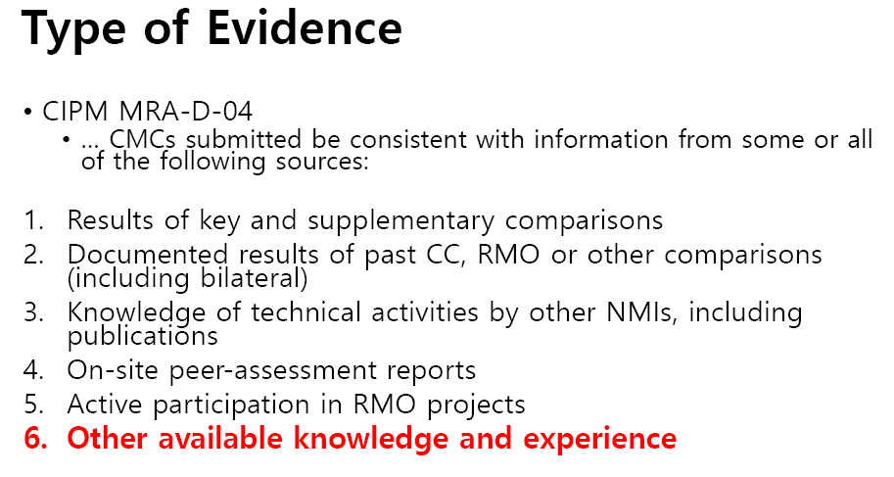
Hybrid comparison
7.1 Hybrid comparison suggested by APMP

Slide 10
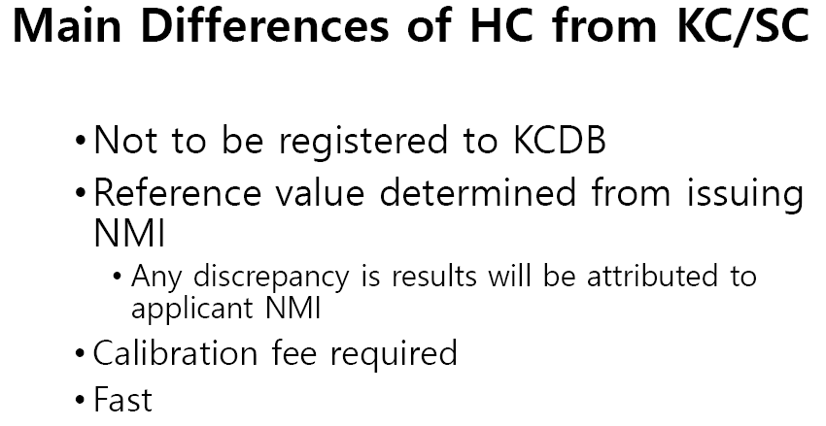
Hybrid comparison
7.1 Hybrid comparison suggested by APMP

Slide 11
Hybrid comparison
7.1 Hybrid comparison suggested by APMP
TCAUVs of AFRIMETS, APMP, COOMET, EURAMET and SIM are in support of Hybrid comparisons used as supporting evidence for AUV CMCs.
JCRB is kindly requested through the CCAUV to reconsider the naming assigned to “Hybrid Comparisons”, mainly to avoid any possible confusion and subsequent misuse.
Accepted

Slide 12
KCDB 2.0
Demonstration of KCDB 2.0 and discussions:
Dr Susanne Picard, BIPM KCDB Coordinator, provided an overview of the workings of KCDB 2.0. KCDB 2.0 will cover both intra-and inter-RMO review processes.
Feedbacks from RMO TC Chairs users and NMI/DIs users are provided.

Slide 13
Recommendations
R01:
Concerning the listing of comparisons as supporting evidence for CMCs, it is noted that only the most recent comparison is to be listed.
R02:
JCRB is kindly requested through the CCAUV to reconsider the naming assigned to “Hybrid Comparisons”, mainly to avoid any possible confusion and subsequent misuse.

Slide 14
Approval of the next Chairperson
CCAUV RMOWG elected Dr Alexander Enyakov from COOMET as the next CCAUV RMOWG Chair for a 4-year period.

Slide 15
Thank you for your attention!
E-mail：sunq@nim.ac.cn

