Slide 1
JCRB Report to the CCL Meeting
Nikita Zviagin
Executive Secretary of the JCRB
15 June 2018

Slide 2
Relevant JCRB meetings since 2015 CCL meeting
    COMPLETED MEETINGS
    March 2016: 35th JCRB (BIPM)
    Sept. 2016: 36th JCRB (Nairobi, Kenya)
    March 2017 : 37th JCRB (BIPM)
    Sept. 2017: 38th JCRB (Bern, Switzerland)
    March 2018 : 39th JCRB (BIPM) – 3 days Meeting
    PLANNED MEETINGS
    No meeting in the September 2018 because of the upcoming GC
    March 2019: 40th JCRB (BIPM)
    Sept. 2019: 41st JCRB (offer from ESMA, Dubai )

Slide 3
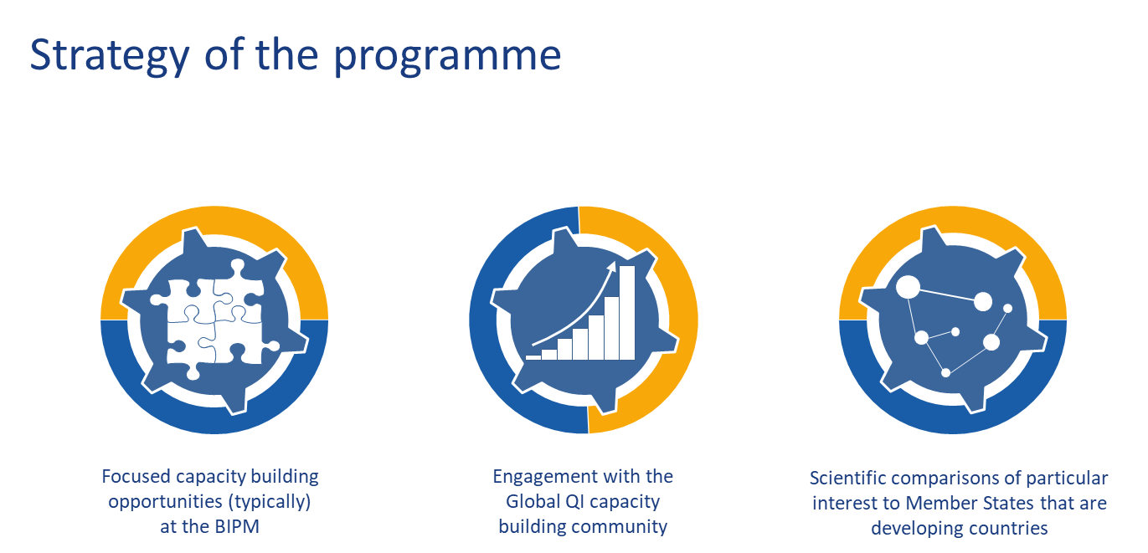

BIPM Capacity Building & Knowledge Transfer Programme
The aim of the BIPM CB&KT programme is to increase the effectiveness with which Member States and Associates engage in the world-wide coordinated metrological system.
CB&KT initiatives
11 Completed
4 Ongoing
5 Planned so far
CB&KT Programme goals
To reinforce the international metrology system and to “balance the load” amongst the NMIs.
To promote efficient operation of the system.
To aid NMIs from Countries and Economies with Emerging Metrology Systems (CEEMS) to engage appropriately and effectively with the international measurement system.
255 participants (124 at the BIPM) from 76 countries participated in various training courses!

Slide 4

BIPM Capacity Building & Knowledge Transfer Programme
Action 39/1 Each RMO will send the name of a person responsible for capacity building activities in their region to C Kuanbayev at BIPM together with a short description of the RMO’s vision for capacity building activities both at the regional and the JCRB levels (by 30th April 2018). BIPM will circulate a summary of the responses to the JCRB.
Resolution 39/1 The JCRB welcomes the efforts made by BIPM in realising the Capacity Building and Knowledge Transfer (CBKT) programme and encourages its further implementation. Furthermore, the JCRB supports the proposal to include those CBKT activities that directly support the effective and efficient operation of the CIPM MRA as core activities within the next BIPM work programme, and encourages the BIPM and the RMOs to develop a framework approach for the delivery of capacity building activities.

Slide 5
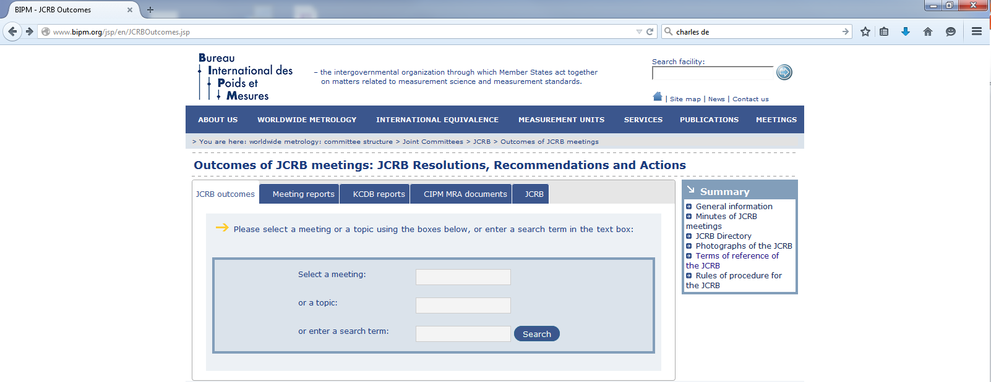
JCRB Outcomes
http://www.bipm.org/jsp/en/JCRBOutcomes.jsp

Slide 6
Resolution 38/1 of the 38th JCRB Meeting
Resolution 38/1 (Risk-based CMC Review and Representative CMCs): RMOs and CCs are encouraged to further implement a risk-based approach to review of CMCs and to develop statements for the levels of CMCs for which an intra-RMO review may be sufficient for the purposes of international acceptance.
Taking note of the needs of NMIs and DIs at all levels, as a means towards implementation of recommendation 3b of the CIPM MRA review, the JCRB encourages Consultative Committees and the BIPM to continue to explore means to allow NMIs and DIs to publish CMCs in the KCDB for only their smallest uncertainty capabilities that are then used to support related services covered by their approved Quality System. Proposals are requested as to how to show the link between these capabilities and the “representative” CMCs. RMOs are encouraged to propose additions to the Quality System review process to effect a fit-for-purpose review of these capabilities.

Slide 7
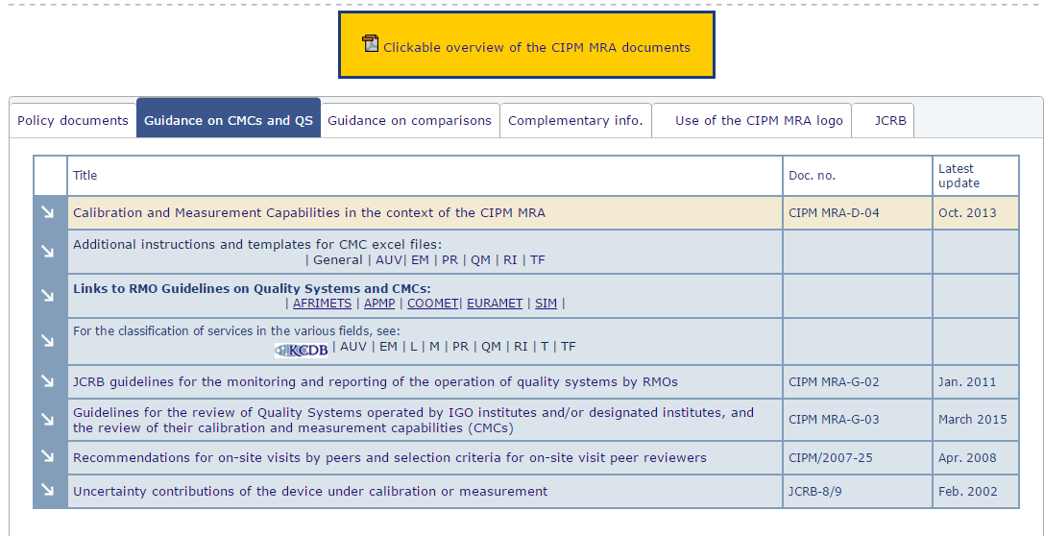
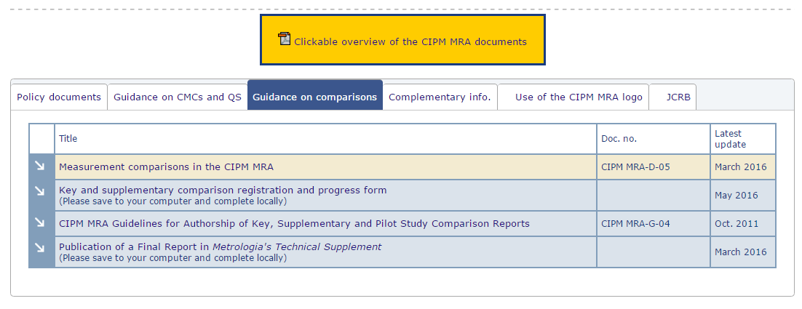
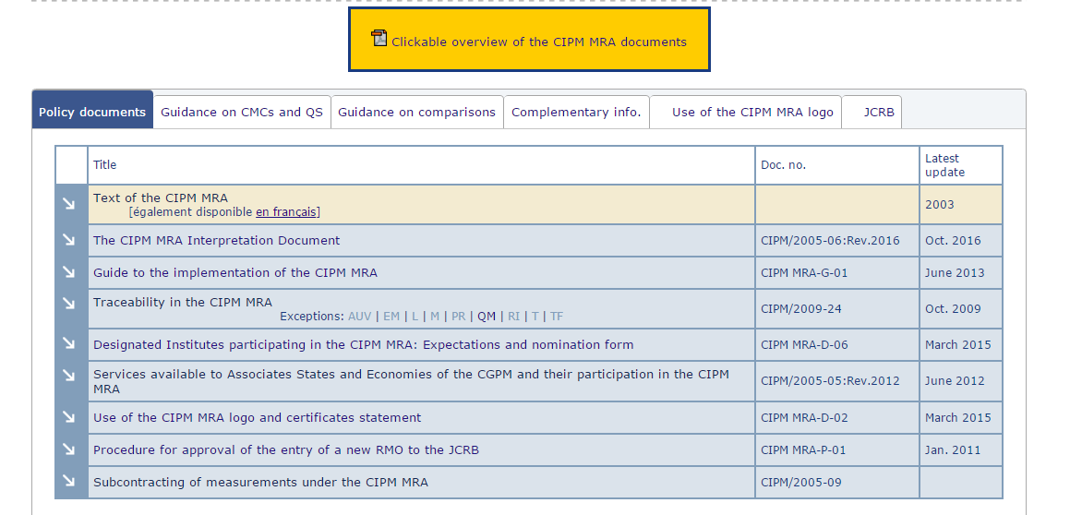
Guidance documents on CMCs and comparisons
http://www.bipm.org/en/cipm-mra/cipm-mra-documents/

Slide 8
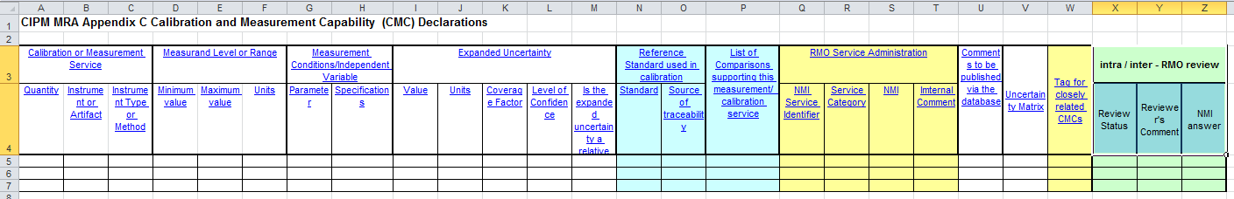
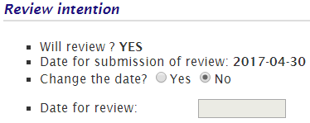
Changes in CIPM MRA Documents
Changes to CIPM MRA-D-04 Calibration and Measurement Capabilities in the context of the CIPM MRA (approved at 37th JCRB Meeting):
Template for CMCs with uncertainty matrices was changed
Text in p.5 of section 5.3 about the possibilty of changing date for review submission was modified in order to correspond to the present options of the system.
Some other minor changes in terminology and structure of the document

Slide 9
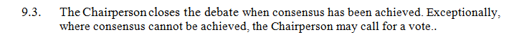
Changes in CIPM MRA Documents
Changes to CIPM MRA-D-01 Rules of procedure for the JCRB (approved at 38th JCRB Meeting):
Changes in chapter “9. Debates” according to the action 37/02
Changes in chapter “11. Minutes” concerning the procedures of approval for JCRB Meeting Report.
Resolution 39/4: The JCRB recommends that the CIPM MRA Guidance documents be updated to reflect the transition period agreed by the JCRB for the adoption of ISO/IEC 17025 and ISO 17034.
Partially done

Slide 10
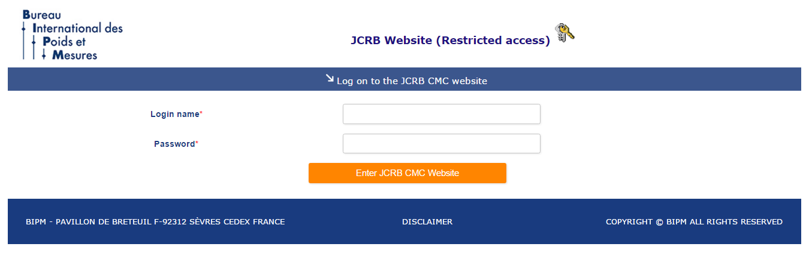
Viewing CMC Reviews
http://www.bipm.org/JCRBCMCs/
Login: tcguest
Password: tcontact

Slide 11
Statistics on CMCs in L(13 June 2018) from the September 2015
Database | Category | All areas | L | %
JCRB website | All CMC sets | 711 | 78 | 11
JCRB website | CMC sets published since September 2015 | 115 | 10 | 9
KCDB (4 June 2018) | All CMC entries | 25123 | 1641 (187 for Lasers) | 7

Slide 12
Statistics on CMCs in L. CMC sets published since September 2015: 10 sets
APMP 1
COOMET 3
EURAMET 2
SIM 4
Name | RMO | Posted on |  | Reviewed on |  | Revised on |  | Published on | Total
APMP.L.26.2017 | APMP | 04-Aug-17 | 42 | 15-Sep-17 | 207 | 10-Apr-18 | 38 | 18-May-18 | 287
COOMET.L.11.2015 | COOMET | 11-Sep-15 | 26 | 07-Oct-15 | 51 | 27-Nov-15 | 19 | 16-Dec-15 | 96
COOMET.L.13.2016 | COOMET | 26-Jul-16 | 27 | 22-Aug-16 | 57 | 18-Oct-16 | 23 | 10-Nov-16 | 107
COOMET.L.14.2017 | COOMET | 22-Jun-17 | 27 | 19-Jul-17 | 87 | 13-Oct-17 | 19 | 02-Nov-17 | 133
EURAMET.L.16.2015 | EURAMET | 01-Apr-15 | 49 | 20-May-15 | 107 | 03-Sep-15 | 41 | 15-Oct-15 | 197
EURAMET.L.17.2016 | EURAMET | 30-May-16 | 59 | 29-Jul-16 | 27 | 25-Aug-16 | 41 | 05-Oct-16 | 127
SIM.L.13.2016 | SIM | 24-May-16 | 30 | 24-Jun-16 | 201 | 11-Jan-17 | 12 | 23-Jan-17 | 243
SIM.L.14.2016 | SIM | 26-May-16 | 28 | 24-Jun-16 | 28 | 21-Jul-16 | 38 | 29-Aug-16 | 94
SIM.L.15.2016 | SIM | 05-Aug-16 | 24 | 30-Aug-16 | 134 | 10-Jan-17 | 30 | 10-Feb-17 | 188
SIM.L.16.2017 | SIM | 15-Nov-17 | 25 | 11-Dec-17 | 3 | 13-Dec-17 | 67 | 19-Feb-18 | 95
Name | RMO | Posted on |  | Reviewed on |  | Revised on |  | Published on | Total
APMP.L.26.2017 | APMP | 04-Aug-17 | 42 | 15-Sep-17 | 207 | 10-Apr-18 | 38 | 18-May-18 | 287
COOMET.L.11.2015 | COOMET | 11-Sep-15 | 26 | 07-Oct-15 | 51 | 27-Nov-15 | 19 | 16-Dec-15 | 96
COOMET.L.13.2016 | COOMET | 26-Jul-16 | 27 | 22-Aug-16 | 57 | 18-Oct-16 | 23 | 10-Nov-16 | 107
COOMET.L.14.2017 | COOMET | 22-Jun-17 | 27 | 19-Jul-17 | 87 | 13-Oct-17 | 19 | 02-Nov-17 | 133
EURAMET.L.16.2015 | EURAMET | 01-Apr-15 | 49 | 20-May-15 | 107 | 03-Sep-15 | 41 | 15-Oct-15 | 197
EURAMET.L.17.2016 | EURAMET | 30-May-16 | 59 | 29-Jul-16 | 27 | 25-Aug-16 | 41 | 05-Oct-16 | 127
SIM.L.13.2016 | SIM | 24-May-16 | 30 | 24-Jun-16 | 201 | 11-Jan-17 | 12 | 23-Jan-17 | 243
SIM.L.14.2016 | SIM | 26-May-16 | 28 | 24-Jun-16 | 28 | 21-Jul-16 | 38 | 29-Aug-16 | 94
SIM.L.15.2016 | SIM | 05-Aug-16 | 24 | 30-Aug-16 | 134 | 10-Jan-17 | 30 | 10-Feb-17 | 188
SIM.L.16.2017 | SIM | 15-Nov-17 | 25 | 11-Dec-17 | 3 | 13-Dec-17 | 67 | 19-Feb-18 | 95
Average time for review: 157 days
Median time for review: 130 days
The longest period of Inter - Regional review is between reviewing and submitting revised file

Slide 13
Statistics on CMCs in L. CMC sets submitted since September 2015: 12 sets
Name | Status | Posted | Published
APMP.L.26.2017 | Published in BIPM KCDB | 04-Aug-17 | 18-May-18
COOMET.L.12.2016 | Review still in progress | 10-Feb-16
COOMET.L.13.2016 | Published in BIPM KCDB | 26-Jul-16 | 10-Nov-16
COOMET.L.14.2017 | Published in BIPM KCDB | 22-Jun-17 | 02-Nov-17
EURAMET.L.17.2016 | Published in BIPM KCDB | 30-May-16 | 05-Oct-16
EURAMET.L.18.2017 | Published in BIPM KCDB | 29-Jun-17 | 24-Oct-17
EURAMET.L.19.2018 | Review still in progress | 24-May-18
SIM.L.13.2016 | Published in BIPM KCDB | 24-May-16 | 23-Jan-17
SIM.L.14.2016 | Published in BIPM KCDB | 26-May-16 | 29-Aug-16
SIM.L.15.2016 | Published in BIPM KCDB | 05-Aug-16 | 10-Feb-17
SIM.L.16.2017 | Published in BIPM KCDB | 15-Nov-17 | 19-Feb-18
SIM.L.17.2018 | Review still in progress | 18-May-18
Name | Status | Posted | Published
APMP.L.26.2017 | Published in BIPM KCDB | 04-Aug-17 | 18-May-18
COOMET.L.12.2016 | Review still in progress | 10-Feb-16
COOMET.L.13.2016 | Published in BIPM KCDB | 26-Jul-16 | 10-Nov-16
COOMET.L.14.2017 | Published in BIPM KCDB | 22-Jun-17 | 02-Nov-17
EURAMET.L.17.2016 | Published in BIPM KCDB | 30-May-16 | 05-Oct-16
EURAMET.L.18.2017 | Published in BIPM KCDB | 29-Jun-17 | 24-Oct-17
EURAMET.L.19.2018 | Review still in progress | 24-May-18
SIM.L.13.2016 | Published in BIPM KCDB | 24-May-16 | 23-Jan-17
SIM.L.14.2016 | Published in BIPM KCDB | 26-May-16 | 29-Aug-16
SIM.L.15.2016 | Published in BIPM KCDB | 05-Aug-16 | 10-Feb-17
SIM.L.16.2017 | Published in BIPM KCDB | 15-Nov-17 | 19-Feb-18
SIM.L.17.2018 | Review still in progress | 18-May-18
APMP 1
COOMET 3
EURAMET 3
SIM 5
No CMC sets in status:
Waiting for electronic approval
Last update > 2 years.
Action 33/10: RMOs contact TC chairs

Slide 14
Status of incomplete comparisons > 5 years old (for L) March 2018
Type | Key comparisons | Supplementary comparisons
AFRIMETS |  | 1
APMP |  | 1
COOMET | 1
EURAMET
SIM
CCAUV
Totally for L | 1 | 2
Totally | 67 | 63
No new comparisons were added in 2018
Complete list of comparisons in this status is published in KCDB report each half a year

Slide 15
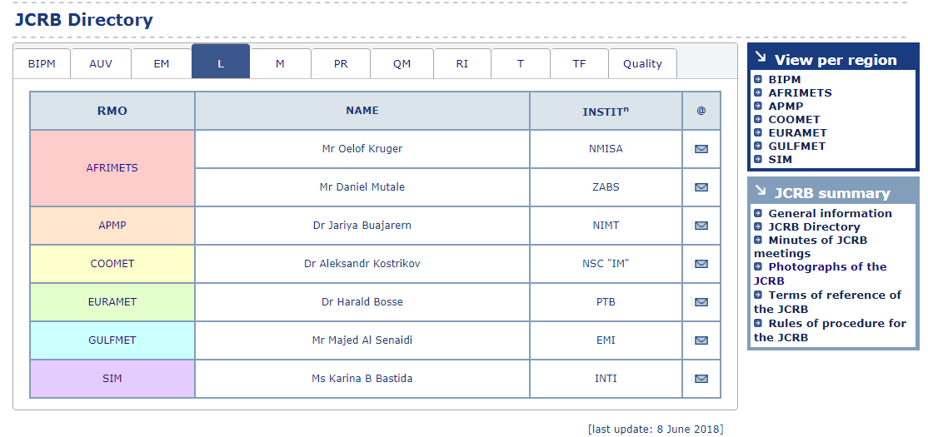
New JCRB Directory
New web-based JCRB directory is already on the website:
Lists of persons by RMOs and by Metrological Areas;
Better antispam possibilities (click the name to send an e-mail)
Phone numbers are deleted from the open access
http://www.bipm.org/en/committees/jc/jcrb/jcrb-directory-per-area.html
https://www.bipm.org/en/committees/jc/jcrb/jcrb-directory.html

Slide 16
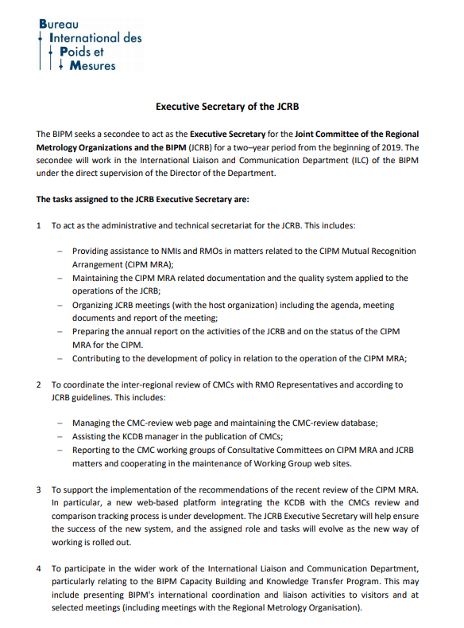
JCRB Executive Secretary position
The vacancy for the 9th JCRB Executive secretary was posted on the BIPM website in February 2018: https://www.bipm.org/utils/en/pdf/vacancy_JCRB2018.pdf Applicants will be interviewed in the beginning of July 2018
JCRB Exec Sec | NMI | RMO | Dates
Dr Angela Samuel | NMIA | APMP | 2002-2003
Dr Ismael Castelazo | CENAM | SIM | 2004-2005
Dr Pedro Espina | NIST | SIM | 2006-2008
Mr Luis Mussio | LATU | SIM | 2008-2010
Mr Ömar Altan | UME | EURAMET | 2010-2012
Mr Chingis Kuanbayev | KazInMetr | COOMET | 2012-2014
Dr Douglas Olson | NIST | SIM | 2015-2016
Mr Nikita Zviagin | VNIIM | COOMET | 2017-2018

Slide 17
Thank you
nikita.zviagin@bipm.org

