Slide 1
Status report of DG2
CCL-18-52, DG2 report to CCL-WG-MRA
June 2018
Makoto Abe, NMIJ

Slide 2
Overview
A number of NMIs have published CMCs for coefficient of thermal expansion (CTE) or thermal expansion coefficient.
Request or opinion to consider a new international comparison for CTE seems not to be significantly loud. DG2 activity has been stalled as reported during the past meetings.
CTE may not be a hot topic. It is however an important parameter in some fields, such as industry for semiconductor, space, etc.
Rather than calibration demand of CTE, (dilatometric) length calibration of low-CTE-materials with intention of the manufacturer to demonstrate the stability in time is slowly increasing at NMIJ.
Some industrial standards require statement concerning CTE of reference artifact when it is used for verifying performance of measuring instruments, e.g. coordinate measuring systems.

Slide 3
Current CMCs on KCDB Appendix-C
2.2.1 End standards. Gauge blocks: {linear} coefficient of thermal expansion, thermal expansivity
  Austria, Germany, Norway
2.2.2 End standards. Length bar (long gauge block): thermal expansivity
  Czech, Germany, U.K.
6.3.1 Thermal expansivity
  Germany, Netherlands

Slide 4
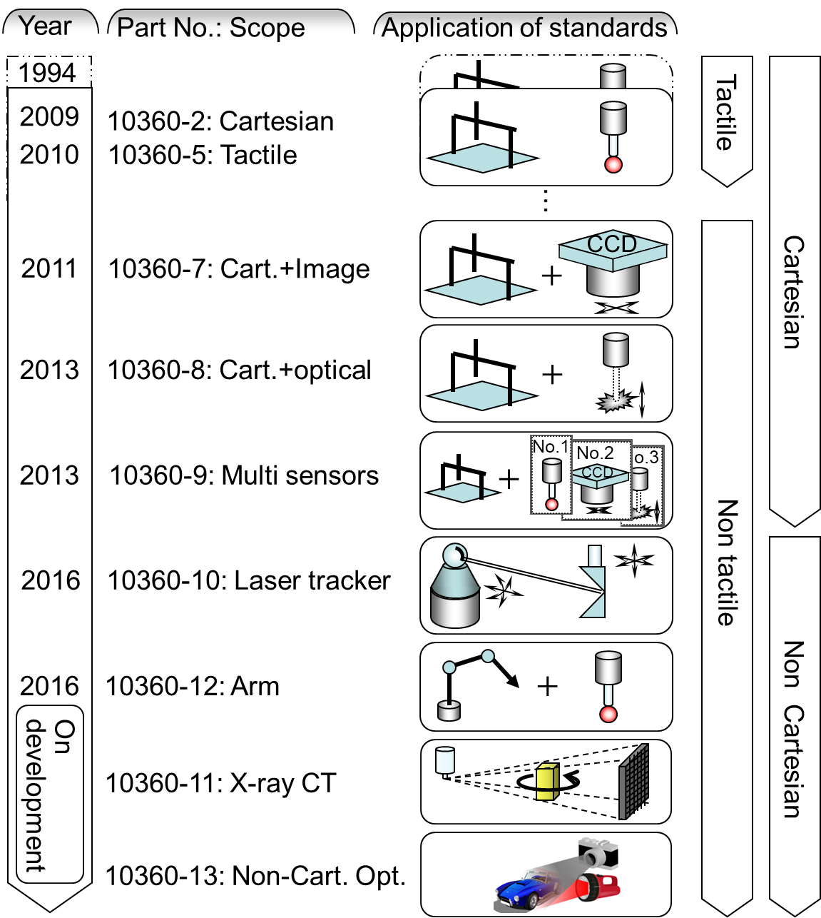
Performance evaluation of CMS

Slide 5
Requirement
The manufacturer shall state the CTE of the reference artifact for length.
The manufacturer may calibrate the CTE of the artifact.
The manufacturer shall specify the uncertainty of the CTE of the artifact.
Sources:
ISO 10360-2:2009, 6.3.2 (Tactile Cartesian CMS)
ISO 10360-7:2011, 6.3.2 (Optical microscopic Cartesian CMS)
ISO 10360-12:2016, 6.4.2 (Tactile articulated-arm CMS)
Common consensus in society of coordinate metrology:
Maximum permissible error when length measurement performed is valid
across wide range of environmental temperature
as rated by the manufacturer, e.g. from 10 deg. C to 30 deg. C.

Slide 6
Recognition as dominant error sources
When performing dimensional measurement,
In case numerical-compensation of thermal expansion is implemented:
  CTE pre-knowledge
  in-situ temperature measuring result
→Uncertainty of CTE becomes dominant.
In case no-numerical-compensation of thermal expansion is implemented as good old days:
→CTE value itself becomes dominant.

Slide 7
Summary
Calibration of CTE
  Majority of modern industry likely happy with conventional indication of CTE and the variation limit when gauge materials or similar are considered.
    Less driving force toward dissemination of CTE calibration
    Dilatometric length measurement time consuming.
    Periodical calibration of CTE less meaningful.
  Not only CTE value but also the associated uncertainty significantly impacts the economical balance in certain niche industries, e.g. CMS.
    Demand might grow slowly up, depending on…
  No urgent need recognized to initiate the international comparison.
    Observation continued and outcome shared.

Slide 8
Status report of DG2
CCL-18-52a, DG2 report-2 to CCL-WG-MRA
June 2018
Makoto Abe, Yoichi Bito,
Akiko Hirai, and Toshi Takatsuji
NMIJ

Slide 9
Source: https://www.bipm.org/utils/common/pdf/ITS-90/Estimates_Differences_T-T90_2010.pdf

Slide 10
Current status
Evaluation of deviation of ITS90 from upcoming-Kelvin across wide range of temperature on progress
Practical temperature scale after re-definition of Kelvin seems to be open topic so far

