Slide 1
On the revision of the KCDB 2.0 Susanne Picard and Stéphanie Maniguet KCDB Office – International Liaison and Communication Department
CCT May/June 2017

Slide 2
CIPM MRA UP TO NOW : CGPM RESOLUTION
CGPM 2014
Resolution 5 On the revision of the CIPM MRA

Slide 3
CIPM MRA UP TO NOW : NMI DIRECTOR WORKSHOP

Slide 4
Context: CIPM MRA review WG recommendations
Recommendation 2 - (On providing better visibility of the services supported by the CMCs in the KCDB)
c. The CCs should work towards better consistency in the expression of CMCs (e.g., units, uncertainty ranges)
Action: CCs

Slide 5
Context: CIPM MRA review WG recommendations
Recommendation 3 - (On constraining the proliferation of CMCs)
a. The results of KCs and SCs should be interpreted as widely as reasonably applicable to indicate coverage of CMCs.
Action: CCs
b. The use of CMCs to cover as many services as is technically justified should be encouraged, so that CMCs become representative rather than comprehensive. /…/
Action: RMOs, JCRB, NMIs
c. The CCs and NMIs are encouraged to use uncertainty equations and matrices to reduce the number of CMCs where possible.
Action: CCs, NMIs

Slide 6
Context: CIPM MRA review WG recommendations
Related directly to KCDB 2.0 design
Recommendation 2 - (On providing better visibility of the services supported by the CMCs in the KCDB)
a. The BIPM should work with the JCRB and the CCs to develop the scope for KCDB 2.0
Action: BIPM, JCRB, CCs
b. The BIPM should implement KCDB 2.0 with (for example) an improved web interface and an improved search facility.
Action: BIPM

Slide 7
Context: CIPM MRA review WG recommendations
Related directly to KCDB 2.0 design (continued)
Recommendation 4 - (On improving the efficiency of the CMC review processes)
a. The CCs should develop a “risk-based” approach to CMC review procedures, that defines the need for intra- and inter-RMO reviews, with inter alia the aim to minimize, or even avoid, the inter-RMO review where justified
Action: CCs, RMOs, JCRB
….
d. More training should be provided, together with improved guidance material to help ensure ‘right first time’ CMCs and common understanding of expectations when review.
Action: CCs, RMOs, JCRB
e. The BIPM should investigate the feasibility of a web-based tool for the complete CMC submission and review giving full tracking of the CMC review process, for example as part of the KCDB 2.0.
Action: BIPM

Slide 8
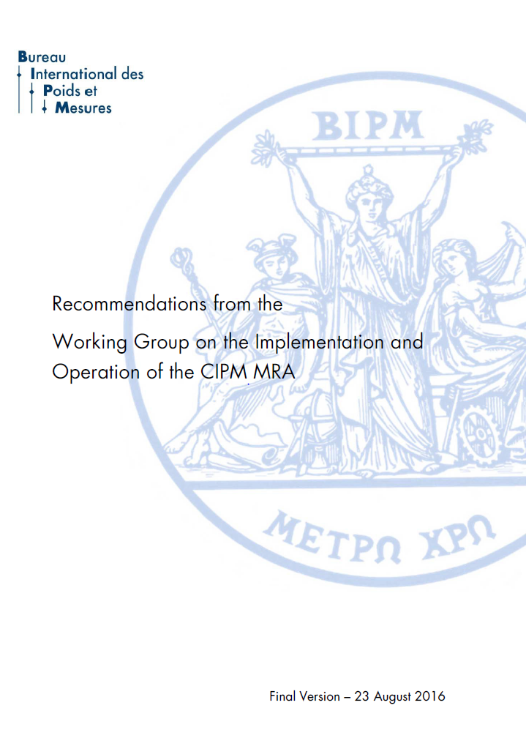
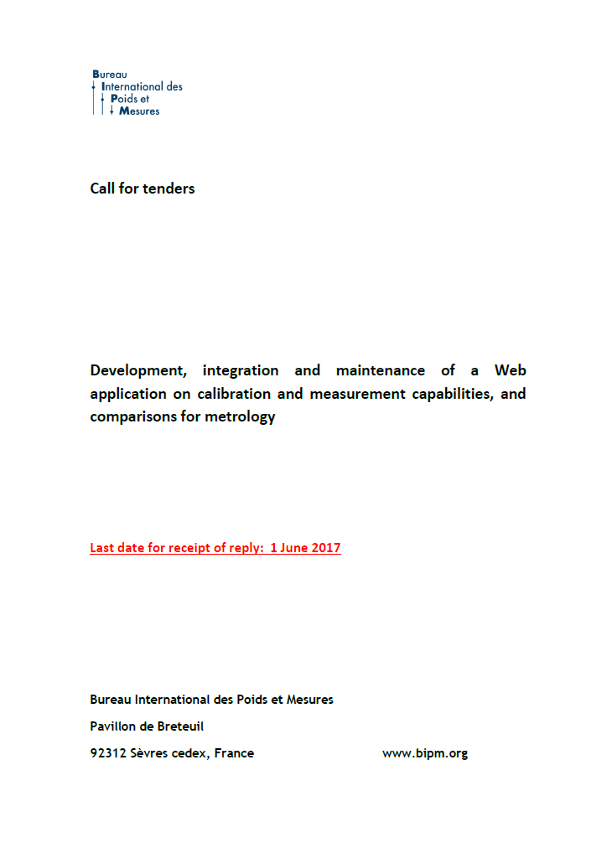
CIPM MRA working group outcome
Extended dely to 30 June 2017

Slide 9
KCDB 2.0 Main Objectives KCDB 2.0
BETTER SEARCH FACILITIES
USERFRIENDLY WEB SUPPORT
WEB BASED CMC SUBMISSION AND REVIEW
TRACK COMPARISONS IN REAL TIME

Slide 10
KCDB 2.0 CMC WEB PLATFORM
BETTER SEARCH FACILITIES
USERFRIENDLY WEB SUPPORT
WEB BASED CMC SUBMISSION AND REVIEW
TRACK COMPARISONS IN REAL TIME

Slide 11
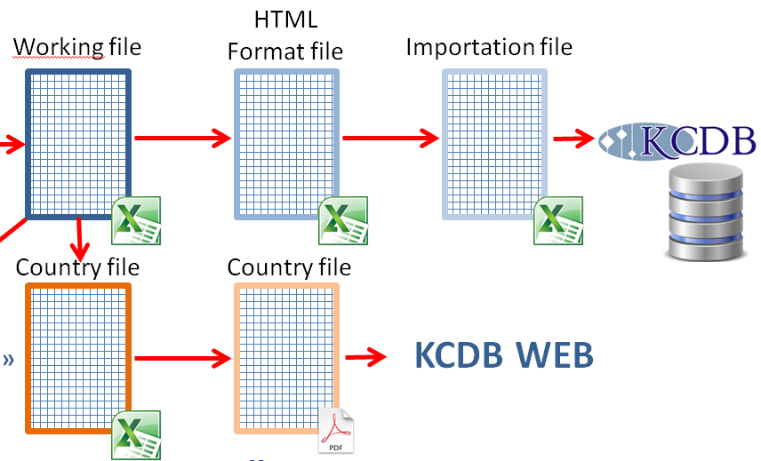
KCDB 2.0 CMC WEB PLATFORM
TODAY

Slide 12
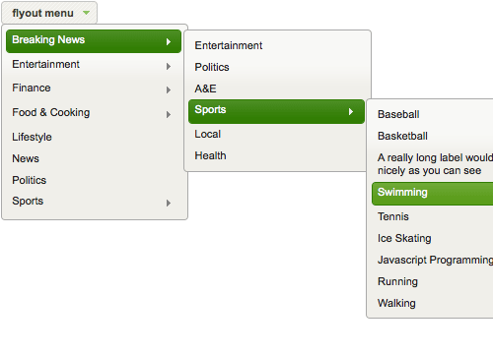
KCDB 2.0 CMC WEB PLATFORM

Slide 13
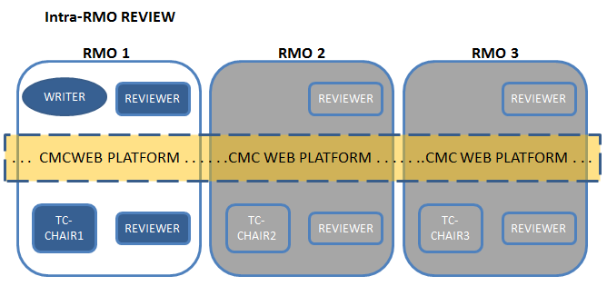
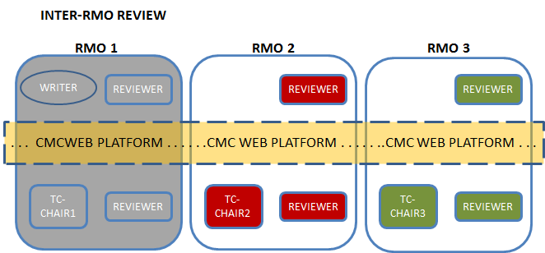
KCDB 2.0 CMC WEB PLATFORM
TOMORROW
WRITER – REVIEWER – FINDER concept
Sequential access
Accessible via a user account
Risk based evaluation included
Support for both intra and inter RMO review
No batches but one-by-one
Broad-scope CMCs to be considered

Slide 14
KCDB 2.0 TRACK COMPARISONS
BETTER SEARCH FACILITIES
USERFRIENDLY WEB SUPPORT
WEB BASED CMC SUBMISSION AND REVIEW
TRACK COMPARISONS IN REAL TIME

Slide 15
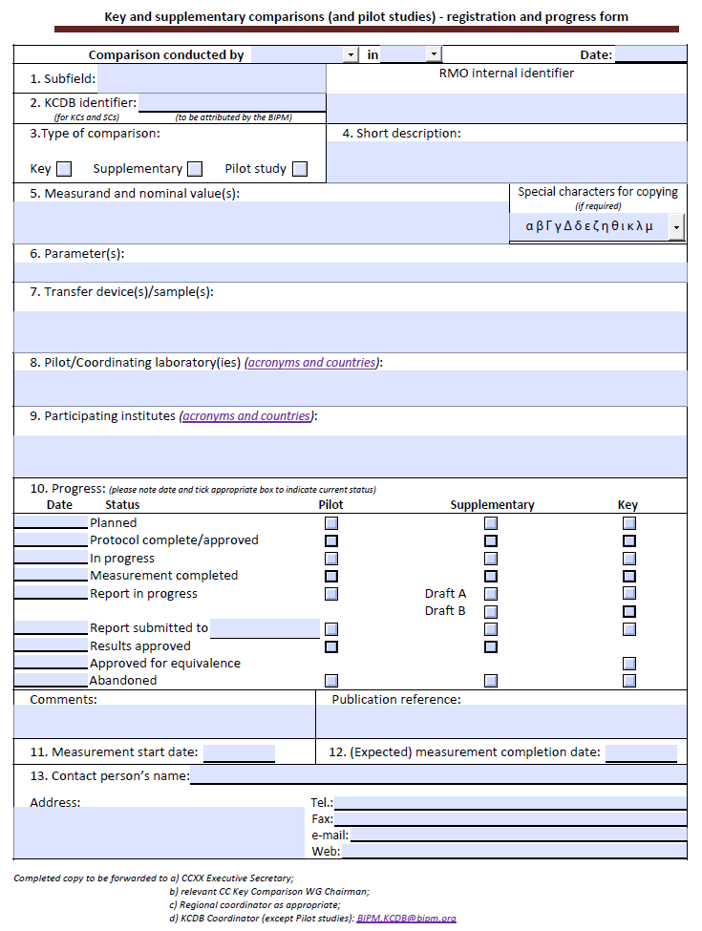
KCDB 2.0 TRACK COMPARISONS
Information into database to allow search on progress.
Alerts to pilots with request for update.

Slide 16
KCDB 2.0 BETTER SEARCH FACILITIES
BETTER SEARCH FACILITIES
USERFRIENDLY WEB SUPPORT
WEB BASED CMC SUBMISSION AND REVIEW
TRACK COMPARISONS IN REAL TIME

Slide 17
KCDB 2.0 BETTER SEARCH FACILITIES
Possibility to search on value of measurand and uncertainty within a range
Improved Thesaurus
Notes:
Susanne: Do we have a number on the percent of total comparisons that have been completed?

Slide 18
KCDB 2.0 CCT issues
Minor revision on equations and units will be requested, not all concerned
Support for thesaurus requested
Find slot without CMC publication to go from KCDB 1.0 to 2.0

Slide 19
Thank you

