Slide 1
CCT meeting 1st June 2017

Slide 2
2. News from the CIPM (CIPM MRA)
The CIPM welcomed the recommendations of the Working Group on the Implementation and Operation of the CIPM MRA and thanked the participants for their contributions. The CIPM agreed to establish an ad hoc Working Group to oversee the implementation of the recommendations with agreed terms of reference.

Slide 3
2. News from the CIPM (CC Membership)
The CIPM decided to revise the Rules for Membership of the Consultative Committees as follows;
all Member States will have the right for one national laboratory charged with establishing national standards in the field to be an Observer at the applicable Consultative Committee and to send one person (only) and following their request for each meeting. Document CIPM-D-01 will be updated accordingly.
The CIPM decided that for all Consultative Committee meetings in 2017 and thereafter: > International organizations will be referred to as “liaisons” and will not be offered membership. > Named individuals will be "guests" or "experts" and will not be offered membership.

Slide 4
2. News from the CIPM (Membership)
The CIPM decided that all Consultative Committees will review whether their Members and Observers fully meet the criteria given in CIPM-D-01. -> active participation in meetings is important
Membership updates for CCT
CMI (Czech Republic) became an official observer of the CCT in 2014
Request from CMI to become member of the CCT

Slide 5
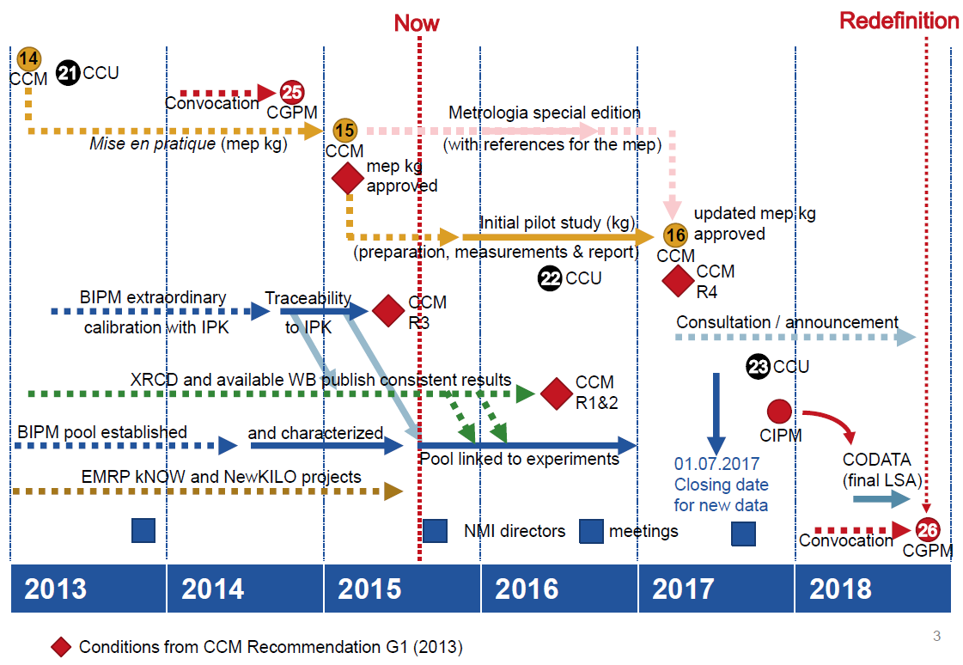
Joint CCM & CCU Roadmap to 2018

Slide 6
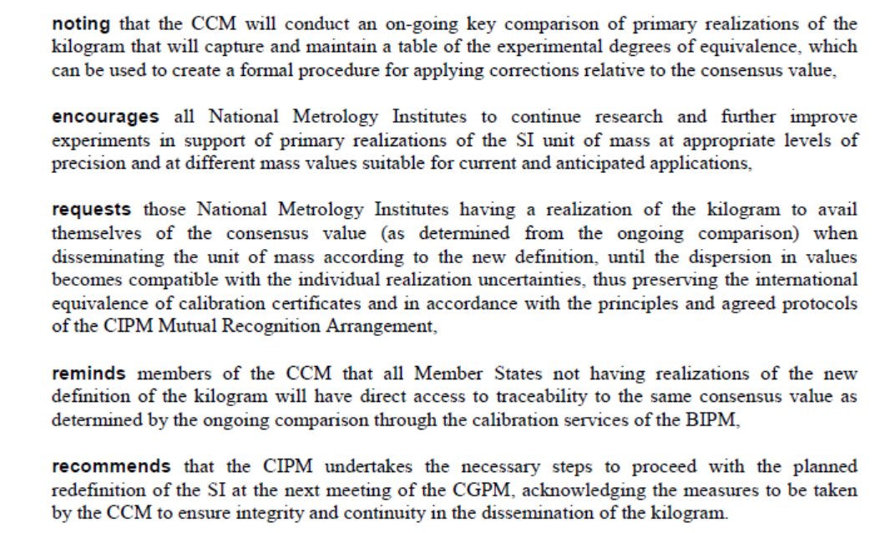

Slide 7
2. Information from the TG for the promotion of the SI
The CIPM recommended that the date on which the redefinition of the SI shall come into force be 20 May 2019 (World Metrology Day).
The CIPM requested from all Consultative Committees an update of the mises en pratique (current online Appendix 2) to be ready on 31 July 2017. This Appendix will continue to be an online Appendix in the context of the new SI Brochure.

Slide 8
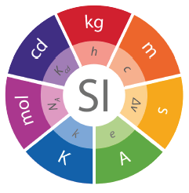
2. Information from the TG for the promotion of the SI
The CIPM requested the Consultative Committees to work together to write a joint statement for all their stakeholders addressing the changes to be expected under the revised SI. -> each CC is also working on a longer statement (2 pages)
Brand book (approach, audience, key messages … and logo)
http://www.bipm.org/en/si-download-area/

