Slide 1
CCTF/17-27
Gulf Association for Metrology
GULFMET …
GULFMET Technical Committee for Electricity, Magnetism, Time and Frequency
TC–EMTF Report
CCTF WG on MRA meeting
BIPM-Paris
June 2017

Slide 2
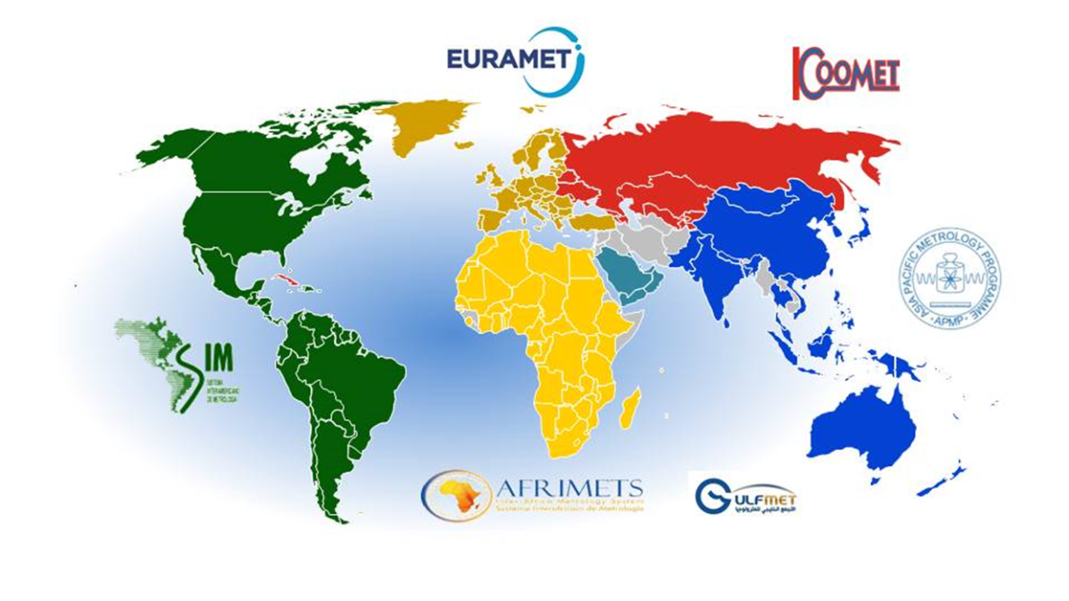
TC-EMTF
Introduction
The GULF Association for Metrology (GULFMET ) was granted provisional acceptance as an RMO at the 34th meeting of the JCRB in September 2015.
Members
Kingdom of Bahrain
Kingdom of Saudi Arabia
Republic of Yemen
State of Kuwait
State of Qatar
Sultanate of Oman
United Arab Emirates
Associate Members
Bosnia & Herzegovina
Egypt
Hong Kong
South Korea
Turkey
TC Details
TC covers Electricity, Magnetism, Time and Frequency
TC meets in April and November each year

Slide 3
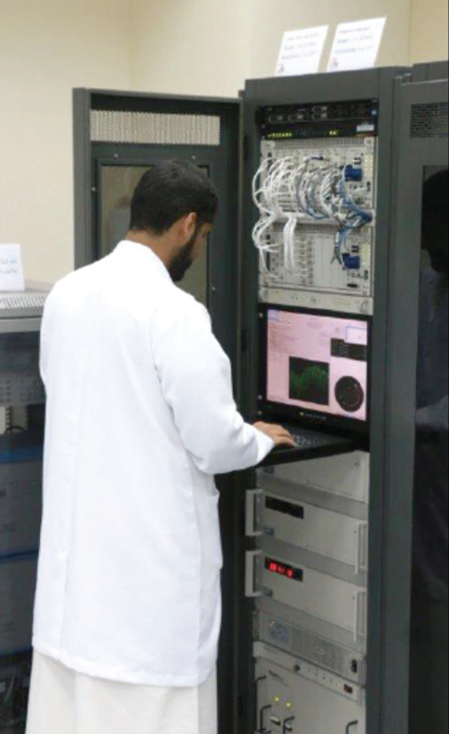
Time and Frequency Capabilities
Time and Frequency Capabilities
Saudi Arabia and United Arab Emirates currently have time and frequency capability.
SASO-NMCC, Saudi Arabia has recently upgraded capability through a development and training project with UME, Turkey.
MAKKAH Time Centre - King Abdulah Centre for Crescent Observations and Astronomy, Saudi Arabia also participate in calculation of UTC.
ADQCC-EMI, has recently developed capability and plan to expand capability over the next few years.

Slide 4
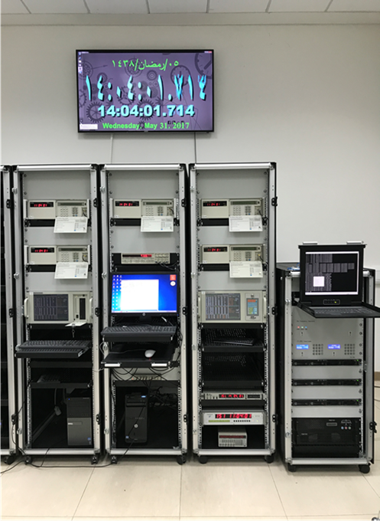
Time and Frequency Capabilities
Frequency Generation and Measurement
DC – 50 GHz
Frequency Measurement Uncertainty (k=2)
DC – 2 GHz (1 x ${10}^{−11}$x f(Hz))
2 GHz – 50 GHz (1 Hz)
Time Measurement
Local Clock < ± 20 ns (1 day avarage)
Remote Clock < ± 50 ns (1 day avarage)
Time Interval Measurement :
ΔT: 0 – ${10}^{10}$ s
Time Interval Measurement Uncertainty (k=2)
ΔT: 0 – 1 μs ( 2x ${10}^{−4}$ x ΔT + 10 ps)
ΔT: 1 ns – ${10}^{10}$s ( 5x ${10}^{−14}$x ΔT + 50 ps)

Slide 5
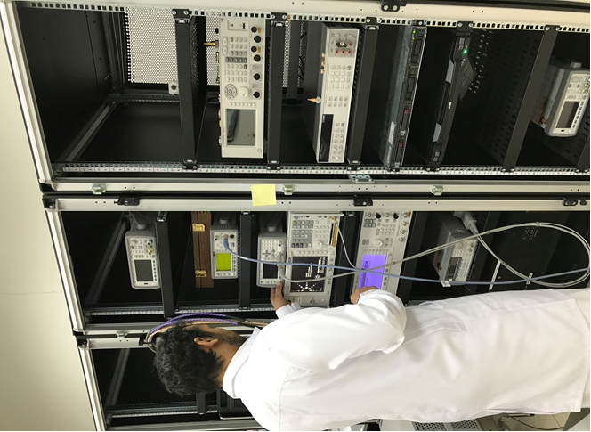
Time and Frequency Capabilities
Amplitude Measurement Range :
-100 dBm to +20 dBm
Amplitude Measurement Uncertainty (k=2)
2 dB (-100 dBm to -10 dBm, 30 Hz – 26.5 GHz)
0.2 dB (-10 dBm to +20 dBm, 50 MHz to 50 GHz)
Modulation Parameter Measurement:
AM ( %0 to %100),
FM (1 kHz to 400 kHz),
PM (0.1 rad to 10 rad)

Slide 6
Time and Frequency Capabilities
Phase Noise Measurement
Carrier Frequency Range : 100 kHz - 26.5 GHz
Offset Range : 1 Hz - 100 MHz
Noise Floor : < -165 dBc/Hz
Rise Time Calibration of High Frequency Oscilloscope Using fs Laser and Photodiode

Slide 7
Time and Frequency Capabilities
Using the SASO time and frequency calibration and measurement
system, it is possible to calibrate the following equipment:
Cs atomic clocks,
Rb atomic frequency standards,
Quartz frequency standards,
Signal generators,
Spectrum analyzers,
Counters,
Tachometers,
Chronometers and Timers

Slide 8
Time and Frequency Capabilities
Frequency standards, including frequency counter reference oscillators.
1 MHz to 30 MHz
Calibration of Frequency Counters
1 MHz to 350 MHz
Calibration of Timers, Stopwatches and Clocks

Slide 9
TC-EMTF
Current Intercomparisons
CCTF- K001.UTC Calculation of the reference time scale UTC
SASO-NMCC and MAKKAH Time Centre, Saudi Arabia.
EMI, UAE will join soon.
GULFMET.TF- S1 Time difference between two pulses
Turkey, Saudi Arabia
EURAMET TCTF Project 1288: Comparison of time interval measurement with high speed oscilloscopes. Recently pilot study completed (Poland, Slowenia, Turkey, Saudi Arabia)
Future Intercomparisons
Probable areas for next intercomparisons
Rubidium frequency standard calibration
Phase noise measurement
Thanks to our Associate Members for supporting GULFMET intercomparisons

