Slide 1
The Mise an Pratique of the definition of the kelvin (MeP-K)
Background and role of the MeP-K
1st Version of the MeP-K
Redefinition of the SI Base Unit Kelvin
2nd Version of the MeP-K
Summary & Outlook

Slide 2
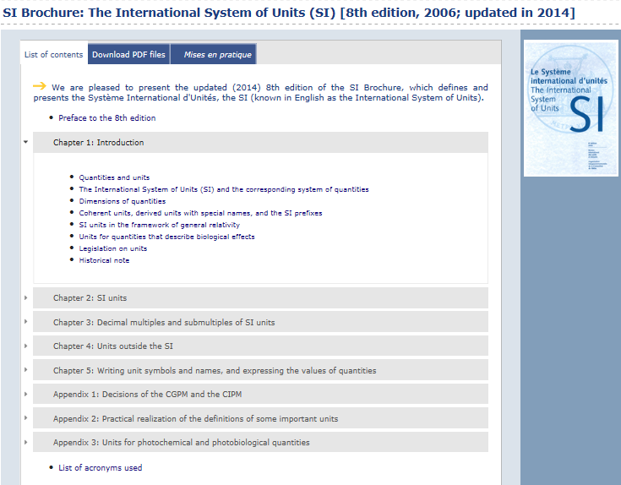
Mise en Pratique of the definition of the kelvin (MeP-K)
Mise en Pratique (MeP):
Practical realisation
The CIPM foresaw desirability of a MeP for each base unit on redefinition of the SI
MeP should include only top-level realisation methods
MeP-K > flexible path for expanding the range of thermometric methods

Slide 3
First version of the MeP-K (approved in 2011)
Text of the defined ITSs
International Temperature Scale of 1990 (ITS-90)
Technical Annex for the ITS-90 (Progress!)
Prescription of the isotopic composition for H₂, Ne, and H₂O
Provisional Low Temperature Scale from 0.9 mK to 1 K (PLTS-2000)
Correction equations for samples having other isotopic compositions
Guides for the realisation of the ITS-90 and PLTS-2000
T – T₉₀ and u(T – T₉₀ ) → conversion of values (Progress!)

Slide 4
T – T₉₀ and u(T – T₉₀ )
Dots: mean values
Line: interpolation with polynomials
Error bars: standard uncertainty
References:
Fischer et al.: Int. J. Thermophys. 32, 12-25 (2011)
Engert et al.: Metrologia 44, 40-52 (2007)

Slide 5
Effects of the redefinition of the kelvin
Direct realisation by primary thermometry
Benefits particularly below ≈ 20 K and above ≈ 1300 K
No immediate impact on the status of ITS-90 and PLTS-2000
Most precise temperature measurements from about 25 K to 1235 K will continue to be traceable to SPRTs calibrated according to the ITS‑90
Relative uncertainty in the determination of k is transferred to T_{TPW}
The T_{TPW} value will not change in the foreseeable future
Definition independent of any material, no favoured fixed point,
no favoured measurement method, no error propagation from TPW

Slide 6
Schematic representation of relationship between MeP-K and other documents
T - T₉₀, u(T - T₉₀)
Solid border: prescriptive document
Dashed border: non-prescriptive guidance
MeP-K 2011
on CCT webpage
under preparation

Slide 7
Second version of the MeP-K (after redefinition of K)
Nomenclature: Primary Thermometry
Thermometers based on well-understood physical systems, for which the equation of state describing the relation between T and other independent quantities can be written down explicitly without unknown constants
Absolute ↔ relative primary thermometry
Relative primary thermometry: Use of fixed points, for which values of T and their uncertainties are known from previous primary thermometry
Absolute primary thermometry: Measurement directly in terms of the definition using the value of k, no reference to any fixed point.
Brief descriptions for AGT, RT, PGT (DCGT, RIGT), JNT
Appendices/references for AGT, RT, PGT (DCGT, RIGT), JNT

Slide 8
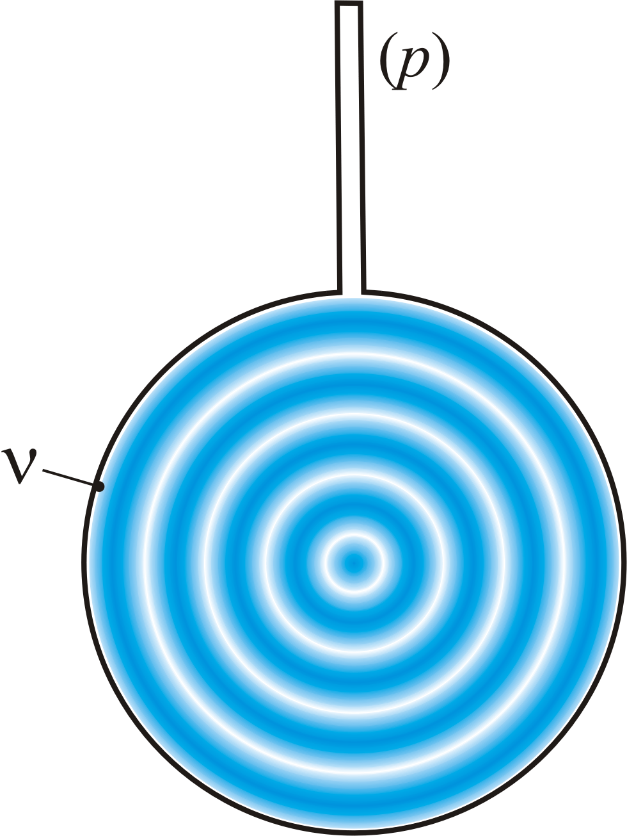
Primary-thermometry methods: AGT
Acoustic Gas Thermometry
Standing waves in a resonator
Equation of state for an ideal gas
Receiver
Transducer
u Speed of sound in the limit of zero ν
γ Heat-capacity ratio (c_{p} / c_{V})
k Boltzmann constant
T Temperature
m mass of a gas particle
ν Frequency
To be measured:
frequency ν_{a}
dimensions via
microwaves ν_{m},
pyknometry, or CMM
d
Quasi spheres and microwaves:
Absolute AGT: u(T) / T of order 1 ppm
Relative AGT: measurement of u ratios
Review paper: Metrologia 2014

Slide 9
Primary-thermometry methods: RT
Spectral-band Radiometric Thermometry
L
E
Φ
Planck law
➔
A₁
A₂
L_{λ} Spectral radiance
λ Wavelength in vacuo
T Temperature
h Planck constant
k Boltzmann constant
c Speed of light in vacuo
E Irradiance (E = Φ / A₂ = A₁L / d ²)
Φ Radiant power (Φ = A₁ A₂L / d ²)
Distance d
Source
(e.g. blackbody)
Geometrical system
Detector
(e.g. diode)
Absolute RT: absolute spectral responsivity, geometric factors defining the solid angle
u(T) of order 0,1 K at 2800 K
Appendices prepared

Slide 10
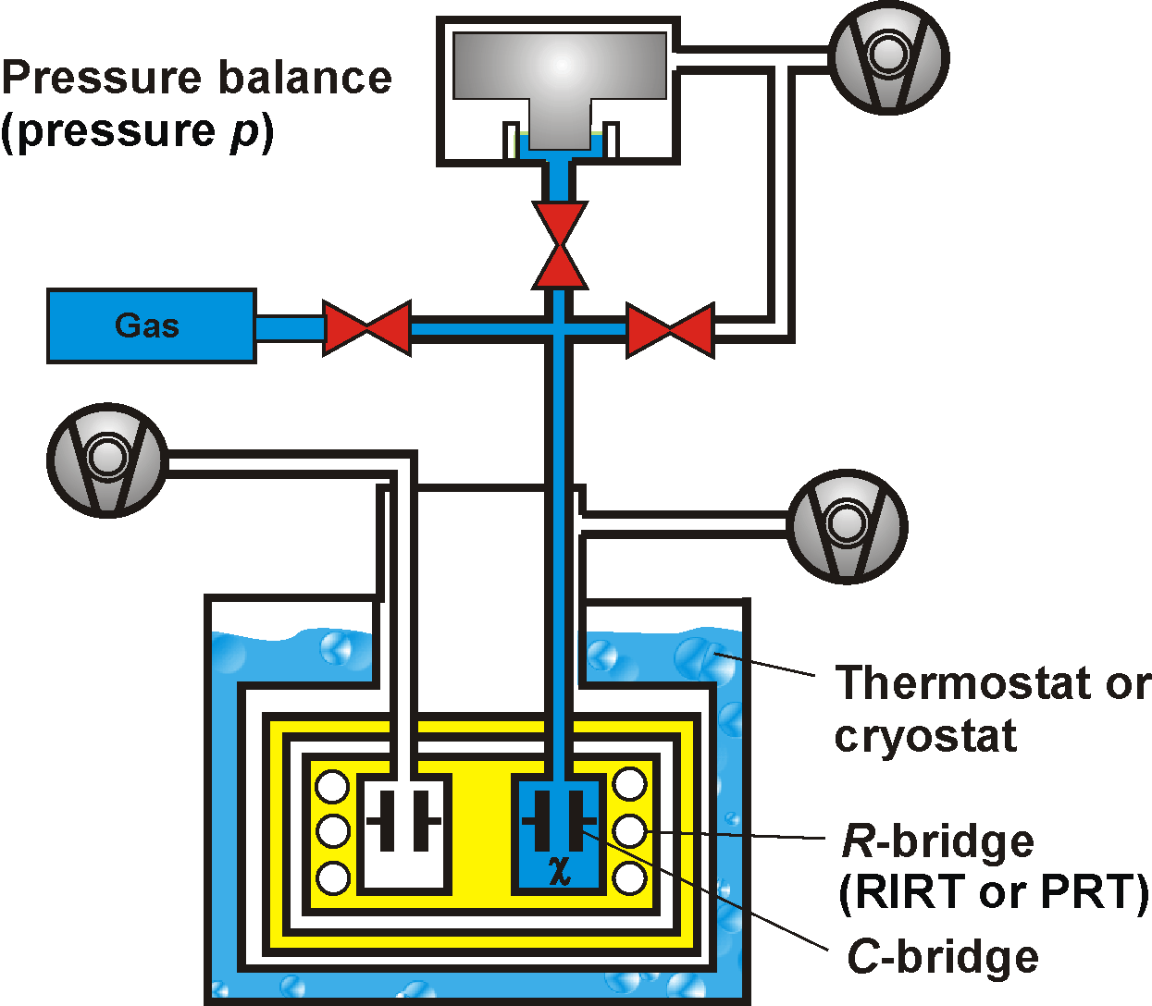
Primary-thermometry methods: PGT
Polarizing Gas Thermometry, e.g.
Dielectric-Constant Gas Thermometry
Clausius-Mossotti equation
combined with the ideal-gas law:
Measuring quantity :
ε_{r} dielectric constant
ε₀ electric constant
α₀ atomic polarizability
κ_{eff} effective compressibility
electric susceptibility
p pressure
T temperature
Main uncertainty components completely different from AGT
u(k)/k ≈ 4 ppm 2015
Review paper: Metrologia 2015

Slide 11
Primary-thermometry methods: JNT
Johnson Noise Thermometry
U Voltage
k Boltzmann constant
T Temperature
R Resistance
Δf Bandwidth
Δt measurement time
Determination of k at the TPW
Nyquist law
U extremely small, typically < 2 μV rms → cross correlation of two channels
Statistical uncertainty ∼ 1 / √Δt
ac-Josephson voltage synthesizers → QVNS → NT is operated as a comparator
ADC + digital signal processing → Δf
u(k)/k ≈ 4 ppm (Qu et al. 2015)
QVNS
(Quantum-accurate pseudo-random Voltage-Noise Source traceable to voltage standard)
Thermometry below 1 K
Basis: Superconducting QUantum Interferometer Devices (SQUIDs) with resolution near to the quantum limit
Voltage to frequency conversion
Current Sensing Noise Thermometry
Magnetic Field Fluctuation Thermometry
Relative uncertainty (0.1 – 1) %

Slide 12
Second version of the MeP-K (after redefinition of K)
Nomenclature: Defined temperature scales
Approximation to T, highly prescriptive, new quantities T_{XX}
Exact temperature values, based on primary thermometry, assigned to fixed points
Interpolating or extrapolating instruments
Interpolating or extrapolating equations
ITS-90: 17 fixed points (He-VP, H₂-VP, TP, MP, FP), CVGT, SPRT, RT
PLTS-2000: ³He melting pressure, 4 intrinsic fixed points (T₂₀₀₀, p₂₀₀₀)

Slide 13
Defined temperature scales
International Temperature Scale of 1990 (ITS-90)
T₉₀ ≥ 0.65 K, lower limit caused by technical reasons (pressure measurement)
Provisional Low Temperature Scale from 0.9 mK to 1 K (PLTS-2000)
p_{mp}(T₂₀₀₀) for ³He (3 MPa – 4 MPa)
T - T₉₀ larger than originally expected, see appendix of the MeP-K
Prescription of the isotopic composition for H₂, Ne, and H₂O in Technical Annex
p_{vp}(T₉₀) for He (0.65 K – 5.0 K) and H₂ (17.025 K – 17.045 K; 20.26 K – 20.28 K)
Fixed points: 6 triple points, 1 melting point, 7 freezing points
Uncertainty of fixed-point realisation from comparisons: 0.03 mK (H₂) – 4 mK (Ag)
Interpolation / extrapolation: ICVGT (3 K – 25 K), SPRT (14 K – 1235 K), RT
4 intrinsic fixed points (p₂₀₀₀, T₂₀₀₀)
Relative thermodynamic uncertainty: 2% (0.9 mK) – 0.05% (1 K)
T₂₀₀₀ – T₉₀ at 0.65 K: -1.6 mK
PTB-2006 (Metrologia 2007) is compatible with PLTS-2000

Slide 14
Second version of the MeP-K (after redefinition of K)
Criteria for the inclusion of a method in the MeP-K
Primary thermometry: Well derived equation of state
Approximation to T: well derived formulas or empirical relations
A complete uncertainty budget must be approved by CCT
Uncertainty acceptable small
At least two independent realisations
Comparison with the results of already accepted methods
Applicable over acceptable temperature ranges
Detailed documentation in the open literature

Slide 15
Summary
1st Version of the Mise en Pratique of the definition of the kelvin (MeP-K)
Redefinition of the SI base unit kelvin
Technical Annex for the ITS-90.
Determination of k with u(k)/k < 1 ppm, at least two independent methods
T – T₉₀ and u(T – T₉₀ ) → conversion of values .
2nd Version of the Mise en Pratique of the definition of the kelvin (MeP-K)
Primary thermometry: Acoustic gas thermometry, radiometric thermometry, Johnson noise thermometry, polarizing gas thermometry (dielectric-constant gas thermometry, refractive-index gas thermometry)
Nomenclature (taxonomy of methods)
Criteria for the inclusion of a method
Defined ITSs: ITS-90 and PLTS-2000
Technical Annex for the ITS-90 and T-T₉₀ together with u(T-T₉₀)
Explicit-constant definition: k = 1.38065X x 10⁻²³ J/K .

Slide 16
Thank You

Slide 17
SI brochure 2.2.1: definition of the kelvin
“The effect of this definition is that the kelvin is equal to the change of thermodynamic temperature that results in a change of thermal energy kT by 1.380 648 52 × 10⁻²³ J.”
Rationale for the term thermal energy:
On the implications of changing the definition
of the base unit kelvin
Report to CIPM, prepared by CCT TG-SI in 2007, see section 4
www.bipm.org/en/committees/cc/cct/publications-cc.html
Only wording with term thermal energy endorsed by CCT !

Slide 18
SI brochure - change requests of
CCT TG-SI chair dated 11 Nov 2015
Page 8: "Note that the ITS-90 defines two quantities T₉₀ and t₉₀ which are close approximations to the corresponding thermodynamic and Celsius temperatures." The non-expert reader may conclude from this note, that the Celsius temperature is not a thermodynamic temperature which is not true here. I suggest to avoid the direct combination "thermodynamic and Celsius temperature" because both are thermodynamic here. Rather, the note may read "Note that the ITS-90 defines two quantities T₉₀ and t₉₀ which are close approximations to the corresponding thermodynamic temperatures T and t."
On page 11 derived units are defined as products of powers of the base units. Under the same heading 2.2.4 "Derived units" in table 4 "The 22 SI units with special names and symbols" the Celsius temperature is listed because it is a special name for the kelvin. However, the Celsius temperature is certainly not a derived unit in the sense of the definition given above. I propose to leave the Celsius temperature in table 4 but to modify the footnote (e). Start with: "The degree Celsius is included in table 4 because it is a special name for the kelvin used to express Celsius temperatures. However, it is not a derived unit. The numerical ...."

Slide 19
Present Information on CCT website:
“Future redefinition of the SI”
The international measurement community, through the International Committee for Weights and Measures, is presently working on updating the International System of Units (SI). This update, which will most probably occur in 2018, will redefine the kilogram, the ampere, the mole, and the kelvin in terms of fundamental physical constants.
The kelvin, instead of being defined by the triple point of water as it is currently, will be defined by assigning an exact numerical value to Boltzmann’s constant. The change would generalize the definition, making it independent of any material substance, measurement technique, and temperature range, to ensure the long-term stability of the unit.
For almost all users of temperature measurements, the redefinition will pass unnoticed; water will still freeze at 0 °C, and thermometers calibrated before the change will continue to indicate the correct temperature. The immediate benefits of the redefinition will be to encourage the use of direct measurements of thermodynamic temperatures in parallel with the methods described in the International Temperature Scale.
In the longer term, the new definition will allow the accuracy of temperature measurements to gradually improve without the limitations associated with the manufacture and use of triple point of water cells. For some temperature ranges at least, true thermodynamic methods are expected to eventually replace the International Temperature Scale as the primary standard of temperature.

Slide 20
Technical Annex for the ITS-90
Isotopic composition and corrections for the TPW
Isotopic composition and corrections for Neon
T_{meas} = T₉₀(Ne TP) + k₀ + k₁ (²²x + ²¹x/2) + k₂ (²²x + ²¹x/2)²
Isotopic composition and corrections for Hydrogen
Vienna Standard Mean Ocean Water (V-SMOW)
IUPAC (International Union of Pure and Applied Chemistry) Composition
T_{meas} = T₉₀(TPW) + A(D) δD + A(¹⁷O) δ¹⁷O + A(¹⁸O) δ¹⁸O
Standard Light Antarctic Precipitation (SLAP)
T_{meas} = T₉₀(e-H₂ TP) + k_{D} (x - x₀)
u_{max}(T_{meas} – T₉₀) < 5 μK
u_{max}(T_{meas} – T₉₀) < 5 μK
u_{max}(T_{meas} – T₉₀) < 20 μK

Slide 21
Redefinition of the SI base unit kelvin in 2018
Actual definition:
1/273.16 of the temperature of the triple point of water
Weakness in the actual definition:
Dependence on the properties of the water sample,
especially the isotopic composition
Planned explicit-constant definition:
The kelvin, symbol K, is the SI unit of thermodynamic temperature; its magnitude is set by fixing the numerical value of the Boltzmann constant to be equal to exactly 1.380 65X × 10^{‑23} when it is expressed in the SI unit s^{‑2} m² kg K^{‑1}, which is equal to J K^{‑1}.
k = 1.380 65X × 10^{‑23} J/K
This means, the kelvin will be defined in terms of the SI derived unit of energy, the joule.

Slide 22
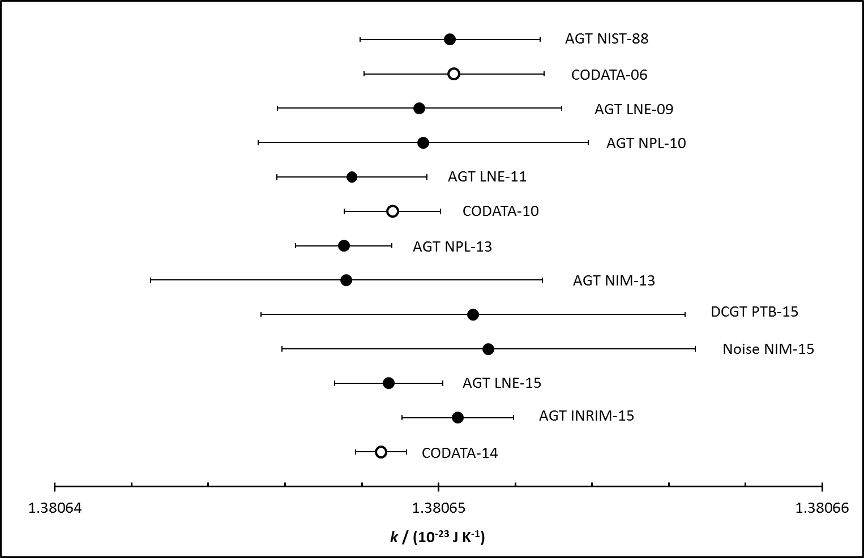
Values of k considered by CODATA 2014
u(k) / k = 0.57 ppm

Slide 23
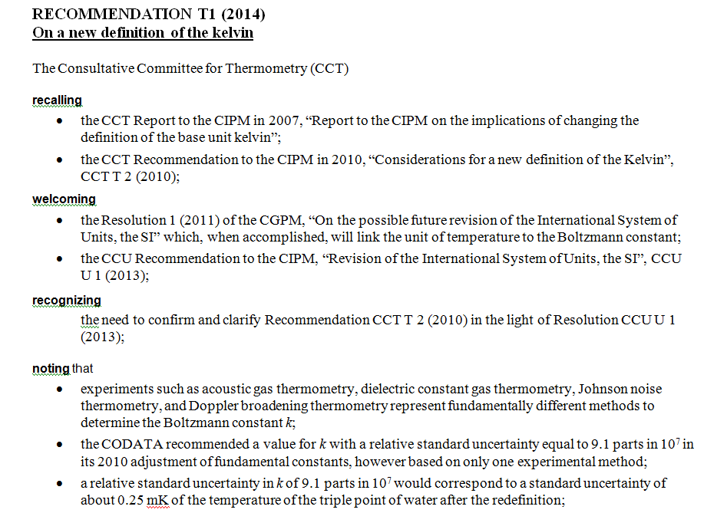
Redefinition of the SI base unit kelvin in 2018

Slide 24
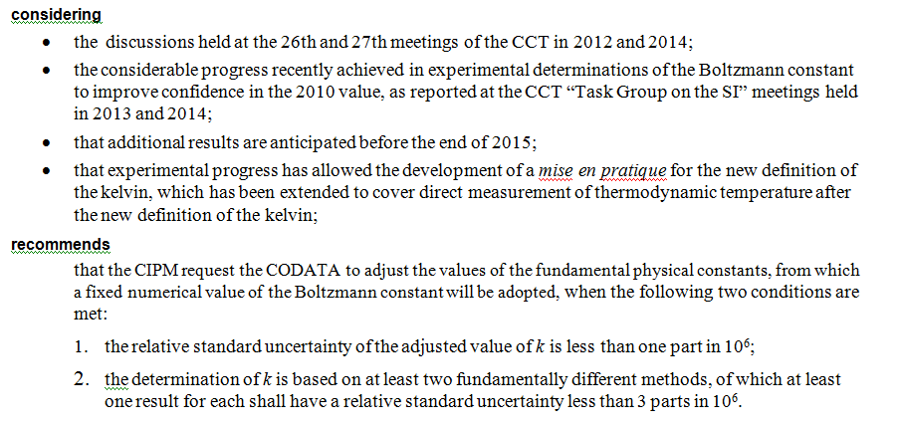
Redefinition of the SI base unit kelvin in 2018
✓
Condition 2 fulfilled for AGT, additional methods: DCGT and noise thermometry

