Slide 1
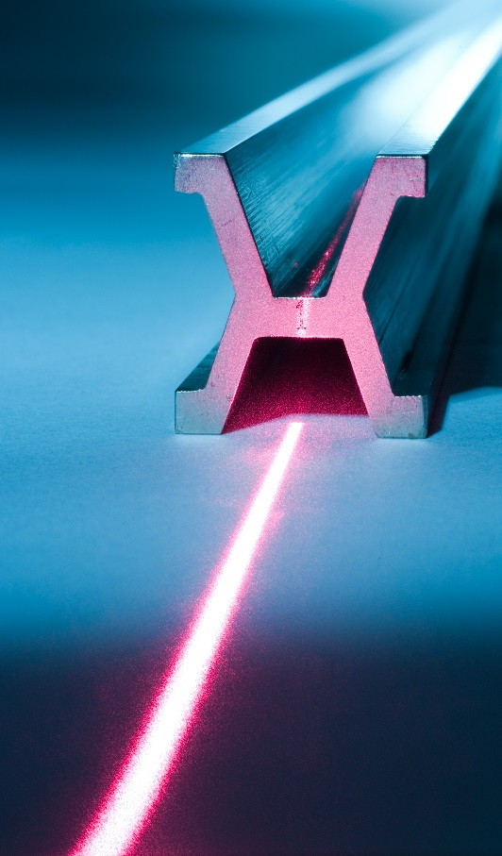
CCL President report to the 2016 meeting of the CCU
Prepared on behalf of CCL President by Andrew Lewis, chair CCL WG-MRA
Presenter: Emilio Prieto, CEM (member CCL WG-MRA)
BIPM, Sèvres 15-16 June 2016
Notes:
The CCL President is unable to attend this meeting of the CCU. At the invitation of the CCU Executive Secretary, the chair of the CCL WG on the MRA, Dr Andrew Lewis of NPL, was asked to prepare a presentation on behalf of CCL. Dr Lewis is unable to give the presentation due to a clash with a CERN workshop and instead Dr Emilio Prieto has kindly agreed to give the presentation to the CCU meeting

Slide 2
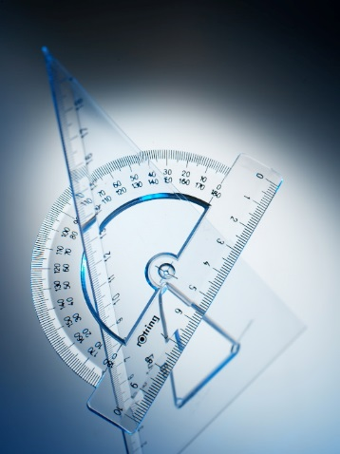
Subject of report
“…actions taken since the 20th meeting of the CCU relevant to the adoption of the revised SI”
Contents
Definition & realisation of the metre
2012 CCL discussion on proposed metre re-definition
Use of Si/TEM for metre realisation for nanometrology
Metre realisations via single frequency list
The radian as an SI base unit
CCL WG members discussions on the radian
Notes:
The topic which CCL was asked to report on is “…actions taken since the 20th meeting of the CCU relevant to the adoption of the revised SI”. The 20th CCU meeting was in September 2010 and in the intervening time, CCL has been active in topics related to the metre definition and realisation. In recent days there has been additional discussion regarding the radian and a proposal for adoption of the radian as a base unit of the SI.
The following 4 slides present these actions and discussions.

Slide 3
2012 CCL discussion on metre re-definition
Since the 20th CCU meeting, CCL has met twice: in September 2012 and again in September 2015
In the 2012 meeting, CCL entered into discussion on the agenda topic of ‘possible future revision of the SI’
  C. Thomas (BIPM) gave the presentation from Ian Mills
  CCL decided to concentrate discussion at the meeting on the revision to the metre definition and its consequences for the length community
Outcome after CCL discussion (from CCL 2012 minutes):
“Agreed proposal: CCL to send a communication to Dr. Mills telling him that CCL is not fully happy with the wording but the reasons behind are understood. So, CCL takes note on the new definitions.”
Notes:
An agenda item for the 2012 meeting of the CCL was THE NEW SI; ADVICE OF THE CCL ON RESOLUTION 1 OF THE 24TH CGPM “ON THE POSSIBLE FUTURE REVISION OF THE INTERNATIONAL SYSTEM OF UNITS, THE SI”.
The meeting discussed this topic, starting with a presentation from CCU President Ian Mills which was given by Claudine Thomas of BIPM. The chair of the meeting proposed to limit the discussion to the possible change in the definition of the metre rather than discussion all the SI base units.
Following discussion, the consensus was that the CCL members were not happy with the wording of the new definition, since it seemed more complicated and less easy for the ‘person in the street’ but they understood the reasons to harmonise the definitions across the SI and so CCL formally noted the new definitions and would not raise any objection.

Slide 4
Use of Si/TEM for metre realisation for nanometrology
CCL’s working group on nanometrology has drafted a document ‘Realisation of the SI metre using silicon lattice and TEM for dimensional nanometrology’
The document gives guidelines for the use of transmission electron microscopy (TEM) and the reference value of the bulk silicon lattice constant as a pathway for traceability to the SI metre for applications in dimensional nanometrology.
Rationale: SI metre realisation via Si lattice may be more accurate and easier for dimensional nanometrology than optical fringe sub-division.
Future traceability routes via Si lattice, e.g. X-ray interferometry may be required to extend the SI metre realisation to pm scales.
Notes:
Realisation of the metre at nanometre scales can be difficult to achieve with high accuracy when classical optical wavelengths are sub-divided. Issues such as non-linearity can limit the accuracy of fringe sub-division. Alternative routes to the SI metre, such as through the Si lattice spacing (which is conveniently sub nanometre) have been utilised by several NMIs for example NIST’s use of a Si reference material in TEM applications and NPL’s & PTB’s use of the Si lattice in X-ray interferometry. As a first step towards formal acceptance of these traceability routes the CCL’s working group on dimensional nanometrology has written a guidance document on using the Si lattice with TEM techniques.
CCL foresees further development of the Si lattice as a traceability route for the SI metre at small length scales.

Slide 5
Metre realisation via single frequency list
Updates to Recommended values of standard frequencies for applications including the practical realization of the metre and secondary representations of the second
CCL 2012
the unperturbed optical transition 3s² ¹S₀ – 3s3p ³P₀ of the ²⁷Al⁺ ion
the unperturbed optical transition 5d¹⁰6s ²S_{1/2} – 5d ⁹6s² ²D_{5/2} of the ¹⁹⁹Hg⁺ ion
the unperturbed optical transition 6s² ¹S₀ – 6s6p ³P₀ of the ¹⁹⁹Hg neutral atom
the unperturbed optical transition 6s ²S_{1/2} – 4f ¹³6s² ²F_{7/2} of the ¹⁷¹Yb⁺ ion
the unperturbed optical transition 6s ²S_{1/2} (F = 0, m_{F} = 0) – 5d ²D_{3/2} (F = 2, m_{F} = 0)
of the ¹⁷¹Yb⁺ ion
the unperturbed optical transition 5s ²S_{1/2} – 4d ²D_{5/2} of the ⁸⁸Sr⁺ ion
the unperturbed optical transition 4s ²S_{1/2} – 3d ²D_{5/2} of the ⁴⁰Ca⁺ ion
the unperturbed optical transition 1S – 2S of the ¹H neutral atom
the unperturbed optical transition 5s² ¹S₀ – 5s5p ³P₀ of the ⁸⁷Sr neutral atom
the unperturbed optical transition 6s² ¹S₀ – 6s6p ³P₀ of the ¹⁷¹Yb neutral atom
the unperturbed ground-state hyperfine transition of ⁸⁷Rb
CCL 2015
Absorbing molecule ¹²⁷I₂, saturated absorption a₁ component, R(36)32-0 transition
Absorbing atom ⁸⁷Rb crossover between the d and f hyperfine components of the saturated absorption at 780 nm (D2 transition)
Notes:
At each CCL meeting, the CCL-CCTF Frequency Standards Working Group proposes new additions and changes to the Recommended values of standard frequencies for applications including the practical realization of the metre and secondary representations of the second – this document is used by both the time & frequency and length communities. From the CCL perspective these frequencies (and their associated vacuum wavelengths) are used as realisations of the metre.
In both the 2012 and 2015 meetings, new additions and changes have been proposed to CIPM and subsequently accepted.

Slide 6
CCL WG discussions on the radian:
NIST proposal to define as a base unit
25 May 2016 – H. Bosse (PTB) informed CCL WG-Strategy about the NIST paper by Mohr & Phillips which was then on the ArXiv server
A. Lewis (chair WG-MRA) asked to open discussion to:
  CCL WG-MRA (which organises angle key comparisons, angle CMC review)
  CCL Discussion Group DG3 on Angle Metrology
  T. Yandayan (UME) – coordinator of a EURAMET research project on next generation angle metrology
  CCL WG-Nano chair
Subsequent contributions to email discussion from P. Kren (CMI), A. Lewis (NPL), A. Balsamo (INRiM), E. Prieto (CEM), R. Thalmann (METAS), K. Bastida (INTI).
Consensus: The ‘problem’ of inconsistency within the current SI text is acknowledged but there is no support expressed so far from within CCL members (except for the official paper from NIST) for the proposal to make the radian a base unit of the SI. Solutions which do not require such a strong change in the SI are to be preferred.
Notes:
In the weeks preceding the CCU meeting, CCL became aware of a proposal from NIST to consider the radian as a new base unit of the SI. Noting that the CCU meeting was imminent, there have been inter and intra-NMI discussions on this topic amongst member laboratories of the CCL, in particular members of the CCL Working Group on the MRA including its Discussion Group on Angle metrology.
Discussions have ranged from the more philosophical (such as what is angle; what properties are required for consideration as a base unit) to potential consequences of such a change.
All discussions have acknowledged that the current situation is not ideal and that there are ways in which this could be improved. However, apart from the NIST paper (which we understand is putting the official NIST position) none of the email discussion responses so far has supported making the radian a base unit of the SI.

Slide 7
Thank you!

