Slide 1
Mise en pratique for the ampere and other electrical units in the revised SI CCU, 22nd meeting, June 2016
Gert Rietveld, CCEM president
Michael Stock, CCEM executive secretary
Barry Wood, CCEM WGSI chair

Slide 2
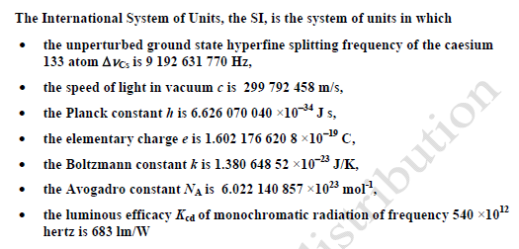
Revised SI and electrical units
The core of revised SI: 7 defining constants
⇒ The revised SI has a major impact on electrical units
Present electrical quantum standards become direct realisations of the SI units of V, R, I

Slide 3
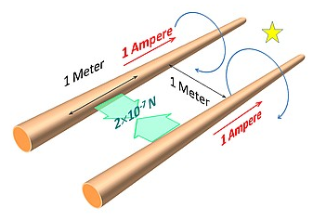
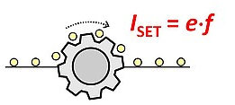
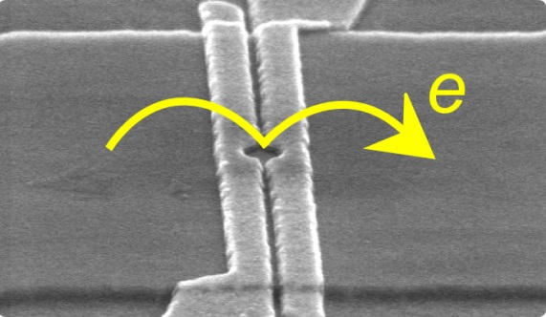
Definition of the ampere
“The ampere is that constant current which, if maintained in two straight parallel conductors of infinite length, of negligible circular cross-section, and placed 1 metre apart in vacuum, would produce between these conductors a force equal to 2 ×10⁻⁷ Newton per metre of length.”
“The ampere, symbol A, is the SI unit of electric current. It is defined by taking the fixed numerical value of the elementary charge e to be 1.602 176 620 ×10⁻¹⁹ C”

Slide 4
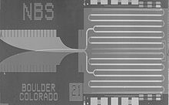
Practical realisations of the ampere
3 options to realise the ampere
Using Single Electron Transport device, unit relation A = C/s, and the value of e and a realisation of the second s
Using Ohm’s law, the unit relation A = V/Ω, and the practical realizations of the units volt V and ohm Ω, based on the Josephson and quantum Hall effects
Using the relation I = C·dU/dt, the unit relation A = F·V/s, and practical realizations of units volt V and farad F and of the SI base unit second s (applying a voltage ramp dU/dt to a capacitor of capacitance C)

Slide 5
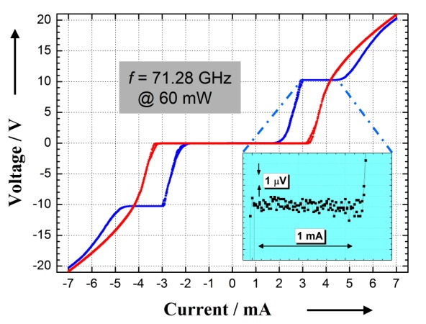
Practical realisation of the volt
The volt V can be realized using the Josephson effect and the value of the Josephson constant K_{J}
With the revised SI:
K_{J,90} conventional value replaced by value based on the values of h and e
Present uncertainty of 4⋅10⁻⁷ removed
Impact:
All calculations (SW) for voltage measurements based on the AC Josephson effects need to use the new value (# digits?)
Step change of ≈ 0.1 ppm (consistency factor ≠ 1!)
Only just visible at practical measurements using Zener-based voltage standards, but > 100 times present realisations of quantum standard!

Slide 6
Practical realisations of the ohm
The ohm Ω can be realized using
the quantum Hall effect and the value of the Von Klitzing constant R_{K}
a calculable capacitor and the value of ε_{o}
With the revised SI:
R_{K,90} conventional value replaced by value based on the values of h and e
Present uncertainty of 1⋅10⁻⁷ removed
Impact:
All calculations (SW) for resistance measurements based on the quantum Hall effect need to use the new value (# digits?)
Step change of ≈ 0.02 ppm ⇒ only visible in best realisations of the (quantum) standard

Slide 7
Magnetic constant μ_{o} and related quantities
The relations between μ₀ , ε₀ , Z₀ and c remain unaltered
ε₀ = 1/μ₀c²
Z₀ = μ₀c = (μ₀/ε₀)^{1/2}
with c = 299 792 458 m s^{–1}
However, μ₀ no longer has the exact value 4π⋅10^{–7} N A^{–2} and must be determined experimentally via
c, h and e are exact in the revised SI ⇒ μ₀ , ε₀ , Z₀ will have the same relative uncertainty as the fine structure constant α
Notes:
magnetic constant (permeability of vacuum) μ0, electric constant (permittivity of vacuum) ε0, characteristic
impedance of vacuum Z0,

Slide 8
Summary
The revised SI has a major impact on electrical units:
Present electrical quantum standards become direct realisations of the SI units of V, R, I
⇒ Advances in these quantum standards lead to direct improvement of realisation of the units
Other practical consequences:
Small step change in V only just visible at industry level (but > 100 larger than realisation using Josephson standard)
R_{K} and K_{J} values need to be updated, per a certain fixed date, in all software of NMIs and industry
μ₀ no longer exact, must be determined experimentally
Impact step changes on other quantities practically negligible

Slide 9
Executive summary
h
e
(no worry – we handled this already back in 1990)
In the SI!

