Slide 1
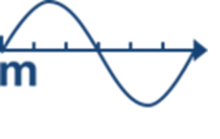
Length Laboratory
2018
PRESENTATION OF THE LABORATORY OF LENGTH
Dariusz Czułek, CCL 2018

Slide 2
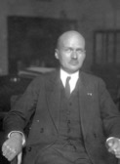
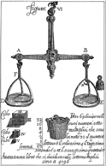
History of the Polish Metrology
Regaining our independence
Establishing the Central Office of Measures
Joining to the Metre Convention
Introducing SI system in Poland
EUROMET
Beginning of the GUM reform, establishing Consultative Metrology Teams
1918
1919
1925
1966
1998
2017

Slide 3
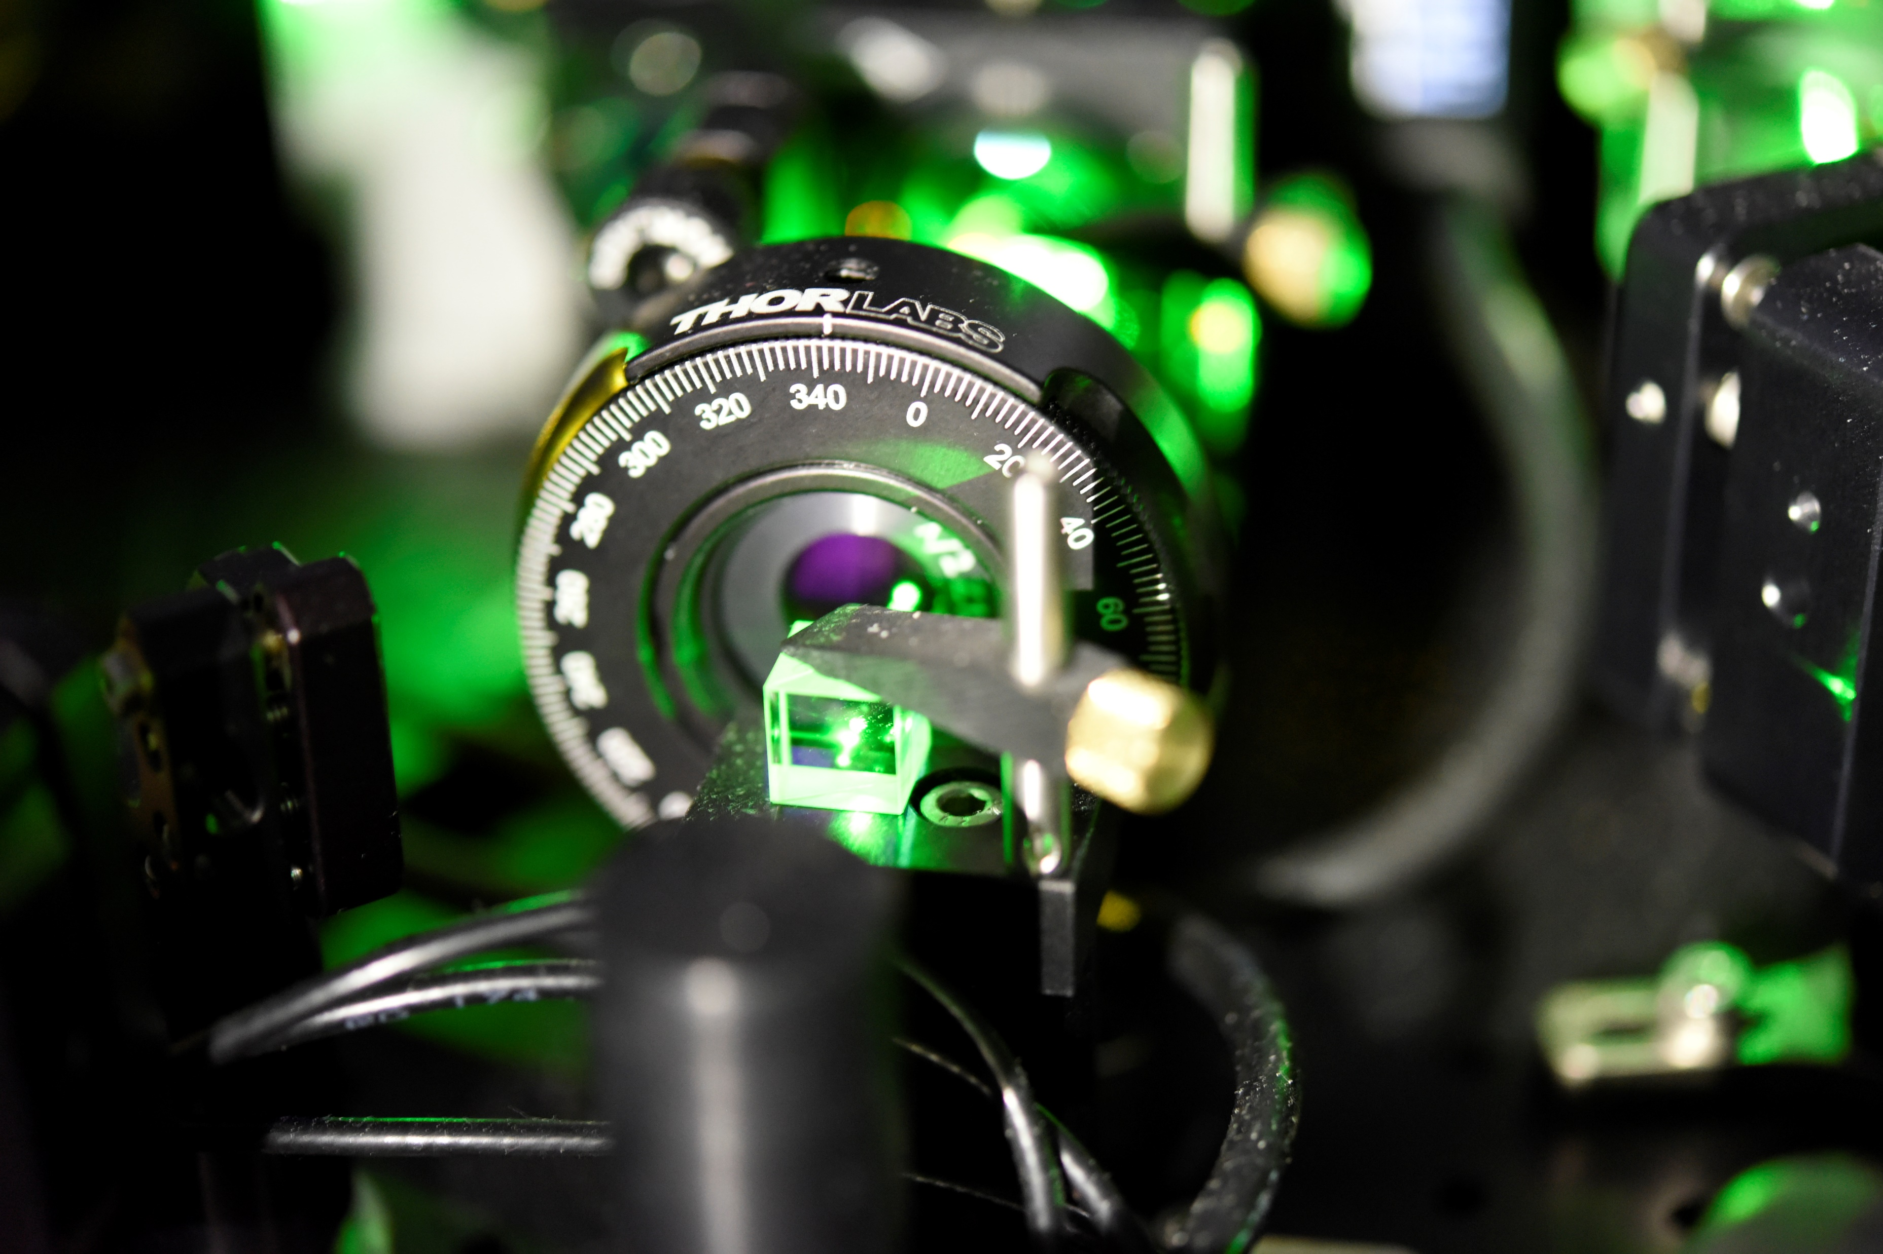
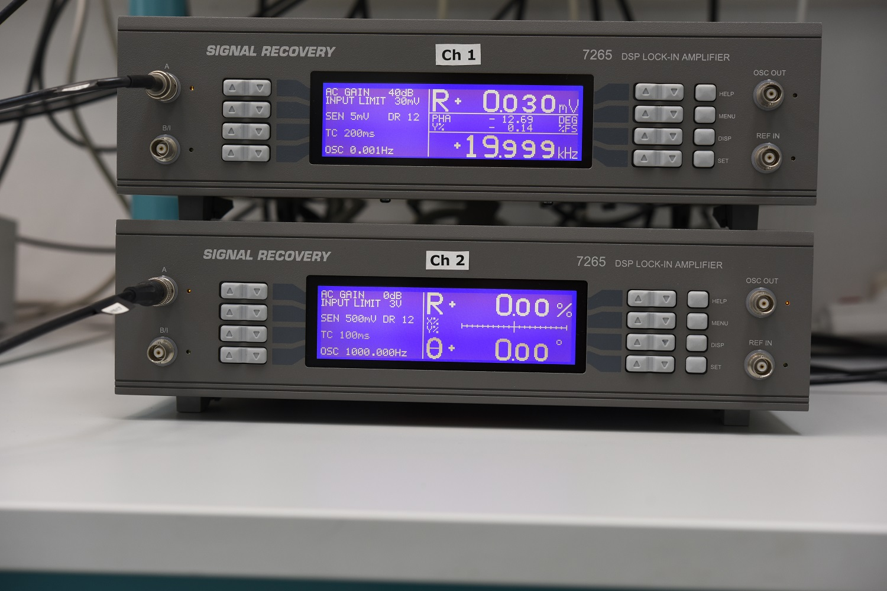
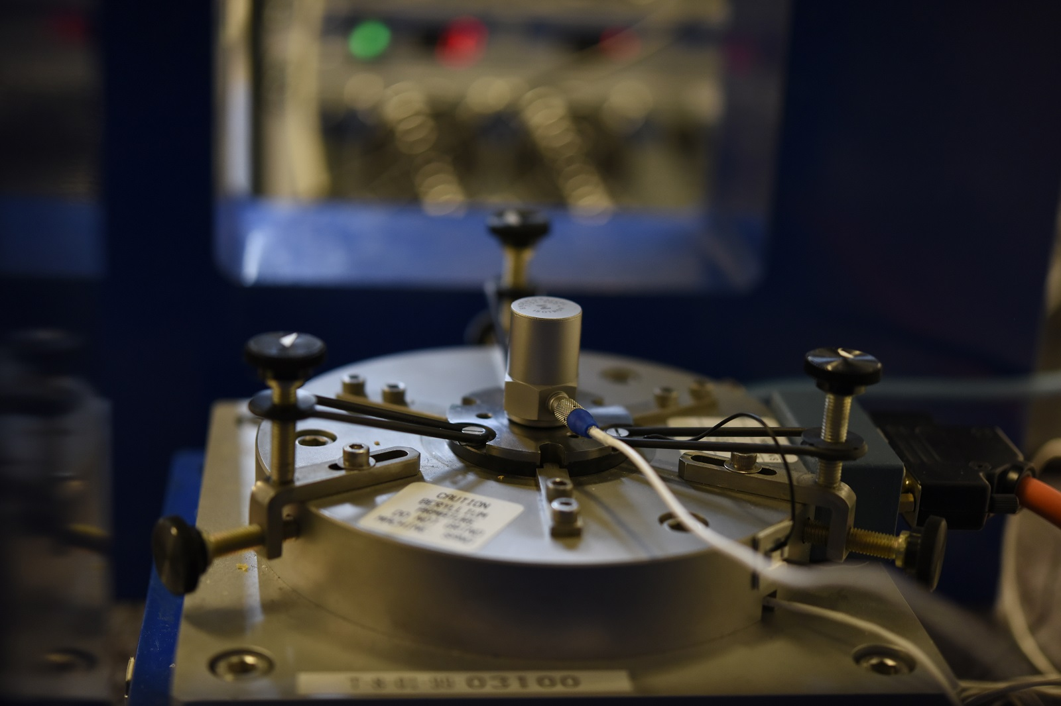
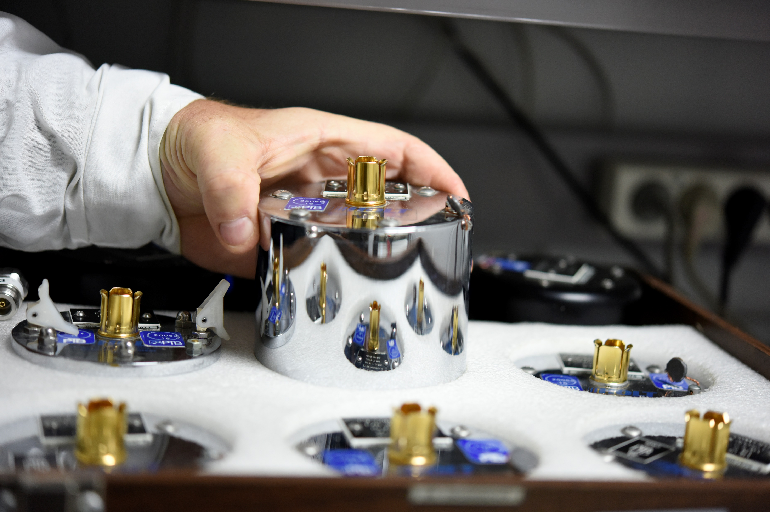
National Standards
Number of National Standards of Measurement Units, maintained in Poland:
GUM - 21,
Polish Designated Institutes: 2 Institute of Low Temperature and Structure Research of Polish Academy of Sciences (INTiBS), National Centre for Nuclear Research (NCBJ) Status of the mesurements standards - established in accordance with the Regulation on the recognition of standards of measurement units as national standards of measurement units

Slide 4
Structure of the Polish metrology system
Metrology Council
Consultative Metrology Teams
National Centre for Nuclear Research
Technical Committees of GUM
Designated Institutes
Institute of Low Temperature
and Structure Research
4 Years Strategic Activities Plan
of GUM
9
Regional Offices of Measures
2
Regional Assay Offices
58
Local Offices of Measures
2
Regional Assay Offices

Slide 5
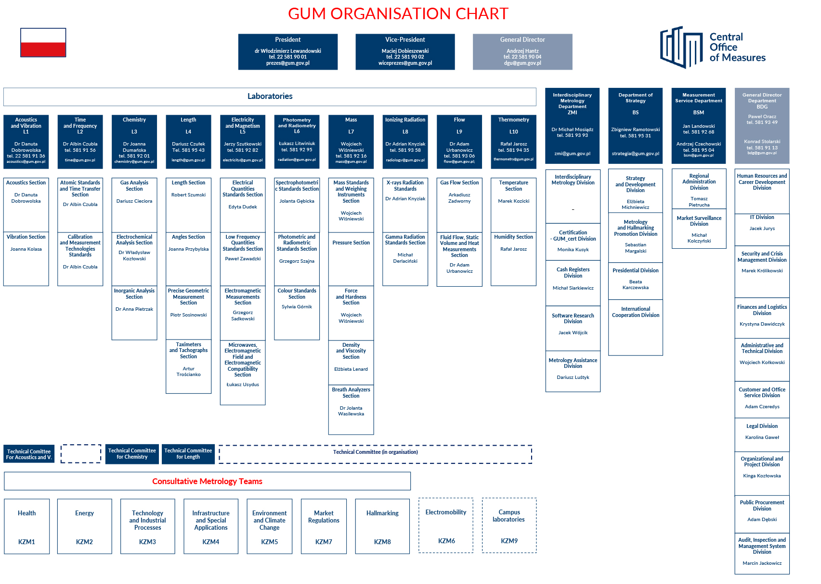
Technical Comitees of GUM

Slide 6
Length Laboratory
Length
Angle
Geometry
He-Ne laser stabilised with iodine
Optical fraquency synthesizer
Lasers
Interferometers
EDMs
Gauge blocks
Diameter standards
Optical polygons,
Rotatory tables, angle encoders,
Autocolimators,
Precision electronic levels,
Wringing angle blocks,
Solid and liquid refractive index standards,
Refractometers, polarimeters,
Optical rotation standards,
Line standards (line scales, stage micrometers, tapes)
Diameter standards
Form: flatness, roundness, straightness,
Complex geometry:
Surface texture standards (type A,B,C,D,E),
CMM artefacts (ball plate, ball bar),
2-D, 3-D instruments (CMM, laser tracker, profile instrument)

Slide 7
Measuring stations – 35
CMC: 50
Staff: 17
Calibration: 3400
Certificates: 1200
National standards:
length, 1980,
plane angle, 1979,
refractive index, 1981,
optical rotation, 1981.
5 measuring stations built by employees (50 m comparator, white light interferometer, line scales comparator, station for optical polygons, small angle generator),
1 measuring station built with cooperation with PW (long gauge block comparator)
2 measuring stations modernized with cooperation with PW (micro interferometer, Kösters interferometer)

Slide 8
Length Laboratory − Quality System
The Central Office of Measures acting as the National Measurement Institute appointed to assure mutual conformation and required accuracy of the results of mensuration carried on in Poland and their conformity with the international measurement system, operates in this field to support reliability of mensuration in all spheres of the public life of the country and in particularly to enable the Polish economy active participation in international exchange of goods and services.
It is going to be achieved by:
maintaining the quality management system according to the standard PN-EN ISO/IEC 17025:2005 and standard PN-EN 45011:2000 and permanent improvement of its effectiveness,
fulfillment of the commitments emerging from the signed international contracts and agreements, in particularly: the Metre Convention and “Mutual recognition arrangement of national measurement standards and of calibration and measurement certificates issued by national metrology institutes” (CIPM MRA),
obtaining the status of the notified body (JN 1440) to the directives NAWI and MID.
peer review evaluations carried on by external experts

Slide 9
Length Laboratory − Length Section
Measurement areas:
Length
Laser radiation (wavelength, stability)
Refractive index (in air)
Flatness

Slide 10
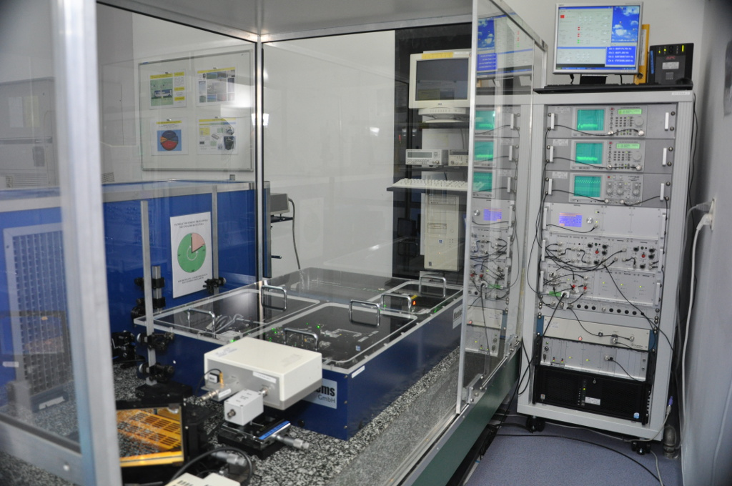
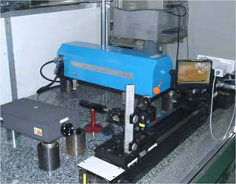
Length Laboratory − Length Section
National measurement
standard of length unit
Measurement range:
(532 ÷ 1064) nm

Slide 11
Length Laboratory − Length Section
Measuring installations in Length Section:
Primary Standard of Length:
Optical frequency comb;
Iodine stabilized helium neon laser;
Gauge block interferometers:
GBI300 automatic laser interferometer, (0 – 305) mm;
Köster type modernized interferometer, (0 – 100) mm;
UKI01 white light and laser interferometer (125 – 500) mm;
Multiwavelength laser interferometer (0 – 1000) mm;
Length measuring machine SIP 3002 M (0 – 3000) mm;
Zygo GPI interferometer;
Setups for calibration of mechanical comparators and measuring machines;
Mechanical comparators, (0 – 500) mm;
Measuring setup for calibration of interferometer compensation unit.

Slide 12
Length Laboratory − Length Section
International key and supplementary comparisons:
EURAMET.L-K4.2015 – Calibration of Diameter Standards,
EURAMET.L- K1.2011 – Calibration by optical interferometry of short and long gauge blocks,
CCL-K11 – Comparison of optical frequency and wavelength standards,
EURAMET.L-S20 #1169 – Comparison of laser distance measuring instruments,
EURAMET.L-K1.2 #1138 – Calibration of gauge blocks by interferometry,
COOMET.L-S7 – Comparison of standards of Length,
EUROMET BIPM.L-K11 #1063 – Comparison of optical frequency and wavelength standards,
EUROMET.L-K2 #602 – Calibration of long gauge blocks from 150 mm to 900 mm,
EUROMET.L-K1.1 #643 – Calibration of gauge blocks by interferometry,
EUROMET.L-S12 #601 – Calibration of gauge blocks by mechanical comparison,
EUROMET BIPM.L-K10 #498 – Comparison of the frequencies of Helium-Neon lasers at wavelength 633 nm.

Slide 13
Length Laboratory − Length Section
Recent, running projects:
EMRP Project IND53 „Large Volume Metrology in Industry” 2013 – 2016
EURAMET Project #1272 „Phase correction for interferometric measurement of gauge blocks” 2013 - 2017
Development of the refractive index compensation method.
Development of the compact setup for calibration of distance metres.
Modernization of the Primary Standard of Length (increasing the measuring range to about 1500 nm)
Participation in the project of developing the compact laser wavelength/frequency standard (the component of the interferometer for industrial purposes)
Development of new measurement methods for the geodesy
Implementation of the measuring method of linear expansion coefficient by interferometry
Modernization of the 1D measuring machine in the scope of position adjustment of the standards during measurements

Slide 14
Length Laboratory − Length Section
Internal projects:
Determination of the long term stabilty of the laser interferometer head
Modernization of the interferometric comparator for line scale calibration
Examination of the long gauge blocks calibration using different measuring stations
Developing an automated measurement system using the LabView application at a 50 m the interference comparator
Developing the application of the Monte Carlo method to for the uncertainty calculation for gauge block length variation on a mechanical comparator
Implementation of a multispectral interferometer for calibration of long reference blocks up to 1000 mm

Slide 15
Length Laboratory − Length section
Conferences:
13–17.02.2006, Międzyzdroje, V Symposium on Measurement Uncertainty
9–13.09.2007, Kraków, IV Metrology Congress - “Metrology – cognition tool and way of development”
4–6.03.2009, Warszawa, XI International Analytics Fairi and Measurement Techniques „EuroLab 2009”
6–8.09.2010, Łódź, V Metrology Congress
19–22.06.2013, Kielce, VI Metrology Congress
13–16.09.2014, Gdańsk - Stockholm, XIX International Seminar of Metrologists MSM'2014 and XLVI Intercollegiate Conference of Metrologists MKM'2014
9–11.03.2016, Wrocław, NanoScale 2016(11th Seminar on Quantitative Microscopy (QM) & 7th Seminar on Nanoscale Calibration Standards and Methods)
(28.06–1.07).2016, Lublin – Nałęczów, VII Metrology Congress
23–26.05.2017, Waplewo, Computer Assisted Metrology

Slide 16
Length Laboratory − Length section
Publications:
Robert Szumski, „Interferometr laserowy GBI300 do pomiarów materialnych wzorców długości – płytek wzorcowych”, Pomiary Automatyka Kontrola, No. 9BIS(Vol. 53), 2007, p. 58-60
Dariusz Czułek, Robert Szumski, „Modernizacja państwowego wzorca jednostki długości poprzez zastosowanie syntezera częstotliwości”, Pomiary Automatyka Kontrola, No. 12(Vol. 56), 2010, p. 1561-1564
Robert Szumski, „Źródła niepewności przy wzorcowaniu płytek wzorcowych metodą interferencyjną reszt ułamkowych”, Praca zbiorowa, NIEPEWNOŚĆ POMIARÓW w teorii i praktyce, GUM, Warszawa 2011, p. 248-260
Dariusz Czułek, Robert Szumski, „Stabilność długoterminowa generatorów kwantowych wykorzystywanych w pomiarach długości”, Elektronika - konstrukcje, technologie, zastosowania, No. 6/2011, p. 19-21
Robert Szumski, „Pomiary długich płytek wzorcowych na zmodernizowanym stanowisku pomiarowym z interferometrem laserowym”, Pomiary Automatyka Kontrola, No. 4(Vol. 59), 2013, p. 304-307
M. Wengierow, L. Sałbut, Z. Ramotowski, R. Szumski, K. Szykiedans, “Measurement system based on multi-wavelength interferometry for long gauge block calibration”, Metrology and Measurement Systems, Vol. XX (3), 2013, p. 479-490
Robert Szumski, „Niepewność pomiaru długich płytek wzorcowych na zmodernizowanym komparatorze interferencyjnym”, Pomiary Automatyka Kontrola, No. 8(Vol. 60), 2014, p. 533-536
Robert Szumski, „Bardzo dobre wyniki GUM w porównaniach międzynarodowych „Pomiary płytek wzorcowych metodą interferencyjną” jako efekt współpracy naukowej z Politechniką Warszawską, MECHANIK Miesięcznik Naukowo-Techniczny, No. 11/2016, p. 1618-1619
Robert Szumski, „Semi-automatic measuring system of the multiwavelength laser interferometer for calibration of long gauge blocks”, DIAGNOSTYKA, 2017, article after review.

Slide 17
Length Laboratory − Angle Section
Measurement areas:
plane angle
refractive index (liquid, solid)
optical rotation

Slide 18
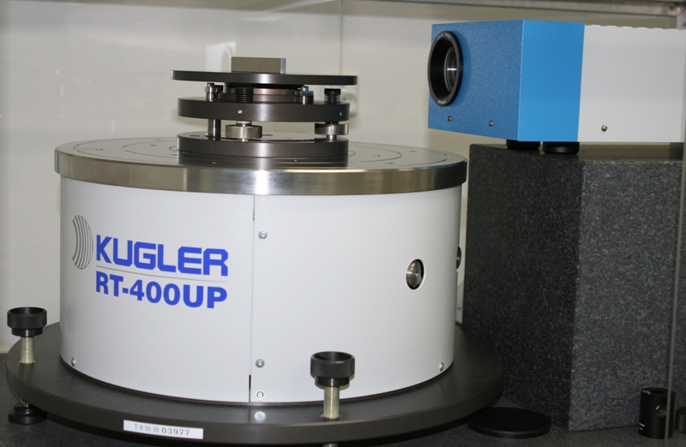
Length Laboratory − Angle Section
National measurement standard for plane angle unit
☞ photoelectric autocollimator, res. 0,001”, meas. range ± 300”
☞ precision rotary table with air bearing, fitted with one reading head angle encoder RON905,res. (measuring step) 0,002”

Slide 19
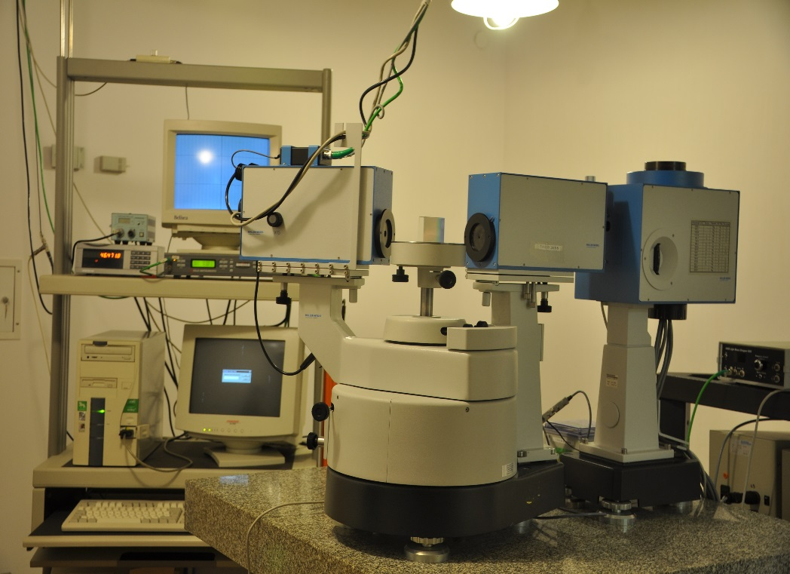
Length Laboratory − Angle Section
National measurement standard for refractive index unit
☞ goniometer-spectrometer II UV-VIS-IR, res. 0,01”
the set of prisms
n = (1,2 ÷ 2,2)

Slide 20
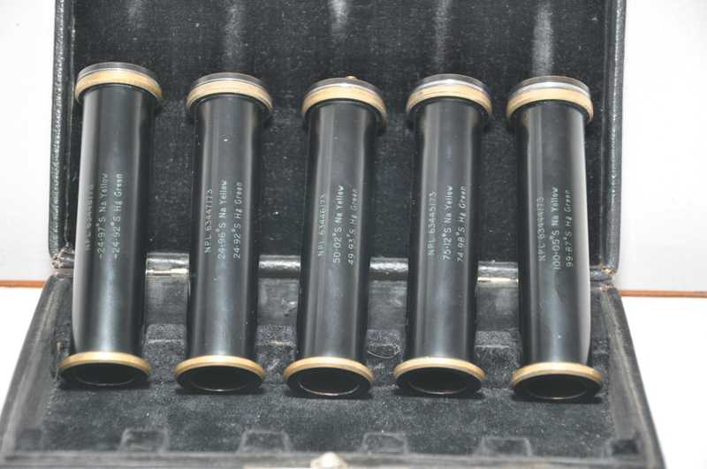
Length Laboratory − Angle Section
National measurement standard for optical rotation unit
☞ the set of five quartz plates
☞ (- 10 ÷ 40)° in angular scale and (- 25 ÷ 100) °Z in sugar scale, in 20° C temperature and in 546,3 nm wavelength

Slide 21
Length Laboratory − Angle Section
Measuring installations in Angle Section:
Primary Standard of plane angle – rotary table with autocollimator and small angle generator;
Goniometer Wild;
Optical polygons and autocollimators;
Optical dividing head;
Primary Standard of refractive index standards – goniometer-spectrometer II UV-VIS-IR;
Pulfrich refractometer, refractometer ABBEMAT550;
Liquid refractive index standards
Primary Standard for optical rotation – the set of five quartz plates;
Polarimeters: POL-S2 and MCP500

Slide 22
Length Laboratory − Angle Section
International key and supplementary comparisons:
EURAMET.L-K3.2009 – angle comparisons using an autocollimator;
SIM.L-K3/2008 – optical polygon and angle blocks;
EUROMET.L-K3 – optical polygons;
EUROMET No. 456 – wringing angle blocks;
COOMET.PR-S2 – quartz control plates;
COOMET Nr 116/PL/95 – determination of refractive index of solid standards using spectrogoniometric method;
Comparisons of solid refractive index standards.

Slide 23
Length Laboratory − Angle Section
Recent, running projects:
EMRP Project SIB58 Angles „Angle Metrology” 2013 – 2016
Development of the method of calibration of precise angle encoders (especially the method of coupling)
Modernizing the small angle generator
Development of the method of determinig the value of liquid refractive index standards, using the goniometer-spectrometer

Slide 24
Length Laboratory − Angle Section
Internal projects:
Developing the calibration methods of the autocollimators using the precise rotary table
Determining the value of the interpolation errors of the precise rotary table
Special device for precise coupling of the angle encoders needed for their calibration
Investigation of the results obtained from the measurements with the use of Pulfrich refractometer – influence of the proper error curve and environmental conditions
Investigation of the results obtained from the new photoelectric polarimeter

Slide 25
Length Laboratory − Angle Section
Conference:
04.÷ 06.09.2017, MKM’2017, Częstochowa, „New frontiers in angle metrology”
28.06.÷ 01.07.2016, KM’2016, Lublin/Nałęczów, „Calibration of precise autocollimators and angle encoders using shearing techniques – the result of the researches in the frame of joint EMRP project SIB58 Angles”
06.÷ 09.09.2015, MKM’2015, Łagów/Zielona Góra, „Precision rotary table with air bearing – methods of calibration”, „Stability of refractometric standard glycerole used as the reference material”
25.09.2014, Workshop – European Metrological Projects EMRP and EMPIR – Chances for Polish Metrology, „Dimensional Metrology in Scientific researches”
15.÷ 18.06.2014, ppm’14, Kościelisko, „Participation of Angle Laboratory in the project SIB58 Angles”
23.05.2013, Workshop, „Proficiency testing organized by GUM for calibration laboratories”
03.÷ 06.06.2012, ppm’12, „Calibration of the Instruments for the Measurements of Small Angles”
06.÷ 08.09.2010, KM’2010, „Modernized Station of the Plane Angle Unit”
14.÷ 17.05.2006, ppm’06, „Optical Polygons and Assuring the Traceability in Angle Measurements”; „National Standard of the Refractive Index Unit”
12.÷ 14.05.2003, ppm’03, „Interlaboratory Comparisons of Angle Standards”

Slide 26
Length Laboratory − Angle Section
Publications:
Luiz Henrique Brum Vieira, Jack Stone, Miguel Viliesid, Bruno R Gastaldi, Joanna Przybylska and K P Chaudhary “SIM.L-K3.2008 final report: calibration of angle standards”, Metrologia 52, Technical Supplement
Ralf D Geckeler, Andreas Just, Valentin Vasilev, Emilio Prieto, František Dvorácek, Slobodan Zelenika, Joanna Przybylska, Alexandru Duta, Ilya Victorov, Marco Pisani, Fernanda Saraiva, Jose-Antonio Salgado, Sitian Gao, Tonmueanwai Anusorn, Siew Leng Tan, Peter Cox, Tsukasa Watanabe, Andrew Lewis, K P Chaudhary, Ruedi Thalmann, Edit Banreti, Alfiyati Nurul, Roman Fira, Tanfer Yandayan, Konstantin Chekirda, Rob Bergmans and Antti Lassila „Angle comparison using an autocollimator”, Metrologia 55, Technical Supplement
Joanna Przybylska, Katarzyna Nicińska, „Najnowsze kierunki rozwoju metrologii kąta płaskiego”, Zeszyty Naukowe Wydziału Elektrotechniki i Automatyki Politechniki Gdańskiej Nr 54, str. 163 – 166, 2017
Joanna Przybylska, Katarzyna Nicińska “Wzorcowanie precyzyjnych autokolimatorów i enkoderów kątowych z zastosowaniem shearing techniques – projekt EMRP SIB58 Angles / Calibration of precise autocollimators and angle encoders using shearing techniques”, Mechanik 11/2016, pp. 1616-1617
Katarzyna Nicińska, Joanna Przybylska, "Państwowy wzorzec jednostki kąta płaskiego", Metrologia Biuletyn Głównego Urzędu Miar, nr 2 (17), rok 2010;
Joanna Przybylska, „Zmodernizowane stanowisko państwowego wzorca jednostki kąta płaskiego”, Metrologia Biuletyn Głównego Urzędu Miar, nr 3 (18), rok 2010;
Katarzyna Nicińska, "Wzorcowanie przyrządów do pomiarów małych kątów”, Metrologia i Probiernictwo Biuletyn Głównego Urzędu Miar, nr 2(2), rok 2013;
Beata Warzywoda, "Pomiary refraktometryczne w GUM", Metrologia i Probiernictwo Biuletyn Głównego Urzędu Miar, nr 3(3), rok 2013;
Katarzyna Nicińska, Joanna Przybylska, „Udział Laboratorium Kąta w projekcie EMRP SIB58 Angles”, Metrologia i Probiernictwo Biuletyn Głównego Urzędu Miar, nr 4(7), rok 2014;
Joanna Przybylska, „Korzyści wynikające z udziału w projektach badawczych w metrologii – EMRP SIB58 Angles”, Metrologia i Probiernictwo – Biuletyn Głównego Urzędu Miar, 1 – 2(16 – 17)2017, str. 18 – 19
Co-authorship – EURAMET Calibration Guidelines: Calibration of Autocollimators; Calibration of Angular Encoders

Slide 27
Length Laboratory − Geometry Section
Measurement areas:
Line standards (line scales, stage micrometers, tapes)
Diameter standards
Form: flatness, roundness, straightness,
Complex geometry:
Surface texture standards (type A,B,C,D,E),
CMM artefacts (ball plate, ball bar),
2-D, 3-D instruments (CMM, laser tracker, profile instrument)

Slide 28
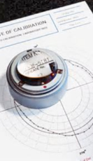
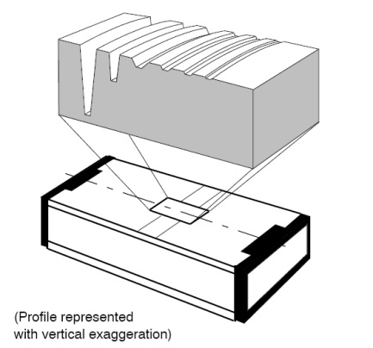
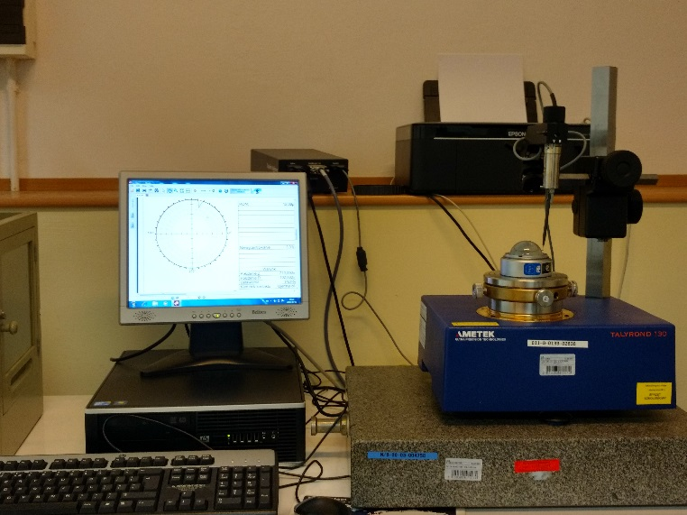
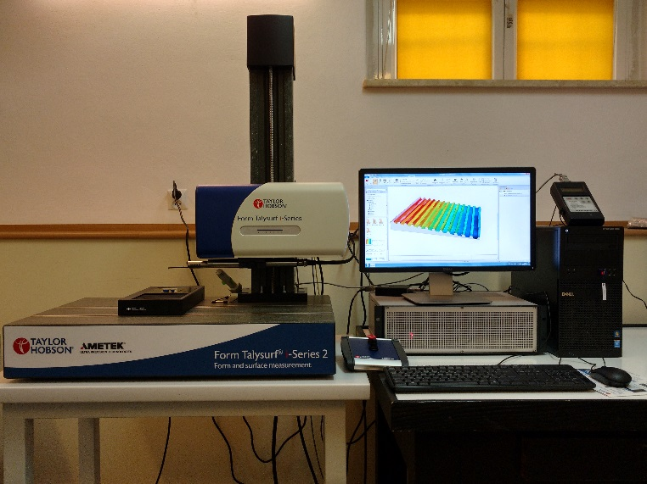
Length Laboratory − Geometry Section
maintenance the reference measurement standards of roundness and surface roughness
maintenance and developing other measuring stations

Slide 29
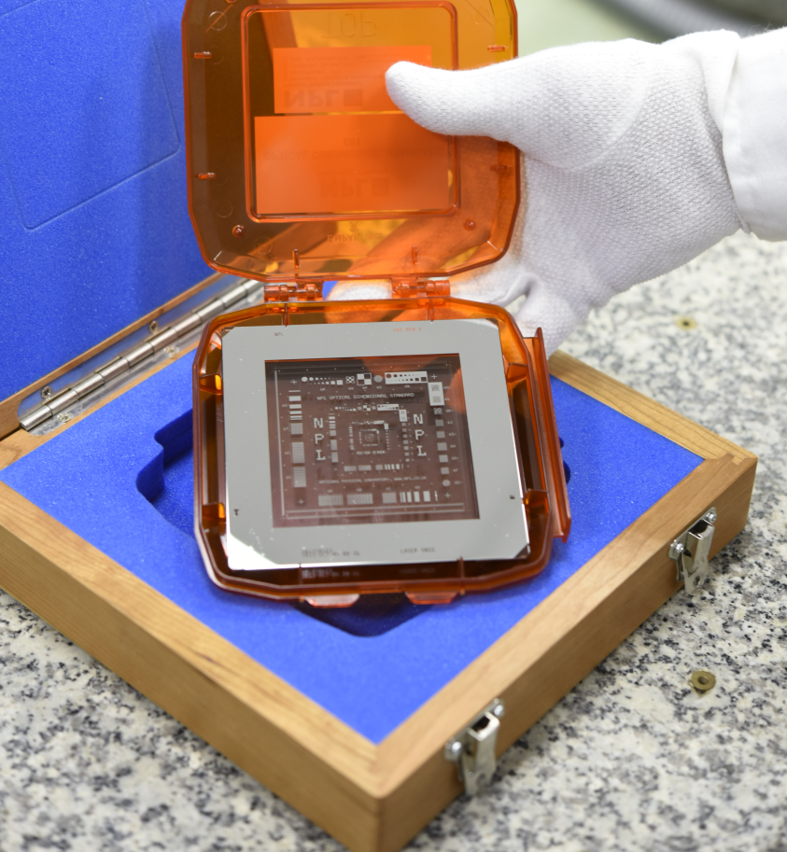
Length Laboratory − Geometry Section
Line scale interferometric comparator

Slide 30
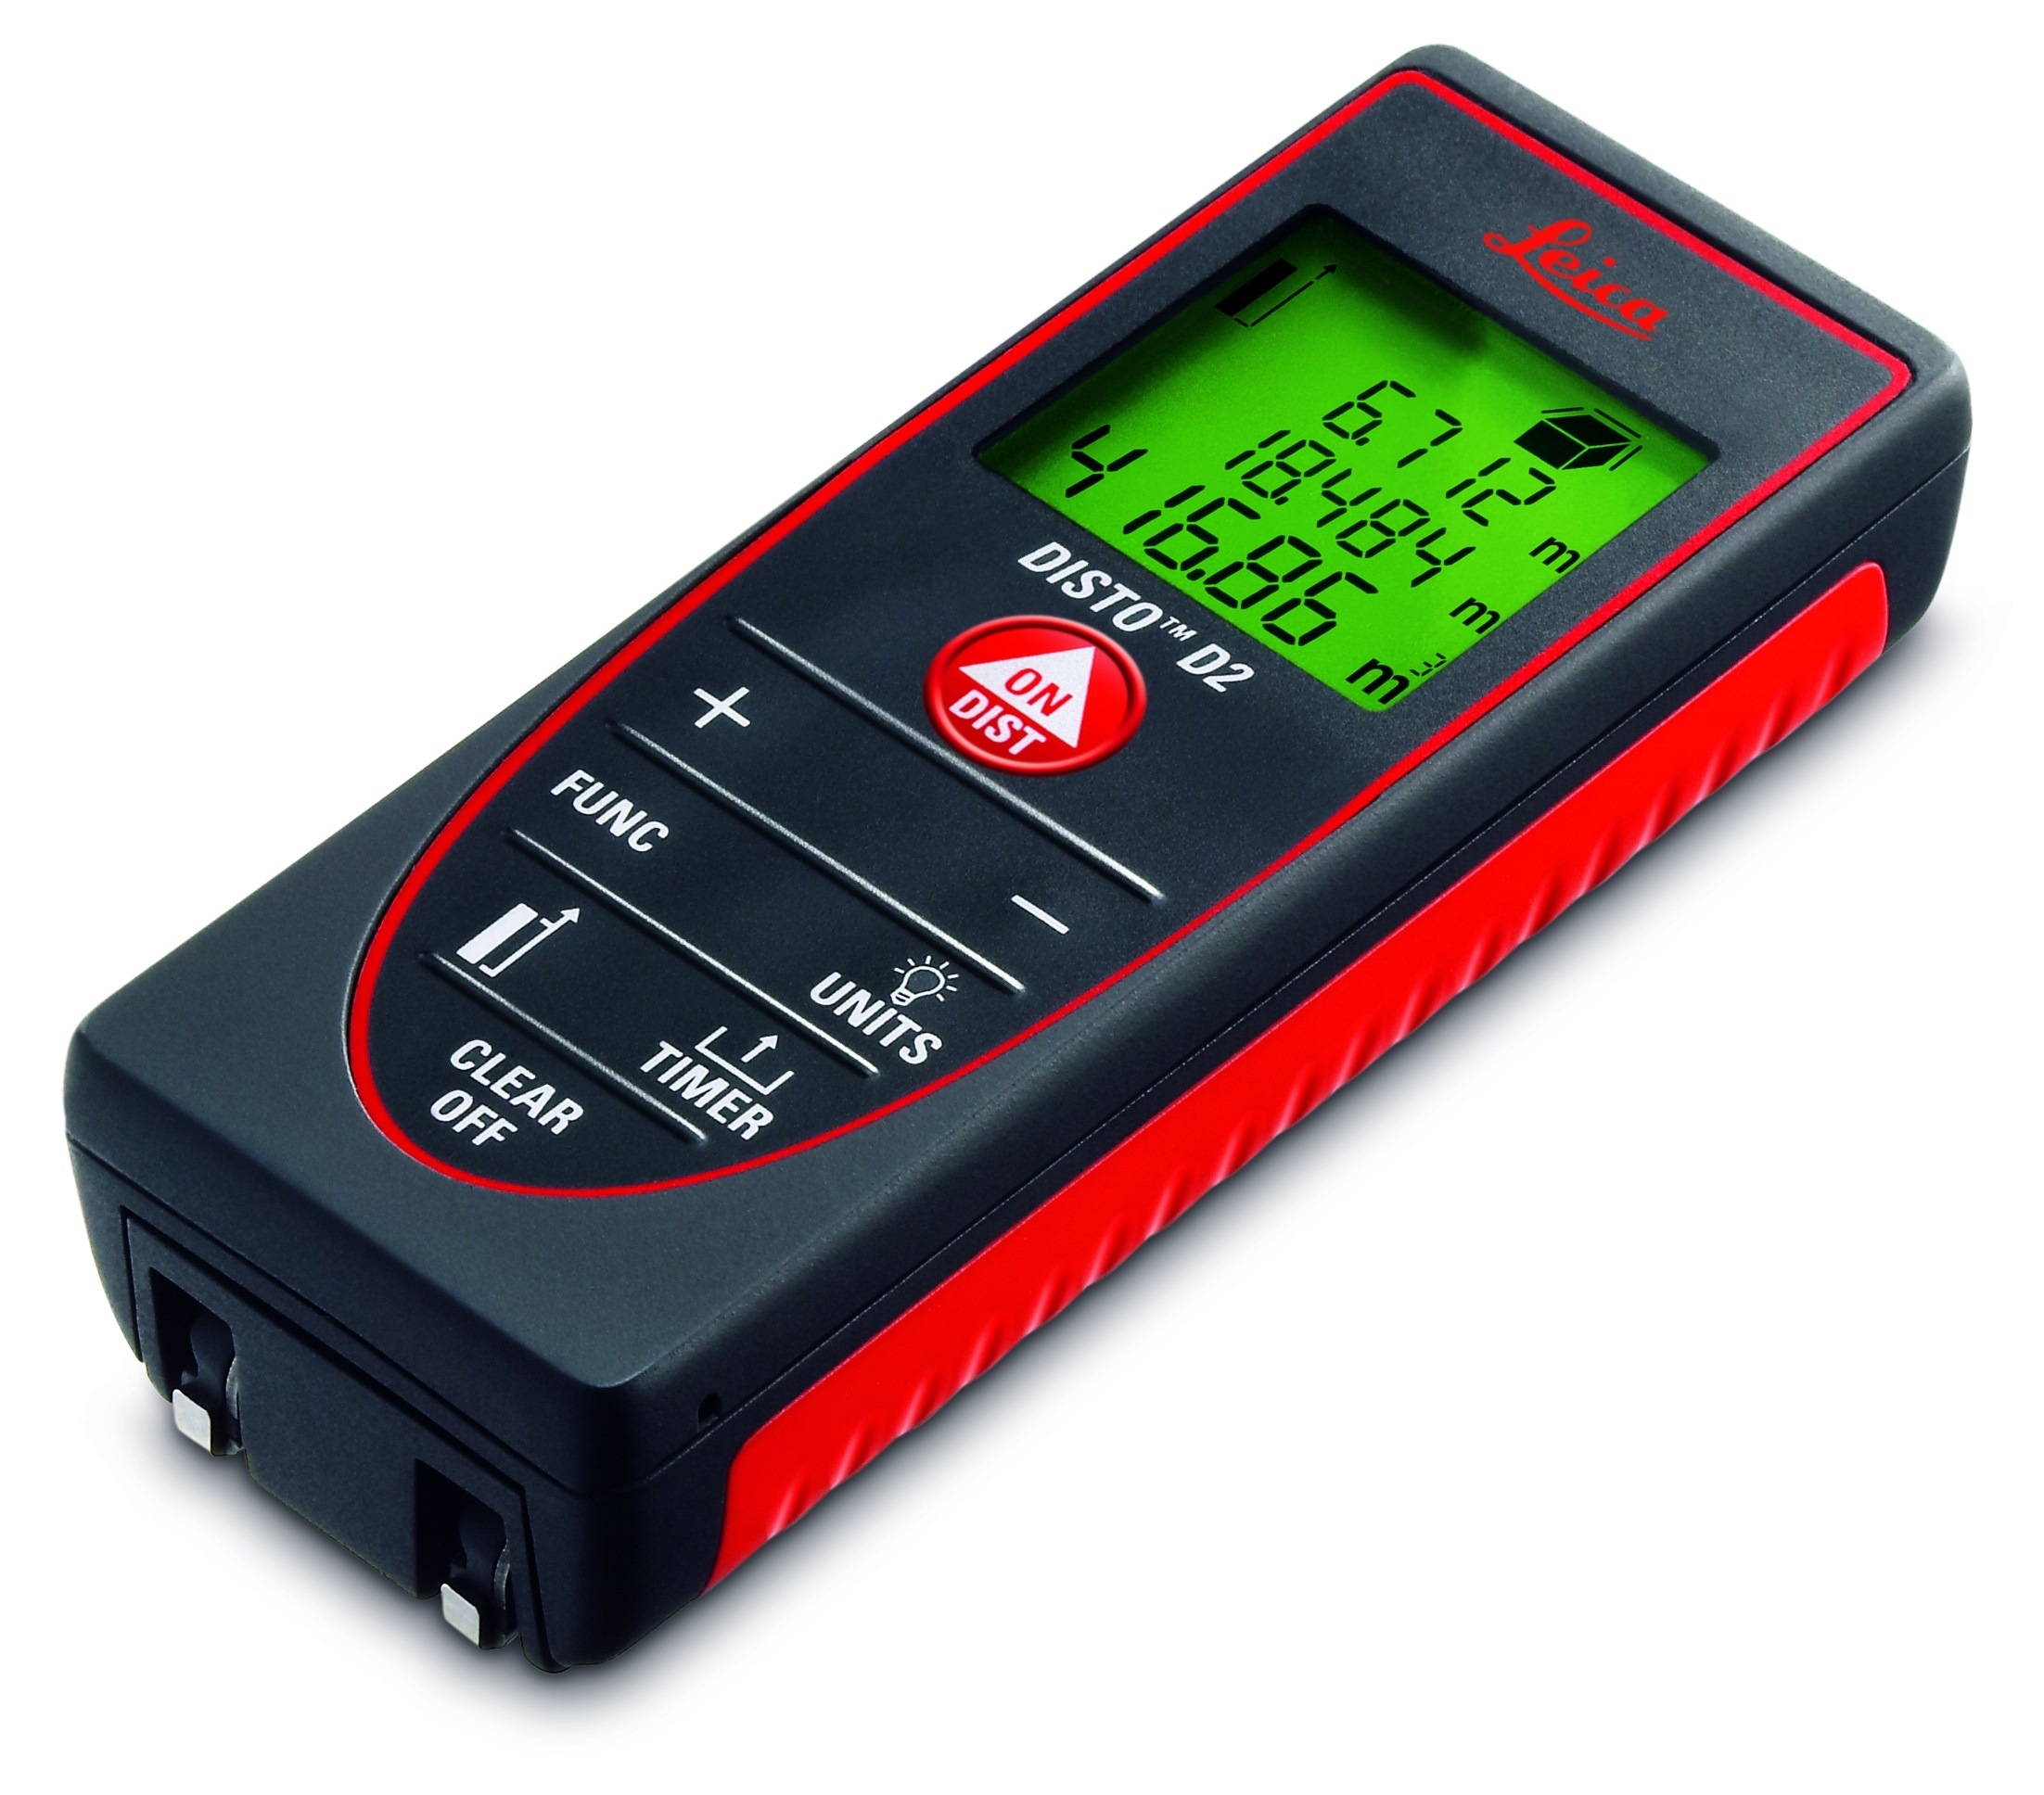
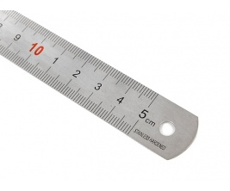
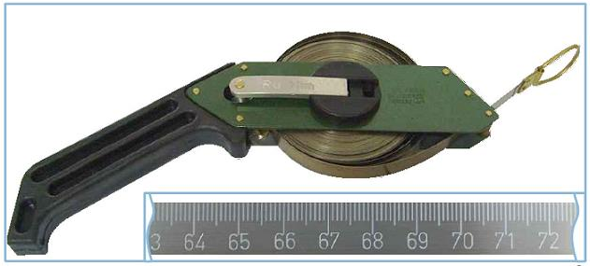
Length Laboratory − Geometry Section
50 m interferometric tape bench

Slide 31
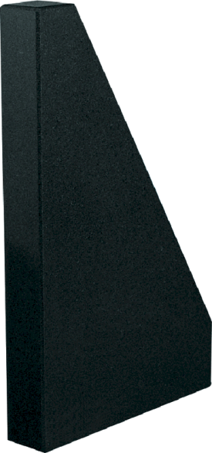
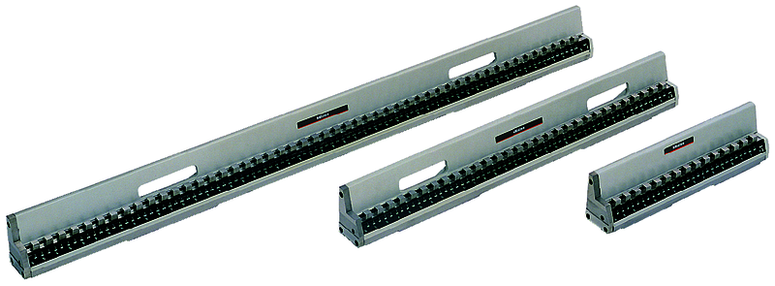
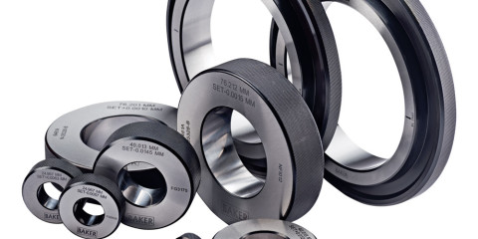
Length Laboratory − Geometry Section
Tactile SIP CMM5

Slide 32
Length Laboratory − Geometry Section
Measuring installations in Geometry Section:
Line scales interferometric comparator
50 m interferometric tape bench
Tactile SIP CMM
Microinterferometer MII4 with an automatic fringe evaluation using a temporal phase shifting method
Form Talysurf Profilometer Series 2 for measurement of surface texture standards (type A,B,C,D,E),
Talyround 210 for roundness deviation measurements
Laser Tracker API and KinAiry evaluation system

Slide 33
Length Laboratory − Geometry Section
International key and supplementary comparisons:
EUROMET.L-K7 Calibration of line scales
EUROMET.L-S14 Steel tape measures
EURAMET.L-K8 Calibration of roughness standards
EUROMET.L-K6 Calibration of ball plate
EUROMET.L-S10 Calibration of granite square and cylindrical steel square
EUROMET.L-K4.2005 Calibration of diameter standards
Nano2 Calibration of hight standards
EUROMET.L-S11 Calibration of surface texture standards
Ongoing:
EURAMET L-K5 Calibration of 1D CMM artefacts (step gauges) (April 2017 r.)
EURAMET.L-S26 Measurement of groove depth standards in the range 1 µm up to 1 mm (October 2017 r.)
EURAMET.L-S27 Measurement of Steel Tapes of 10 m and 50 m (April 2018 r.)

Slide 34
Length Laboratory − Geometry Section
Participation in research projects (national and international), in the field of dimensional metrology
Projects (EMPIR):
LAVA Large Volume Aplications
EUCoM Standards for the evaluation of the uncertainty of coordinate measurements in industry

Slide 35
Length Laboratory − Geometry Section
Participation in research projects (national and international), in the field of dimensional metrology
Planned projects (EMPIR):
Call 2018
SRT s07: Traceable measurement chain for textures on 3D surfaces at below 10 nm uncertainty level
SRT s09: Large-scale dimensional measurements for geodesy
SRT-r02: Traceability for contact probes and stylus instruments measurements

Slide 36
Length Laboratory − Geometry Section
Planned projects (national – Consultative Group on Metrology):
New measuring station based on a multisensor measuring machine (optical, tactile, WLD)
Polish microprofilometer based on low-coherence interferometry (LCI) for the study of the structure of surface layers in industry
Development of new measurement methods for the geodetic measurements
Interferometric comparator for calibration of 2D standards (photomask)
Participation in the project using MEMS for AFM calibration

Slide 37
Length Laboratory − Geometry Section
Conference:
11th - 13th of April 2018 XIII International Scientific Conference Coordinate Measuring Technique, Bielsko-Biała, „Traceability of coordinate measurements at Central Office of Measures”, „Calibration procedure for portable coordinate measuring systems”
04.÷ 06.07.2017, CNM2017 „5th conference on nano and micromechanics” Wroclaw, poster „Electromagnetically actuated microbridges for nanometrology application”
23.÷ 26.05.2017, MWK’17, Waplewo, poster „Analysis of the accuracy of measurements of the nanometric surface microgeometry standards using a microinterferometer and stylus profilometer”
18.÷ 20.04.2016, XII CMT, Bielsko-Biała „Comparative analysis of a measurement uncertainty of the diameter standards using the cmm5 coordinate measuring machine and the 1-d measuring machine equipped with a laser interferometer”
09.÷ 11.03.2016, Nanoscale2016, Wroclaw, posters: „Measurement accuracy analysis for surface microgeometry nano standards with irregularity height/depth below 1 µm for 2D parameters” and „Development of a long-travel nanopositioning air bearing stage”
21 – 24.09.2015, XX International Seminar of Metrology, Rzeszów „An accurate method of alignment of the laser interferometer using quadrant photodiode”
28th – 30th October 2014, BEV, Vienna, Austria, MACROSCALE, posters: „Simulation of industrial environment in EMRP project JRP IND53 LUMINAR „Large Volume Metrology in industry” and „Modernized interferometric comparator for calibration of line scale”

Slide 38
Length Laboratory − Geometry Section
Publications:
Piotr Sosinowski: Źródła niepewności przy wzorcowaniu wzorców kreskowych na komparatorze interferencyjnym. Biuletyn GUM, nr 3 (2011).
Emilio Prieto, Nicholas Brown, Antti Lassila, Andrew Lewis, Michael Matus, Georges Vailleau, Leonardo De Chiffre, Gerard W J L Kotte, Mikael Frennberg, Howard McQuoid, Vít Zelený, Zbigniew Ramotowski, Edit Bánréti, Alexandru Duta, Gian Bartolo Picotto, Kostadin Doytchinov, Jose Carlos Valente de Oliveira, Miguel Viliesid Alonso, Konstantin Chekirda. Final report on inter-RMO Key Comparison EUROMET.L-K5.2004: Calibration of a step gauge. Metrologia, vol. 49 (2012), Technical Supplement.
O. Jusko, E. Banreti, R. Bergmans, L. de Chiffre, Antti Lassila, A. Lewis, Z. Ramotowski, F. Saraiva, R. Thalmann, P. Turner, V. Zeleny. Final report on RMO key comparison EURAMET.L-K6: CMM 2-D artifact: ball plate. Metrologia, vol. 50 (2013), Technical Supplement.
Piotr Sosinowski: Modernizacja przesuwu karetki pomiarowej na stanowisku komparatora interferencyjnego do wzorcowania wzorców kreskowych. PAK, nr 05 (2013).
.Piotr Sosinowski: Wpływ wzrokowego ustalania środka kreski na niepewność wyników wzorcowania wzorców kreskowych na komparatorze interferencyjnym w GUM. PAK, nr 8 (2014).
Mariusz Wisniewski, Zbigniew Ramotowski, Florian Pollinger, Martin Wedde, Michael Matus, Zita Banhidi-Bergendorf, Oliver Stalder, Rudolf Thalmann, Antti Lassila, Jarkko Unkuri, Petr Balling, Jaromír Hynek, Milena Astrua, Marco Pisani, Emilio Prieto, Helge Karlsson, Peter Hansrud Kjær, Olena Flys, Lauri Lillepea, Indrek Odrats, Roman Fíra, Anna Fodrekova, Eva Harnosova, Alexandru Duta, Dragos Teoderescu: Final report on supplementary comparison EURAMET.L-S20: Comparison of laser distance measuring instruments. Metrologia, vol. 51 (2014), Technical Suplement.
Mariusz Wiśniewski, Dariusz Czułek, Robert Szumski: Simulation of industrial environment in Large Volume Metrology. Macroscale 2014, BEV, Wiedeń, Austria.
Piotr Sosinowski: Zastosowanie fotodiody kwadrantowej do precyzyjnego justowania interferometru laserowego. Przegląd Elektrotechniczny, nr 12 (2015).
Mariusz Wiśniewski, Zbigniew Ramotowski: Comparison of laser distance measuring instruments. IMEKO 2015 World Congress”, Praga, Czechy. 29. 31. R. Thalmann, A. Nicolet, F. Meli, G. B. Picotto, M. Matus, L. Carcedo, B. Hemming, O. Ganioglu, L. De Chiffre, F. Saraiva, S. Bergstrand, S. Zelenika, A. Tonmueanwai, C –L. Tsai, W. Shihua, O. Kruger, M. M. de Souza, J. A. Salgado, Z. Ramotowski: Calibration of surface roughness standards. Metrologia, vol. 53 (2016), Technical Supplement.
A. Kapińska-Kiszko, A. Wójtowicz: Assuring of measurement results credibility using coordinate technique through international comparisons, Proceedings of the XI International

Slide 39
A new laboratory campus
Aims of the project:
Creating center of the Polish metrology
Building the modern metrological research and scientific center for science, economy, industry and social life;
Components of the project:
innovative laboratory basis (biotechnology, nanometrology);
Educational-conference campus
Hotel and acommodation base;
Specialized scientific metrology staff;

Slide 40
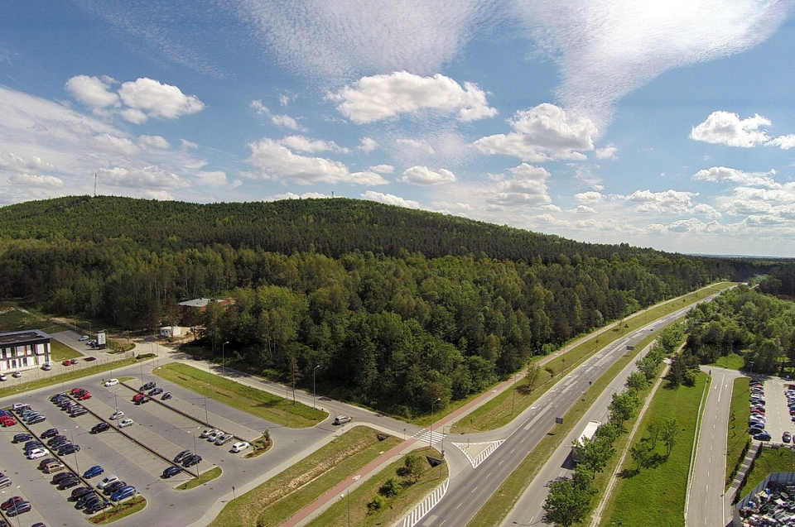
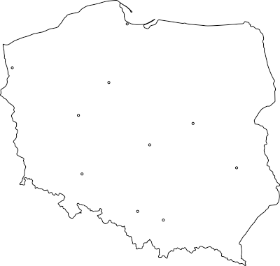
A new laboratory campus
Place of the project realization
Kielce City, foothills of the Świętokrzyskie Mountains
Estimated budget of the project
Ca.. 200 mln PLN
Area of the Campus:
Ca. 14 ha (investment area of the Kielce City and State Forest)

Slide 41
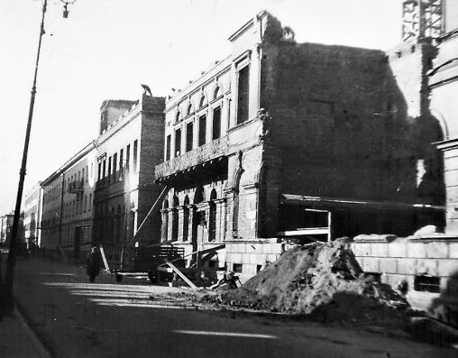
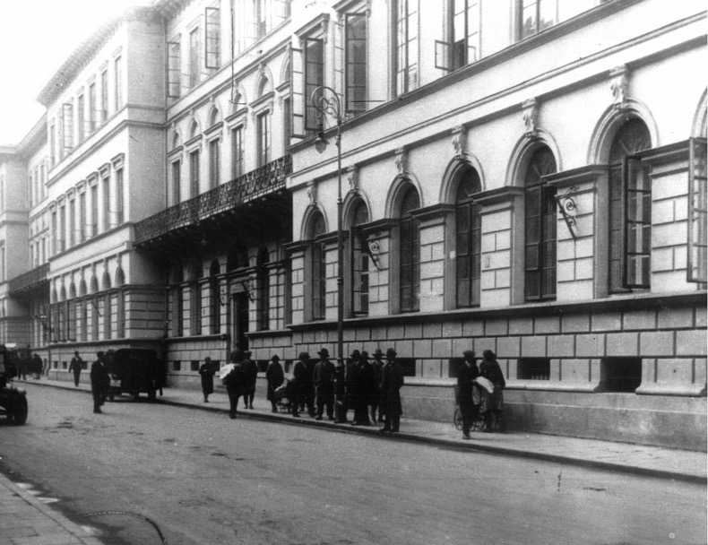
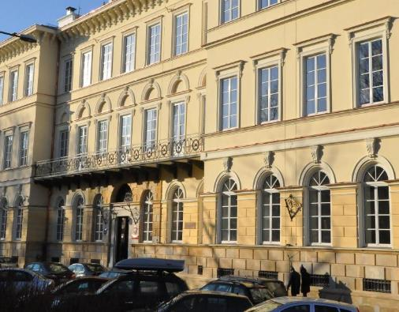
Elektoralna st. 2, 00-139 Warsaw, Poland
length@gum.gov.pl
tel.: +48 22 581 95 43
www.gum.gov.pl
Measurement Standards
Technologies
Administration of Measures

