Slide 1
Length Activities at NIS
National Institute of Standards (NIS)
Egypt
Presented by:
Dr. Osama Terra
Head of Primary Length Standard lab.
Vice Chair of AFRIMETS TCL

Slide 2
Overview
Overview about NIS
Length division at NIS
Laboratories capabilities
- Primary Length standard and laser technology
- End and line standard
- Engineering and Surface Metrology
Research and publications
Comparisons and CMCs

Slide 3
NIS Mission
Establish, maintain and disseminate the SI units
Provide calibration, training and consulting services.
Research and develop new and improved measurement procedures

Slide 4
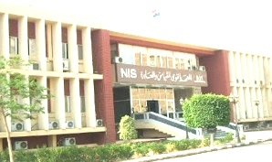
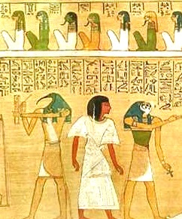
NIS Timeline
NIS moved to recent premises in Haram, Giza
Egypt signed
The meter convention
Metrology begins
in Egypt.
The Royal
Egyptian Cubit
1992
1962
2000
2700BC
1963
NIS Signed
CIPM MRA
NIS is
Founded

Slide 5
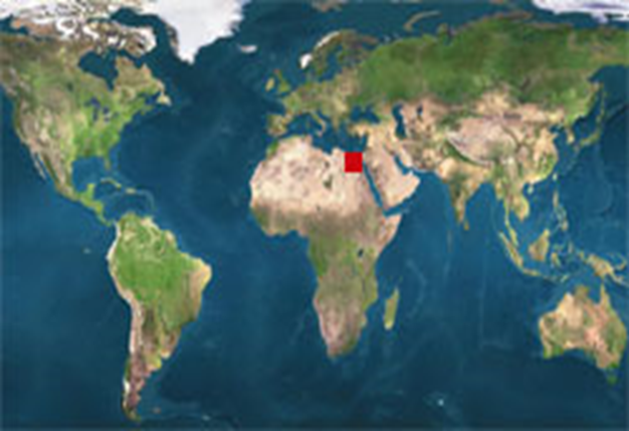
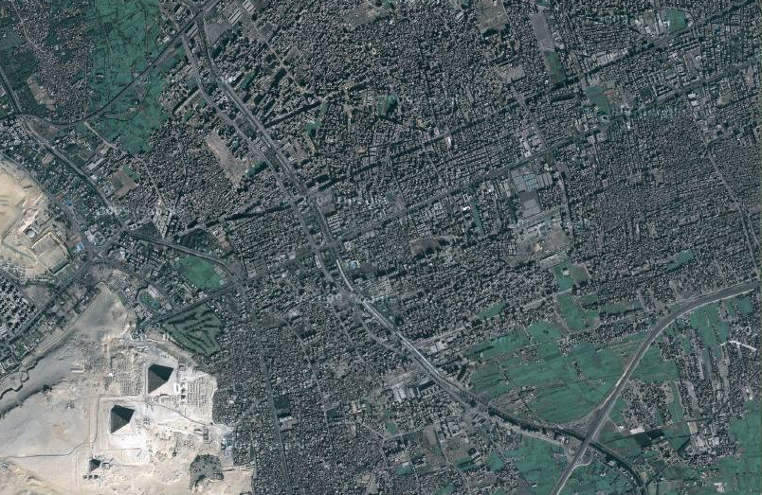
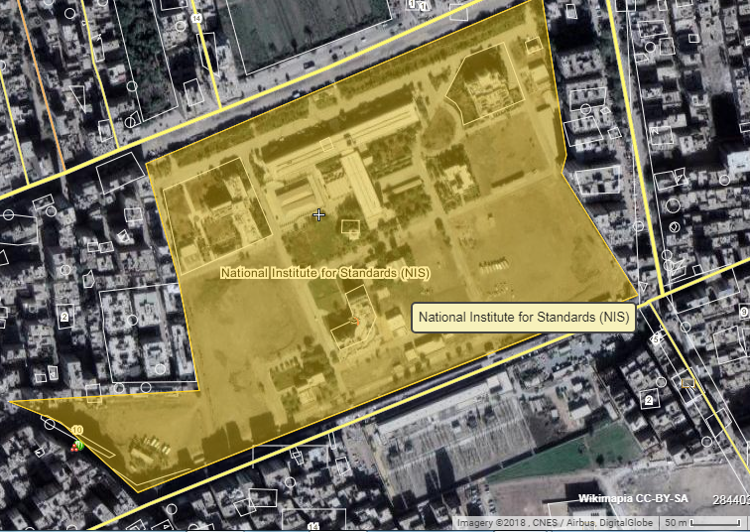
NIS Location
3 km
NIS area ~ 150,000 m²

Slide 6
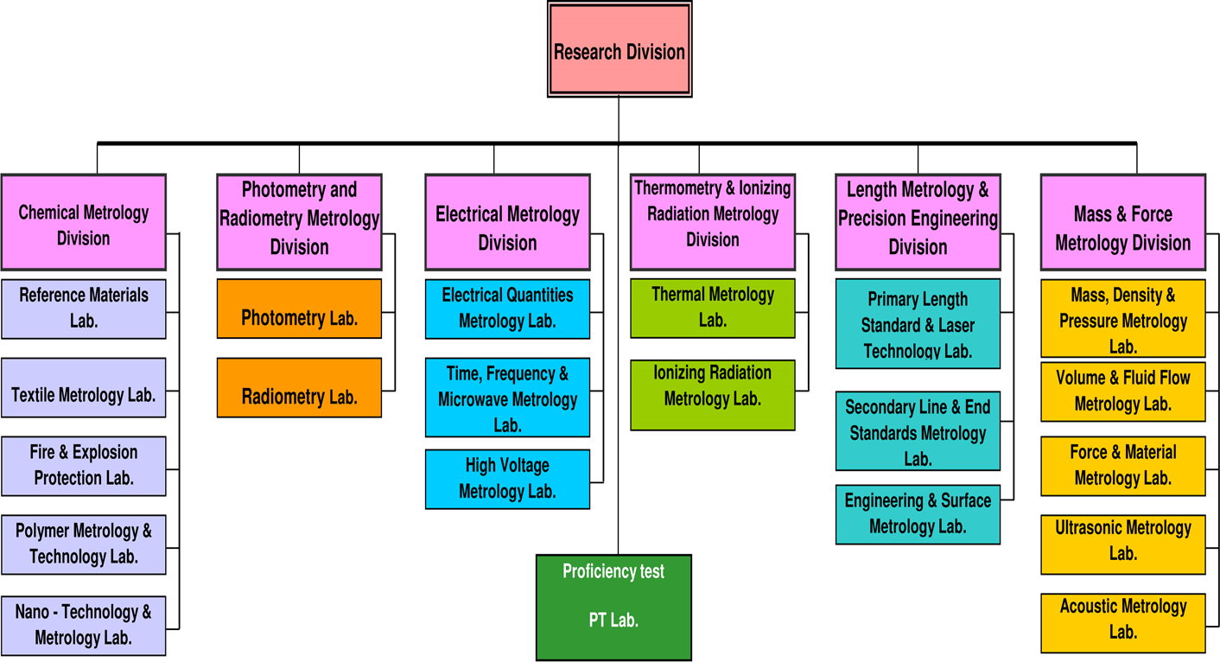
NIS Structure
NIS has 21 laboratories (in 6 divisions ). NIS Head: Prof. Dr. Mohamed A. Amer
Notes:
Each division related to quantity
Electrical ampere and second

Slide 7
NIS published CMCs
NIS has published 39 CMCs in different metrology areas such as:
1- Length
2- Mass
3- Pressure
4- Time and Frequency
5- DC Current, resistance, voltage and capacitance
6- Viscosity
7- Force
8- Torque
9- Chemistry
10- Ionizing radiation
I expect a significant increase in the number of published CMCs in the
near future, since the current NIS top management is currently promoting the
active participation in the CIPM MRA activities.

Slide 8
Length Division

Slide 9
Length Division
Head: Prof. Dr. Hatem Hussein
(1)
(3)
(2)
Primary length Standard
and Laser technology
End and Line Standards
Engineering and Surface Metrology
GB Calibration by mech. comparison.
Roundness Measurements.
Optical and Mechanical surface Measurements.
Angle measurement.
Dimensional measurement (CMM, universal microscope, Profile projector).
Hand measurement tools calibration (caliper, Micrometer, dial gauges).
Head: Prof. Dr. Salah Ali
Optical frequency measurement.
Laser sources characterization.
Fiber optics metrology.
Laser Doppler velocimeter calibration
EDM calibration
GPS receivers calibration.
Head: Dr. Osama Terra
GB Calibration by Interferometry.
Line Standards Calibration.
Polarimetric measurement.
Head: Dr. Niveen Fareed
Division staff
10 researchers (PhD holder)
10 assistant researchers (MSc, BSc)
4 technicians

Slide 10
(First Laboratory)
Primary Length Standard
& laser technology Lab.

Slide 11
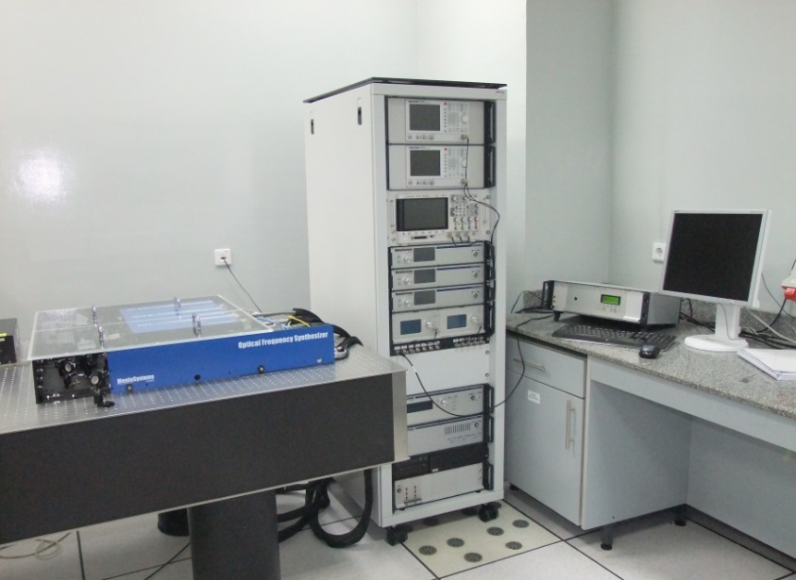
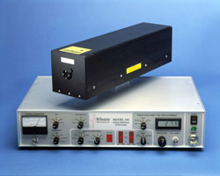
Primary Length Standard & Laser Technology (Laboratory 1)
1.1 - Optical Frequency Measurement
Iodine stabilized He-Ne Lasers
Stability 2.5 x 10⁻¹¹
Femtosecond frequency comb
Wavelengths: 500 nm – 2100 nm
Stability 2 x 10⁻¹²

Slide 12
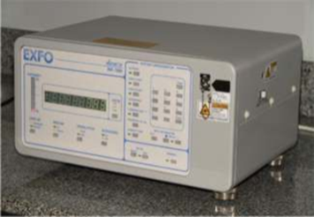
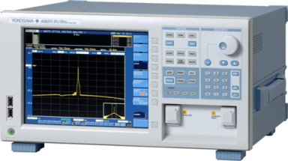
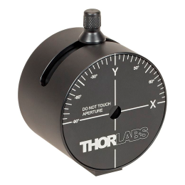
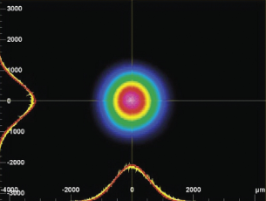
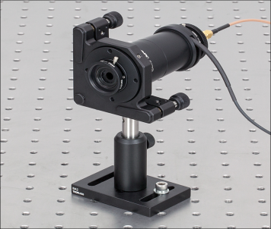
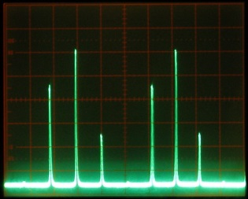
Primary Length Standard &
Laser Technology (Laboratory 1)
1.2 - Laser Sources Characterization
1- Wavelength Measurement
Wavelength range: 400 to 1700nm
Uncertainty: ±0.3 pm
2- Spectrum Analysis
Wavelength range: 600 to 1700nm
Wavelength accuracy: ±0.02 nm
3- Spatial modes characterization (beam width)
4- Longitudinal modes characterization

Slide 13
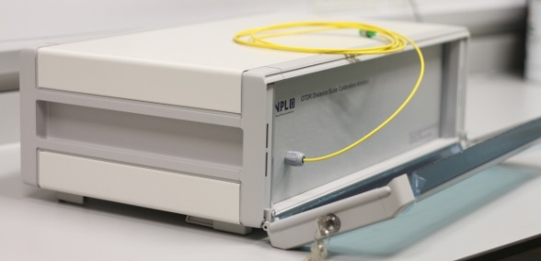
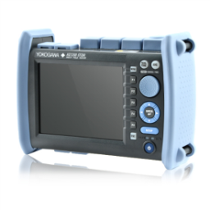
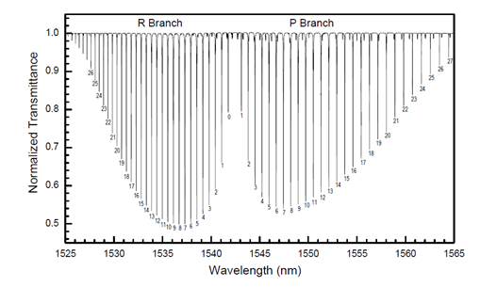
Primary Length Standard &
Laser Technology (Laboratory 1)
1.3 – Optical fiber Metrology
1- OTDR calibration
Range: 1- 50 km
Uncertainty: ± 30 cm
Using Recirculating loop artifact
2- Optical spectrum analyzer calibration
Using H¹³C¹⁴N absorption spectrum
range 1540 -1560 nm
Uncertainty: ± 0.6 pm
3- DWDM laser characterization
range 800 -1700 nm
Accuracy: ± 0.02 nm

Slide 14
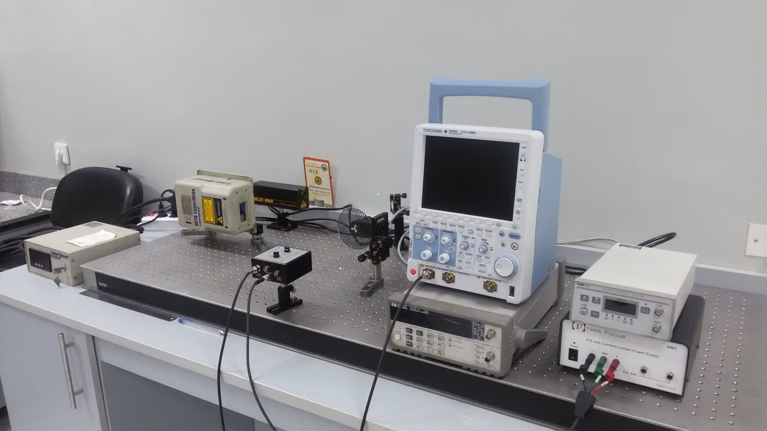
Primary Length Standard &
Laser Technology (Laboratory 1)
1.4 – Calibration of Laser Doppler Velocimeters (LDV)

Slide 15
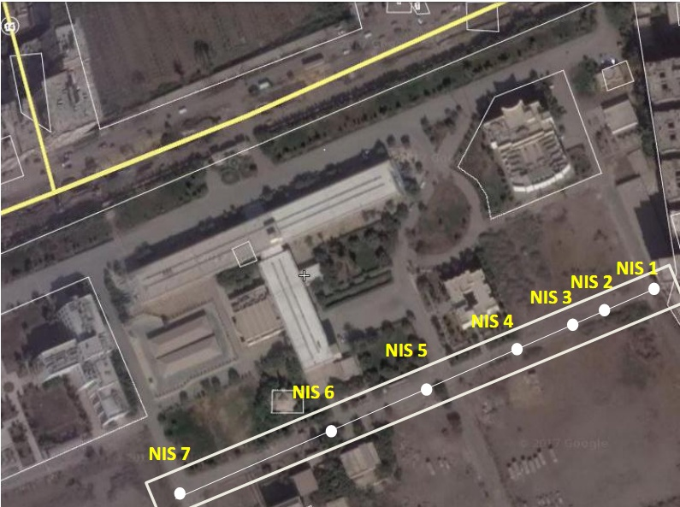
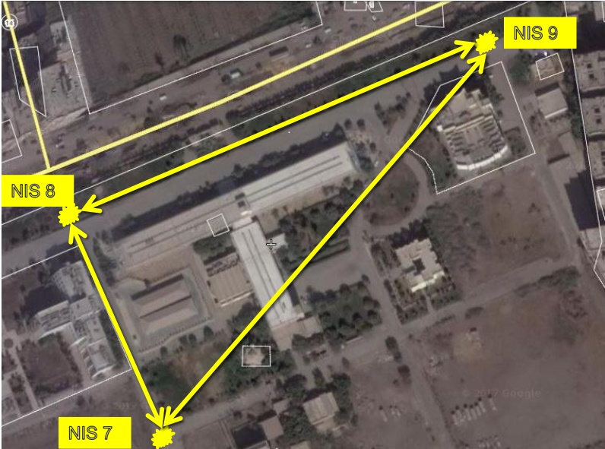
Primary Length Standard &
Laser Technology (Laboratory 1)
1.5 – Calibration of large scale measuring equipment
EDMs instruments
GNSS receivers
300 m
300 m
According to (ISO 17123-4:2012)
According to ISO 17123-8:2015
Notes:
Master and PhD thesis

Slide 16
(Second Laboratory)
End and line standard

Slide 17
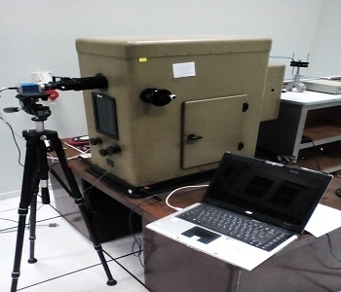
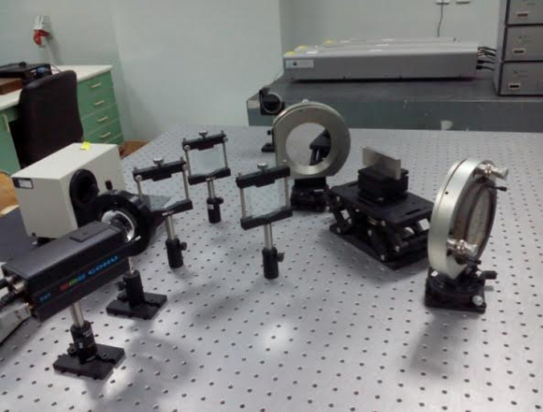
End and line standard (Laboratory 2)
2.1 –Gauge block calibration by Interferometry
1-Köster Interferometer
Range: 0.5 – 100 mm
Uncertainty: ±20-70 nm
2- Double-Sided calibration
(Project with NMISA, South Africa )
Range: 0.5 - 100 mm
Uncertainty: ±60 nm

Slide 18
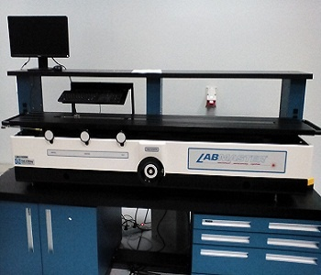
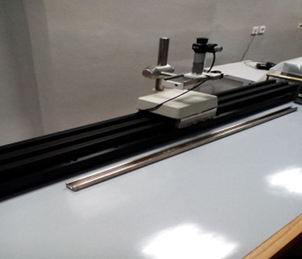
End and line standard (Laboratory 2)
2.2 – Long-gauge block calibration
Lab Master
Range: up to 1 m
Uncertainty: ± 0.5 µm
2.3 – Line scale measurement
Displacement interferometer
Range: 1.2 m
Uncertainty: ± 2 µm
Notes:
Uncertainty of lab master, displacement interferometer

Slide 19
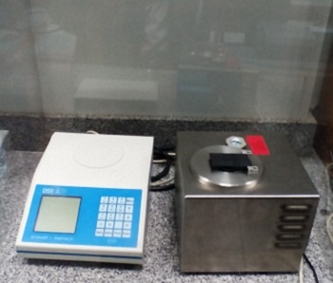
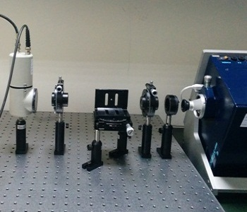
End and line standard (Laboratory 2)
2.3 – Refractometry and Polarimetry
-Calibration of auto-refractometers
Range: 1.3 – 1.7
Calibration of polarimeters and Quartz plates

Slide 20
(Third Laboratory)
Engineering and Surface Metrology

Slide 21
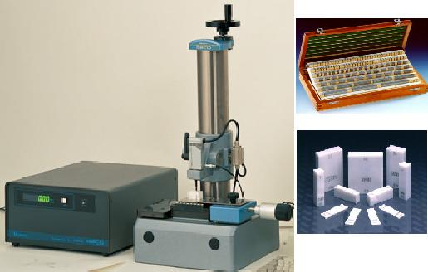
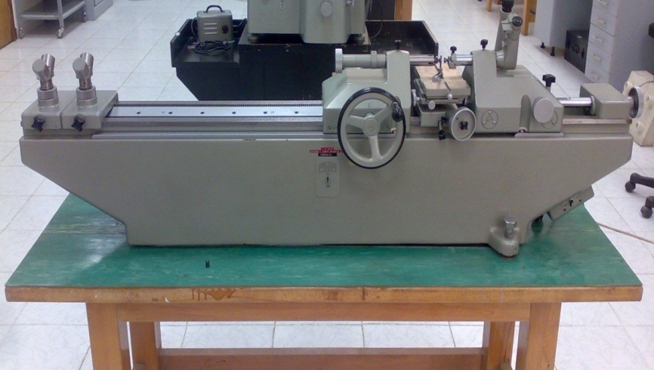
Engineering and Surface Metrology (Laboratory 3)
3.1 – Gauge- Block calibration by comparison
Electromechanical Comparator
Range : 250 mm
Uncertainty: ±80nm
Gauge block set
(122 piece , Ceramic, steel , Tungsten carbide)
inch, meter).
Range: 0-100 mm (0-4 inch) Accuracy: grade k
3.2 – Diameter standard calibration
-Universal Length measuring machine
- Reference setting rings
Range : 1 m
Uncertainty < ±1 µm
Notes:
GB uncertainty
How many accredited labs in hand tools

Slide 22
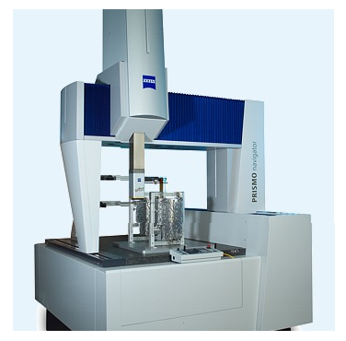
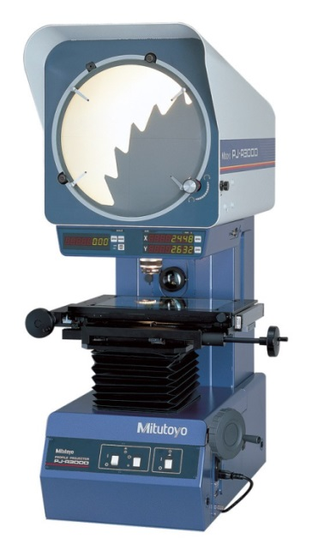
Engineering and Surface Metrology (Laboratory 3)
3.3 – Dimensional Metrology
1- CMM (3D)
Regular and irregular form
Range : 700x900x500 mm.
Uncertainty: ±2 um.
2- Profile projector (2D)
Range : 100 x 200 mm.
uncertainty: ±5 um.
Notes:
You don’t need to mention accurac
Model enough

Slide 23
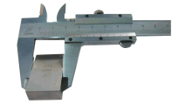
Engineering and Surface Metrology (Laboratory 3)
3.4 –Machine tools metrology
- Laser displacement interferometer Calibration of CMM, CNC and universal microscope
Range 40 m: .
uncertainty: ±1 ppm.
3.5 – Hand Instruments calibration (caliper, Micrometer, dial gauges).
Steel Gauge blocks set ( Range: 0-1000 mm, accuracy: Grade:1)

Slide 24
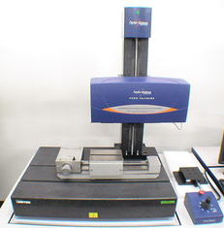
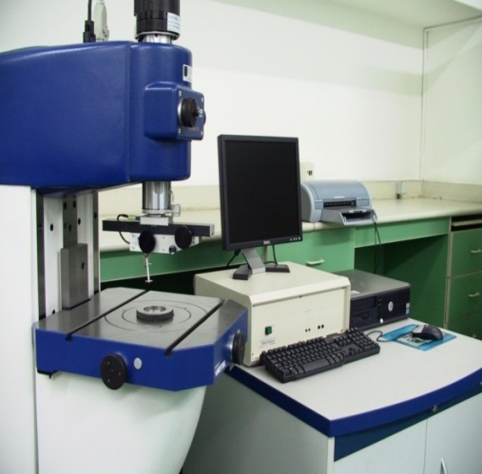
Engineering and Surface Metrology (Laboratory 3)
3.6 –Mechanical form measurements
1- Stylus (Talysurf i120)
Range: H: 60 mm V: 1mm
uncertainty: ± 60 nm.
2- Roundnes measurement
(Taylor and Hobson Talyrond 73)

Slide 25
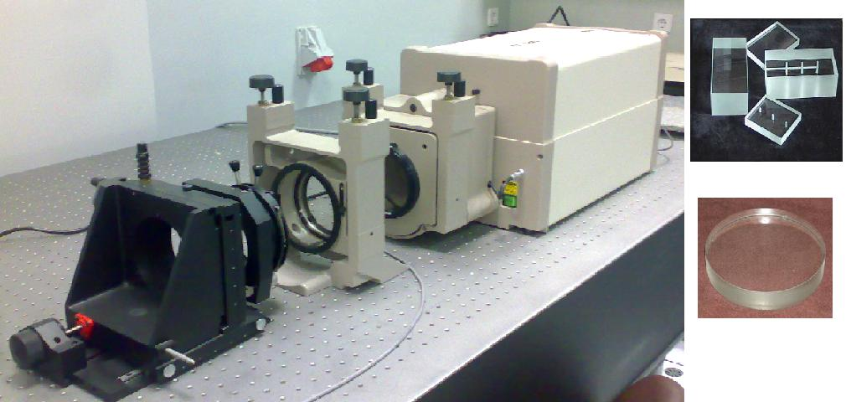
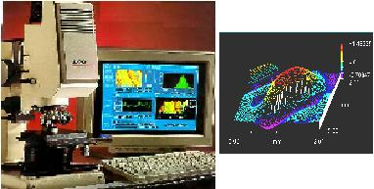
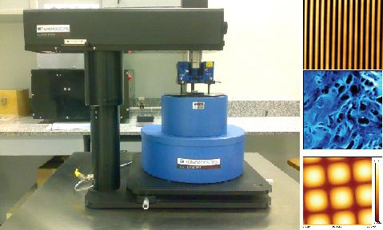
Engineering and Surface Metrology (Laboratory 3)
3.7 – Surface measurement
Large object Interferometers (Zygo GPIXP)
-used in: Flatness, parallelism , and radius of
Curvature & aberration (for lenses)
Range: (H: 100 mm, V: 100 um)
Uncertainty: V: ±2 nm
Interference Microscope (Zygo Maxim GP200)
- Using phase shifting and white light scanning
- Used in: Surface texture and Thin film analysis
Range: (H: 3×2 mm , V: 100 um) .
Uncertainty: (H: ±2 µm, V: ± 1 nm )
Atomic Force Microscope (Thermomicroscope Ap100)
- Used in: Nanometrology, research
(scanner1) Range: (H: 100 µm, V: 8 um) .
Resolution: (H: 0.25 A, V: 0.025 A )
(scanner2) Range: (H: 5 µm, V:2.5 µm)
Resolution: (H: 0.013 A, V: 0.009A)

Slide 26
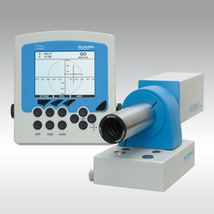
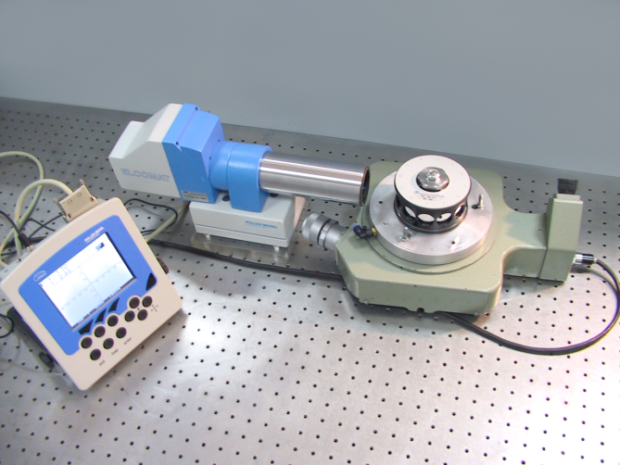
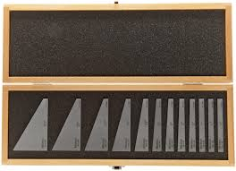
Engineering and Surface Metrology (Laboratory 3)
3.8 – Angle measurements
1- Autocollimator (2)
Measurement range: ±1000 arcsec.
Uncertainty: ± 0.05 arcsec.
2- Indexing table
Range: 360^{O}
Uncertainty: ± 0.5 arcsecond.
3- Reference angle gauge blocks (12 steel pieces)
Range: 2 - 90^{O}
Uncertainty: ± 2 sec.

Slide 27
Highlights on the Research Activities
Length division at NIS has published more than
60 publications in journals indexed in SCOPUS
during the period from 2010 to 2018.

Slide 28
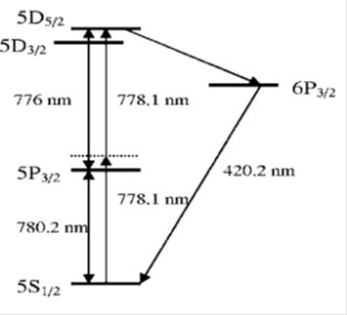
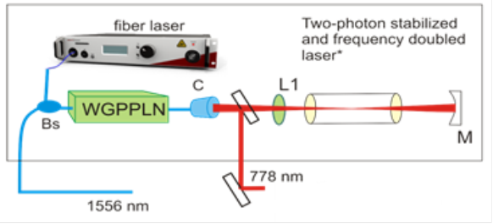
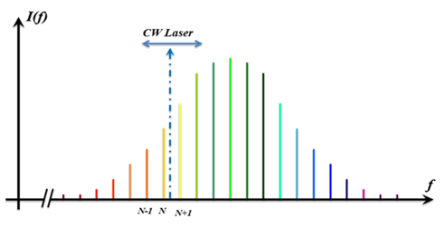
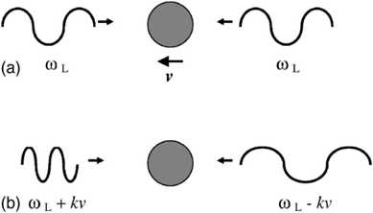
Title: An ultra-stable optical frequency standard for telecommunication purposes based upon the 5S_{1/2} → 5D_{5/2} two-photon transition in Rubidium
Authors: Osama Terra, Hatem Hussein
Journal: Applied Physics B (2016)
Femtosecond frequency
comb

Slide 29
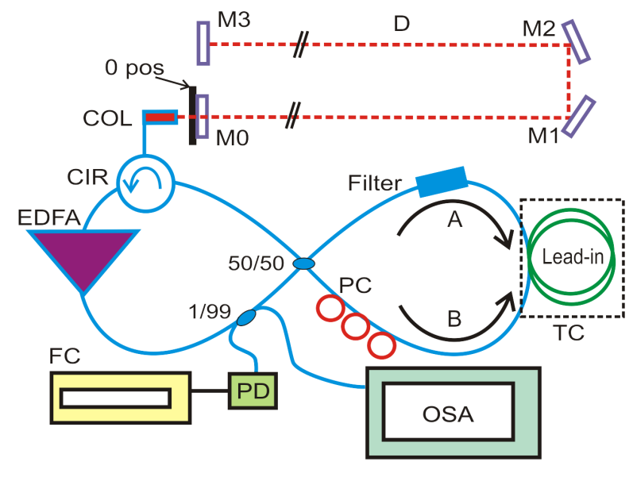
Title: LASER RANGING IN AIR UTILIZING MODE-LOCKING IN LASER CAVITIES
Authors: Osama Terra
Journal: IEEE photonics technology letters (2017)
$$D=\left(c/{{ n}_{air}}(\frac{1}{f_{2}}−\frac{1}{f_{1}})\right)$$

Slide 30
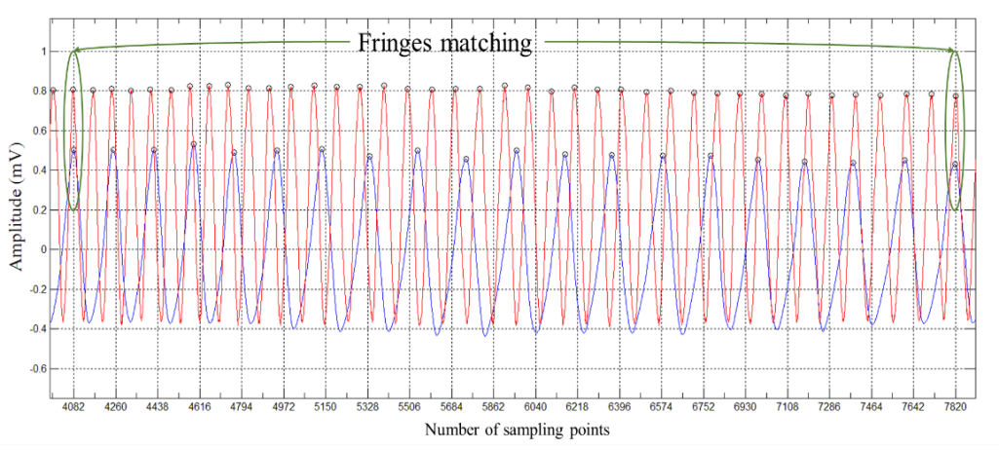
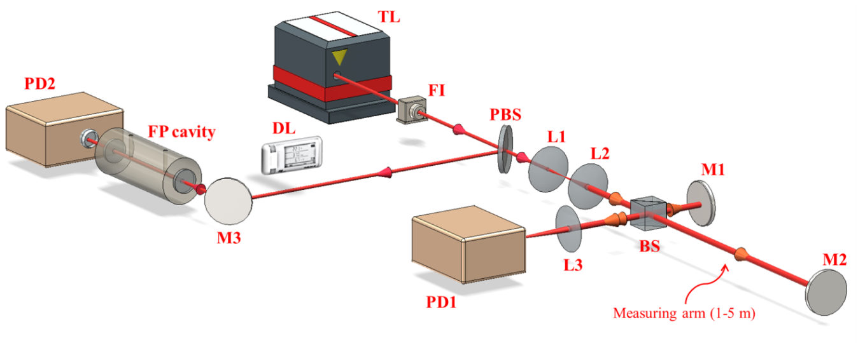
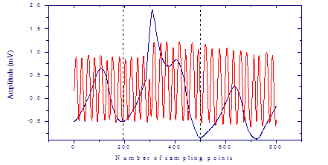
Title: Distance measurement using frequency scanning interferometry with mode-hoped laser
Authors: M. Medhat, M. Sobee, H. M. Hussein, and Osama Terra
Journal: Optics and Laser Technology (2016)
$$L=\frac{c⋅N}{2⋅n⋅FSR⋅r}$$
Notes:
Master thesis

Slide 31
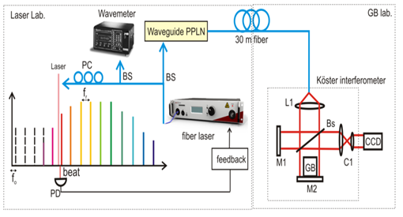
Title: Absolute gauge block calibration using ultra-precise optical frequency synthesizer locked to a femtosecond comb.
Authors: Hatem Hussein, Niveern Farid, Osama Terra
Journal: Applied Optics (2015)
Multiwavelength GB length measurement equation
$$L=λ_{i}/2\left(N_{i}+Δn_{i}\right)$$

Slide 32
CMCs and Comparisons

Slide 33
Published CMCs in Length

Slide 34
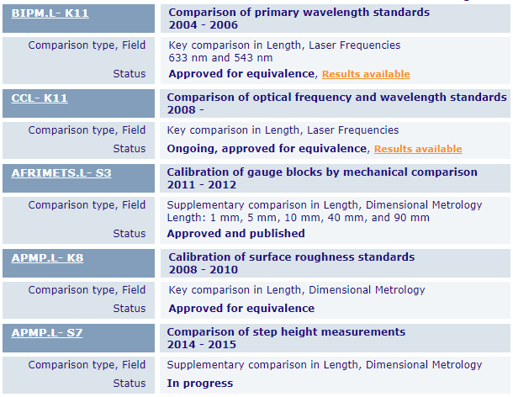
International Comparisons (1)
CCL

Slide 35
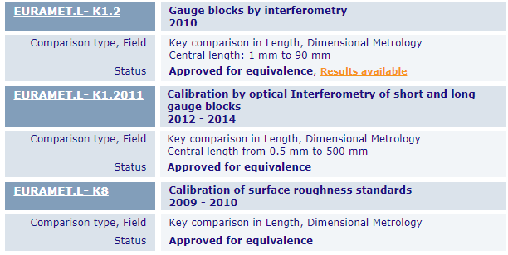
International Comparisons (2)
CCL

Slide 36
International Comparisons (3)
CCPR

Slide 37
BIPM.L-K11 (Laser radiation)

Slide 38
COOMET.PR-S8 (Wavelength for fiber optics)

Slide 39
APMP-K8 (Surface roughness)

Slide 40
AFRIMETS.L-S3 (gauge block by mechanical comparison)

Slide 41
Thank you for attention

