Slide 1


Processing of CGGTTS data
Bharath Vattikonda
NPL India
bharath.nplindia@csir.res.in
Secondee at the BIPM
Time Department
Together with the BIPM Time department
July 2025

Slide 2
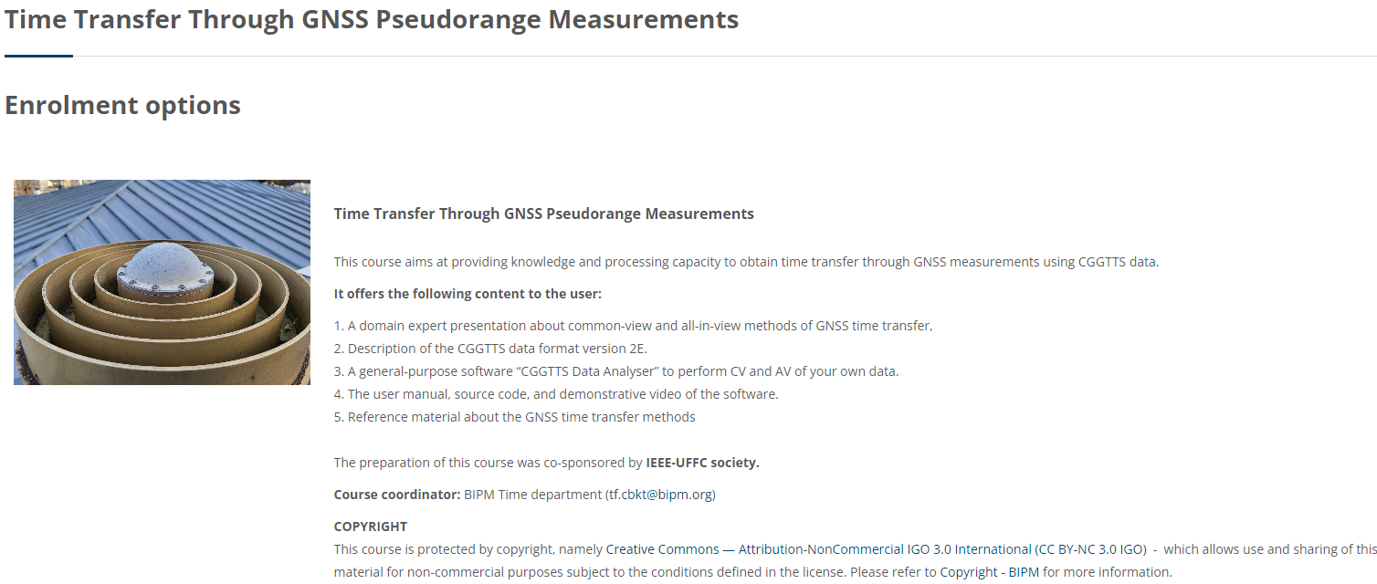
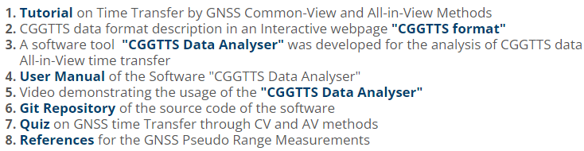
BIPM e- Learning Course: https://e-learning.bipm.org/
Filters: Course catalogue -> BIPM -> Time & Frequency
CCTF Technical Exchange
9th July 2025
Video tutorial by Dr. Pascale Defraigne, chair of the CCTF WG on GNSS Time Transfer

Slide 3
Common Generic GNSS Time Transfer Standard (CGGTTS) data format
(CGGTTS standard)
CCTF Technical Exchange
9th July 2025
A standard data format for the GNSS time transfer methods based on pseudorange measurements
Used to perform the Common–View and All-in-View time transfer methods
The observations recorded are at every 16 minutes interval as per BIPM tracking schedule
Time transfer receivers automatically generates the CGGTTS files or else you can use the “r2cggtts’’ ROB software
to convert Rinex data to CGGTTS (available from BIPM ftp with using UTC(k) lab credentials or asking ROB for a copy).
Versions: CGGTTS V1.0 (GPS),
CGGTTS V2.0 (GPS, GLONASS),
CGGTTS V2E (GPS, GLONASS, Galileo, BDS2, QZSS)
Currently one single frequency and one Iono free combination is recognized per GNSS system:
GPS: L1C/A, L1P and L3P Glonass: L1C/A, L1P and L3P
    BDS2 : B1i and L3B Galileo: E1 and L3E QZSS : L1C and L3Q
The antenna location should be known better than 3 cm accuracy (through PPP) to match the 0.1 ns numeric precision of
the format
UTC(k) labs share regularly their CGGTTS files to BIPM for the computation of UTC.

Slide 4
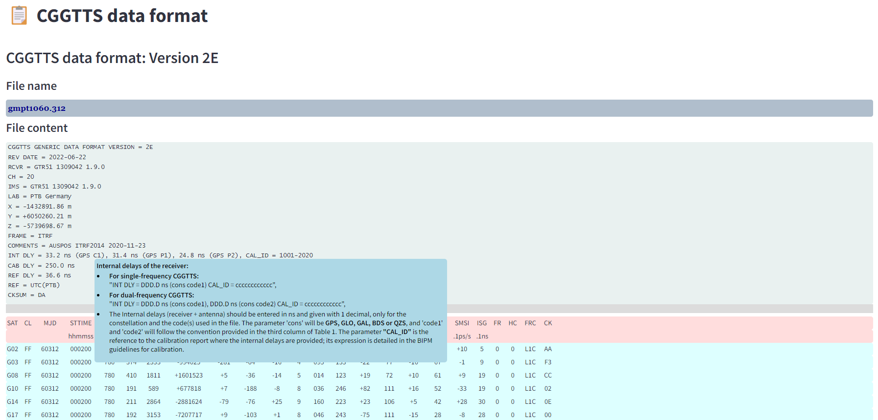
Software application: https://cbkt-time.bipm.org/
Source code : https://github.com/TheBIPM/CCTF_CBKT_software
CCTF Technical Exchange
9th July 2025
Interactive description of the data format

Slide 5
CCTF Technical Exchange
9th July 2025
https://cbkt-time.bipm.org/

Slide 6
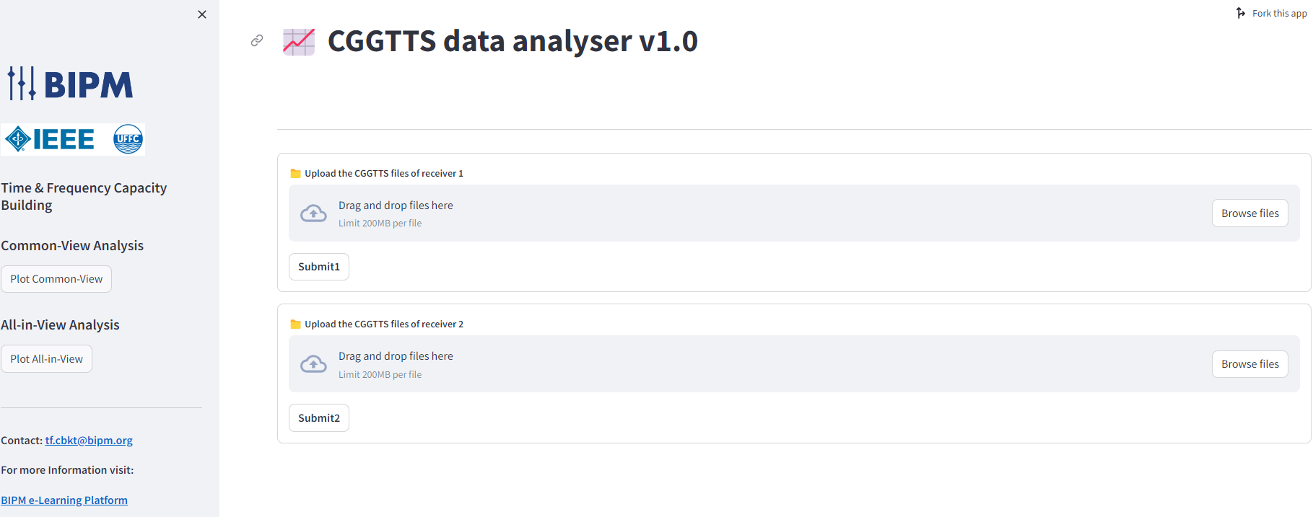
Software application: https://cbkt-time.bipm.org/
Source code : https://github.com/TheBIPM/CCTF_CBKT_software
CCTF Technical Exchange
9th July 2025

Slide 7
CGGTTS - Analyser:
Demo video : CGGTTS – Analyser: Time & Frequency BIPM CBKT - YouTube
CCTF Technical Exchange
9th July 2025
User can upload multiple CGGTTS files and investigate the details of the data
(MJD, REFSYS, frequencies, gaps or jumps in the data )
The interactive plots helps the user for detailed observations
Can perform Common-View and All-in-View time transfer between two receivers' data.
The user has option to perform the CV and AV methods by filtering the data based on
GNSS measurement code (L1P, L1C,L2P etc., )
MJD range
Satellite selection
Outlier selection (as multiples of standard deviation)
Elevation mask (0 to 90 degrees)
The user can download the CSV files of each corresponding plot, for further processing

Slide 8
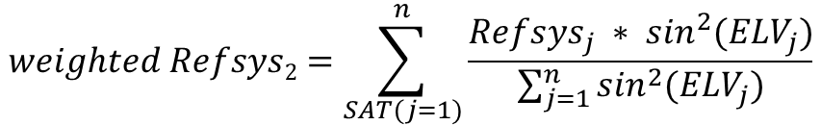
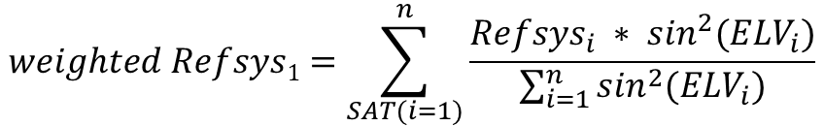
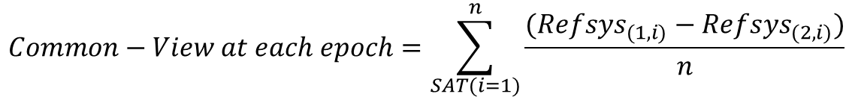
CCTF Technical Exchange
9th July 2025
Calculations
Weighted Refsys of each receiver
Sum of the weighted REFSYS values of all satellites available, with respect to their elevation angles
$$weighted Refsys1=\sum_{SAT(i=1)}^{n}{\frac{{Refsys}_{i} ∗ \sin^{2}({ELV}_{i})}{\sum_{i=1}^{n}{\sin^{2}({ELV}_{i})}}}$$
$$weighted Refsys2=\sum_{SAT(j=1)}^{n}{\frac{{Refsys}_{j} ∗ \sin^{2}({ELV}_{j})}{\sum_{j=1}^{n}{\sin^{2}({ELV}_{j})}}}$$
Common – View method
Average of difference between Refsys values at each epoch
$$Common−View at each epoch=\sum_{SAT(i=1)}^{n}{\frac{({Refsys}_{(1,i)}−{Refsys}_{(2,i)})}{n}}$$
All - in– View method
All-in-view at each epoch = $weighted Refsys1$ - $weighted Refsys2$

Slide 9
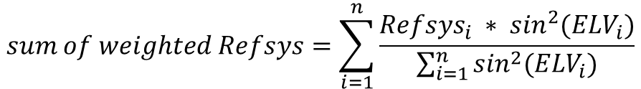
CCTF Technical Exchange
9th July 2025
Example for calculating: Performance of
Receiver clock - GNSS(time)
CGGTTS data snippet
At each epoch
SAT | MJD | STTIME | ELV | REFSYS | FRC
 |  | hhmmss | .1dg | .1ns
G10 | 60269 | 140000 | 392 | -94 | L1C
G10 | 60269 | 140000 | 392 | -86 | L1P
G10 | 60269 | 140000 | 392 | 247 | L2C
G10 | 60269 | 140000 | 392 | -69 | L2P
G10 | 60269 | 140000 | 392 | 159 | L5C
G15 | 60269 | 140000 | 351 | -25 | L1C
G15 | 60269 | 140000 | 351 | -8 | L1P
G15 | 60269 | 140000 | 351 | 308 | L2C
G15 | 60269 | 140000 | 351 | -26 | L2P
G18 | 60269 | 140000 | 697 | -17 | L1C
G18 | 60269 | 140000 | 697 | 1 | L1P
G18 | 60269 | 140000 | 697 | 339 | L2C
G18 | 60269 | 140000 | 697 | 4 | L2P
Sum of the weighted REFSYS values of all satellites available, with
respect to their elevation angles
$$sum of weighted Refsys=\sum_{i=1}^{n}{\frac{{Refsys}_{i} ∗ \sin^{2}({ELV}_{i})}{\sum_{i=1}^{n}{\sin^{2}({ELV}_{i})}}}$$
$$sum of weighted Refsys=\frac{−8.6∗ \sin^{2}\left(39.2\right)−0.8∗ \sin^{2}\left(35.1\right)+0.1∗ \sin^{2}(69.7)}{\sin^{2}\left(39.2\right)+\sin^{2}\left(35.1\right)+\sin^{2}\left(69.7\right)}$$
= -2.24 ns

Slide 10
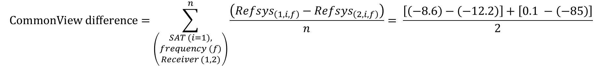
CCTF Technical Exchange
9th July 2025
Example for calculation: Common-view Performance at each epoch
GPS Receiver 1 data
(CGGTTS V2E)
GPS Receiver 2 data
(CGGTTS V2)
SAT | MJD | STTIME | ELV | REFSYS | FRC
 |  | hhmmss | .1dg | .1ns
G10 | 60269 | 1400 | 392 | -94 | L1C
G10 | 60269 | 1400 | 392 | -86 | L1P
G10 | 60269 | 1400 | 392 | 247 | L2C
G10 | 60269 | 1400 | 392 | -69 | L2P
G10 | 60269 | 1400 | 392 | 159 | L5C
G15 | 60269 | 1400 | 351 | -25 | L1C
G15 | 60269 | 1400 | 351 | -8 | L1P
G15 | 60269 | 1400 | 351 | 308 | L2C
G15 | 60269 | 1400 | 351 | -26 | L2P
G18 | 60269 | 1400 | 697 | -17 | L1C
G18 | 60269 | 1400 | 697 | 1 | L1P
G18 | 60269 | 1400 | 697 | 339 | L2C
G18 | 60269 | 1400 | 697 | 4 | L2P
SAT | MJD | STTIME | ELV | REFSYS | FRC
 |  | hhmmss | .1dg | .1ns
8 | 60269 | 1400 | 188 | -80 | L1C
32 | 60269 | 1400 | 289 | -63 | L1C
27 | 60269 | 1400 | 595 | -47 | L1C
16 | 60269 | 1400 | 451 | -23 | L1C
23 | 60269 | 1400 | 458 | -70 | L1P
18 | 60269 | 1400 | 267 | -85 | L1P
10 | 60269 | 1400 | 835 | -122 | L1P
26 | 60269 | 1400 | 291 | -40 | L1P
8 | 60269 | 1400 | 188 | -104 | L2P
32 | 60269 | 1400 | 289 | -88 | L2P
27 | 60269 | 1400 | 595 | -68 | L2P
27 | 60269 | 1400 | 595 | -23 | L3P
16 | 60269 | 1400 | 451 | -4 | L3P
Choice of signal Frequency
(L1P)
Common Satellites
Refsys values for CV
(units: 0.1 ns)
$$CommonView difference=\sum_{\left(\begin{aligned}SAT (i=1), \\ frequency (f) \\ Receiver (1,2)\end{aligned}\right)}^{n}{\frac{\left({Refsys}_{\left(1,i, f\right)}−{Refsys}_{\left(2,i,f\right)}\right)}{n}= \frac{\left[\left(−8.6\right)−\left(−12.2\right)\right]+\left[0.1 −\left(−85\right)\right]}{2}}$$
= 6.1 ns

Slide 11
CCTF Technical Exchange
9th July 2025
Example for calculating: All-in-view Performance at an epoch
GPS Receiver 1 data
(CGGTTS V2E)
At each epoch
GPS Receiver 2 data
(CGGTTS V2)
SAT | MJD | STTIME | ELV | REFSYS | FRC
 |  | hhmmss | .1dg | .1ns
G10 | 60269 | 1400 | 392 | -94 | L1C
G10 | 60269 | 1400 | 392 | -86 | L1P
G10 | 60269 | 1400 | 392 | 247 | L2C
G10 | 60269 | 1400 | 392 | -69 | L2P
G10 | 60269 | 1400 | 392 | 159 | L5C
G15 | 60269 | 1400 | 351 | -25 | L1C
G15 | 60269 | 1400 | 351 | -8 | L1P
G15 | 60269 | 1400 | 351 | 308 | L2C
G15 | 60269 | 1400 | 351 | -26 | L2P
G18 | 60269 | 1400 | 697 | -17 | L1C
G18 | 60269 | 1400 | 697 | 1 | L1P
G18 | 60269 | 1400 | 697 | 339 | L2C
G18 | 60269 | 1400 | 697 | 4 | L2P
SAT | MJD | STTIME | ELV | REFSYS | FRC
 |  | hhmmss | .1dg | .1ns
8 | 60269 | 1400 | 188 | -80 | L1C
32 | 60269 | 1400 | 289 | -63 | L1C
27 | 60269 | 1400 | 595 | -47 | L1C
16 | 60269 | 1400 | 451 | -23 | L1C
23 | 60269 | 1400 | 458 | -70 | L1P
18 | 60269 | 1400 | 267 | -85 | L1P
10 | 60269 | 1400 | 835 | -122 | L1P
26 | 60269 | 1400 | 291 | -40 | L1P
8 | 60269 | 1400 | 188 | -104 | L2P
32 | 60269 | 1400 | 289 | -88 | L2P
27 | 60269 | 1400 | 595 | -68 | L2P
27 | 60269 | 1400 | 595 | -23 | L3P
16 | 60269 | 1400 | 451 | -4 | L3P
Choice of signal Frequency
(L1P)
Elevation Angle
(unit 0.1 degrees)
All available Satellites
Refsys values for AV
(units: 0.1 ns)
$sum of weighted Refsys for receiver 1=\frac{−8.6 ∗ \sin^{2}\left(39.2\right)−0.8 ∗ \sin^{2}\left(35.1\right)+0.1 ∗ \sin^{2}\left(69.7\right)}{\sin^{2}\left(39.2\right)+\sin^{2}\left(35.1\right)+\sin^{2}\left(69.7\right)}$ = -2.24 ns
$sum of weighted Refsys for receiver 2=\frac{−7.0 ∗ \sin^{2}\left(45.8\right)−8.5 ∗ \sin^{2}\left(26.7\right)−12.2 ∗ \sin^{2}\left(83.5\right)−4.0 ∗ \sin^{2}\left(29.1\right)}{\sin^{2}\left(45.8\right)+\sin^{2}\left(26.7\right)+\sin^{2}\left(83.5\right)+\sin^{2}\left(29.1\right)}$ = -9.43 ns
All-in-view performance = (-2.24) – (-9.43) = 7.19 ns

Slide 12
CCTF Technical Exchange
9th July 2025
Features
User can upload multiple CGGTTS files and investigate the details of the data
(MJD, Refsys, frequencies, gaps or jumps in the data )
The interactive plots helps the user to select their choice of frequency and
MJD range of the files for detailed observations
To perform the common view and all in view time transfer, two sets of CGGTTS files
need to be uploaded by the user
The user can also select choice of satellites instead of default ALL option, set elevation mask and outlier filter to evaluate the performance of the CV and AV.
The user can also download the CSV files of each corresponding plots

Slide 13
CCTF Technical Exchange
9th July 2025
CGGTTS – Analyser:
Overview of the Course on e-learning
https://e-learning.bipm.org/
Live Demo
https://cbkt-time.bipm.org/

Slide 14
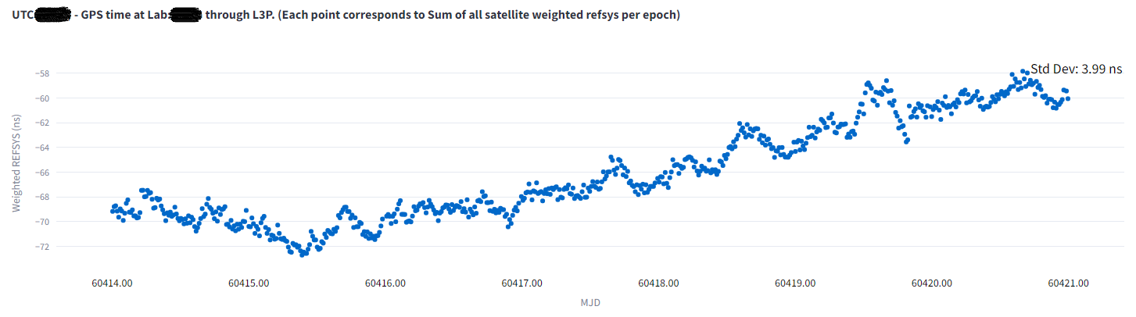
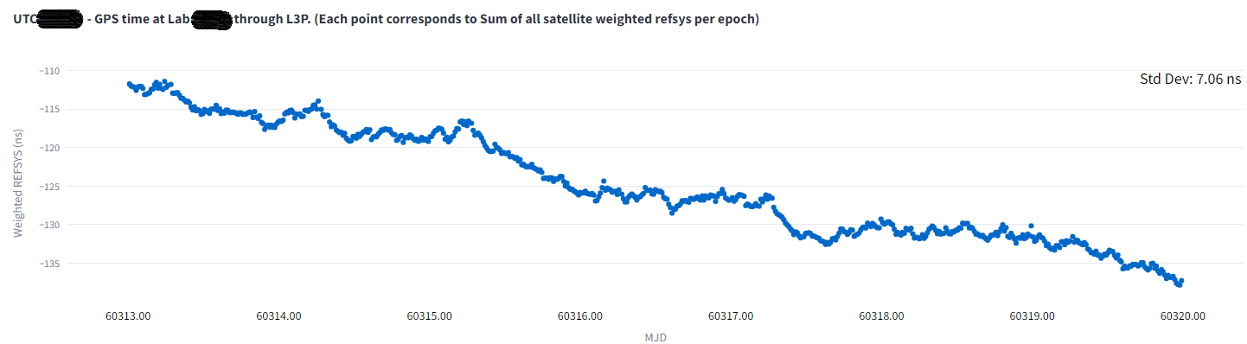
CCTF Technical Exchange
9th July 2025
Use case Example: Drift in UTC(k)
Linear drift
Linear drift

Slide 15
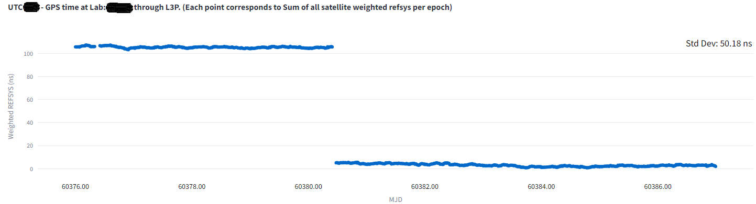
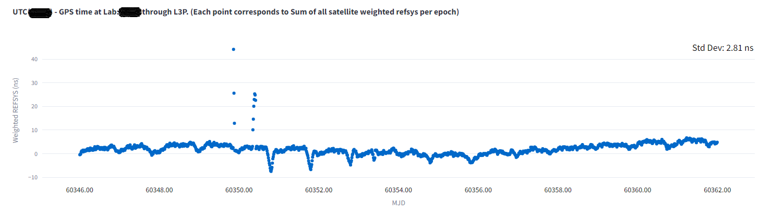
CCTF Technical Exchange
9th July 2025
Use case Example: Jump & Outliers
Jump due to Rx calibration/change in lab setup
Outliers

Slide 16
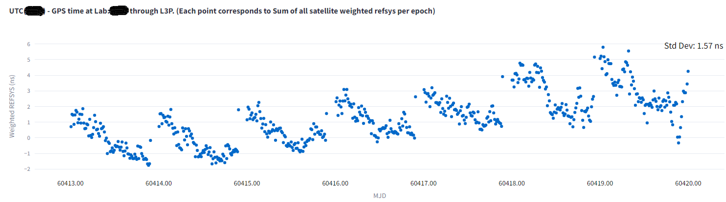
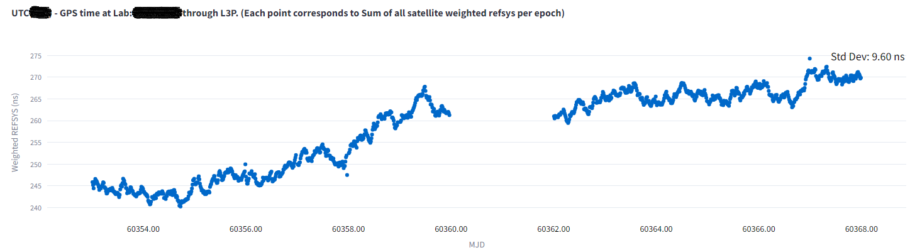
CCTF Technical Exchange
9th July 2025
Use case Example: Phase jumps and Gaps
Phase corrections(steering) applied to UTC(k)
Gaps In data

Slide 17
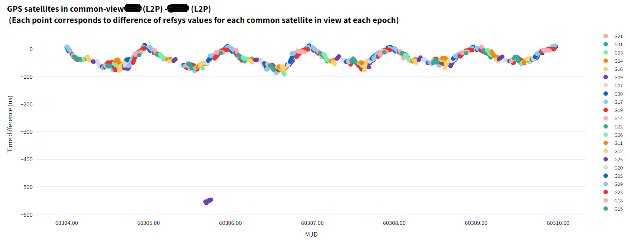
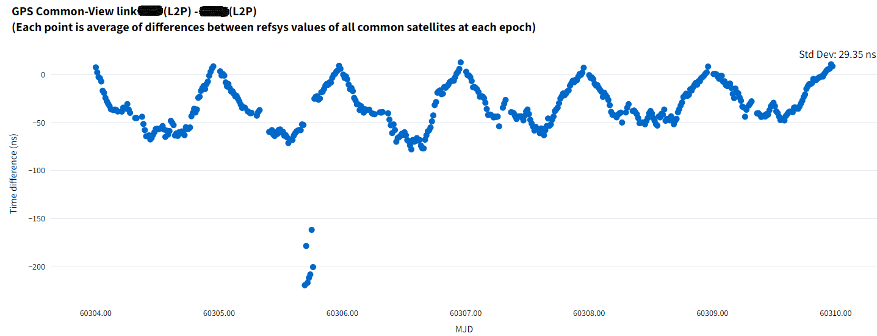
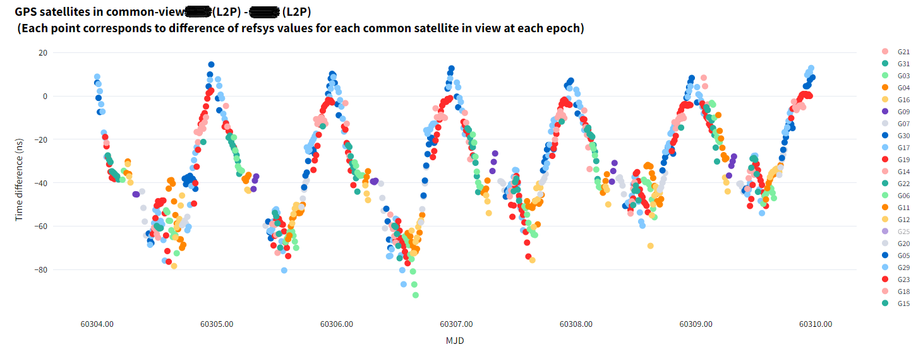
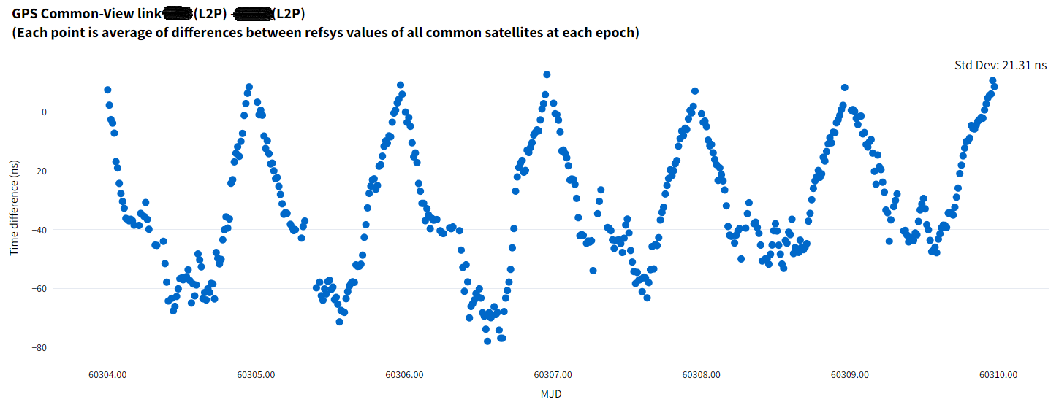
CCTF Technical Exchange
9th July 2025
Use case Example: Outlier due to one satellite
Sat ID: G25

Slide 18
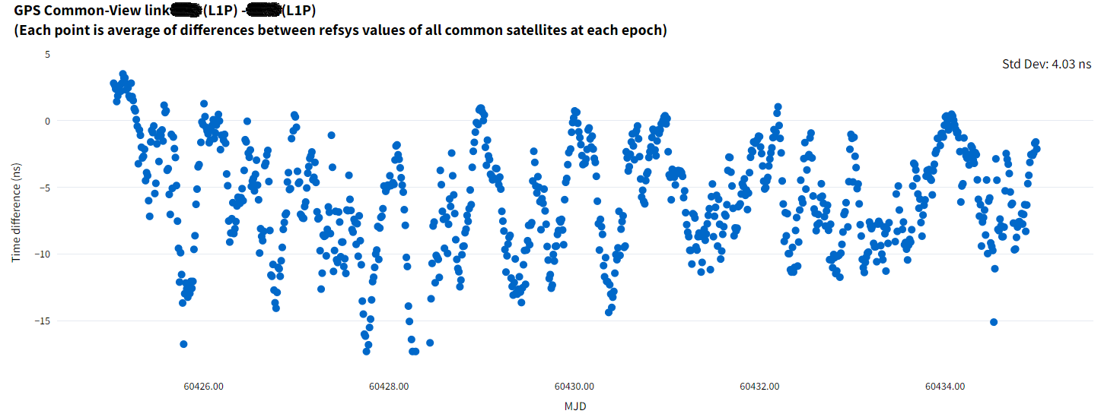
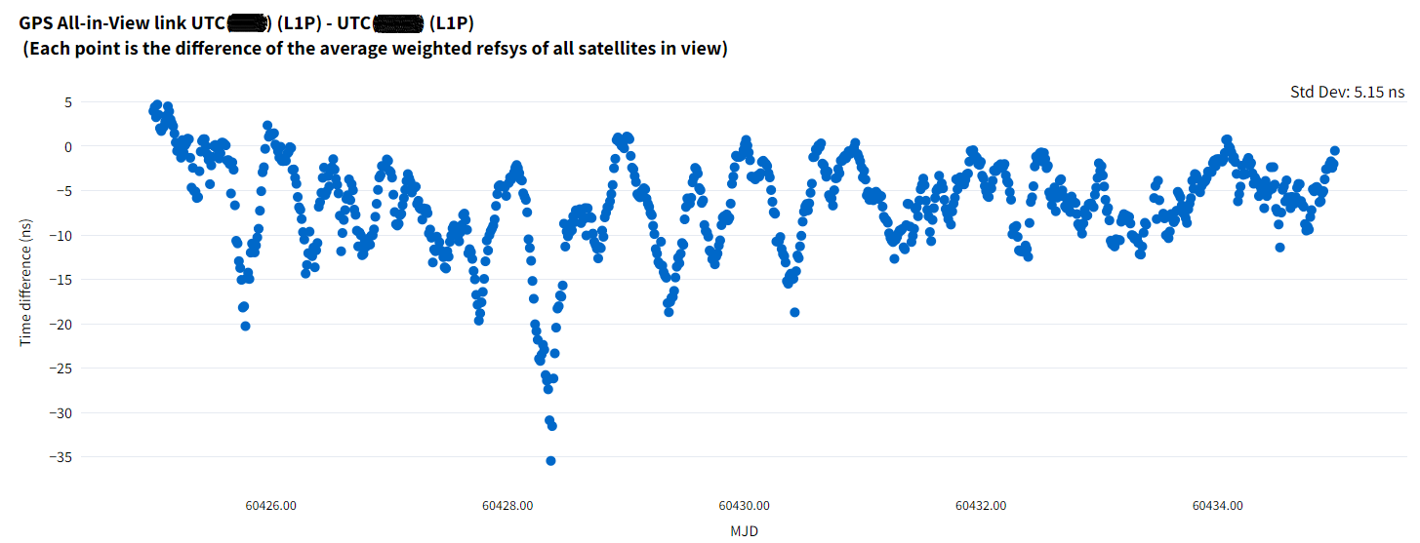
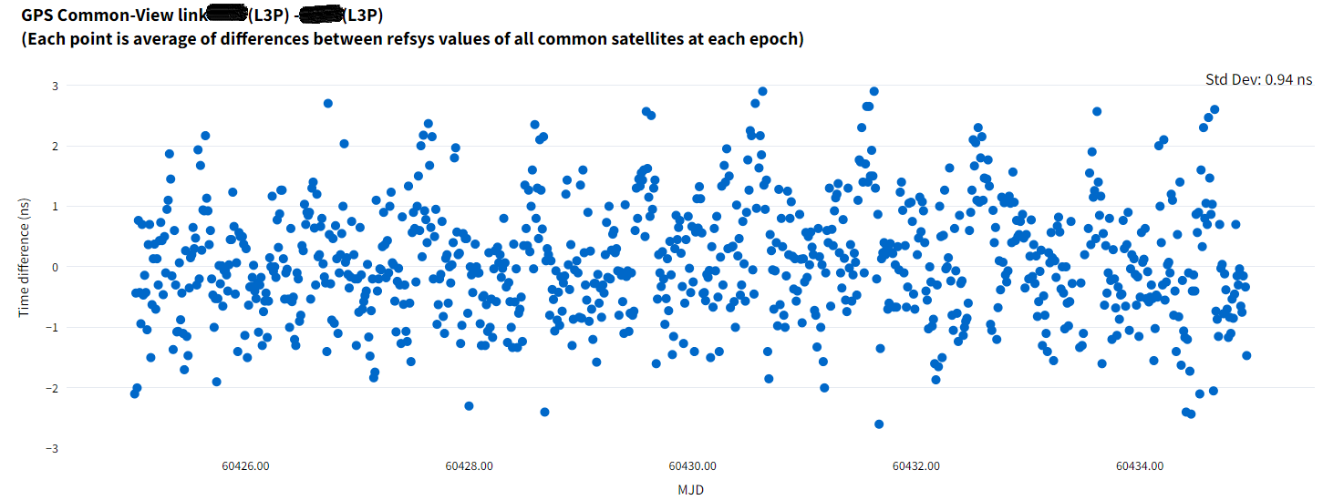
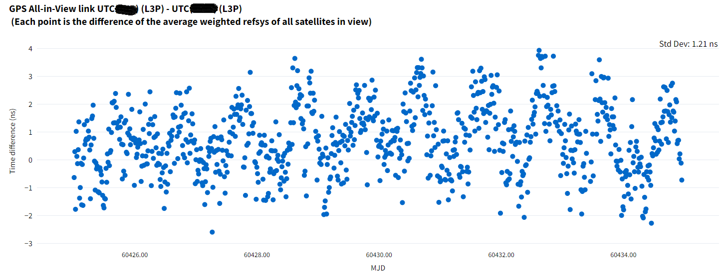
CCTF Technical Exchange
9th July 2025
Use case Example: CV with different frequencies
Single frequency (L1P)
Iono free combination (L3P)

Slide 19
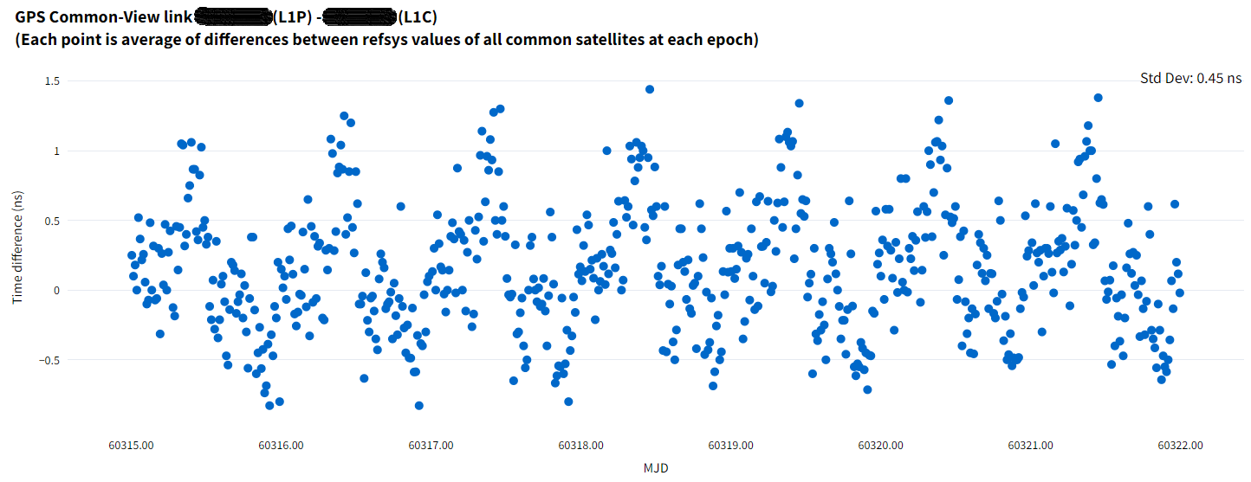
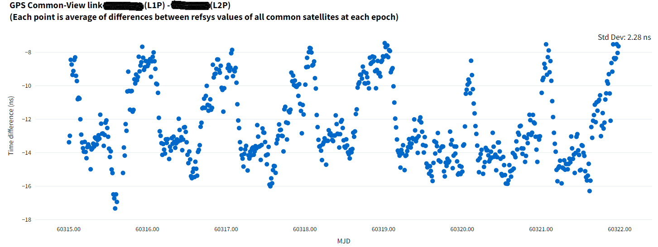
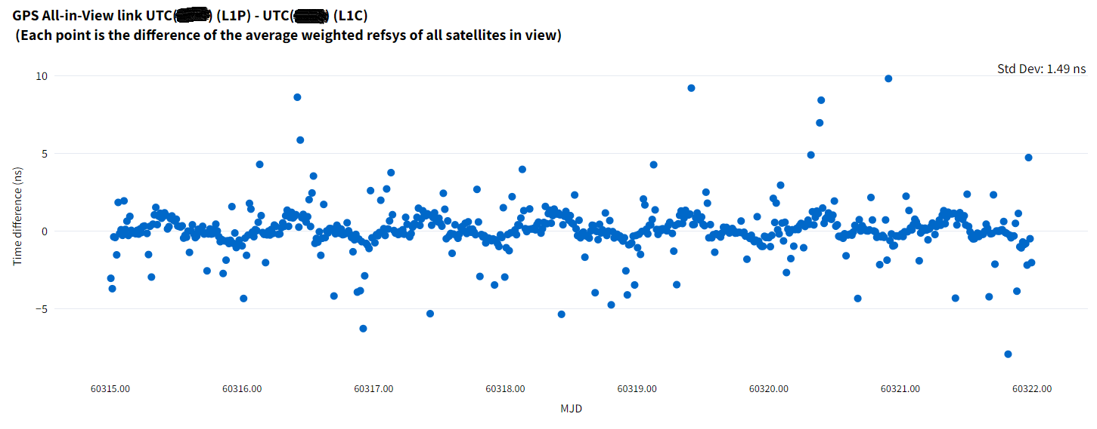
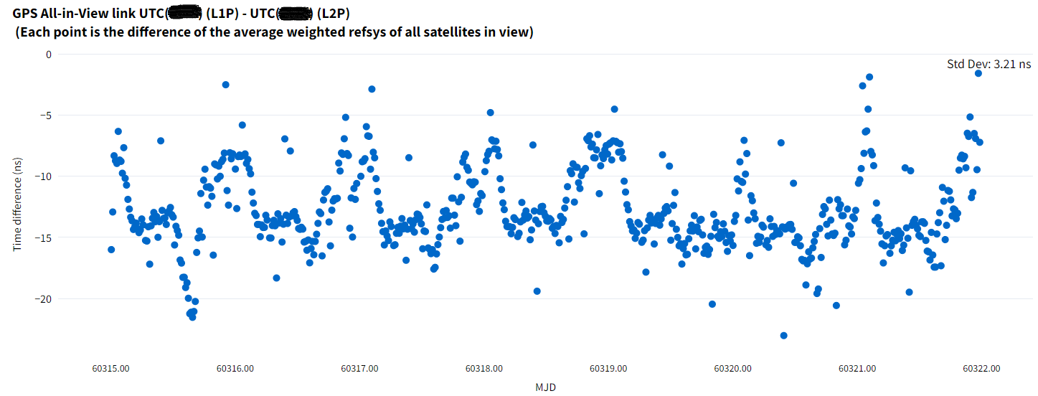
CCTF Technical Exchange
9th July 2025
Use case Example: CV & AV with Same receiver itself (atmospheric effects)
Common-View [Same Frequency : Multipath effects]
Common –View [different Frequencies : Iono effect]
All-in-View [Same Frequency : Multipath effects]
All-in-View [different Frequencies : Iono effect ]

Slide 20
CCTF Technical Exchange
9th July 2025
Use cases of CGGTTS Analyser and execution steps (1)
Monitor the Performance of the UTC(k)
a. Jump in Time Scale: Jump in weighted Refsys data w.r.t all the constellations at that point of time
b. Jump in the GNSS system: No jump in weighted Refsys data w.r.t other GNSS systems at that point of time
c. Performance of UTC(k) steering : Drift correction in weighted Refsys data w.r.t all GNSS systems
d. Accuracy of UTC(k) w.r.t other UTC(k): Perform CV or AV methods w.r.t another UTC(k) (if you have access to other UTC(k) data}
e. Outliers in the time scale data: Vary the outlier filter, if it exits in all the constellations at same time its an outlier in time scale
Satellite based effect on time link
a. Effect of selected satellites on the time transfer link: Choose required Satellite’s(PRN) and perform AV and CV methods
b. Does one satellite is sufficient for time transfer ? : Select only one satellite and perform the CV and AV method
c. Effect of low altitude satellites on time transfer: Vary the Elevation angle filter and observe the CV and AV links
d. Outliers in a particular satellite data: Vary the outlier limit and select the satellite causing outliers in the link
If you have only one time transfer receiver
a. Atmospheric effects on GNSS signals: Perform CV and AV with different frequencies (Ex: L1C & L2C or L1C & L2P) of same
GNSS system of same receiver of same CGGTTS files
b. Performance of GNSS w.r.t UTC(k): Compare the weighted Refsys data for each GNSS system.
c. Multipath observation: Perform CV and AV with same frequencies (Ex: L1C & L1P)

Slide 21
CCTF Technical Exchange
9th July 2025
Use cases of CGGTTS Analyser and execution steps (1)
Effect of base line and method of time transfer : {short base line < 60 km, long base line > 1000 km}
Perform CV & AV between short and long base line stations to observe the following
a. Why AV is more suitable for long base lines
b. CV or AV which is more suitable for short base line time transfer
c. Check if Iono-free combination (L3P) is more noisy than single frequency (L1C) CV method in case of short base line
Effect of GNSS frequency on time transfer between two receiver stations:
a. Higher frequency has better performance : Perform CV/AV with L1C (1575.42 MHz) and then with L5C(1176 MHz)
b. Why Ionosphere free combination has better performance than single frequency time transfer : Perform CV/AV with
single frequency (Ex. L1C/L1P/E1/B1i) and then with Iono-free combination (Ex. L3P/L3E/L3Q/L3B) to see the difference
Receiver calibration
a. Offset in AV/CV plots of the receivers connected to common clock indicates the calibration offset between the receivers

Slide 22
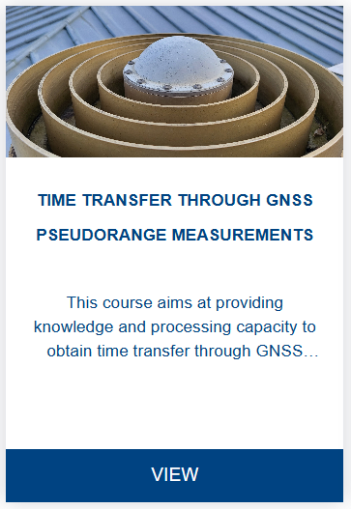
CCTF Technical Exchange
9th July 2025
Thanks for your participation
https://e-learning.bipm.org/

