Slide 1
CCTF- Technical Exchange meeting of WG TAI
28th March 2025
Clock Data Analysis and Visualization
Dr. Bharath Vattikonda
Senior Scientist
bharath.v@nplindia.res.in
(CSIR-NPLI, New Delhi)

Slide 2
CBKT Project of BIPM Time Department
CCTF- TE 28th March 2025
Application: Clock Data Checking
Development & Validation:
Yuko Hanado, Giulio Tagliaferro, Bharath Vattikonda, Tara Fontier, Patrizia Tavella
Project Sponsored by:
BIPM and IEEE - UFFC
Driven by:
Elizabeth Donley, Marina Gertsvolf and Patrizia Tavella
Copy right Disclaimer:
GNU General Public License (GNU GPL)
https://www.gnu.org/licenses/

Slide 3
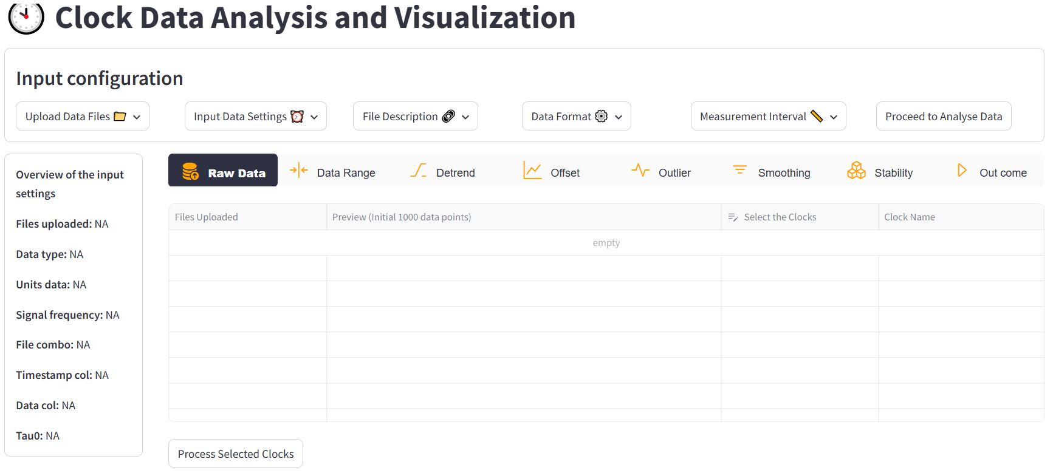
Overview of the Application: https://clock-data-analysis.streamlit.app/
CCTF- TE 28th March 2025
Clock Data Checking

Slide 4
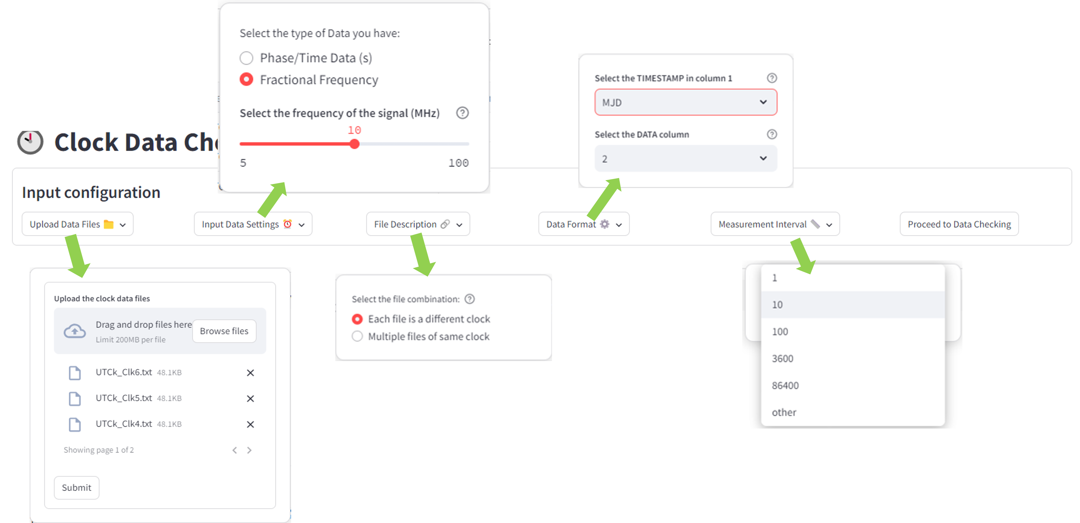
Overview of the input settings in the application
CCTF- TE 28th March 2025

Slide 5
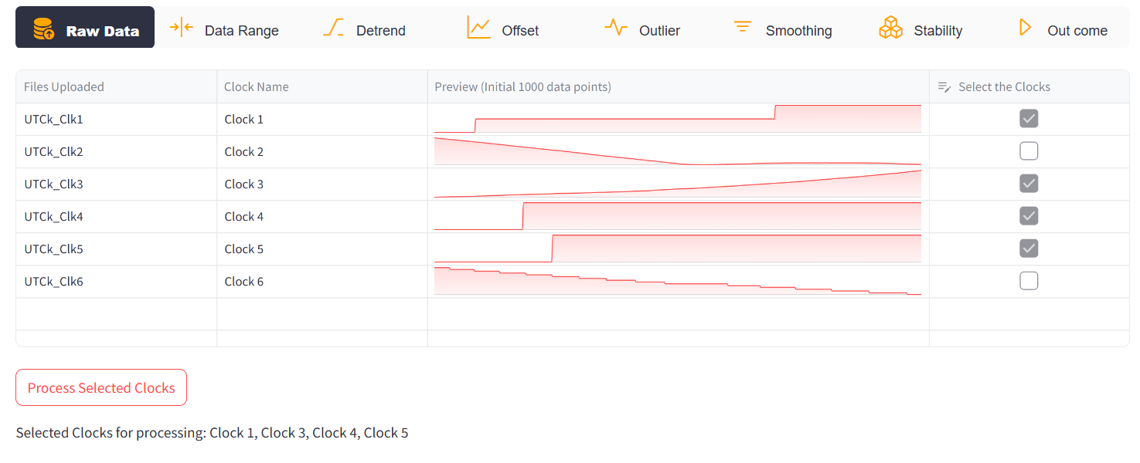
Overview of the functionalities in the application
CCTF- TE 28th March 2025
Confirms data has been uploaded and clock selection for data processing

Slide 6
Overview of the functionalities in the application
CCTF- TE 28th March 2025
Data Range: Allows the user to select the desired data range
How can it be used:
To analyse only a specific portion of the data
Discard the data recorded before and after the required time stamp/duration
Provide visualization of the raw data set

Slide 7
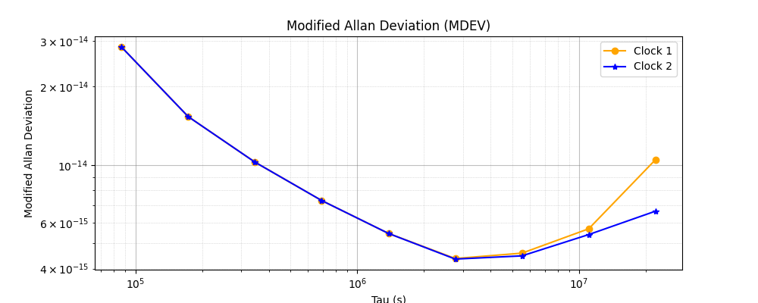
Overview of the functionalities in the application
CCTF- TE 28th March 2025
Requirement & Caution
To check for frequency offsets (Linear) and frequency drifts (quadratic) in the phase data
Tip
Time error Vs measurement time
If a clock behaves like this
it means it has
frequency offset
Removing the deterministic quadratic drift enables better visualization of other noise processes.
$$x\left(t\right)$$
$$x\left(t\right)= x_{0}+ y_{0}t+ ε(t)$$
Initial sync
Error x0
$$t$$
_{Raw data c}
$$x\left(t\right)= x_{0}+ y_{0}t+ \frac{1}{2} d t^{2}+ ε(t)$$
negative frequency drift
MDEV
Data with quadratic
trend removed
Freq Drift
Least squares Quadratic fit to the time
deviations gives the frequency drift
Frequency offset
of the clock
Tau (s)

Slide 8
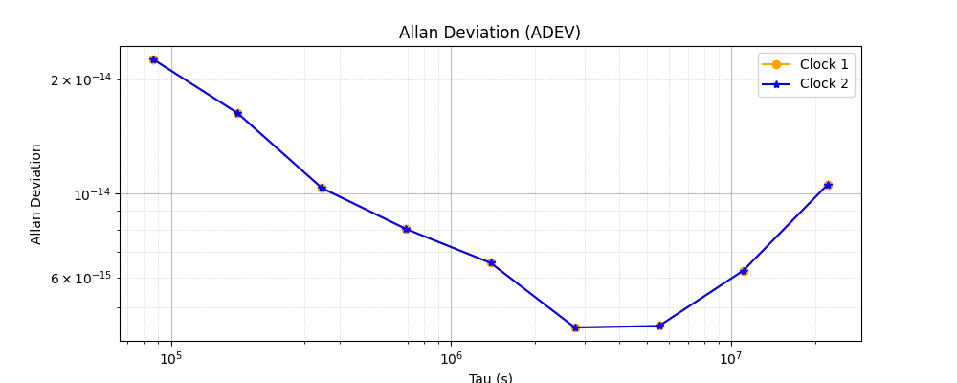
Overview of the functionalities in the application
CCTF- TE 28th March 2025
Offset: To remove the offset in the data
Requirement & Caution
Removing a constant frequency or phase offset does not effect the stability of the ADEV, MDEV etc.,
With Offset
$$x\left(t\right)$$
Offset removed
Offset
ADEV
0
Zero Offset
$$t$$
Tau (s)

Slide 9
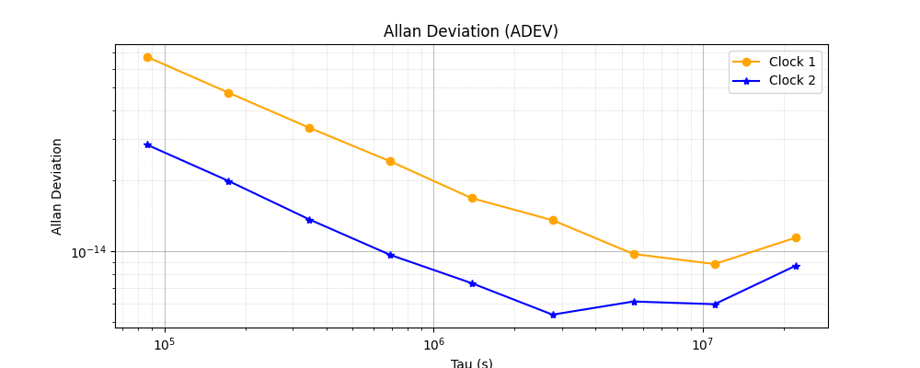
Overview of the functionalities in the application
CCTF- TE 28th March 2025
Outlier: Can remove the outlier manually or based on the std.dev of the data
Requirement & Caution
Be careful to distinguish a true outlier from a data anomaly in the data.
Removal of large sections of data can cause artificial steps in the data that can artificially increase the short-term instability of the calculated ADEV, MDEV etc. This is because the code automatically concatenates the data set.
Data with gap removed
Raw data
Gap due to outlier removal
Phase data (s)
ADEV
MJD
Tau (s)

Slide 10
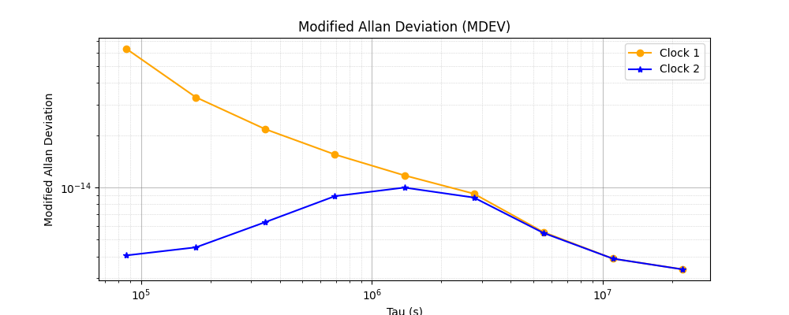
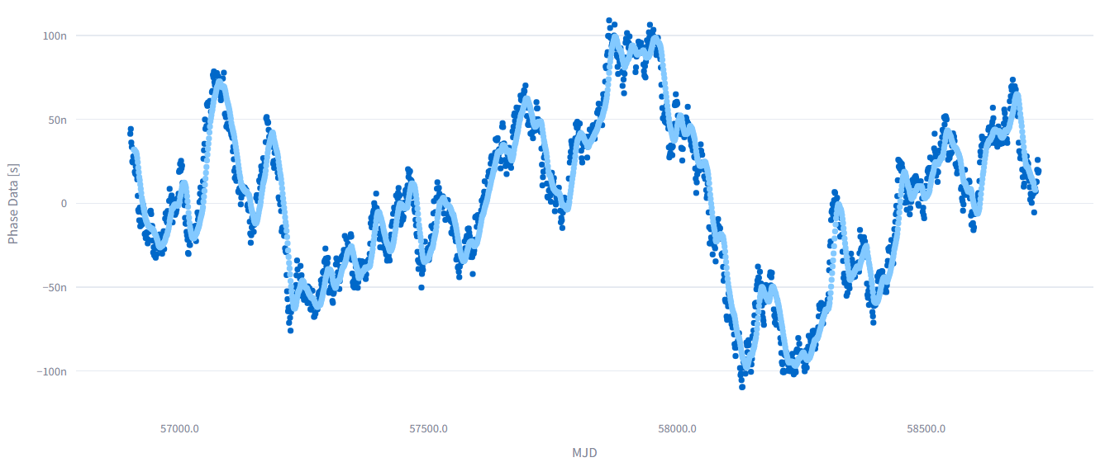
Overview of the functionalities in the application
CCTF- TE 28th March 2025
Smoothing: Apply a moving average by defining a window size
Uses & Caution
To uncover underlying behavior after smoothing
Removal of fast noise (this will remove short term data from the ADEV, MDEV, etc.)
Actual data
Smoothing @15 s
Phase data (s)
MDEV
Tau (s)
MJD

Slide 11
Overview of the functionalities in the application
CCTF- TE 28th March 2025
Stability: Can evaluate ADEV, MDEV, OADEV and TDEV based on the open source ALLANSTOOL https://pypi.org/project/AllanTools/
Allan Deviation (ADEV): Square root of the two-sample variance
MDEV: It is used to discriminate between white and flicker phase noise
 | ADEV | MDEV | OADEV | TDEV
Overview | Computes first differences of fractional frequency over non-overlapping intervals. | Computes differences of time-averaged frequencies; averaging filters high-frequency noise. | Same as ADEV but computed over overlapping intervals to increase the number of samples. | Derived from MDEV; expressed in time units to represent time-domain instability.
Main usage | Standard tool for evaluating clock frequency stability over various averaging times. | Useful for distinguishing overlapping phase noise processes. | Improves confidence in ADEV estimates, especially at long averaging times with limited data. | Used in timekeeping to evaluate timing jitter and synchronization instability.
Sensitivity to Noise | Slopes help identify dominant noise types, but white and flicker phase noise cannot be distinguished from each other using this method. | More sensitive to white (∝ 𝜏⁻³ᐟ²) and flicker (∝ 𝜏⁻¹) phase noise than ADEV. The MDEV value depends on the averaging filter and the base sampling interval (𝜏₀). | Same noise sensitivity as ADEV, but with reduced statistical uncertainty due to more overlapping samples. | Same as MDEV, but expressed in time units instead of fractional frequency.

Slide 12
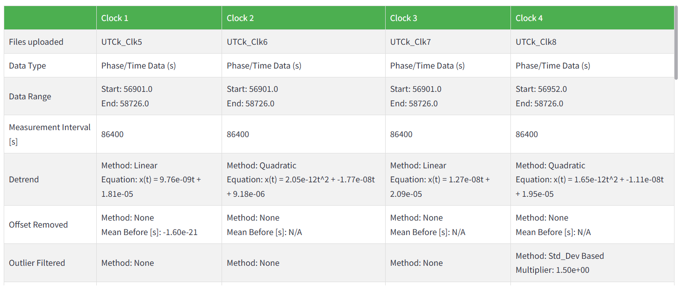
Overview of the functionalities in the application
CCTF- TE 28th March 2025
Outcome: Over-View of the actions you performed and their outcome

Slide 13
CCTF- TE 28th March 2025
Let’s work on the actual application
https://clock-data-analysis.streamlit.app/
I kindly request all the participants to try installing the application
in your local PC now if not done earlier

Slide 14
Test cases
CCTF- TE 28th March 2025
Effect of detrend on the data (Ex: UTCk_Clk1.txt)
Effect of Gaps/dead time in the data on the stability of the clock (Ex: UTCk_Clk2.txt)
Effect of outlier removal on the stability (Ex: UTCk_Clk5.txt)
Effect of the offset removal in the data (Ex: UTCk_Clk4.txt)
Effect of Phase jumps in the data (single jump or Uniformly distributed jumps) (Ex: UTCk_Clk5.txt)
Effect of Jitter and smoothing on the data (flicker floor) (Ex: UTCk_Clk8.txt)
Effect of Periodic Phase Correction (Sawtooth behaviour) on the stability of the clock (Ex: UTCk_Clk9.txt)
Effect of Frequency Steered clock data (Ex: UTCk_Clk10.txt)
Analyse different portions of the data at a time
(upload same file with different names, select each portion as a clock)
10. Backward tasks: If we want to remove the outliers first and then detrend
(download the file after outlier removal and upload it )

Slide 15
CCTF- TE 28th March 2025
Thanks for your participation
https://e-learning.bipm.org/

