Slide 1
Clock data checking
Yuko Hanado（ Retired NICT, Japan）
CCTF Technical Exchange: “Visualizing clock data analysis"
March 28, 2025
Notes:
Hello everyone!
In this talk, I would introduce some basic techniques that are useful for checking measured clock data.
Clean clock data improves the quality of timescale.
Let’s learn how to process, check, and verify your clock data!

Slide 2
Table of contents
Does the data show true clock quality?
Tips for detecting bad data
Summary and important note
Notes:
This is the contents:
In the first part, some misleading examples are introduced to show why the data checking is so important. ---
In the second part, some tips for detecting bad data are introduced. ---
In the last slide, I would like to mention about some points to keep in mind in the data processing.

Slide 3
1. Does the data show true clock quality?
Why is the data checking so important?
Because, bad data added at the measurement may mask the actual quality of your clocks.
Example-1: Degraded evaluation due to outliers
Example-2: Overlooking outliers due to a large slope
Example-3: Overlooking abnormal trend masked by large noise
Notes:
Let’s start the first part.
Needless to say, the quality of clock data will directly affect the quality of atomic timescale.
No matter how good clock you have, however, bad data added at the measurement may mask the actual quality of the clock.
Therefore, precise data check is SO important.
The following three slides --- provide some potentially misleading examples.

Slide 4
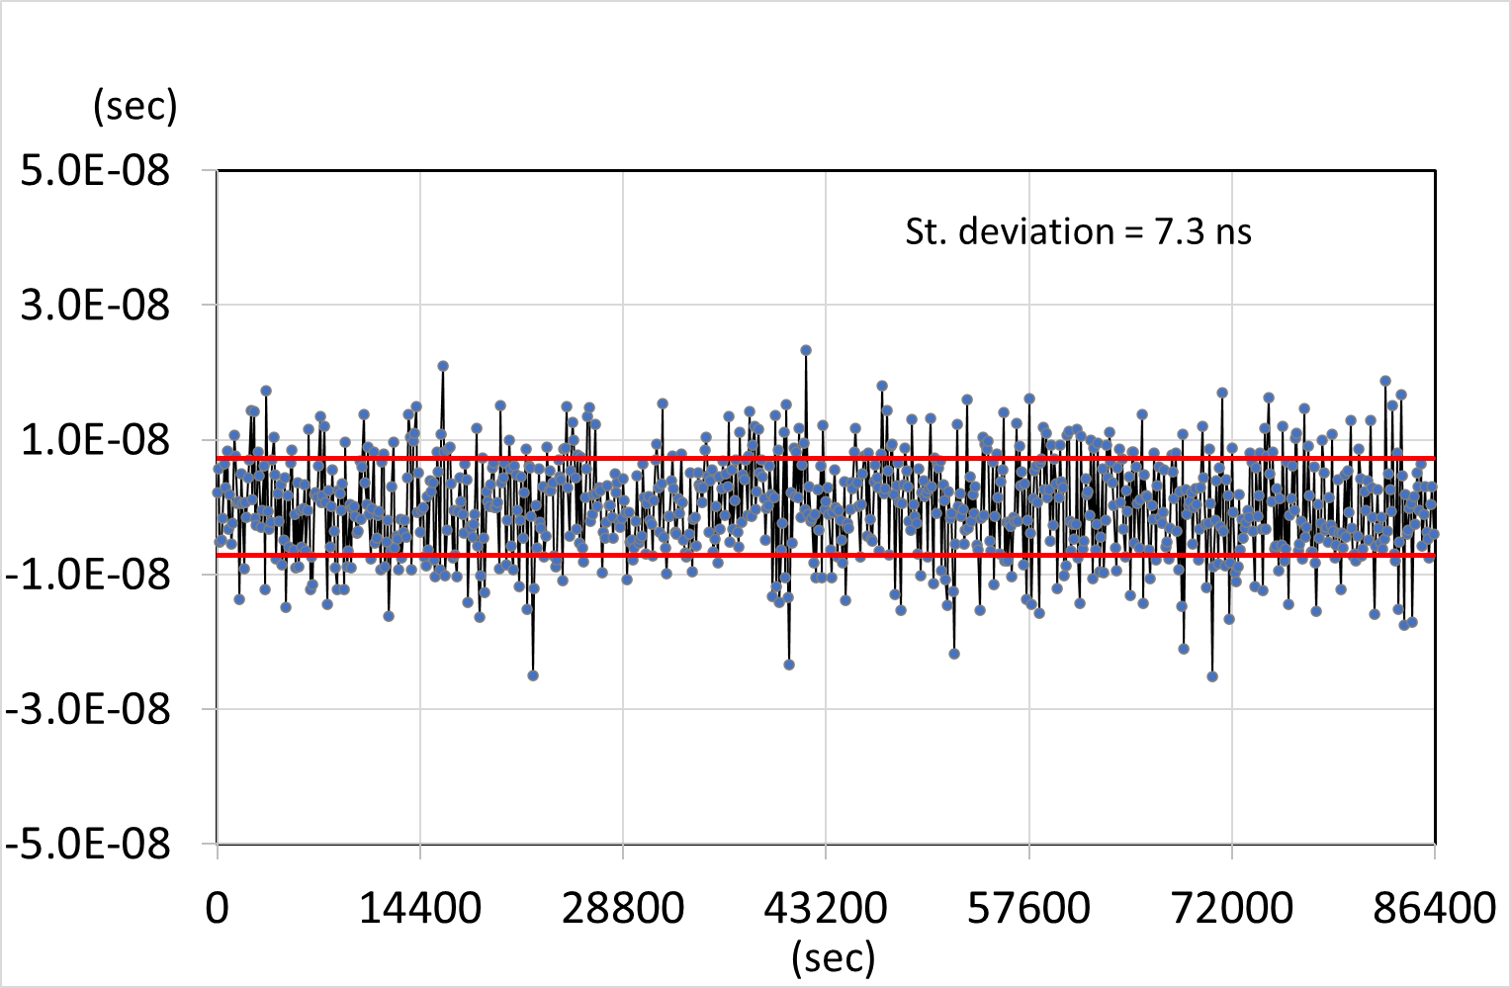
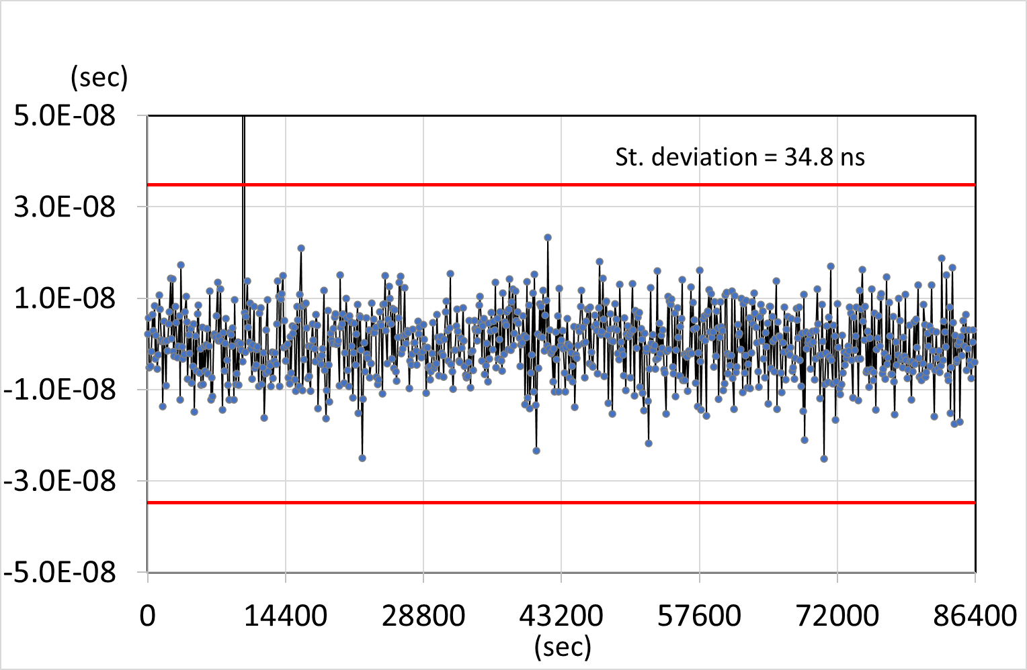
1. Does the data show true clock quality?
Example-1: Degraded evaluation due to outliers
If outliers (usually due to the instrumental trouble) are included, the standard deviation may look worse than true performance of the clock.
True clock performance
If one outlier added
A
B
Outlier (~1μs)
St. Dev. = 7.3ns
St. Dev. = 34.8ns
Notes:
Example-1 shows a degraded evaluation due to outlies.
Plot (A) shows the true performance of the clock.
However, if outliers (usually due to the instrumental trouble) are included, --- the standard deviation may look worse than true performance of the clock.

Slide 5
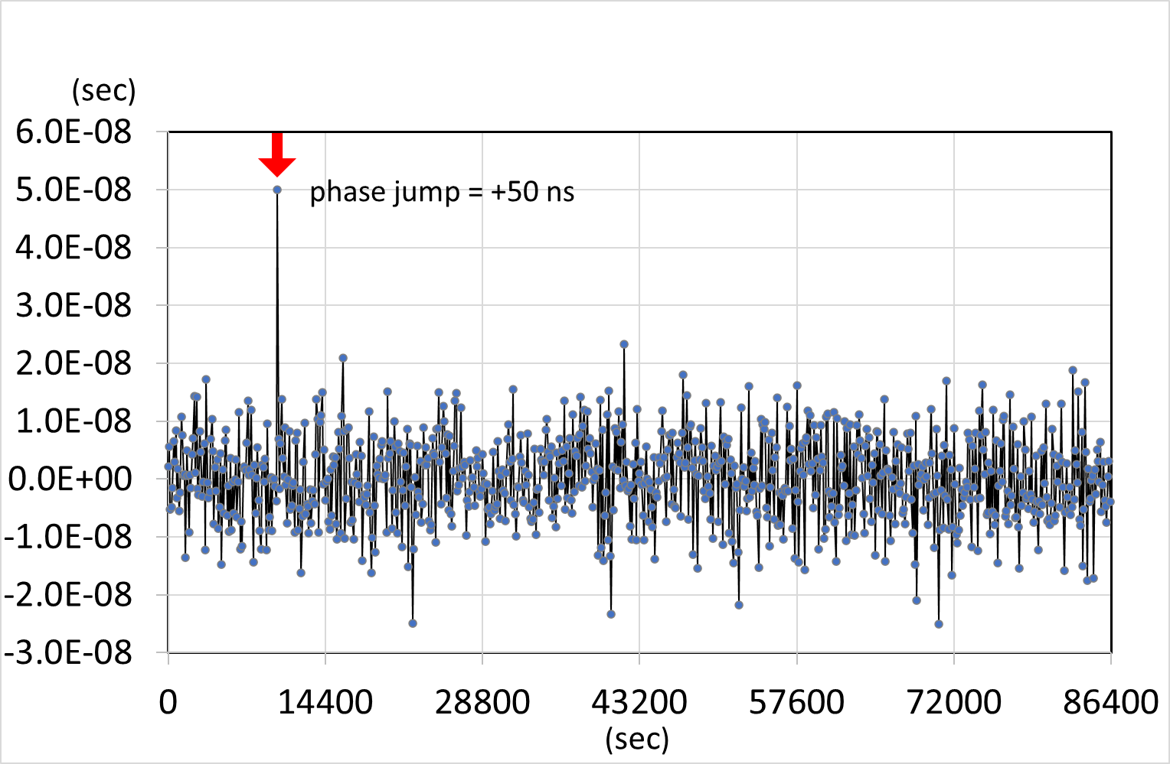
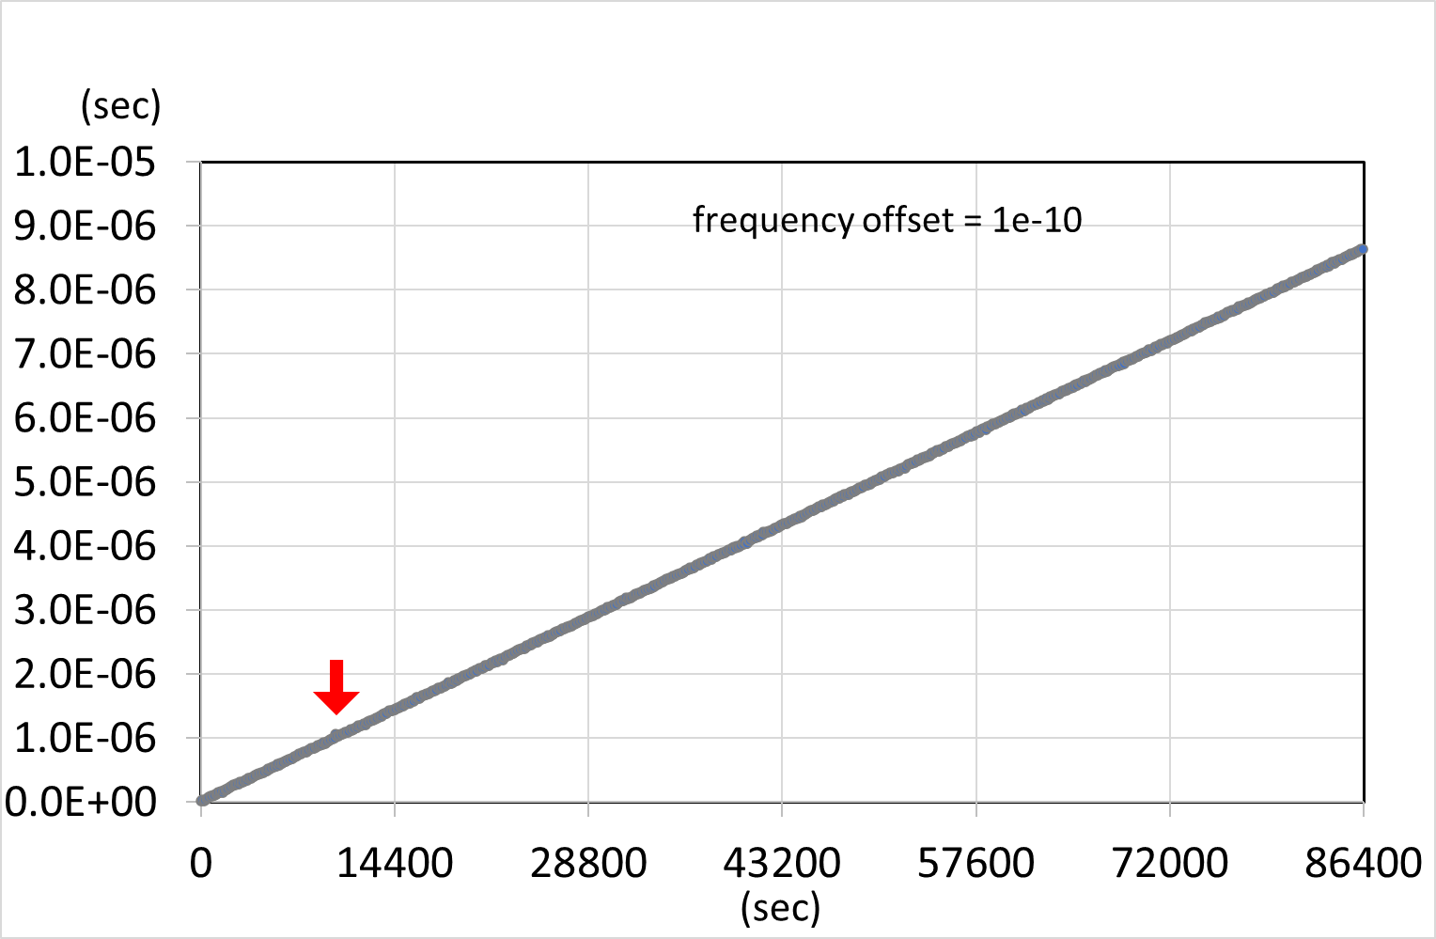
1. Does the data show true clock quality?
Example-2: Overlooking outliers due to a large slope
If a large trend exists in addition, outliers are hidden so that we overlook them.
A
Outlier
B
If large trend is added…
It’s difficult to find the outlier!
Notes:
Example-2 shows the problem of overlooking outliers due to a large slope.
In plot (A), we can easily recognize the outlier.
However, --- if a large trend exists in addition like in the plot (B), outliers are hidden so that we overlook them.

Slide 6
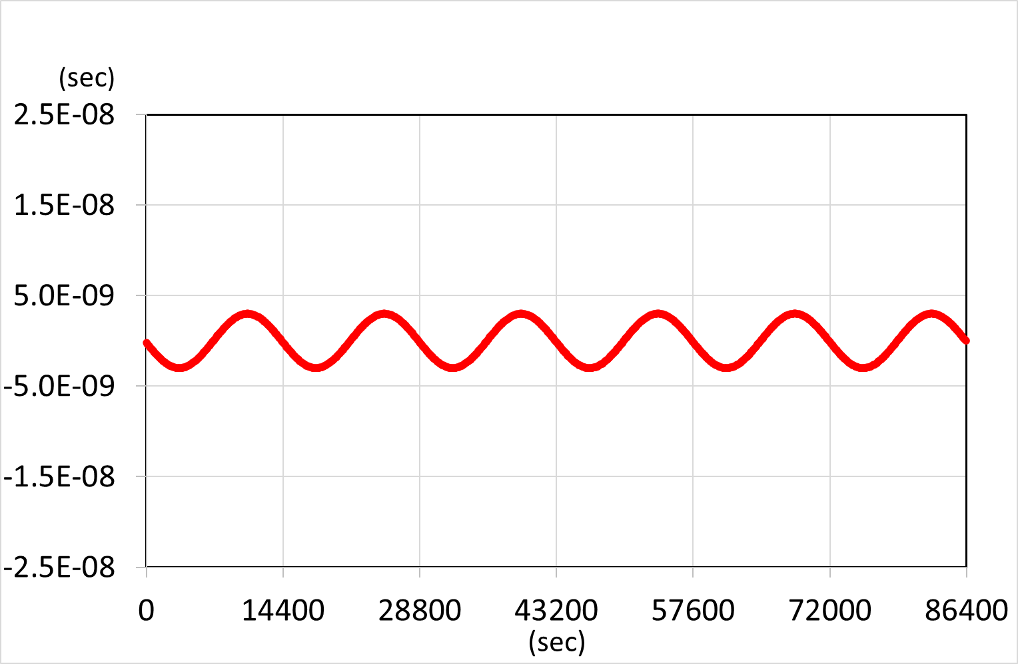
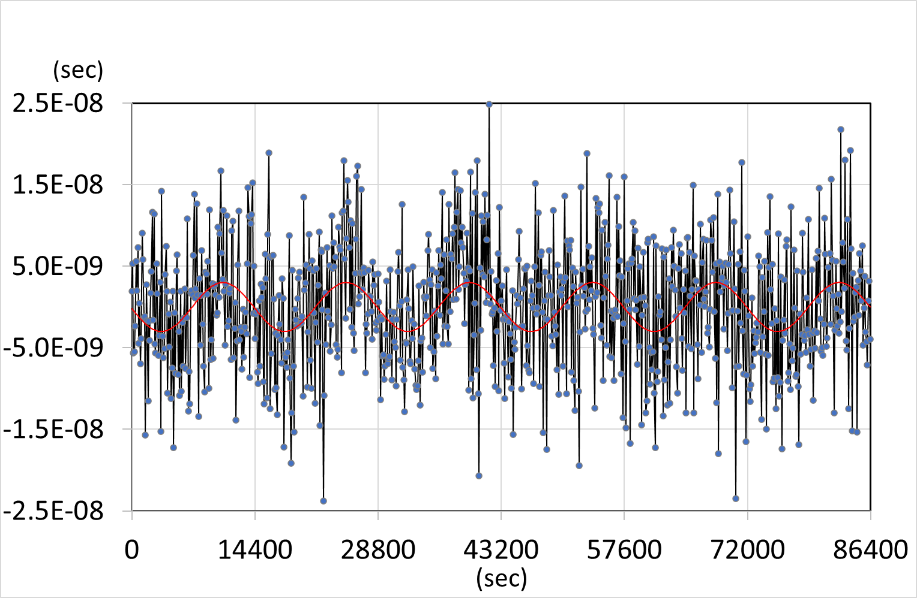
1. Does the data show true clock quality?
Example-3: Overlooking abnormal trend masked by large noise
Inversely, systematic trends are hidden in the noise.
Air conditioner and AC noise may add such periodic trend.
If white phase noise is added…
Sine wave is not so obvious.
A
B
Notes:
The last example shows the problem of overlooking abnormal trend masked by large noise.
The former-example in the previous page showed the outlier masked by a linear trend.
Inversely, there may be a case that systematic trends are hidden in the noise.
The plot (B) actually contains a sine wave as in the plot (A), however it is not obvious by a large white noise.

Slide 7
2. Tips for detecting bad data
Several simple methods for checking the clock data:
Tip-1: plotting the whole data set + zooming the scale,
Tip-2: Removing evident trends,
Tip-3: Smoothing (moving average),
Tip-4: Checking the continuity of data sampling,
Tip-5: Checking the distribution of sampled data.
Notes:
For getting the true performance of the clock from its measurement data, I would introduce here five simple methods for checking the clock data.

Slide 8
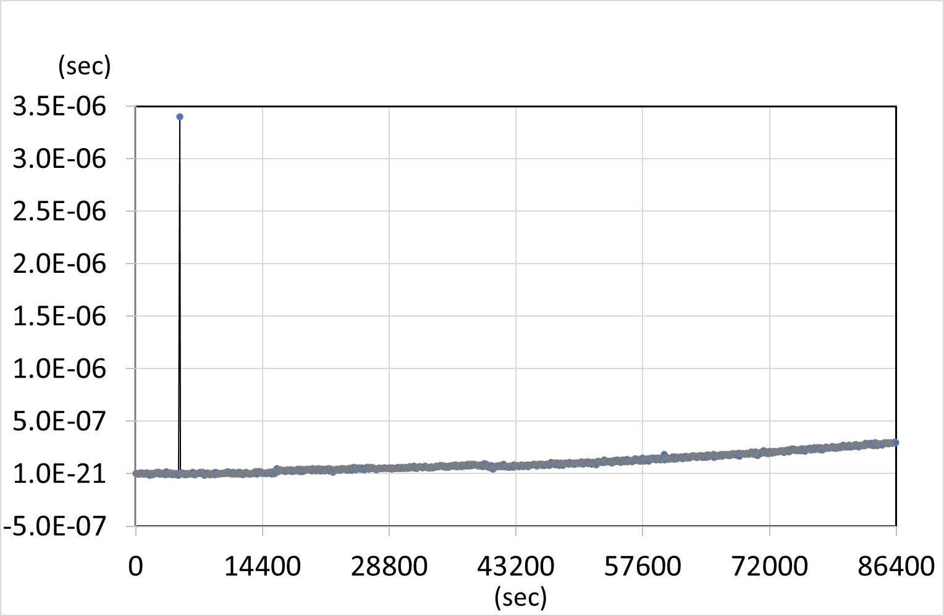
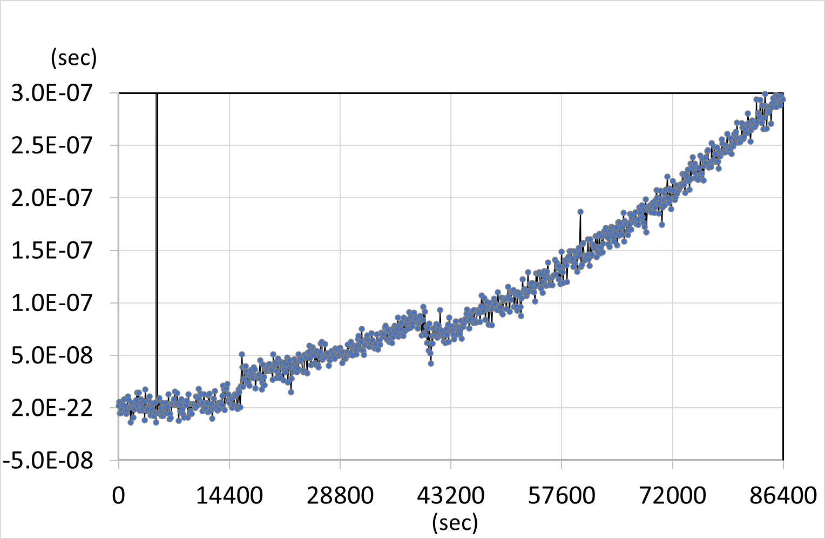
2. Tips for detecting bad data
Tip-1: Plotting the whole data set + zooming the scale
Plotting the whole data set is effective for grasping general tendency.
In addition, let’s expand the scale and check the detail.
Whole
Detail
A
B
Another Outlier
Outlier
Phase offset
Quadratic trend?
Notes:
The first tip is plotting the whole data-set plus zooming the scale, to identify possible bad data.
Plotting the whole data set is effective for grasping general tendency.
In the plot (A), we can find an outlier. In addition, there seems to be a quadratic trend, but it is less obvious in this plot.
By expanding the scale --- like in plot (B), the quadratic trend become more apparent.
In addition, we can find a small outlier and a phase offset that were not visible in the plot (A).

Slide 9
2. Tips for detecting bad data
Tip-2: Removing evident trends
Removing an evident trend helps to detect outliers or small other trends.
A
B
Outlier
It’s easy to find the outlier!
If large slope is removed…
Notes:
The tip-2 is removing evident trends.
Removing an evident trend helps to detect outliers or small other trends.
For example, an outlier masked by a large slope in the plot (A) becomes clear --- in the plot (B) by removing the trend.

Slide 10
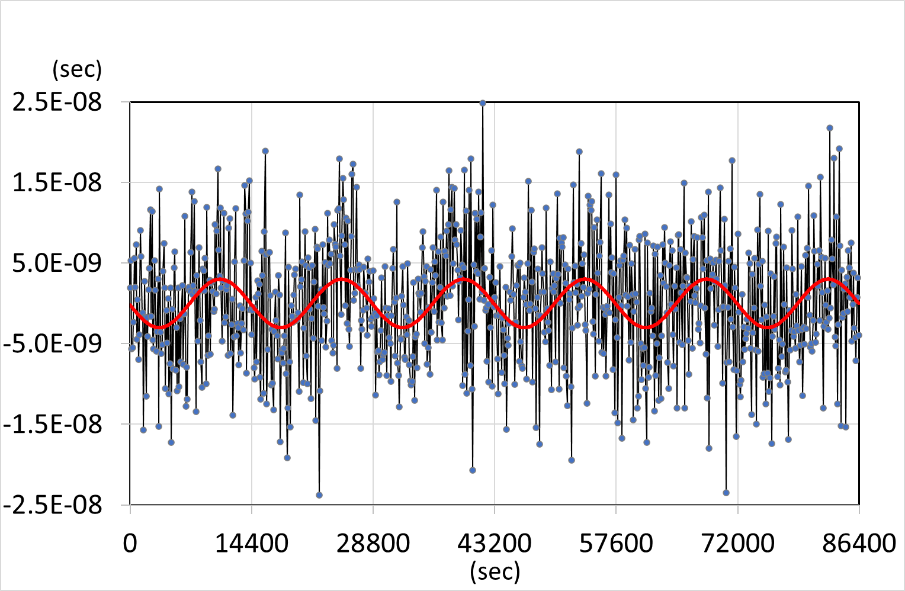
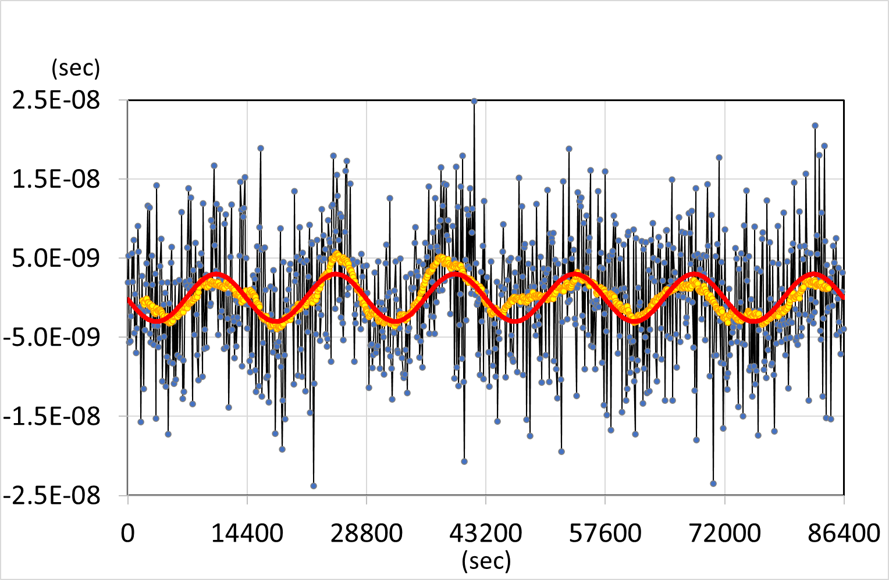
2. Tips for detecting bad data
Tip-3: Smoothing (moving averaging)
Moving average helps to detect a long-term trend.
Note that fluctuations shorter than the average interval are not visible.
4 hour periodic trend (red) is hidden under the white phase noise.
Moving average over 1 hour (in yellow) suggests this periodical trend (in red).
A
B
Notes:
Tip 3 is smoothing, for which a moving average is often used.
Moving average helps to detect a long-term trend.
Here, please note that fluctuations shorter than the average interval are not visible.
In the plot (A), 4-hour-periodic-trend is hidden under the white phase noise, but it is not obvious.
However --- in the plot (B), by proceeding a moving average over 1 hour, the result in yellow suggests this periodical trend (in red).

Slide 11
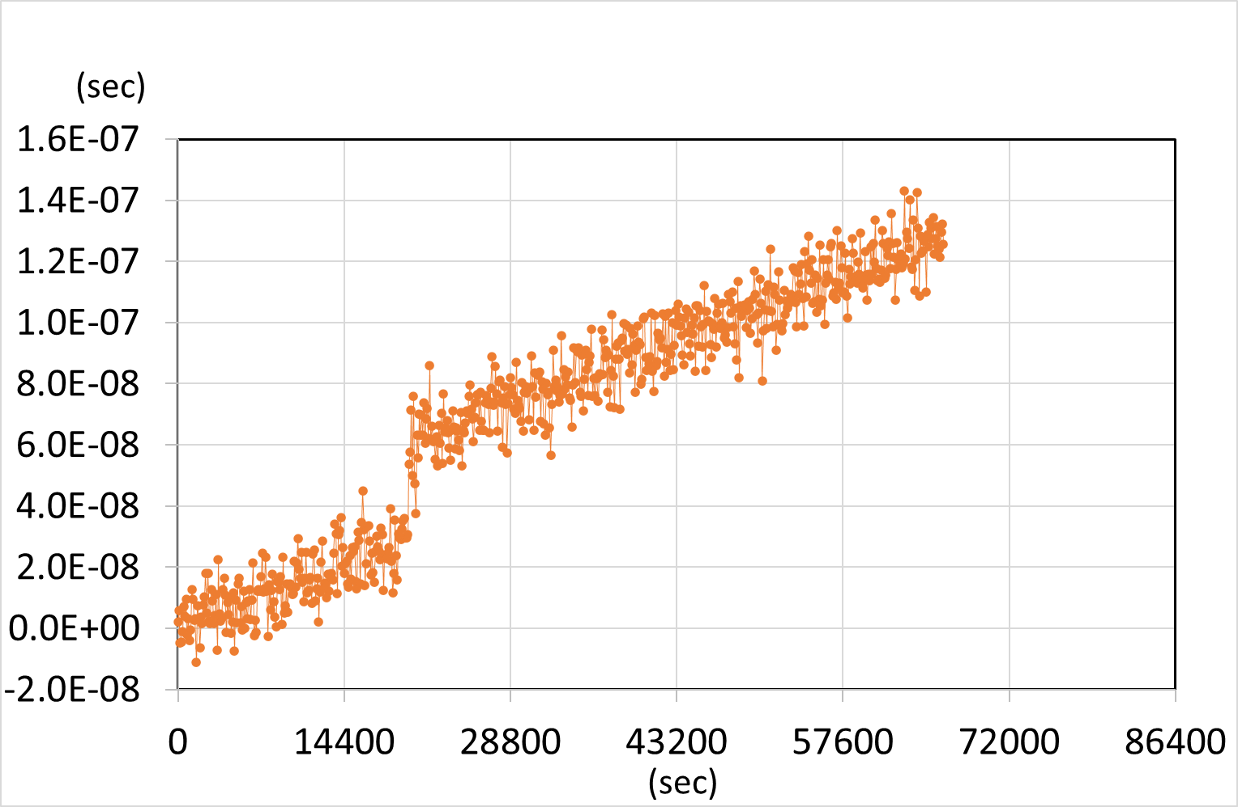
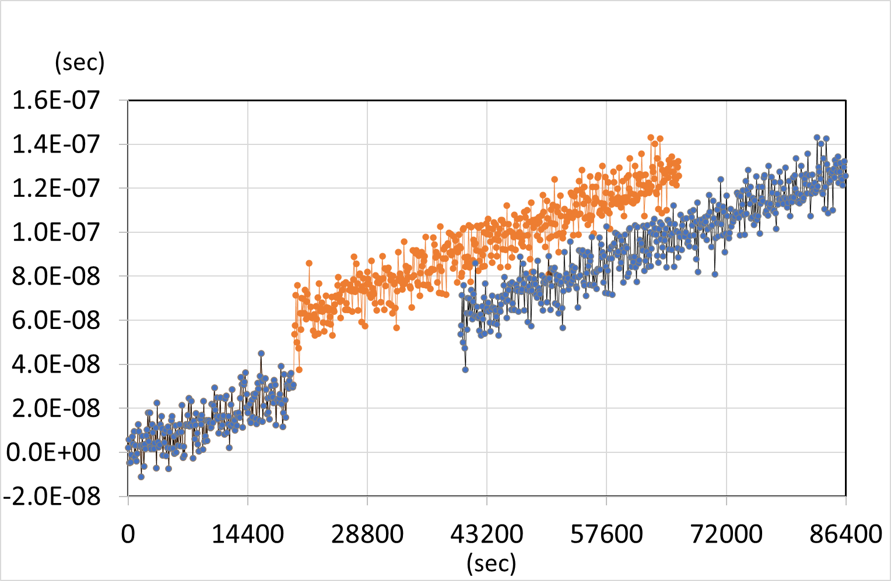
2. Tips for detecting bad data
Tip-4: Checking the continuity of sampling duration
Overlooking of missing data can cause false discontinuity of the data.
In (A), there seems to be a phase jump, but it is a misunderstanding due to the absence of correct time stamping.
This misunderstanding is caused by missing data being not properly taken into account.
A
B
True behavior
Phase jump??
Data missing
Notes:
Tip4 is checking the continuity of sampling duration.
Overlooking of missing data can cuse false discontinuity of the data.
In the plot (A), a phase jump seems to occur, but it is a misunderstanding due to absence of correct time stamping.
This misunderstanding is caused by missing data --- being not properly taken into account.
In plot (B), the gray line with a correct time stamp shows the true normal behavior.

Slide 12
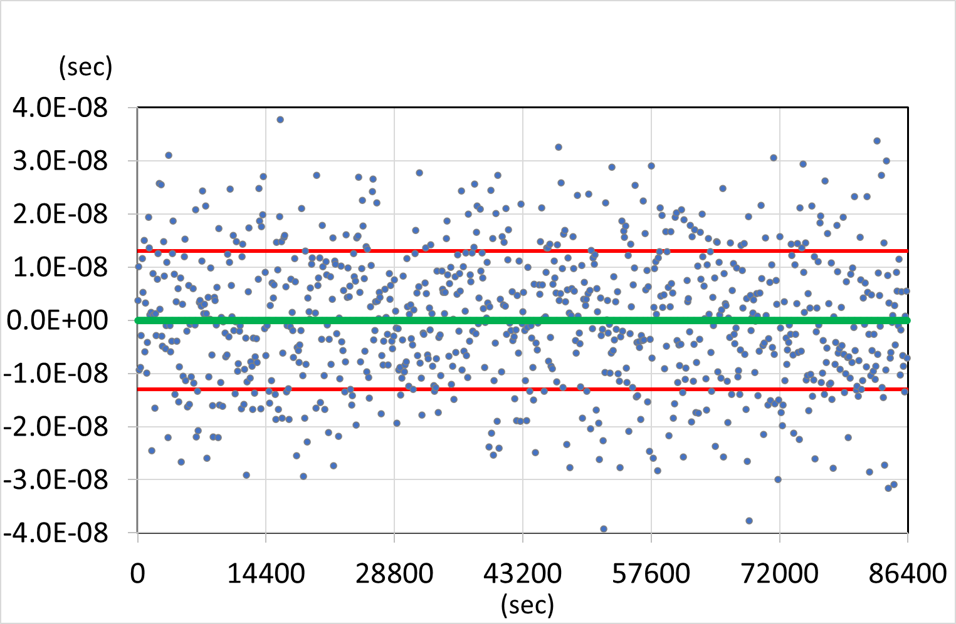
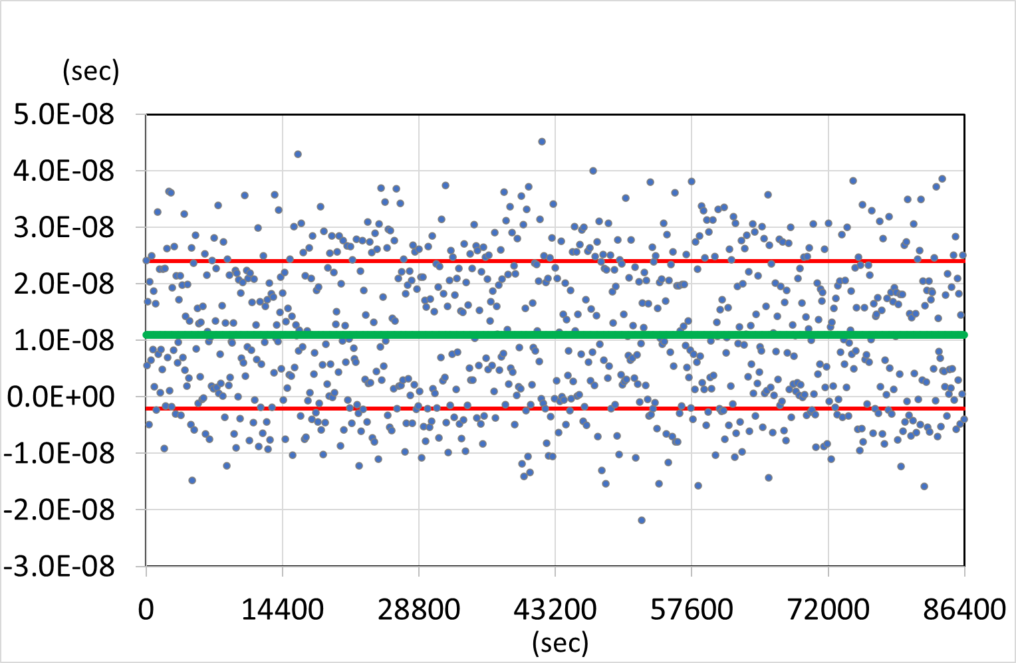
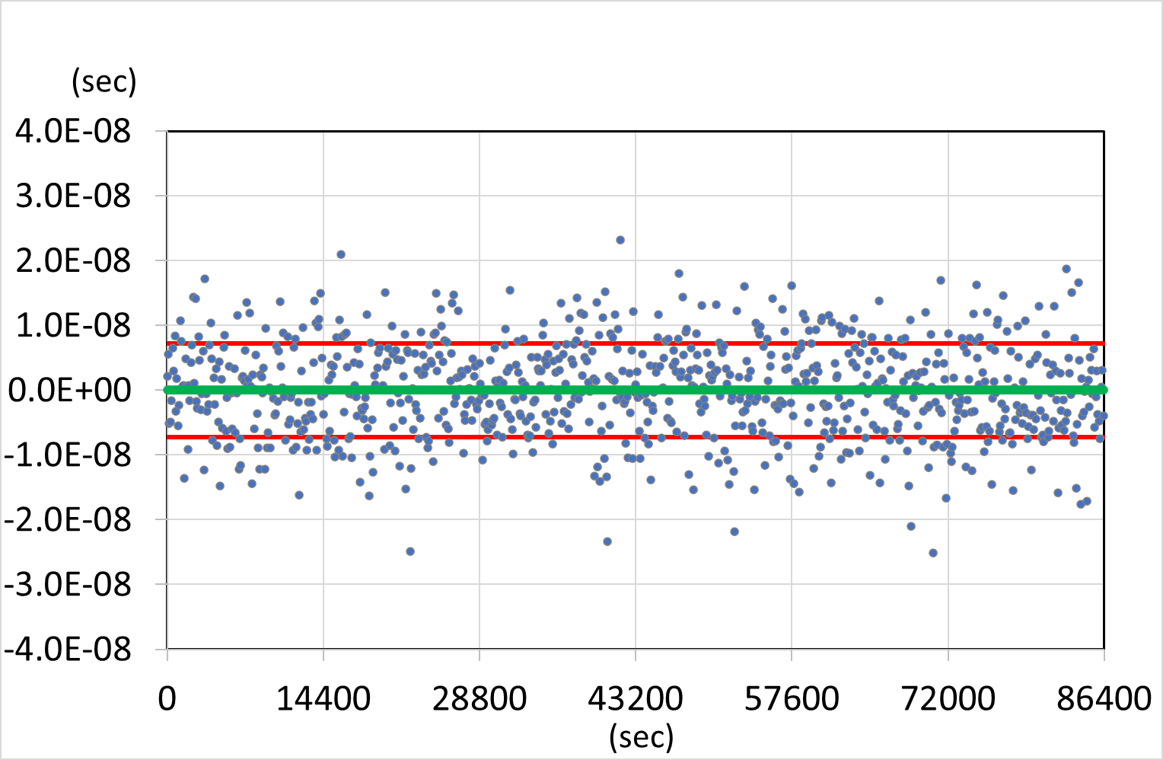
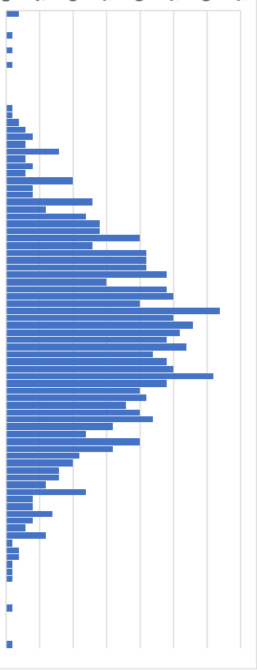
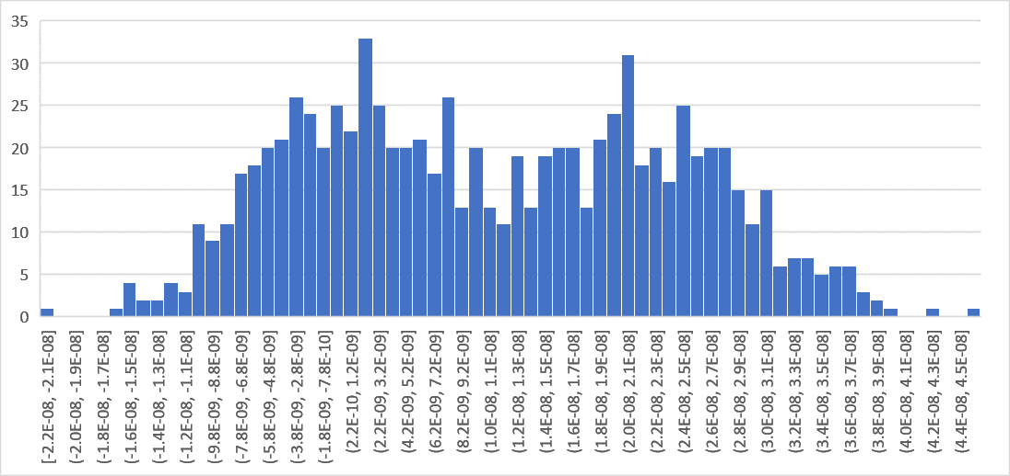
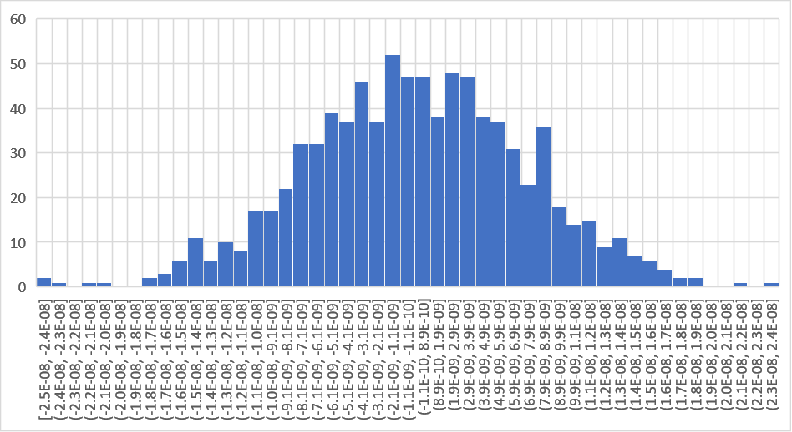
2. Tips for detecting bad data
Tip-5: Checking the distribution of sampled data
Abnormal data distribution may indicate some troubles in the process.
(A) and (B) show the same standard deviation, but the data distributions are different.
In fact, plot (B) is the result of occasional phase jumps of 20ns has been occurred in the C data. If without such 20ns phase jump in (B), the true clock performance would be like (C).
However, it is difficult to know that from the plot and STDEV only.
Observing the distribution of (B) precisely, the peak offset around 20 ns can be seen, and this fact gives us some useful information.
STDEV = 13 ns
A
STDEV = 13 ns
B
STDEV = 13 ns
STDEV = 7.2 ns
C
Notes:
The last tip is Checking the distribution of sampled data.
Abnormal data distribution may indicate some troubles in the process.
(A) and (B) show the same standard deviation, but the data distributions are different.
--- In fact, plot (B) is the result of occasional phase jumps of 20ns has been occurred in the C data.
If without such 20ns phase jump in (B), the true clock performance would be like (C).
However, it is difficult to know that without the distribution plot.
In fact, observing the distribution of (B) precisely, the peak offset around 20 ns can be seen, and this fact gives us some useful information.

Slide 13
3. Summary and important note
Data checking is so important to know the true condition of your data.
Several tips can be used for detecting bad data or strange behavior.
Data checking may help to improve your UTC(k) time scale and the data submitted for UTC.
If anomalies are detected, please investigate their origin and try to remove the originating cause.
Bad data tell you so much information of the systems!
It’s not recommended to only remove bad data.
If the anomalies are due to system trouble, other future measurement data may include other anomalies. In such a case, removing the spotted bad data may not be enough.
Please check the origin of anomalies and judge how to treat the data.
Notes:
That’s all for the mentioned tips, and here is the summary and important notes:
Data checking is so important to know the true condition of your data.
Several tips can be used for detecting bad data or strange behavior.
Data checking may help to improve your UTC(k)-timescale and the data submitted for UTC.
* And lastly, I would like to emphasize the following ---
If anomalies are detected, please investigate their origin and try to remove the originating cause.
Bad data tell you so much information of the systems! ---
It’s not recommended to only remove bad data.
If the anomalies are due to system trouble, other future measurement data may include other anomalies. In such a case, removing the spotted bad data may not be enough.
Please check the origin of anomalies and judge how to treat the data.

Slide 14
Thank you very much for your kind attention!
To get points, please try the exercise with the related Python tool!
Notes:
*That’ all, and thank you very much for your attention.
To get points, please try the exercise with the related Python tool!

