Slide 1
A short assessment of LEAP second prediction
Christian BIZOUARD
Observatoire de Paris / LTE & IERS Earth Orientation Center
Consultative Committee on Time and Frequency (CCTF) On line meeting 13/27 March 2025

Slide 2
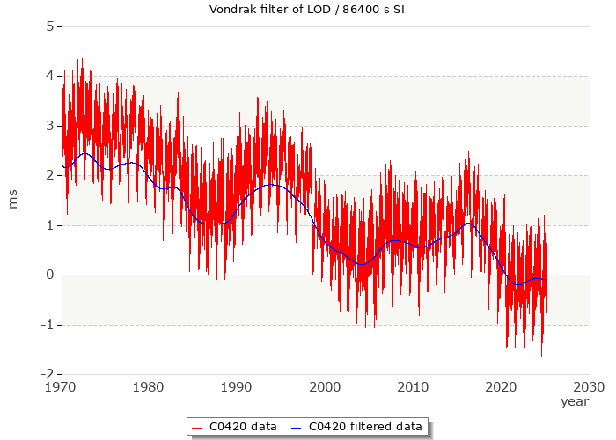
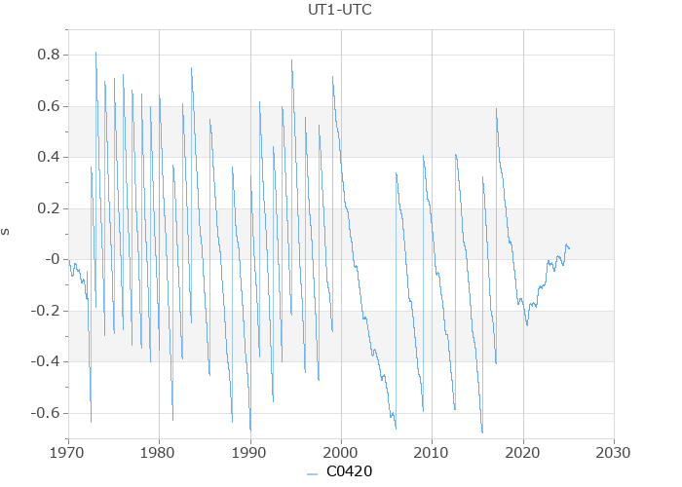
When do we have to adjust UTC by 1 one second?
Leap second in UTC introduced when UT1 – UTC becomes smaller than -0.5 s Decided 6 months in advance for the next 30 June or 31 December lasting 86401 s For the first time of his history UT1-UTC increases since 5 years. No leap second since 2017
Will this trend continue or stop and reverse?
Do we have to remove a second in UTC by 2030 as Agnew’s recent paper in Nature asserts?
?
?
Yearly average of ΔLOD < 0

Slide 3
Physical context
Leap second occurrence depends on the secular and (multi)-decadal fluctuations of the Earth’s rotation speed / length of day (LOD)
Physical modeling cannot predict the most important of these, which arise from core-mantle interaction. We do not know how long the strong negative trend observed since 1970 in LOD will last.
→ prediction based on extrapolating past-behavior od UT1/LOD.
Cause | Trend 1970-2025 for LOD in ms/cy | Temporal window
Core-mantle interaction | $$−6$$ | Multi-decadal
Glacial Isostatic Adjustment | $$−1.1$$ | Millennial (constant)
Tidal friction | $$+1.7$$ | Geological (constant)
Present day mass transfer (PDMT) | $$+1.9$$ | From 2000

Slide 4
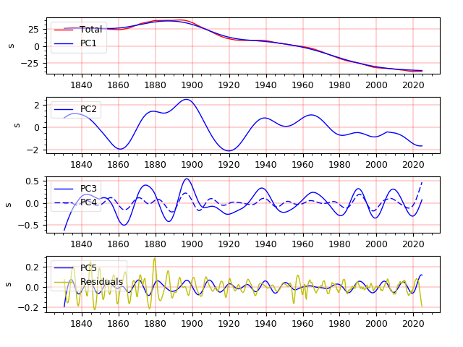
Singular Spectrum Analysis of UT1 since 1830
~parabolic trend + 136 year : 25 s
~65 year : 2 s
~32 year / 21 year : 0.5 s
~13.85 year + residuals < 0.2 s

Slide 5
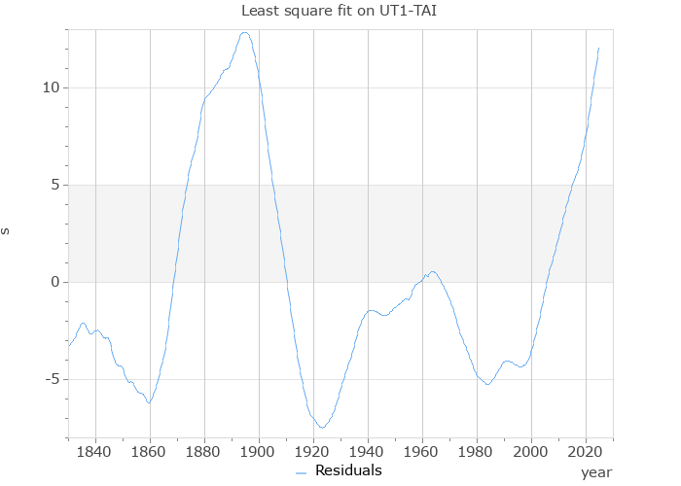
Multi-decadal residual in UT1-TT(TAI) highlighting a nearly 136 year periodicity?
Residuals after removing parabolic trend (ms)
Multi-decadal changes in UT1 are up to 18 s peak to peak. So, they are involved in leap second readjustment of UTC.
Periodicity in 136 years with a maximum by 2025-2030?
~136 years
~68 years
2040

Slide 6
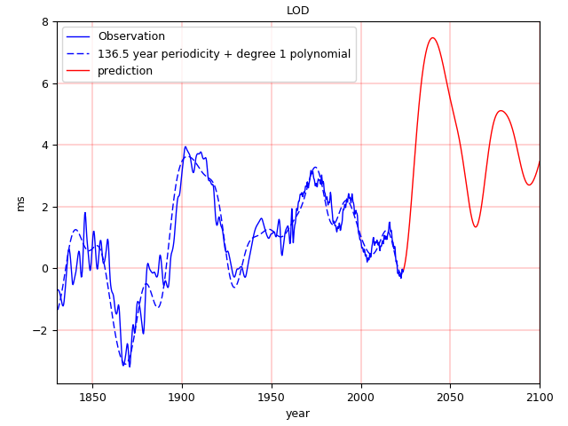
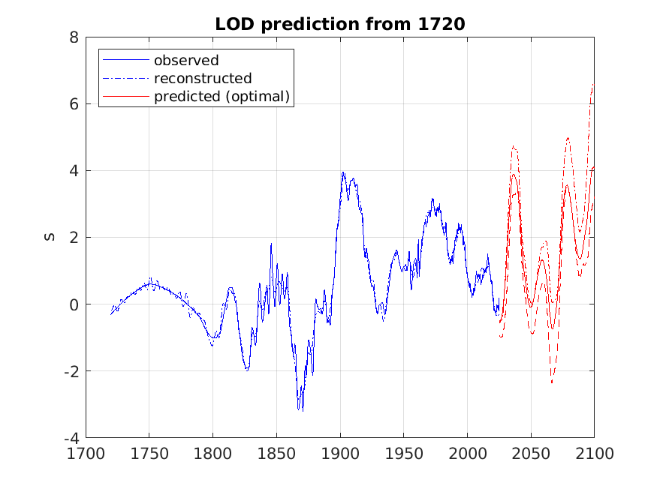
Corresponding prediction of the length-of-day offset
Harmonic model + prediction (for data from 1830)
SSA model + prediction

Slide 7
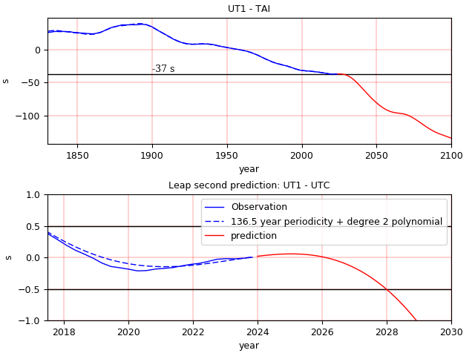
Prediction of UT1 – TAI / UT1 – UTC by extrapolating an harmonic model
Adjustment of a model composed of:
a parabolic trend
136.5 year periodic signal (with 8 harmonics)
No “negative” leap second by 2030, but a common leap second to be introduced in 2028?

Slide 8
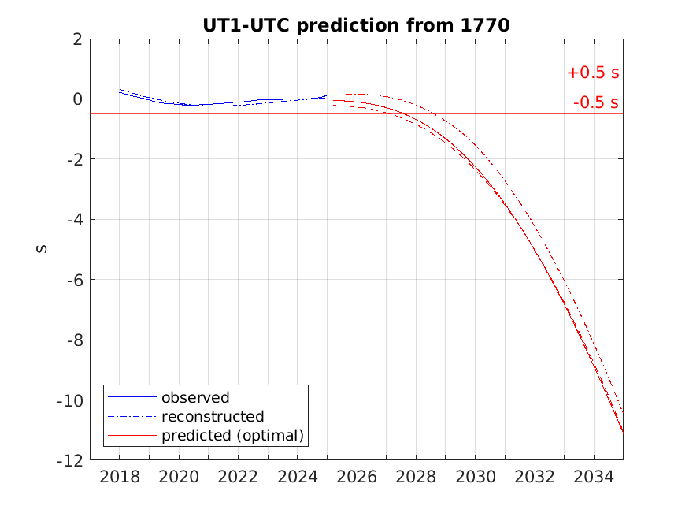
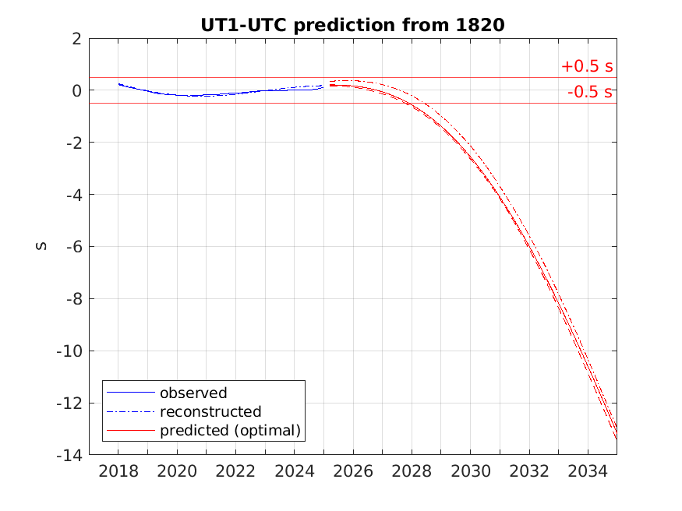
Prediction based upon SSA
No negative leap second, but up to 12 common leap seconds to be added until 2035!

Slide 9
Conclusion
LOD / UT1 prediction is non conclusive
Prediction based upon the past signal (since 1720) suggests that the multi-decadal acceleration of the Earth's rotation has come to an end, and will be followed by a phase of deceleration in the next years
Usual leap seconds by 2027-2030 ?
But I wouldn't put my hand to the fire

