Slide 1
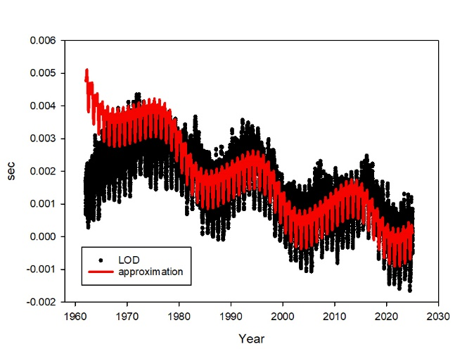
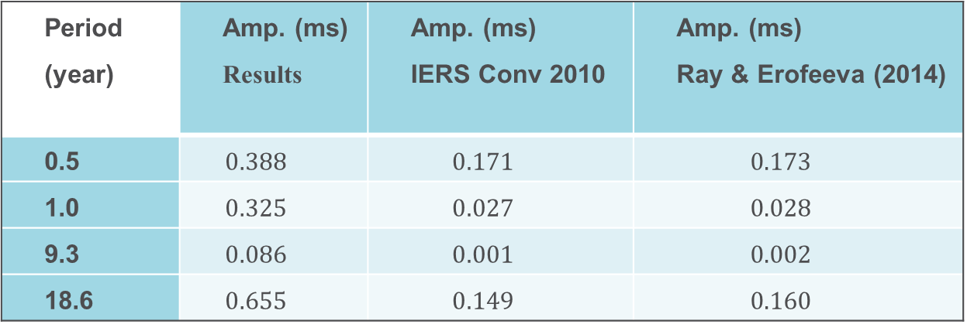
LOD time series
1962-2025
Period (year) | Amp. (ms) Results | Amp. (ms) IERS Conv 2010 | Amp. (ms) Ray & Erofeeva (2014)
0.5 | $$0.388$$ | $$0.171$$ | $$0.173$$
1.0 | $$0.325$$ | $$0.027$$ | $$0.028$$
9.3 | $$0.086$$ | $$0.001$$ | $$0.002$$
18.6 | $$0.655$$ | $$0.149$$ | $$0.160$$

Slide 2
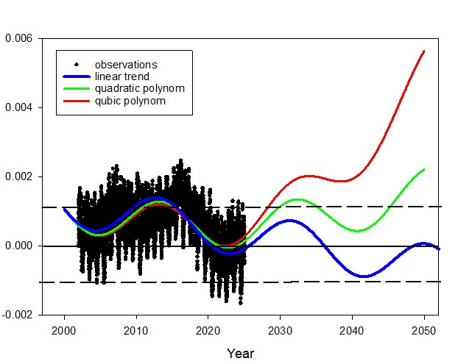
1960s
LOD
Prediction;
18.6-year signal + trends
(Seconds)
1. (main cause) 18.6-year signal
2. (other causes) trends and other harmonics signal (also 11.9 year, Jupiter?)
3. 10-y LOD prediction? (2028) If LOD = +0.5 ms – blue (negative leap second ~2040);
If LOD = +0.8 ms – green (positive leap second ~2033);
If LOD = +1.0 ms – red (catastrophic)
A “quite” scenario between blue and green lines is possible

