Slide 1

CONSULTATIVE COMMITTEE
FOR TIME AND FREQUENCY
together with
Workshop on negative leap second
Stochastic modelling and prediction
Giulio Tagliaferro, Patrizia Tavella
Thursday March 13, h 14 -16 UTC

Slide 2
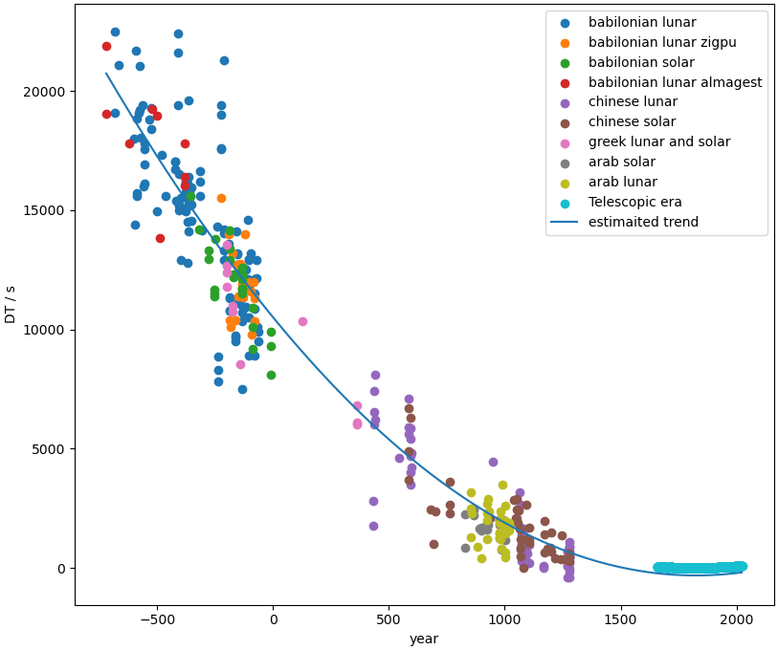
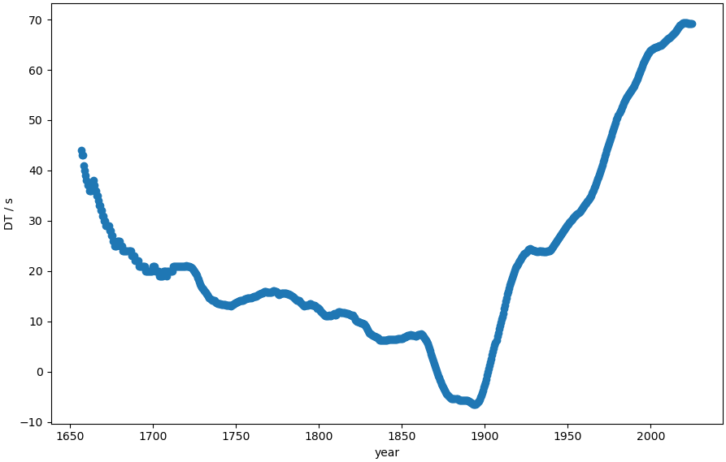
We are not expert in Earth rotation, we are used to see times series and estimate a stochastic model
ΔT(t) = “TT”-UT1 = d/dt LOD(t)
From the ΔT in the long term we can identify:
A millennial slowing down
Stochastic behavior
Plus there are well modeled periodic terms due to tidal variations and seasonal effects.
zoom
Data from
Stephenson F. R., Morrison L.V., and Hohenkerk C. Y., Measurement of the Earth's rotation: 720 BC to AD 2015, Proc. R. Soc. A.472 2016, http://doi.org/10.1098/rspa.2016.0404
Dennis D. McCarthy, Alice K. Babcock, The length of day since 1656, Physics of the Earth and Planetary Interiors, Volume 44, Issue 3, 1986, https://doi.org/10.1016/0031-9201(86)90077-4
IERS Bulletin A

Slide 3
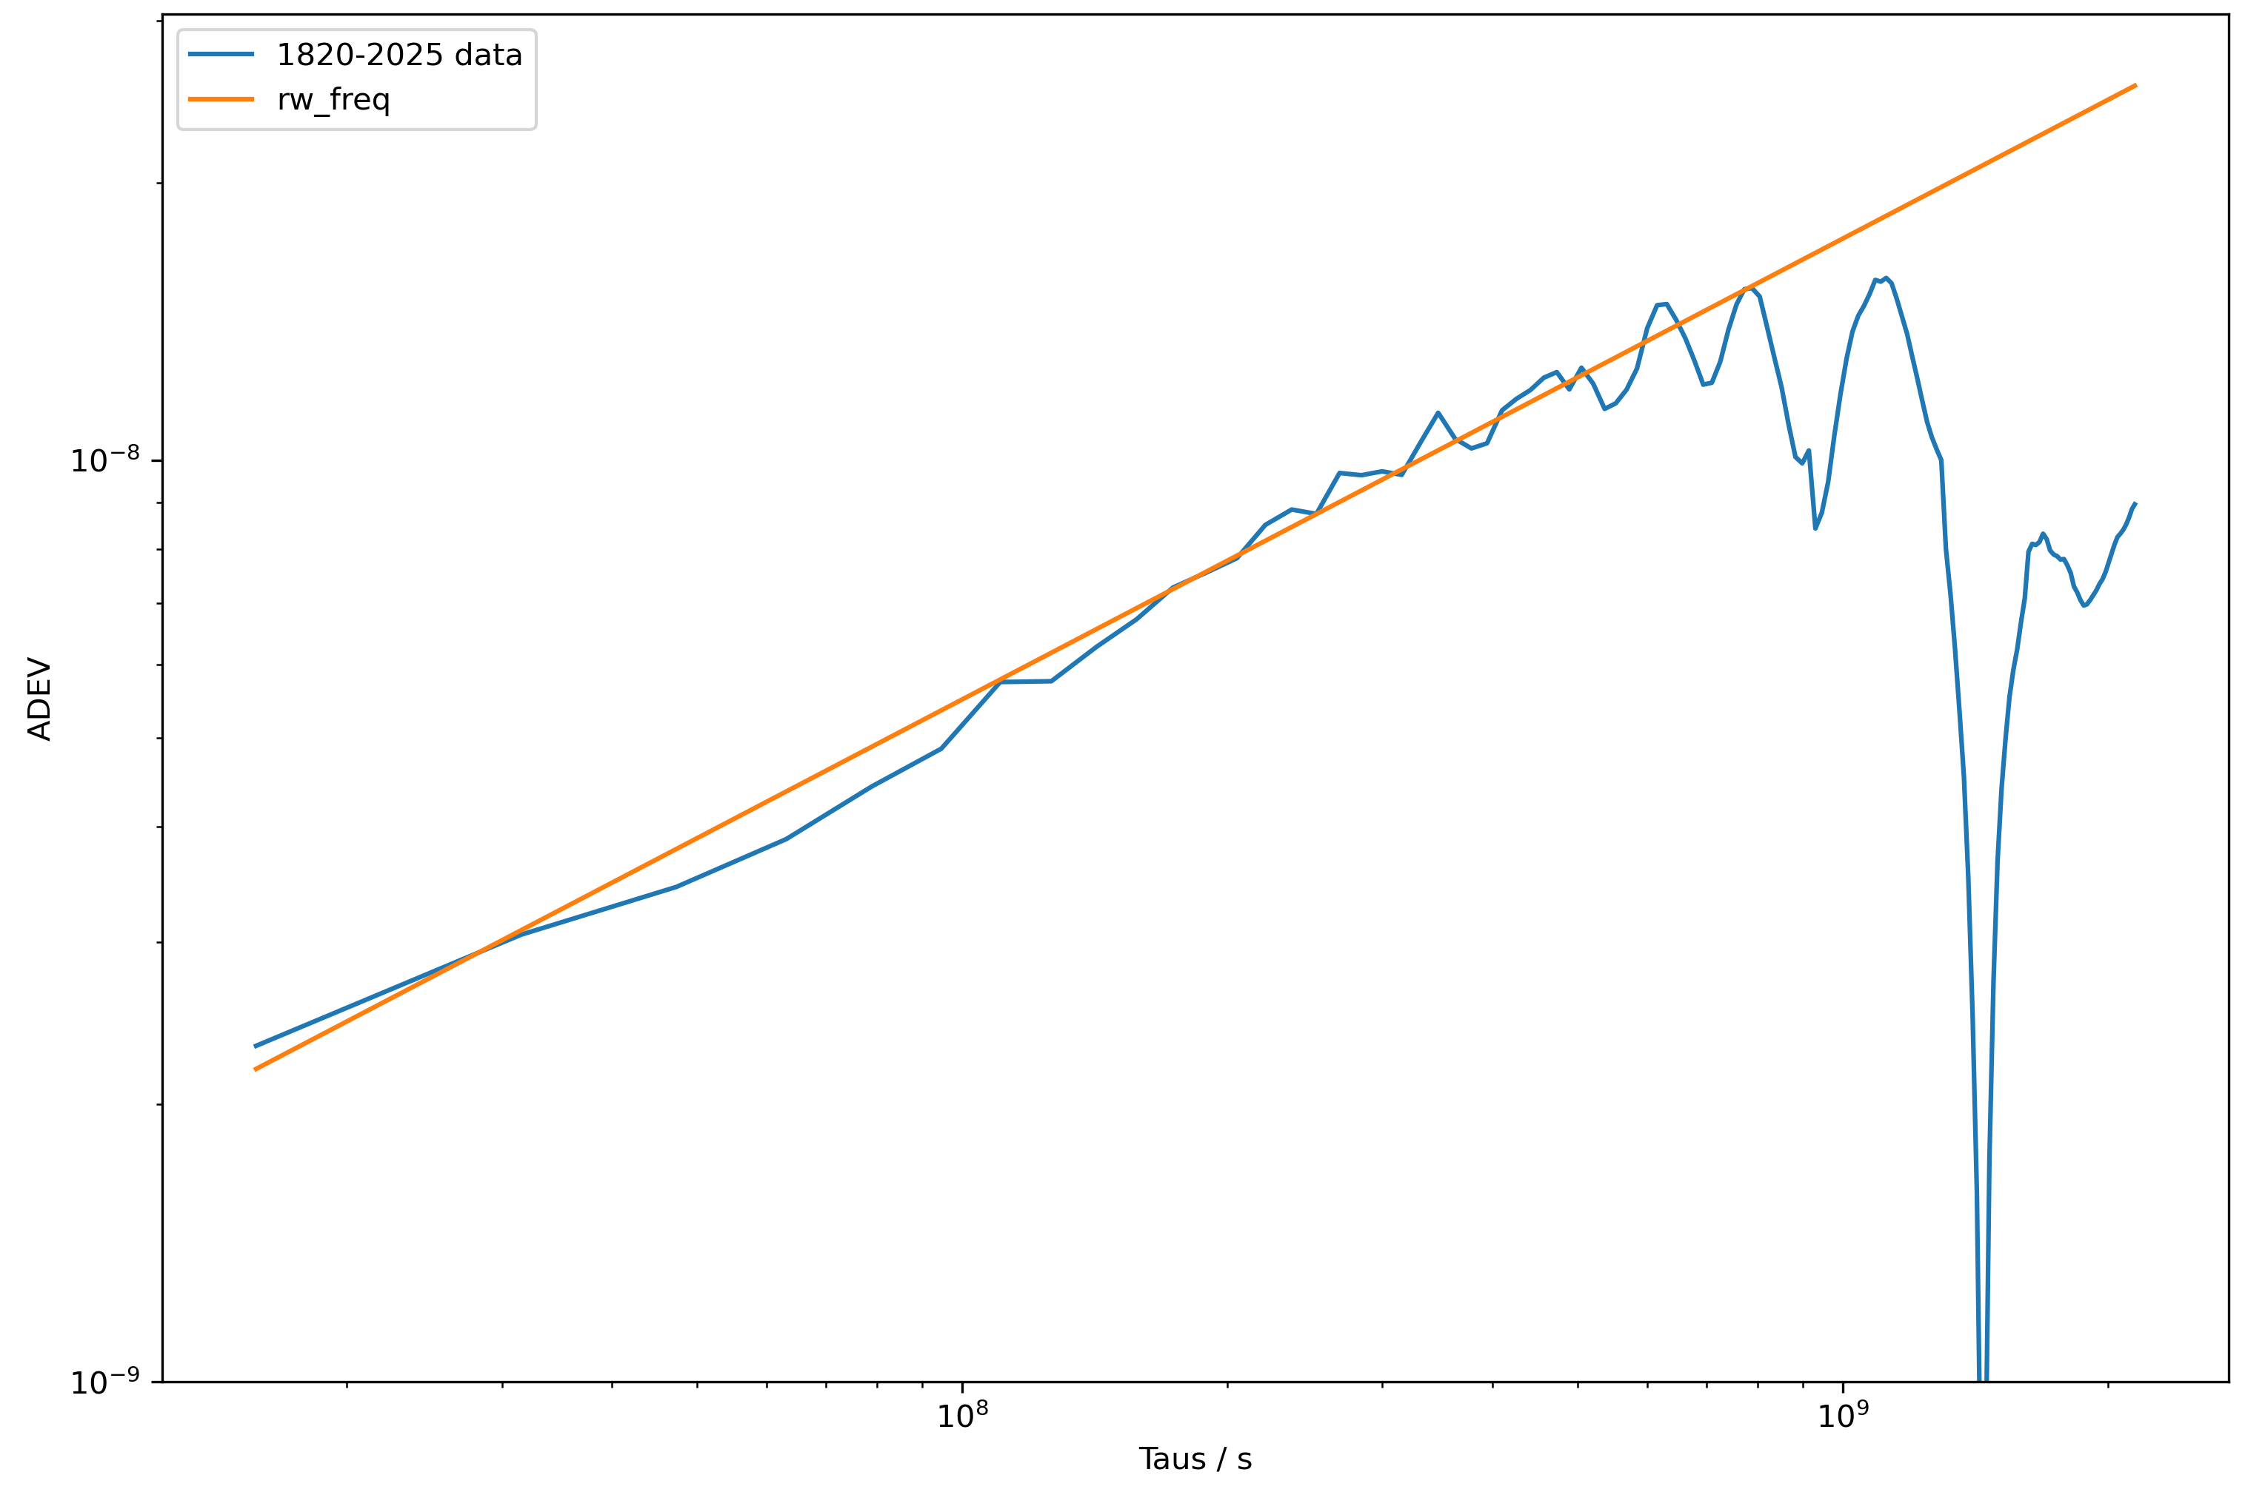
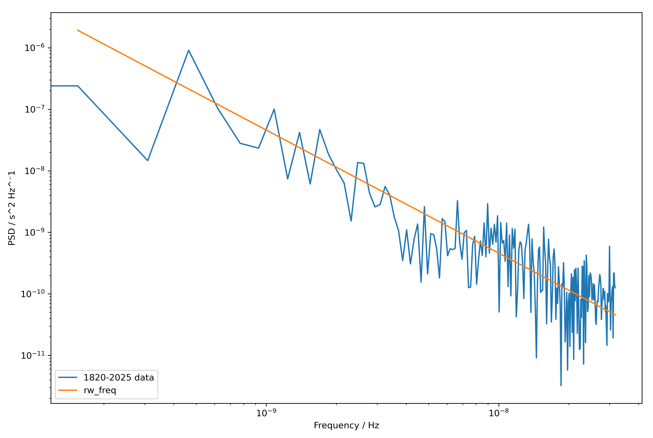
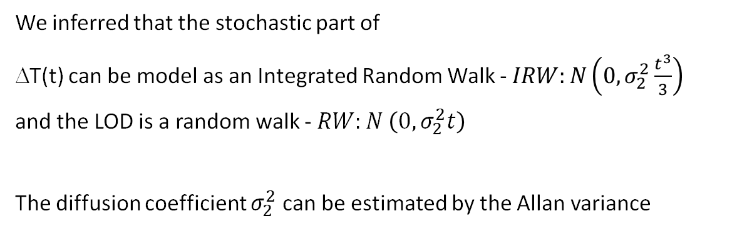
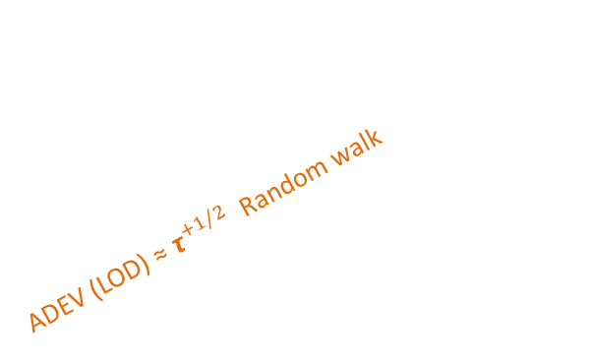
Estimating a stochastic model
ΔT(t) = “TT”-UT1 = d/dt LOD(t)
The stochastic model can be estimated by
the power spectrum,
the Allan variance
studying the distribution of the increments
ADEV (LOD) ≈ $τ^{+1/2}$ Random walk
We inferred that the stochastic part of
ΔT(t) can be model as an Integrated Random Walk - $IRW:N\left(0, σ_{2}^{2}\frac{t^{3}}{3}\right)$
and the LOD is a random walk - $RW:N \left(0, σ_{2}^{2}t\right)$
The diffusion coefficient $σ_{2}^{2}$ can be estimated by the Allan variance

Slide 4
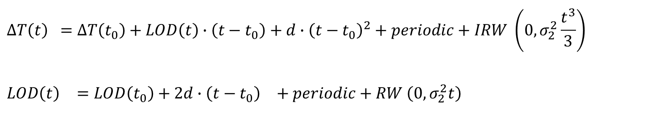
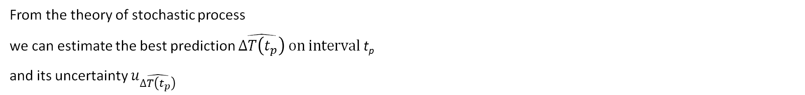

Mathematical model
A millennial slowing down
Periodical terms due to seasonal and tidal effects
Stochastic behavior
ΔT(t) = “TT”-UT1 = d/dt LOD(t)
$${∆T\left(t\right)}^{}=∆T\left(t_{0}\right)+LOD\left(t\right)∙\left(t−t_{0}\right)+d∙{\left(t−t_{0}\right)}^{2}+periodic+IRW \left(0, σ_{2}^{2}\frac{t^{3}}{3}\right)$$
$${LOD\left(t\right)}^{}=LOD\left(t_{0}\right)+2d∙{\left(t−t_{0}\right)}^{}+periodic+RW \left(0, σ_{2}^{2}t\right)$$
We choose:
$t_{0}$= Feb 26, 2025 from IERS Bulletin A
$t_{p}$= 10 years, till 2035
$∆T\left(t_{0}\right)$ and $LOD\left(t_{0}\right)$ values and uncertainties from IERS rapid
d = 32,5 s/century² and uncertainty from Stephenson, 2016
Periodic terms from IERS Convention 2010 and Chen, Jianli 2005
$σ_{2}^{2}$ from the Allan variance = $\sqrt{3}∙5.5∙{10}^{−13}$
No uncertanty for the periodic terms.
From the theory of stochastic process
we can estimate the best prediction $\hat{∆T\left(t_{p}\right)} on interval$ t_{p}
and its uncertainty $u_{\hat{∆T\left(t_{p}\right)}}$
$${\hat{∆T\left(t_{p}\right)}}^{}=∆T\left(t_{0}\right)+LOD\left(t_{0}\right)∙\left(t_{p}\right)+d∙{\left(t_{p}\right)}^{2}+periodic$$
$${u_{\hat{∆T\left(t_{p}\right)}}= {u }_{∆T\left(t_{0}\right)}^{2}+{u }_{LOD\left(t_{0}\right)}^{2}∙{\left(t_{p}\right)}^{2}+{u }_{d}^{2}∙{\left(t_{p}\right)}^{4}+{u }_{periodic}^{2}+σ_{2}^{2}\frac{t_{p}}{3}}^{3}$$

Slide 5
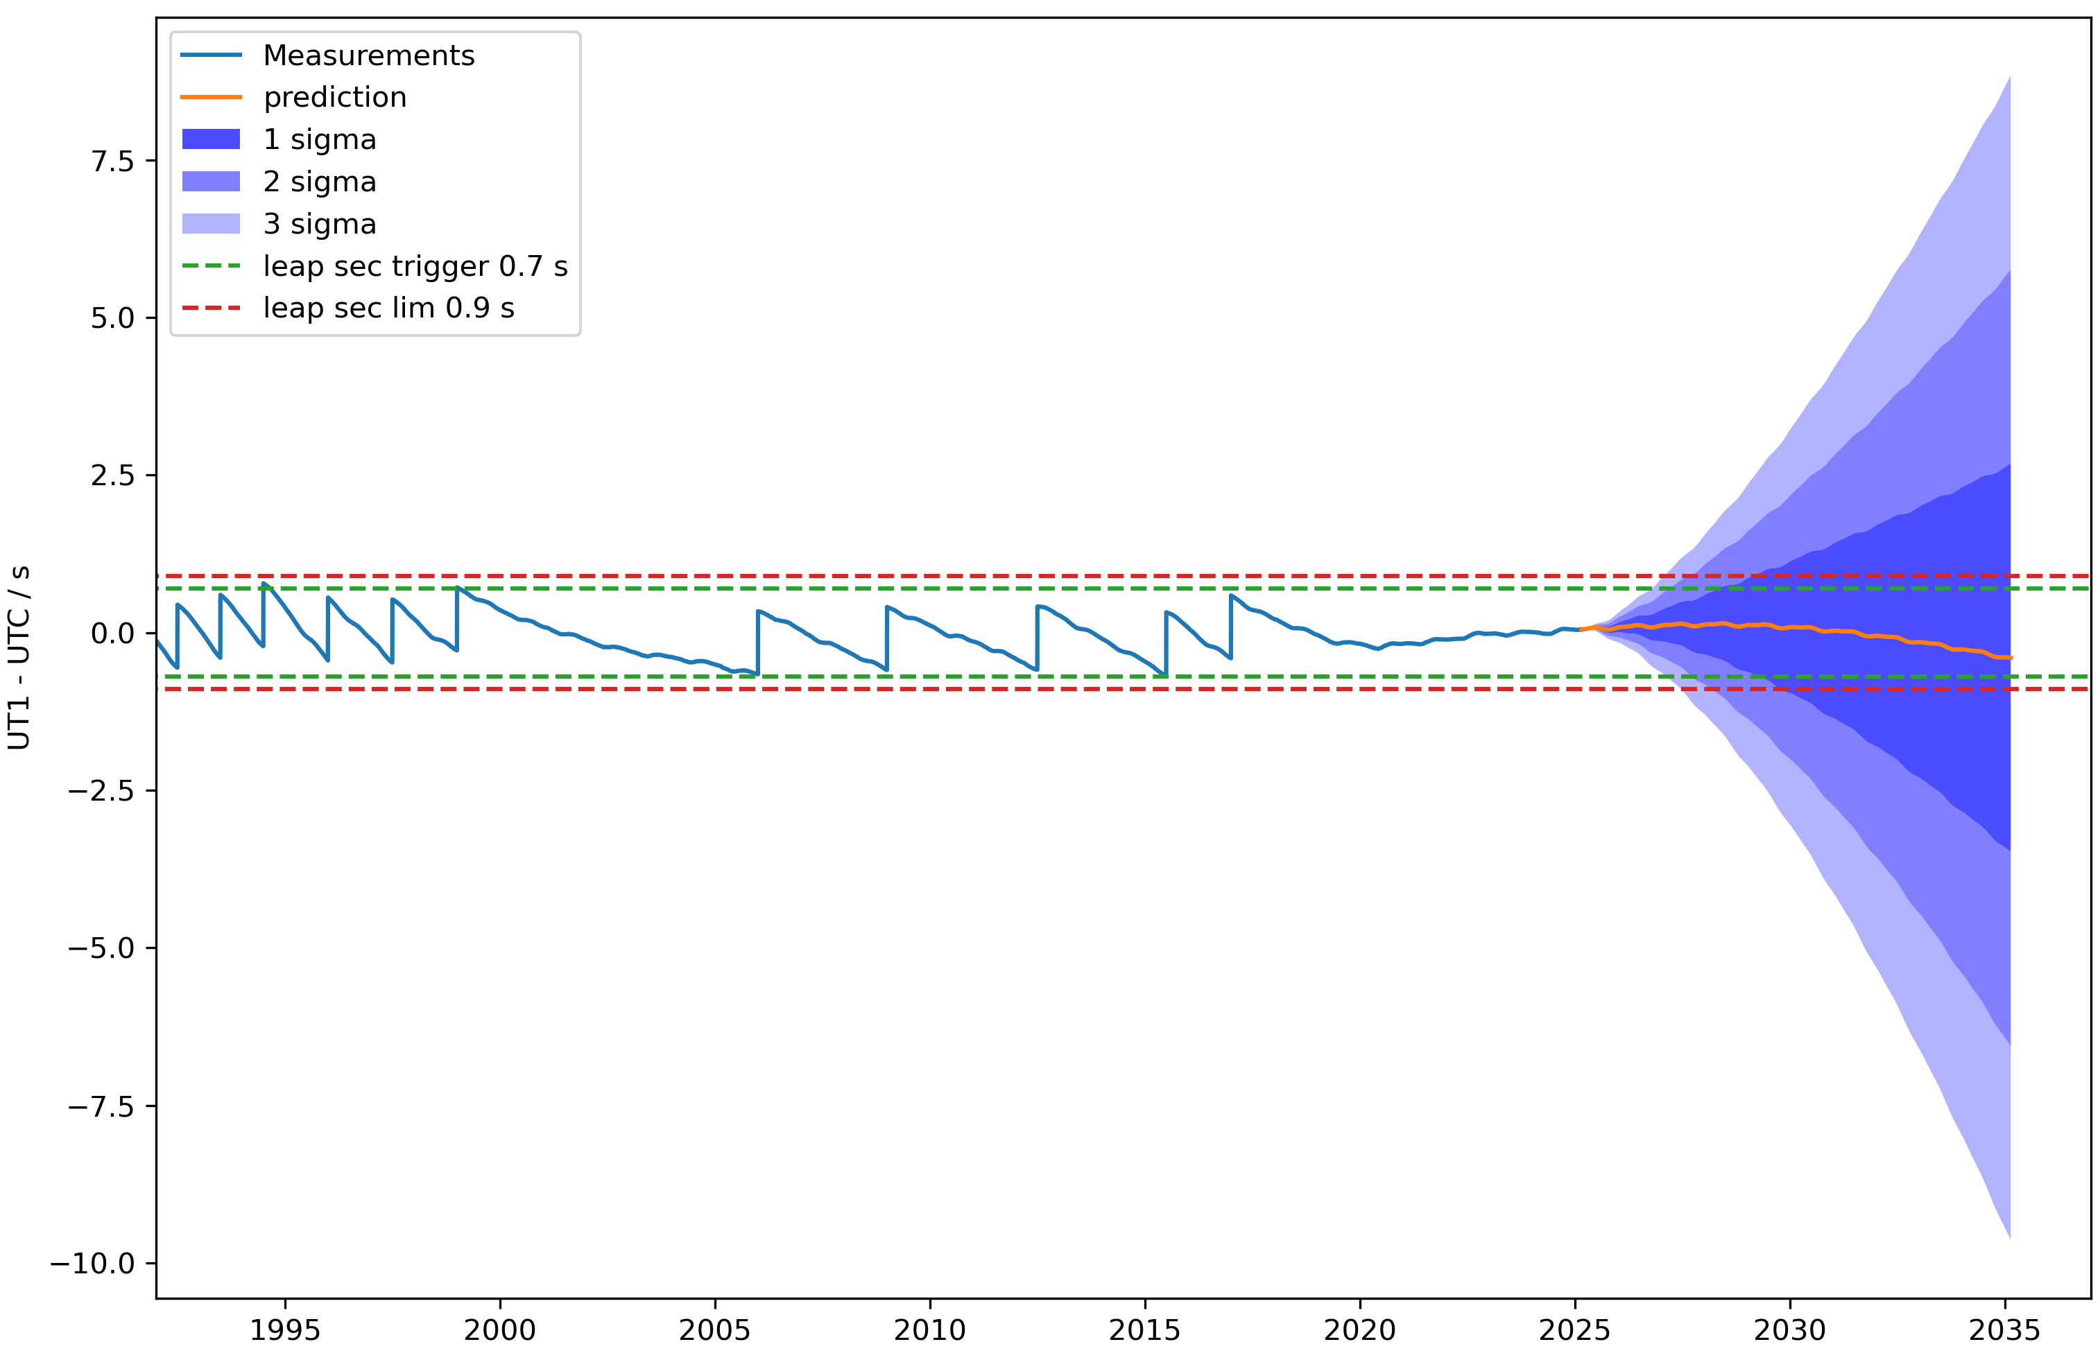
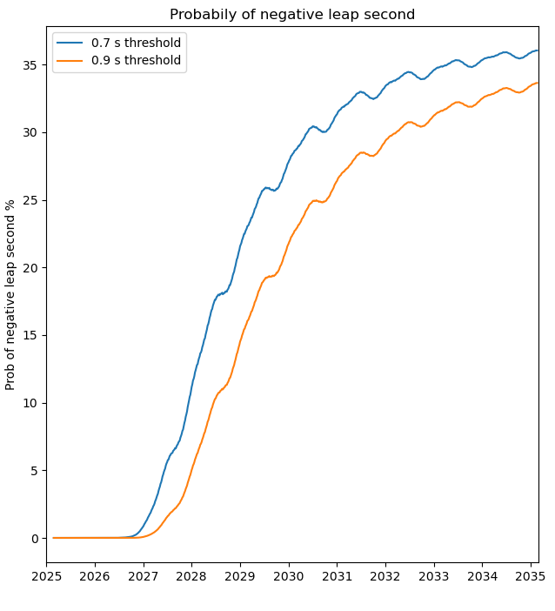
Prediction on UT1-UTC
current UT1-UTC ≈ 0
current LOD excess ≈ 0
millennial slowing down is slow
periodical terms are limited
the stochastic behavior has zero mean value and contributes, largely, to the uncertainty

Slide 6
Summary
Which is the main cause of Earth rotation irregularity that you have considered?
No consideration on physical effects. Only a stochastic model based on
Which other causes of irregularity do you think may be dominant?
Not applicable
Which is the prediction of UT1-UTC or of LOD
for the next 10 years according to your study?
A millennial slowing down
Periodical terms due to seasonal and tidal effects
Stochastic behavior

Slide 7
References
Stephenson F. R., Morrison L.V., and Hohenkerk C. Y., Measurement of the Earth's rotation: 720 BC to AD 2015, Proc. R. Soc. A.472 2016, http://doi.org/10.1098/rspa.2016.0404
Dennis D. McCarthy, Alice K. Babcock, The length of day since 1656, Physics of the Earth and Planetary Interiors, Volume 44, Issue 3, 1986,
https://doi.org/10.1016/0031-9201(86)90077-4
Mc Carthy, Matsakis https://insidegnss.com/will-we-have-a-negative-leap-second/
Chen, Jianli. "Global mass balance and the length‐of‐day variation." Journal of Geophysical Research: Solid Earth 110.B8 (2005). https://doi.org/10.1029/2004JB003474
G Petit, B Luzum (2010). IERS conventions (2010).
https://hpiers.obspm.fr/iers/bul/bulb/explanatory.pdf
G. Panfilo, P. Tavella, "Atomic Clock Prediction based on stochastic differential equations", Metrologia 45, 6, (2008) S108-S116
Thanks to Gerard Petit for the support and the helpful discussions

Slide 8
Extra

Slide 9
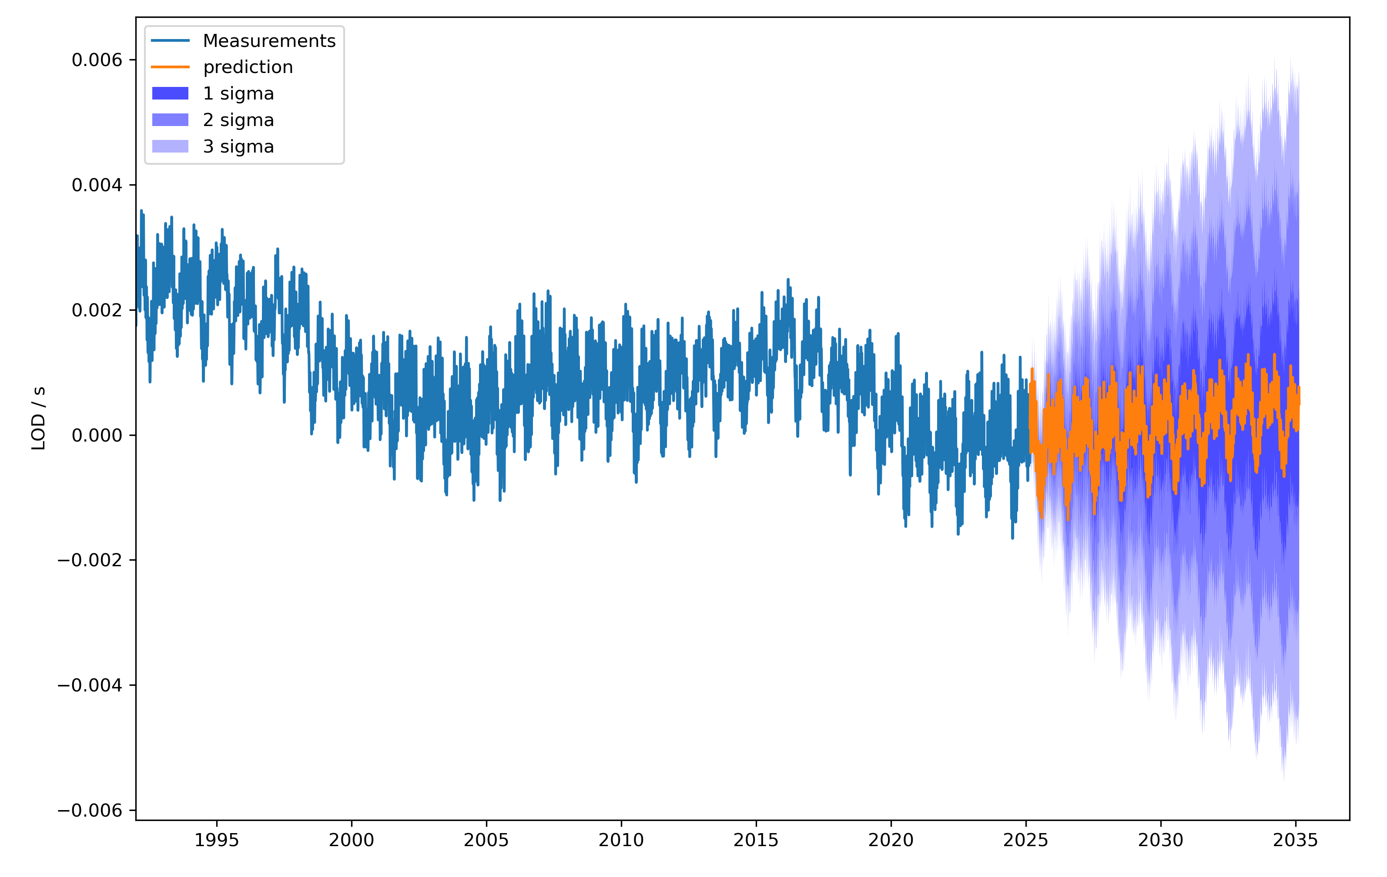
Prediction on LOD

Slide 10
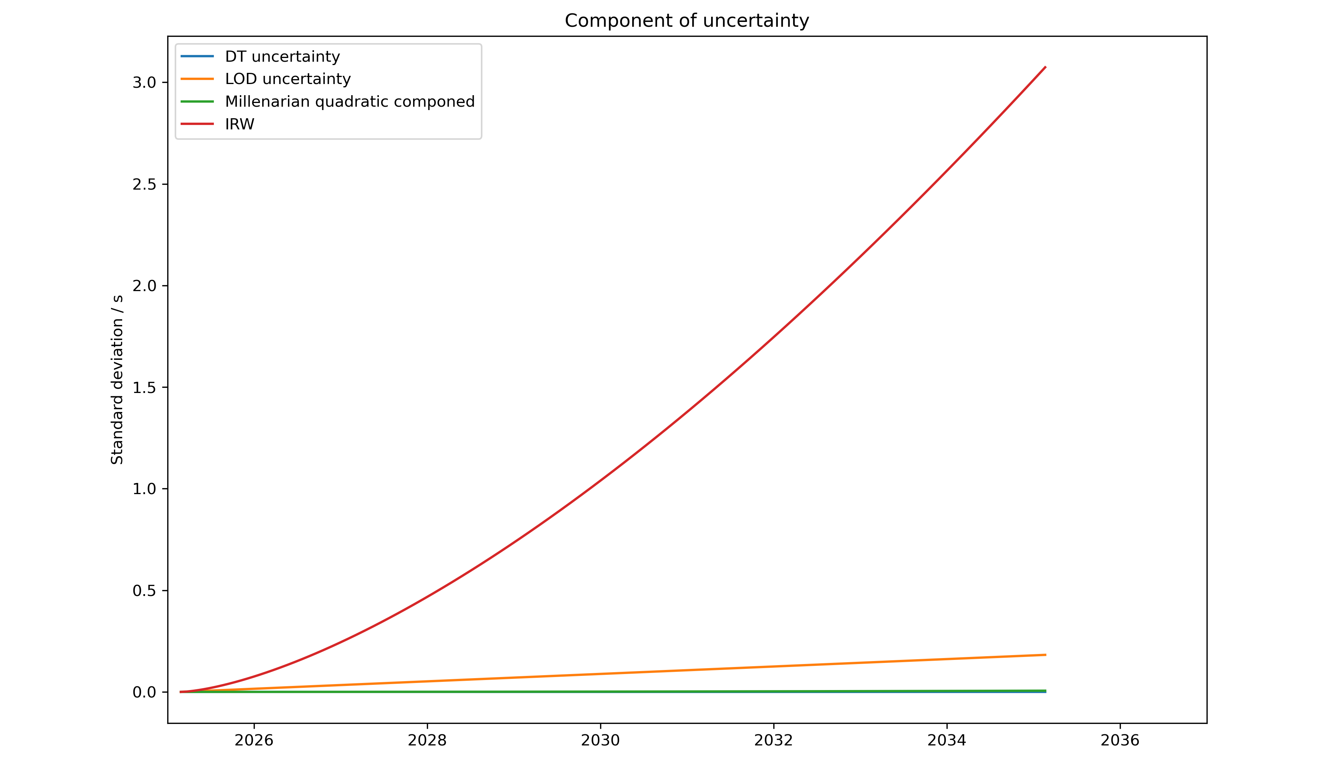
Component of uncertanty on DT

