Slide 1
© 2025 California Institute of Technology. Government sponsorship acknowledged. Climate contributions to LOD change in the recent and coming decades Surendra Adhikari Jet Propulsion Laboratory, California Institute of Technology surendra.Adhikari@jpl.nasa.gov
NASA/GSFC Scientific Visualization Studio: https://space-geodesy.nasa.gov

Slide 2
Outline
Climate => lateral ice/water mass transport on Earth’s surface on seasonal to centennial timescales, including induced solid Earth response.
Focus on 25 years in the past and future
A detail account of how we go about computing LOD for Greenland Ice Sheet
Results for Antarctic Ice Sheet, global glaciers, and terrestrial water storage
Total climate-induced signals and uncertainties.

Slide 3
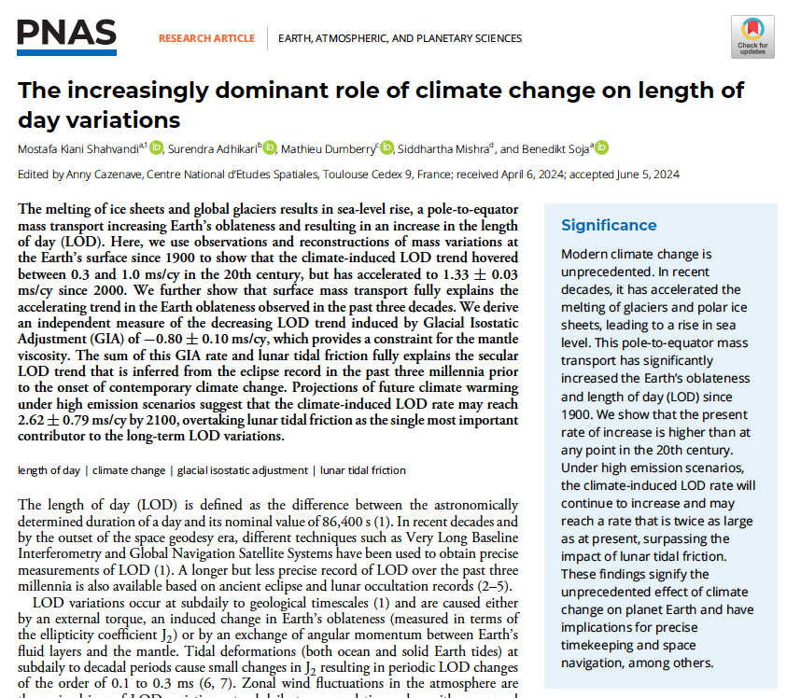
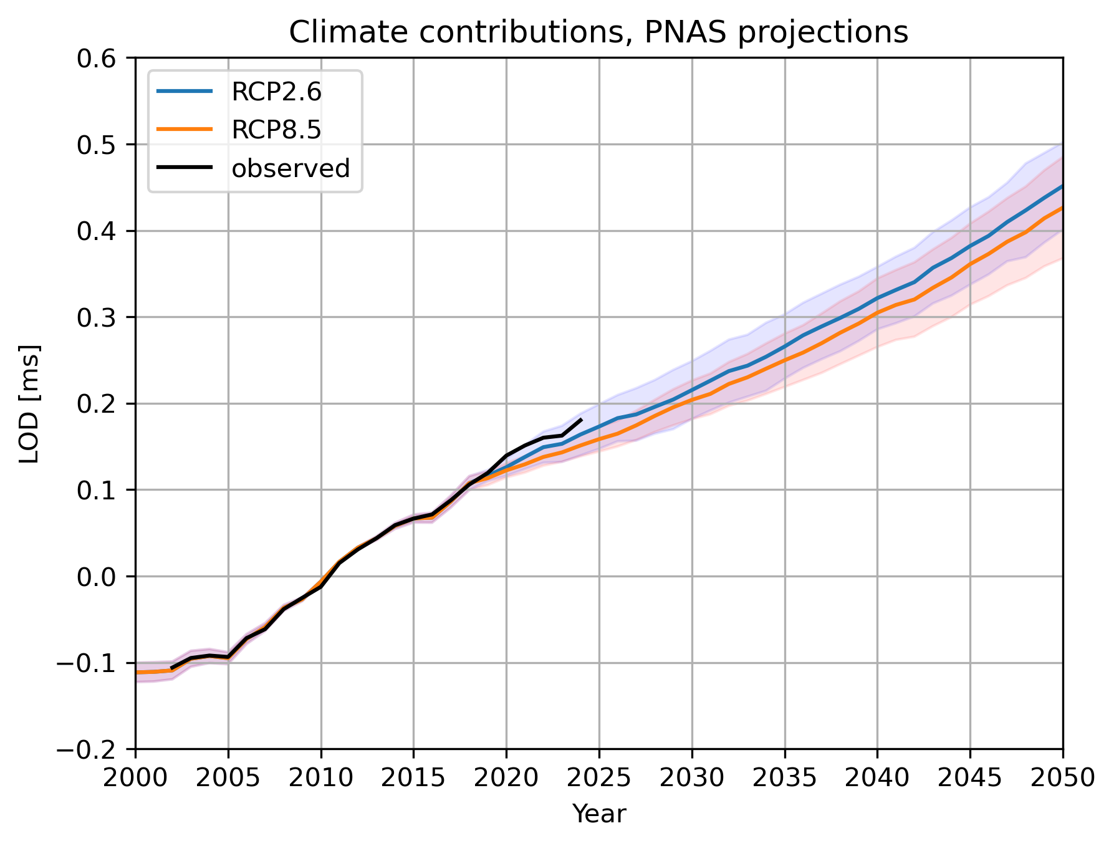
We are here
Projections start at 2018

Slide 4
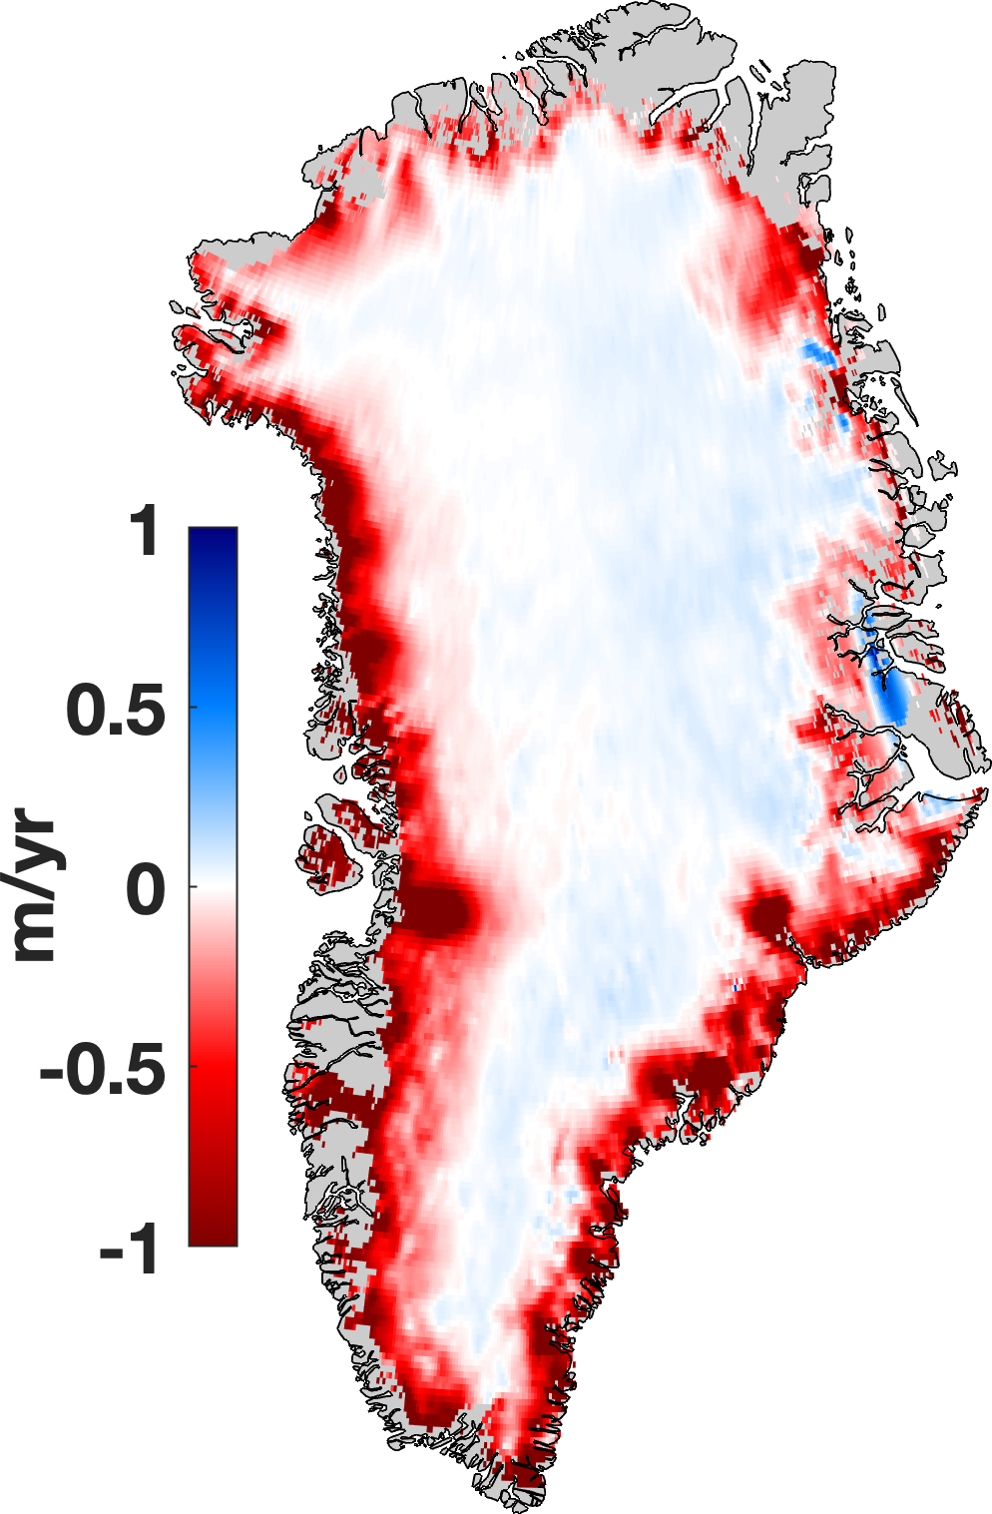
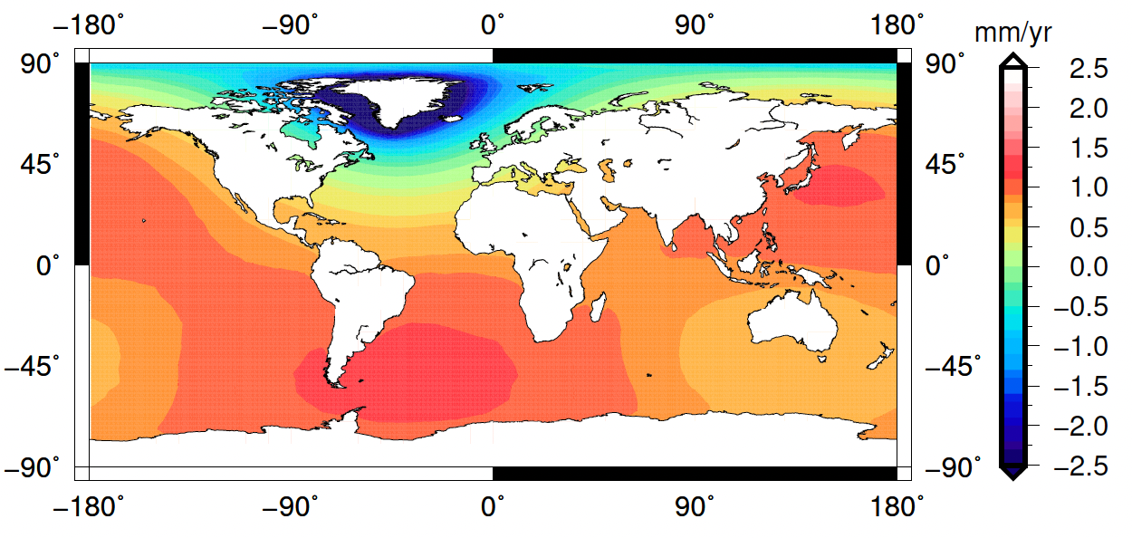
Greenland Ice Sheet

Slide 5
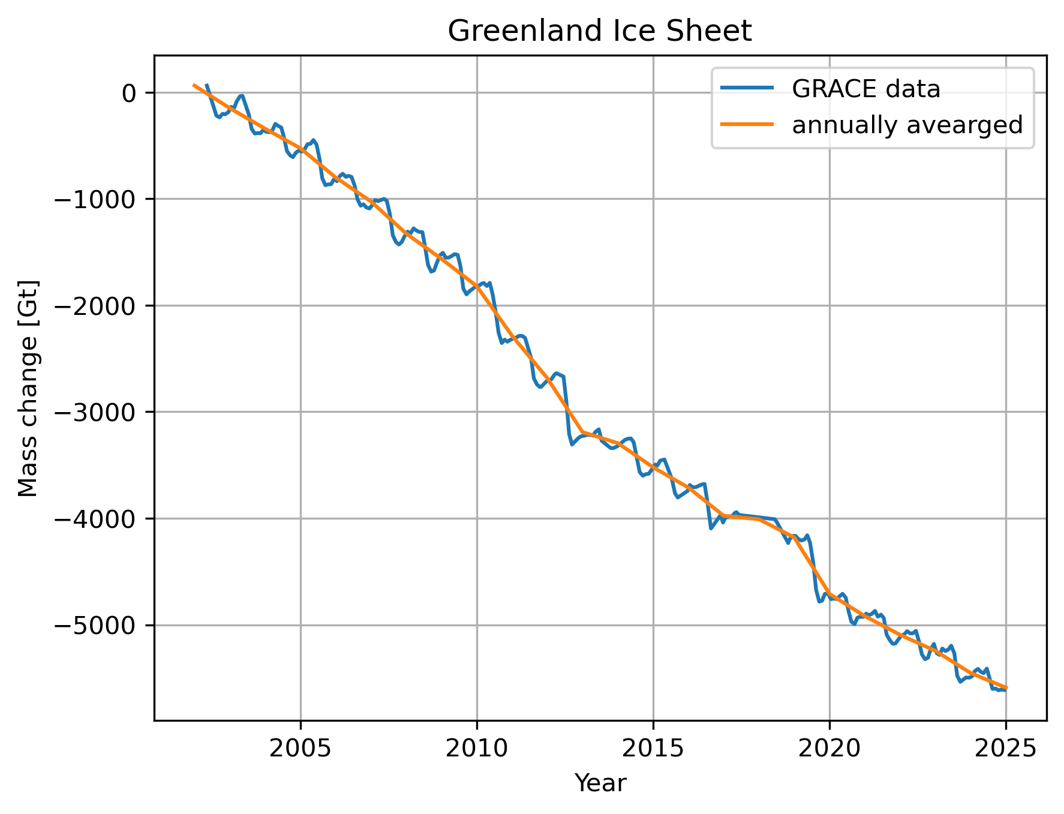
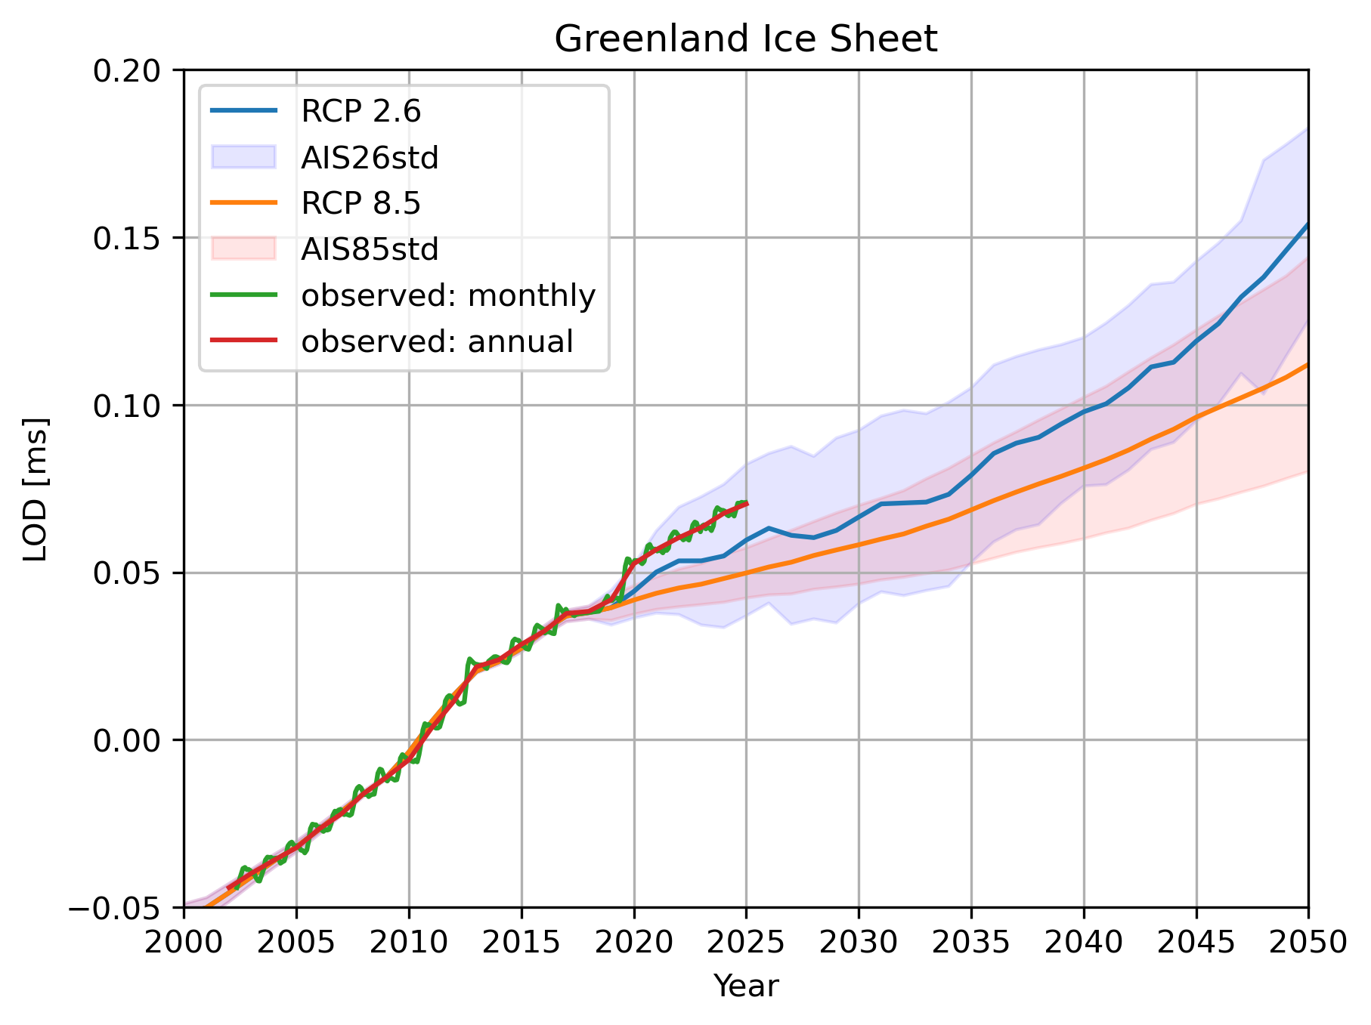

Slide 6
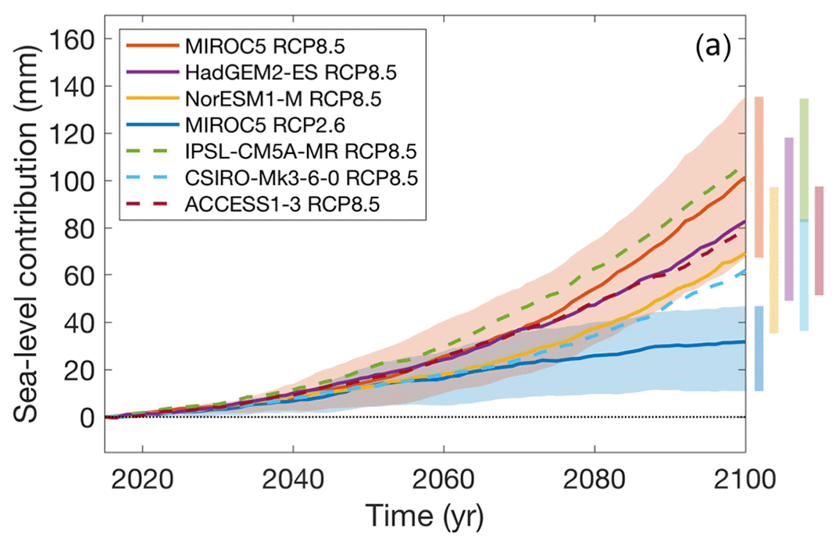
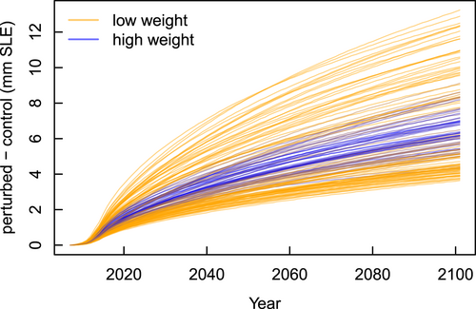
ISMIP6 projections do NOT include committed sea level contributions [Goelzer et al., 2020]
Estimates of committed sea-level contributions using a particular ice-sheet model [Nias et al., 2023]

Slide 7
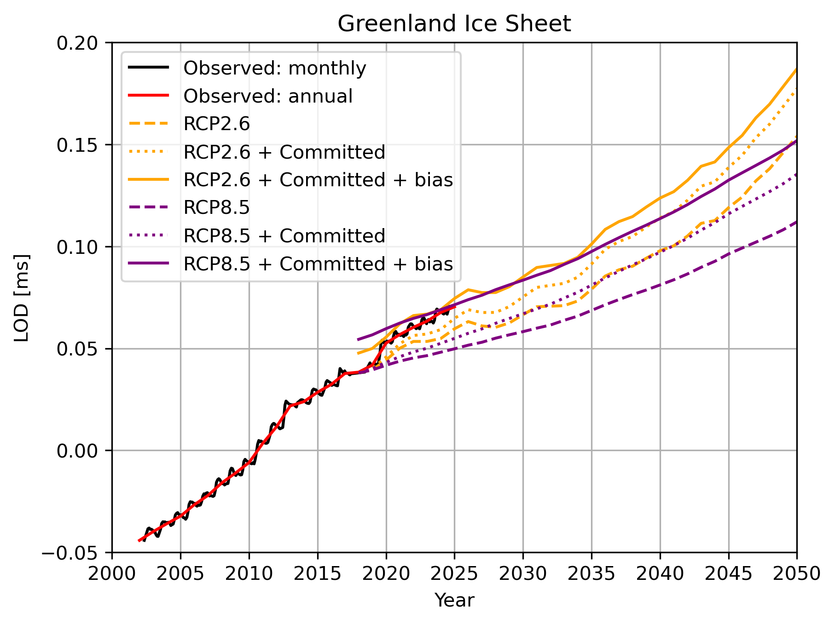

Slide 8
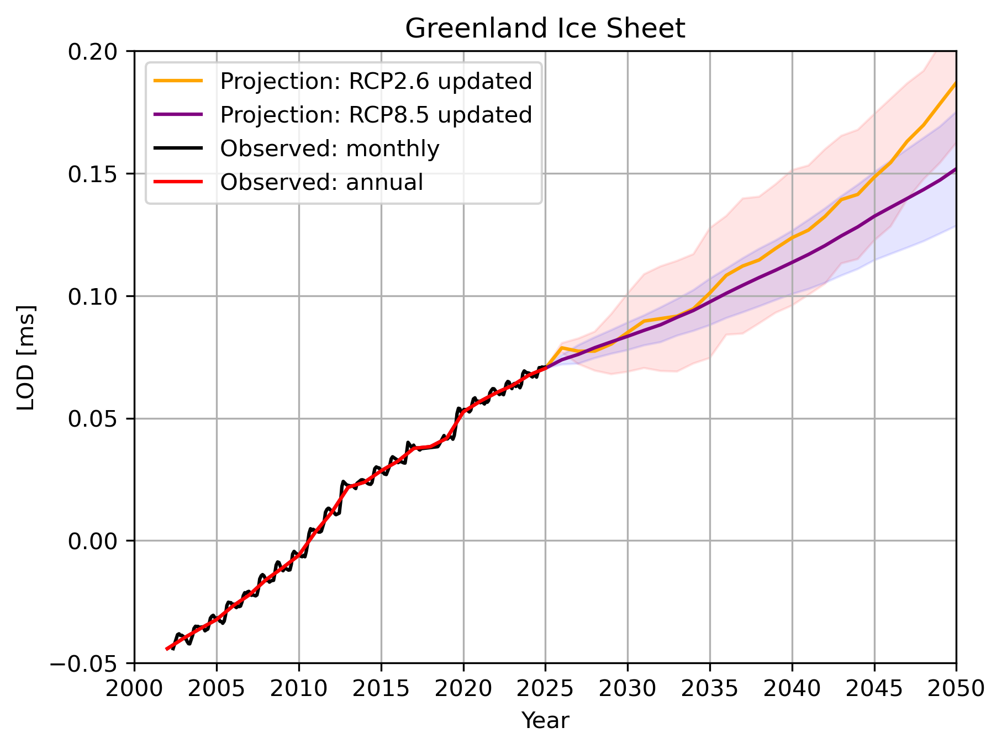

Slide 9
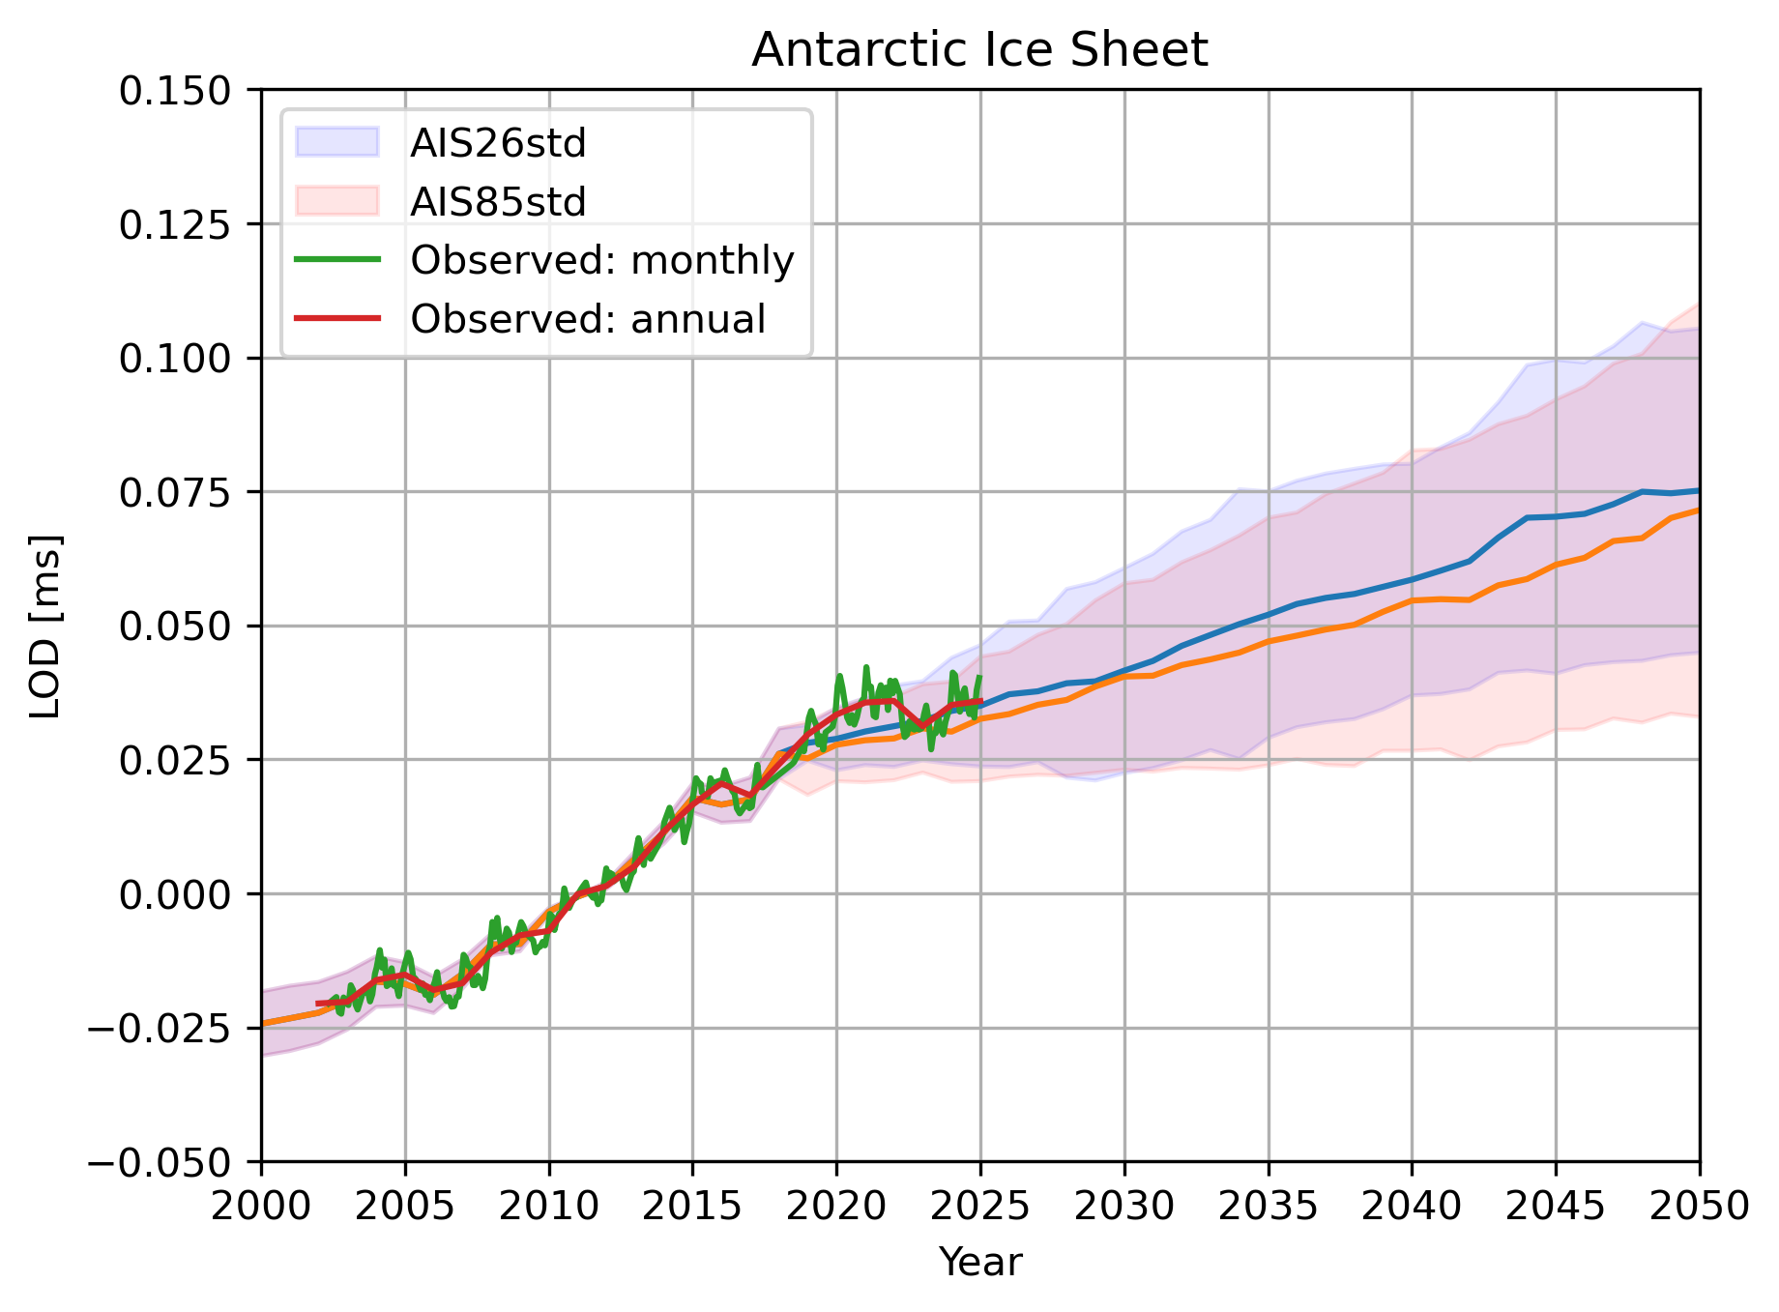
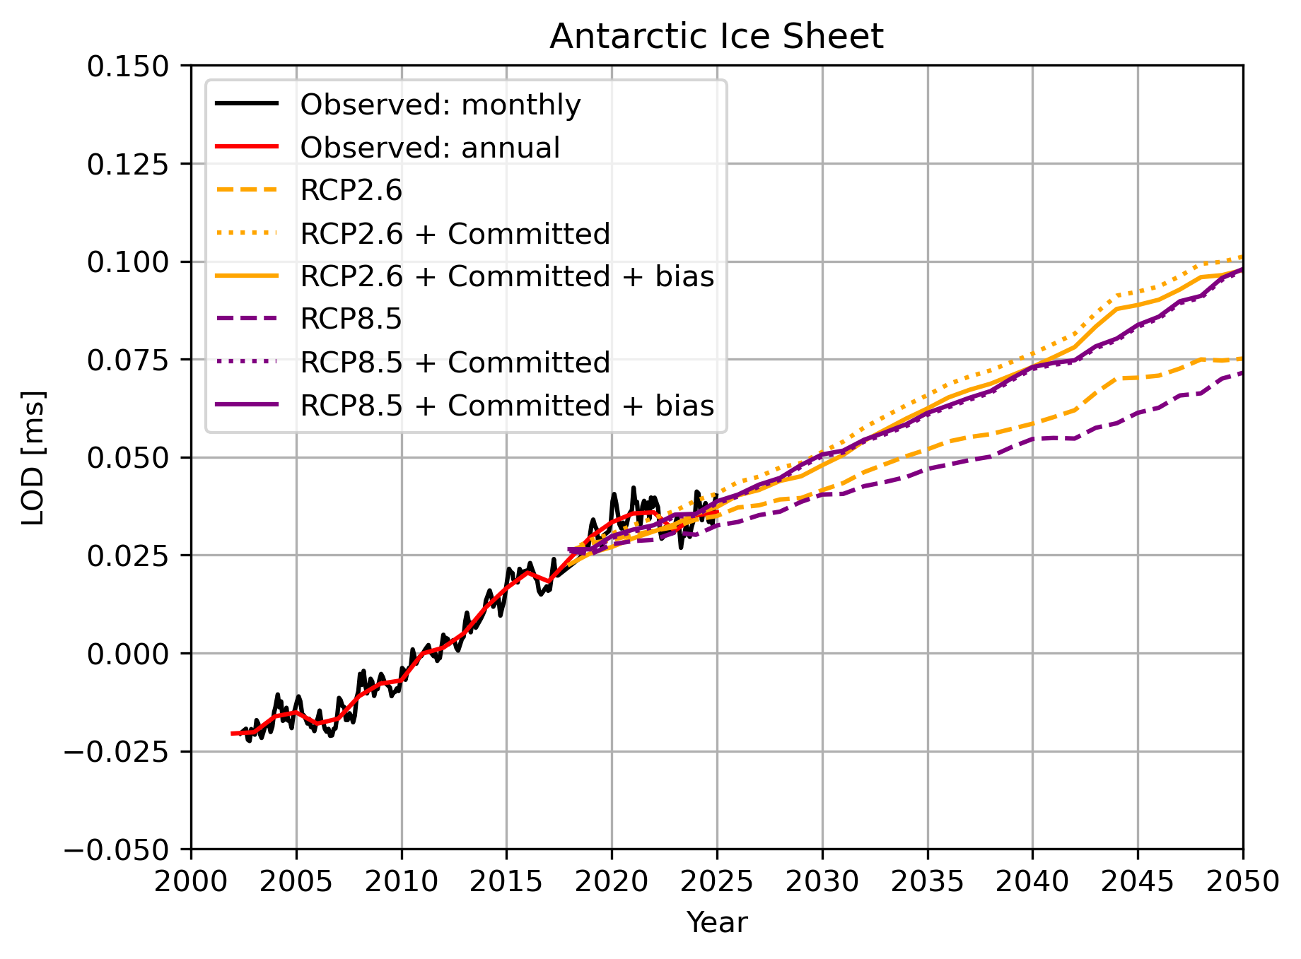
Antarctic Ice Sheet

Slide 10
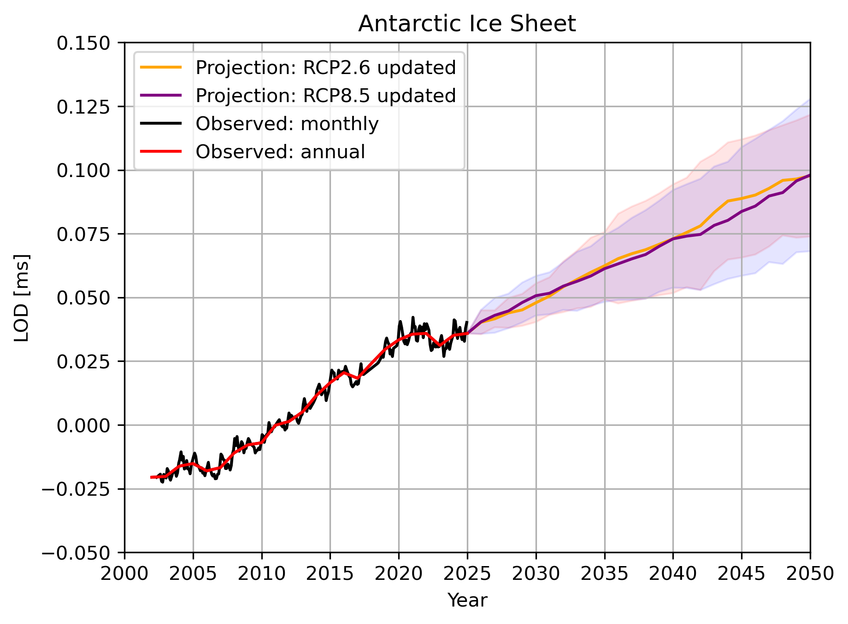

Slide 11
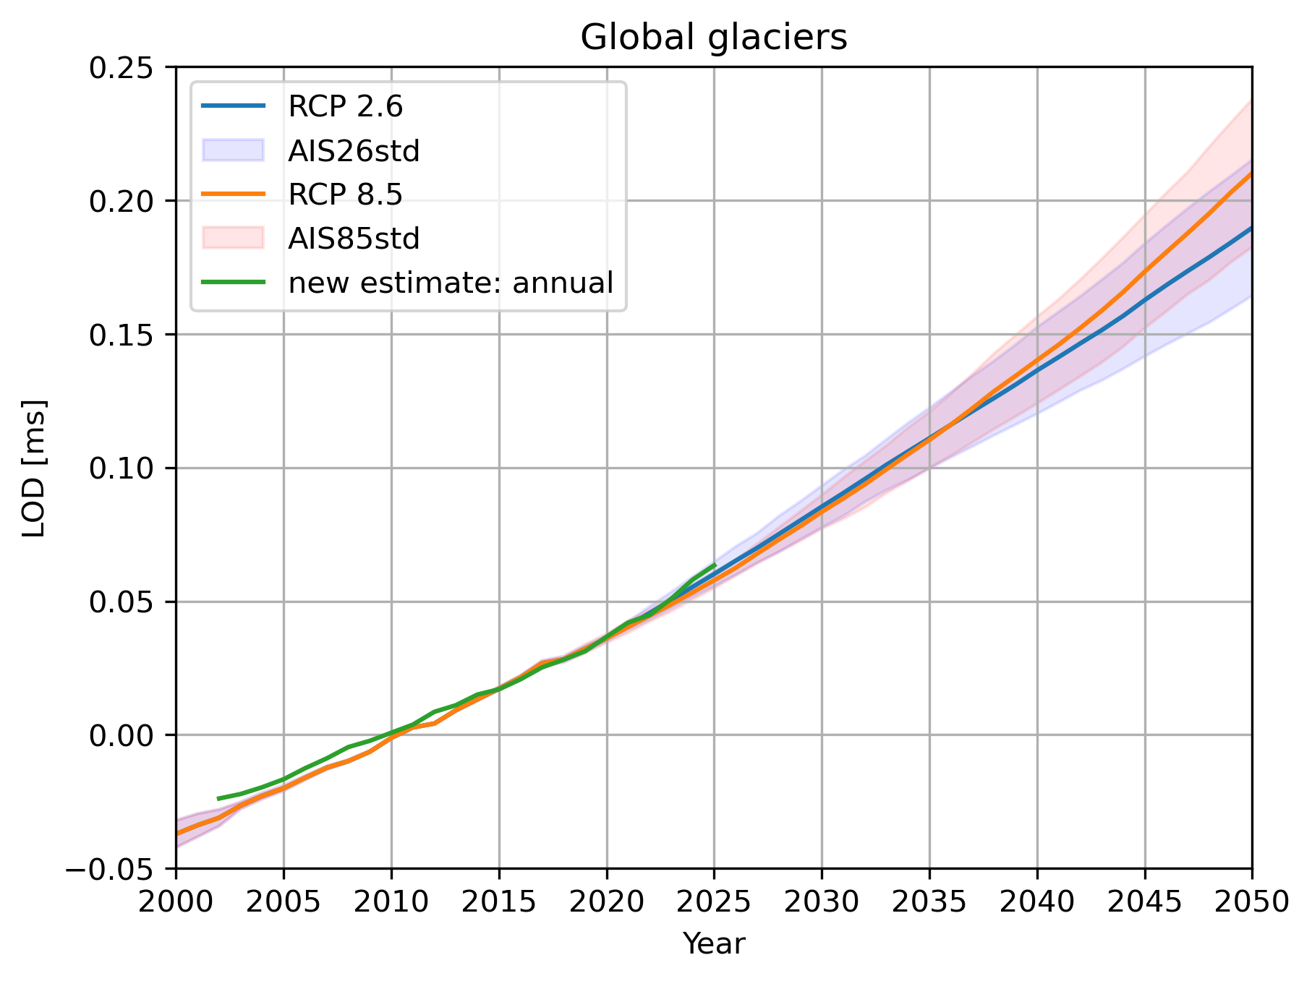
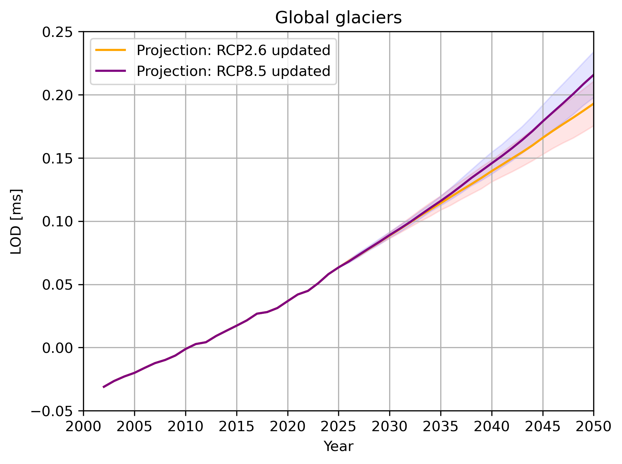
Global glaciers

Slide 12
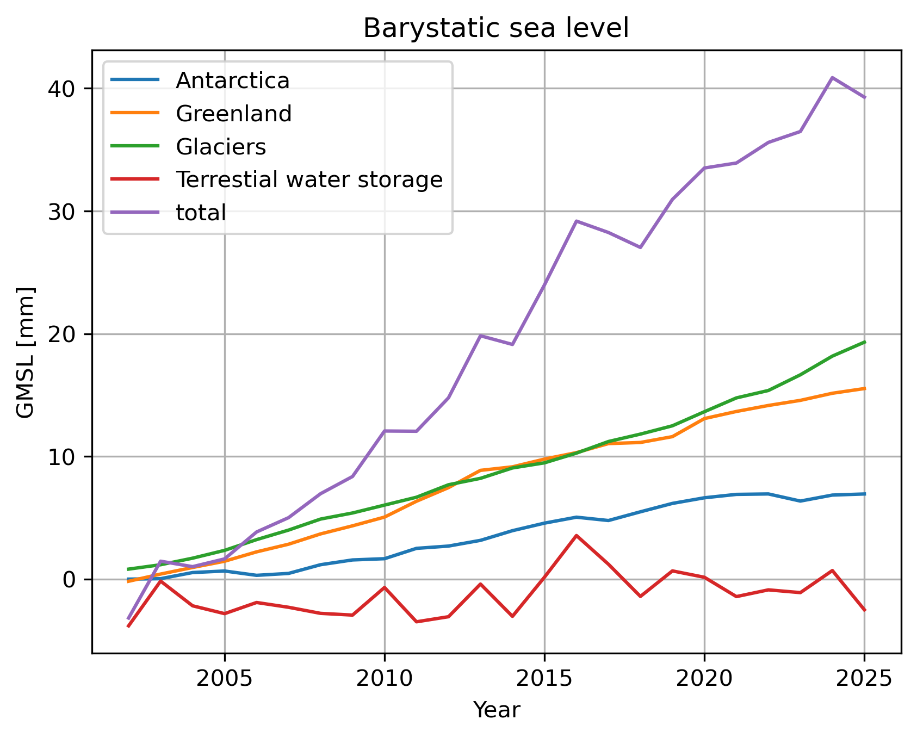
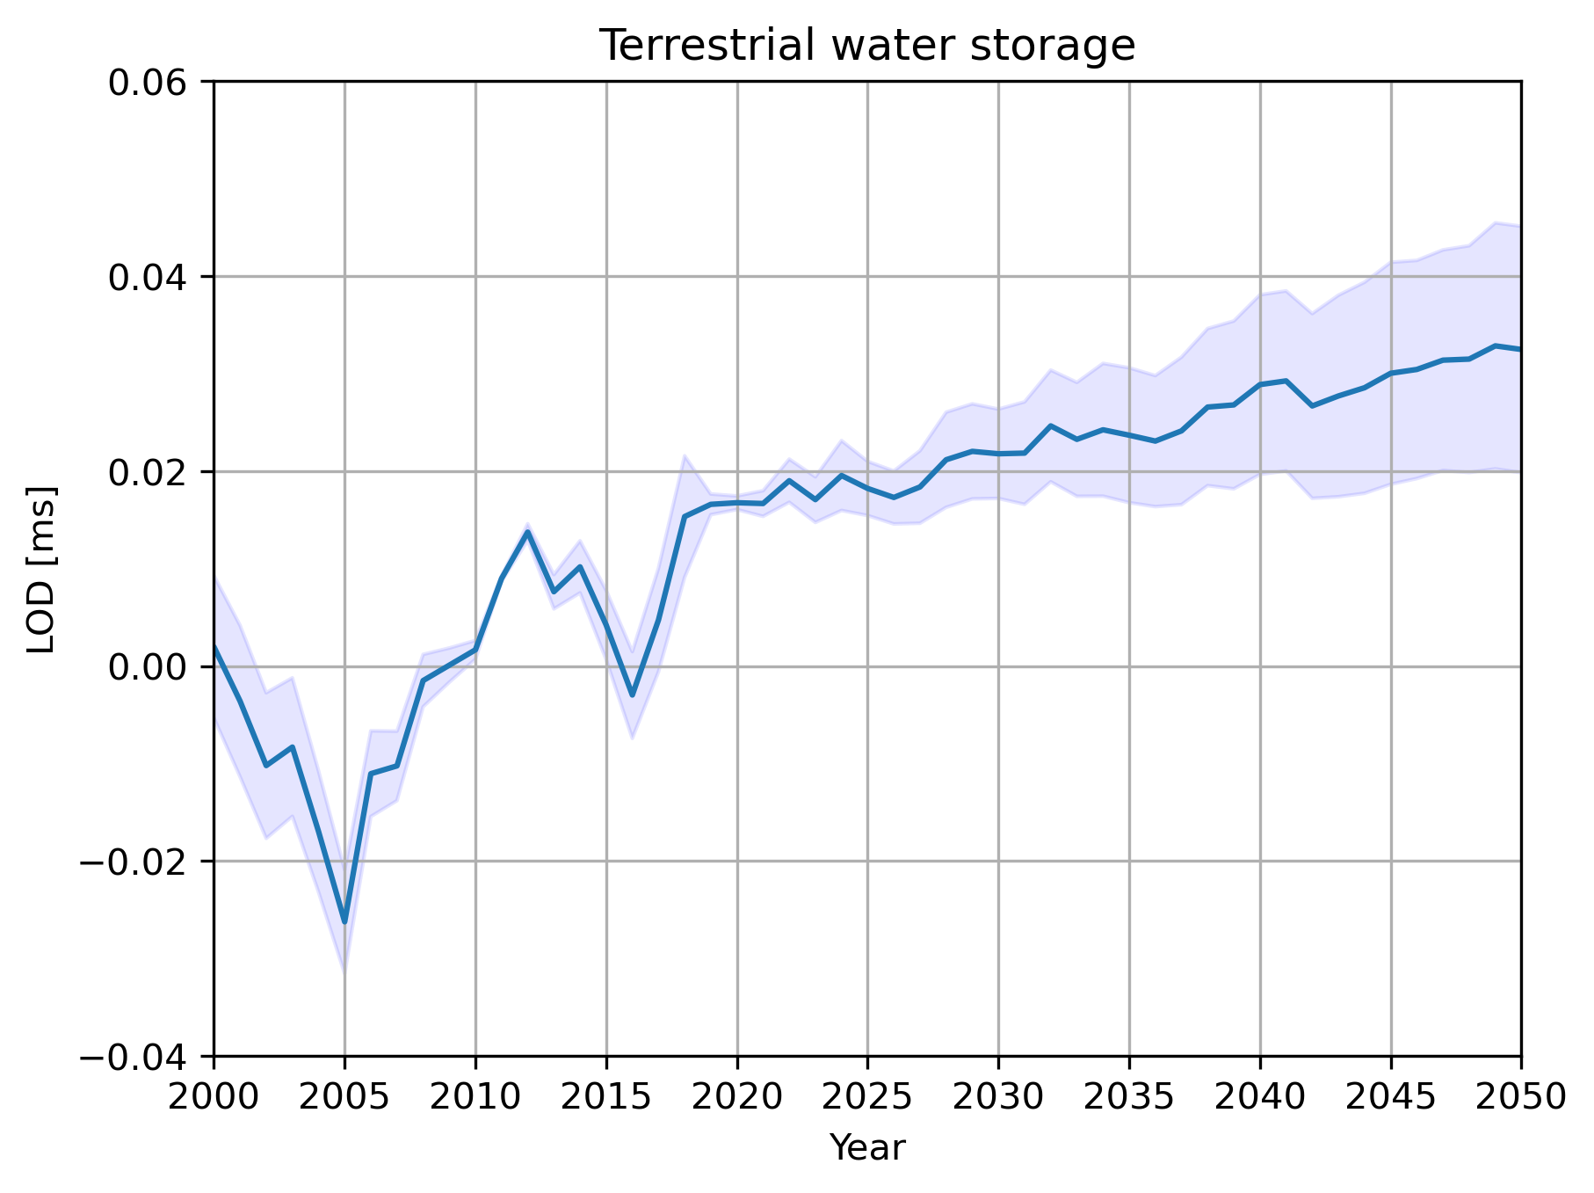
Terrestrial water storage

Slide 13
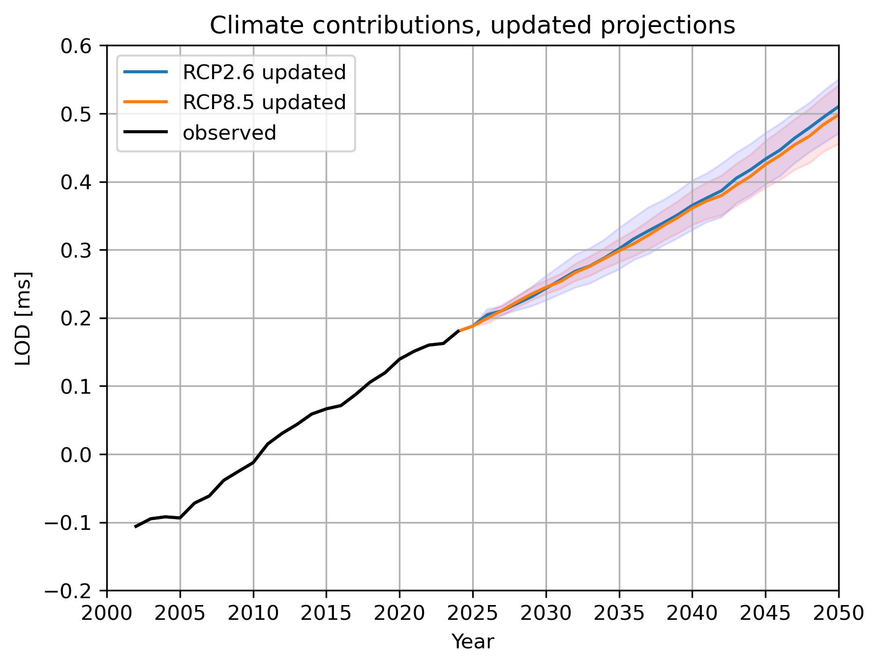
Sum of all

Slide 14
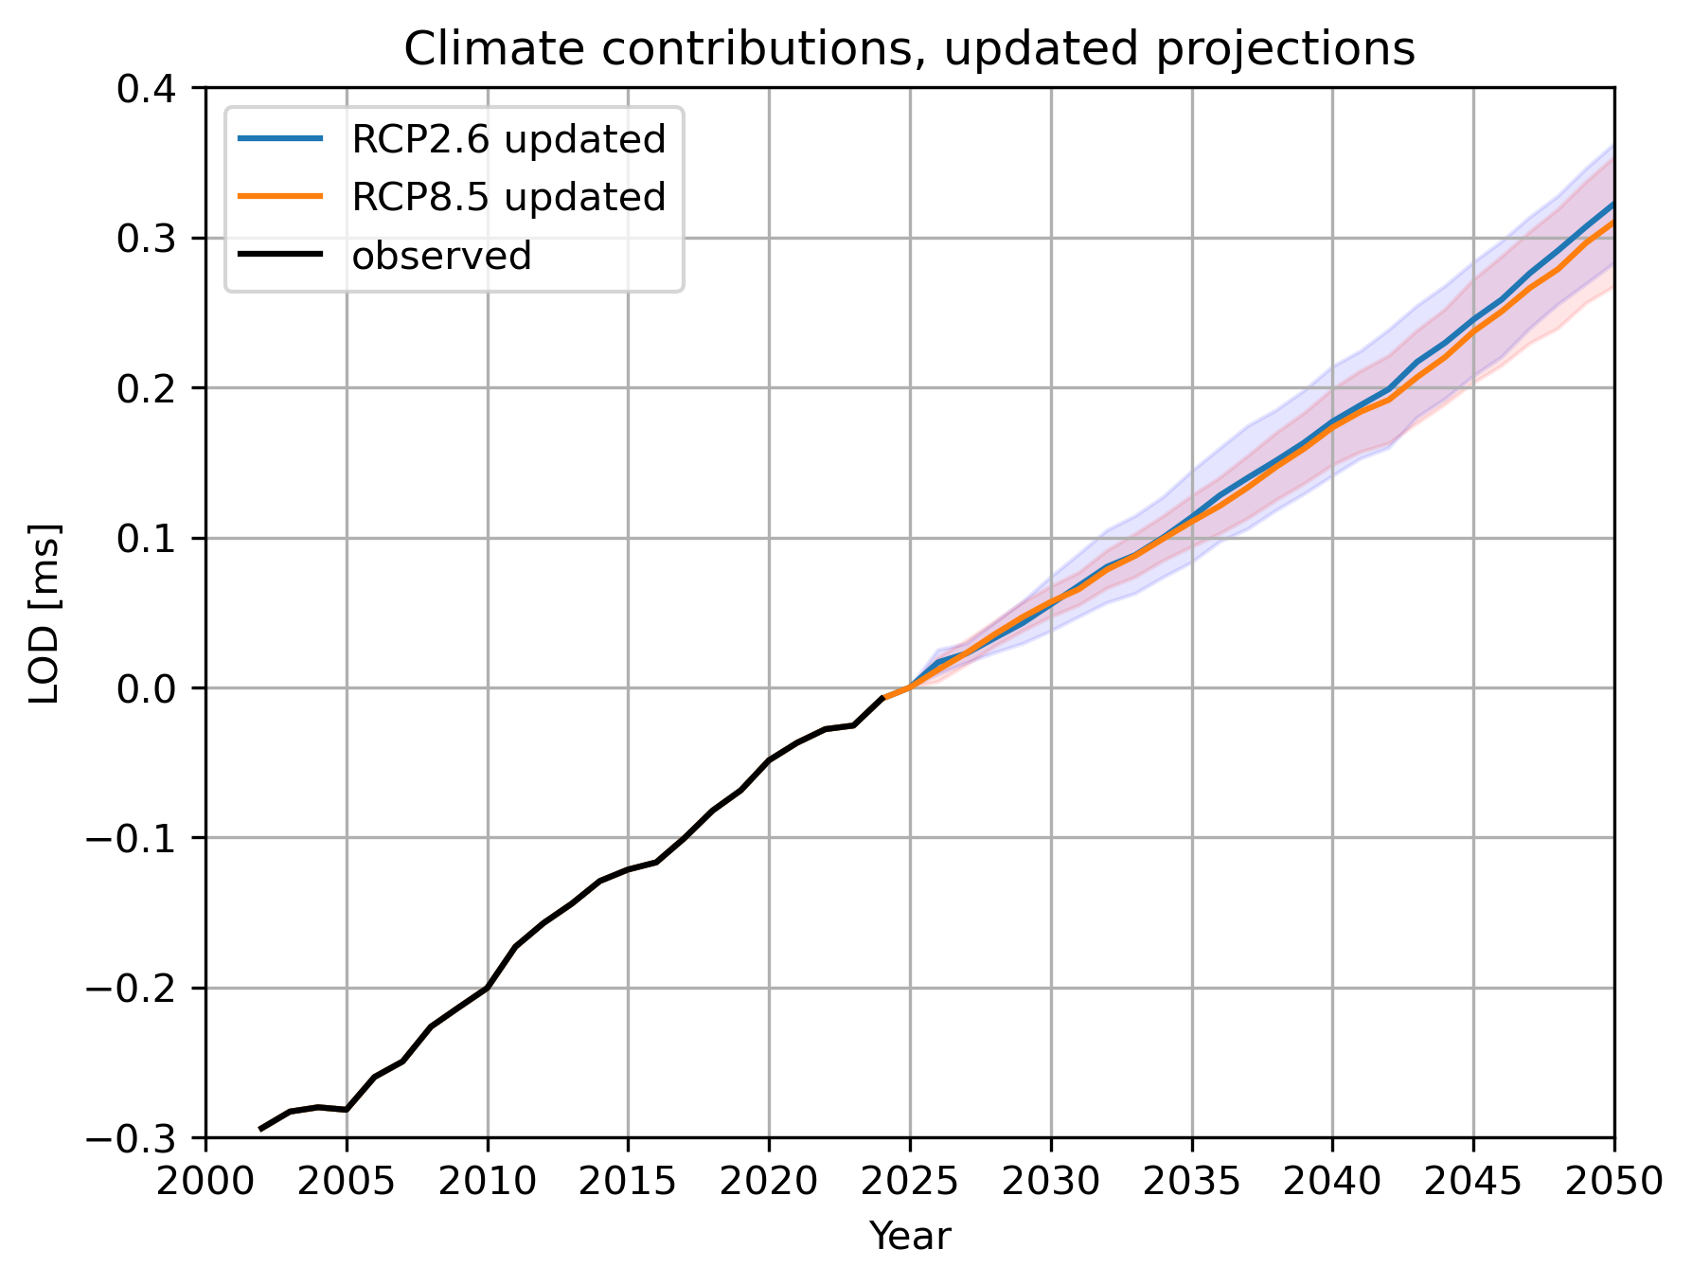
Summary
What is the main causes of Earth rotation irregularity that you have considered?
Climatic processes responsible for large-scale surface and sub-surface mass transport.
Which other causes of irregularity do you think may be dominant?
[Climate base is well covered.] Core contributions?
[Climate contributions to] LOD and uncertainty for the next decades?
See figure.

