Slide 1

CONSULTATIVE COMMITTEE
FOR TIME AND FREQUENCY
together with
Workshop on negative leap second
Thursday March 13, h 14 -16 UTC
Thursday March 27, h 14-16 UTC

Slide 2
Agenda of Thursday March 13, h 14 -16 UTC
Each presentation has 10 min
Stamatakos USNO: IERS observation of UT1 and LOD
Mc Carthy IAU: An Astronomer's Overview
Mitrovica, Harvard Univ: Looking Back at Geophysical Effects on Earth Rotation
Agnew, UCSD: The Futures of UT1: A Geophysical Discussion
Surendra Adhikari: Climate-driven LOD change in the 20th and 21st centuries
Dehant V., Chicot G., Laariara D., Gillet N., Mandea M., Cazenave A., ORB, Belgium : Core contributions to LOD
G. Tagliaferro BIPM: Stochastic modelling and prediction
O. Titov: zonal tidal terms of LOD (5 min)
C. Bizouard: unpredictability of the Earth rotation (5 min)
The meetings is organized as a webinar.
The speakers can share the presentation and the video.
The participants can ask questions in the chat
The meeting is not recorded

Slide 3
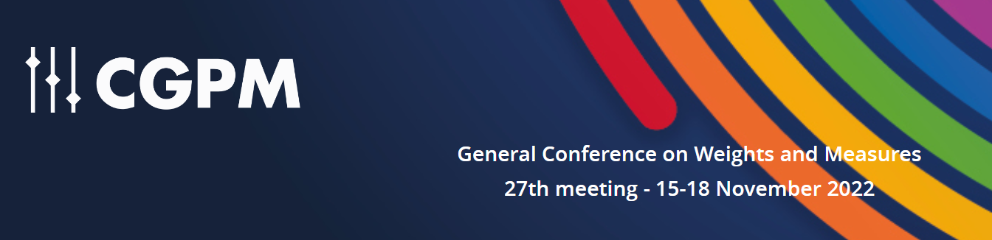

ENDORSED by
CGPM 2022 Resolution 4 - On the use and future development of Universal Coordinated Time (UTC)
When?
decides that the maximum value for the difference (UT1-UTC) will be increased in, or before, 2035,
requests that the CIPM consult with the ITU, and other organizations that may be impacted by
this decision in order to
propose a new maximum value for the difference (UT1-UTC) that will ensure the
continuity of UTC for at least a century,
prepare a plan to implement by, or before, 2035 the proposed new maximum value for the
difference (UT1-UTC),
propose a time period for the review by the CGPM of the new maximum value following
its implementation, so that it can maintain control on the applicability and acceptability of
the value implemented,
draft a resolution including these proposals for agreement at the 28th meeting of the
CGPM (2026),
encourages the BIPM to work with relevant organizations to identify the need for updates in the
different services that disseminate the value of the difference (UT1-UTC) and to ensure the correct
understanding and use of the new maximum value.
What?
Review
Next step

Slide 4
Workshop on negative leap second
Thursday March 13, h 14 -16 UTC
Thursday March 27, h 14-16 UTC
The workshop is organized as follows:
today Earth rotation experts give a short presentation, from different points of view, on the variation of the Earth rotation and LOD, and its prediction that could lead to the need of a negative leap second.
Between the two meetings a CCTF IERS group works with Earth rotation experts to get a common framework, notation, and understanding of the assumptions and predictions
In the second meeting the CCTF IERS group will propose an overall evaluation of the best and worst cases for the need for a negative leap second to be discussed with all the Earth rotations, CCTF, and IERS experts. The result of this discussion will be a report to the CCTF and possibly a journal paper
Please provide a summarizing table answering these questions:
Which is the main cause of Earth rotation irregularity that you have considered?
Which other causes of irregularity do you think may be dominant?
Which is the prediction of UT1-UTC or of LOD for the next 10 years according to your study? (a plot would be useful). Can you assign a degree of uncertainty to your prediction?

Slide 5
Presentations

Slide 6
Workshop on negative leap second
Thursday March 13, h 14 -16 UTC
Thursday March 27, h 14-16 UTC
Thanks for the contributions and your study.
If agreed, slides will be available, for participants only, in
https://www.bipm.org/en/committees/cc/cctf/wg/cctf-tgutc/2025-03-13
A group formed by
Noel Dimarcq, Patrizia Tavella, Giulio Tagliaferro, Judah Levine, Pascale Defraigne from BIPM- CCTF
Dennis Mc Carthy from IAU
Christian Bizouard, Böhm Sigrid, Nick Stamatakos, and Robert Heinkelmann from IERS
will keep in touch in the next two weeks
See you on March 27
Agenda of Thursday March 27, h 14 -16 UTC
CCTF IERS presentation of a proposed common understanding and summary from the first meeting
Discussion with all the Earth rotation, IERS, and CCTF colleagues
Final assessment and way forward

Slide 7
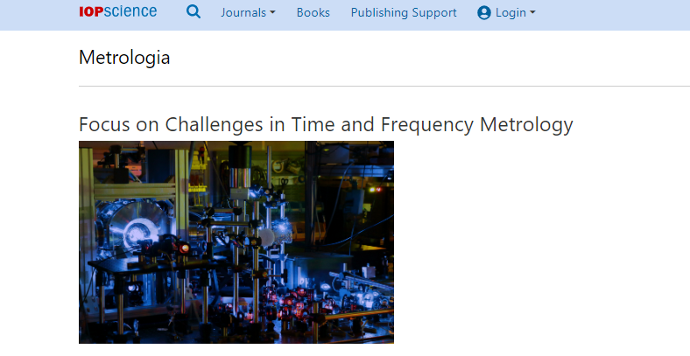
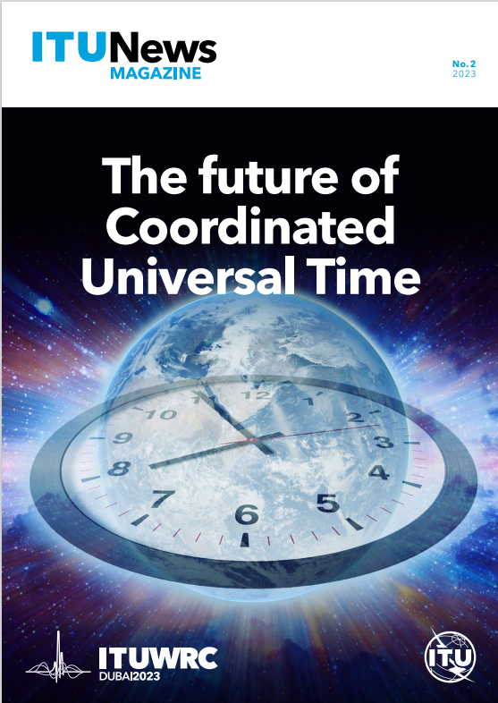
Publications (suggestions are welcome)
Metrologia paper on « Towards a consensus on a continuous coordinated universal time”
https://iopscience.iop.org/article/10.1088/1681-7575/ac9da5
ITU NEWS magazine on « the future of Coordinated Universal Time »
https://www.itu.int/en/itunews/Documents/2023/2023-02/2023_ITUNews02-en.pdf
Mc Carthy, Matsakis https://insidegnss.com/will-we-have-a-negative-leap-second/
L. Zotov, C. Bizouard, C.K. Shum, C. Zhang, N. Sidorenkov, V. Yushkin, “Analysis of Earth’s polar motion and length of day trends in comparison with estimates using second degree stokes coefficients from satellite gravimetry”, Advances in Space Research 69, 308–318 (2022). https://doi.org/10.1016/j.asr.2021.09.010
Mitrovica, Reconciling past changes in Earth’s rotation with 20th century global sea-level rise: Resolving Munk’s enigma https://www.science.org/doi/10.1126/sciadv.1500679
Agnew, A global timekeeping problem postponed by global warming,
https://www.nature.com/articles/s41586-024-07170-0, https://pubs.aip.org/physicstoday/online/44015
Mostafa Kiani Shahvandi Surendra Adhikari et al, The increasingly dominant role of climate change on length of day variations, https://www.pnas.org/doi/abs/10.1073/pnas.2406930121,https://www.science.org/doi/10.1126/sciadv.1501693 )
Malkin Z.M. Should We Expect Further Acceleration of the Earth's Rotation in the Coming Years? Astron. Rep., 2024, Vol. 68, No. 10, 1022-1028. https://link.springer.com/article/10.1134/S1063772924700884

